Slide 1


Cross-Site Scripting Attacks in
Social Network APIs
Yuqing Zhang, Xiali Wang, Qihan Luo, Qixu Liu

Slide 2





RESTful API
Third-Party Application Server
XML-RPC
3%
REST
JavaScript
71%
Third-Party Application Server
Third-Party Application Server
All kinds of Websites(e.g. Social Network)
6%
SOAP
18%
Third-Party Application Server
Data From: http://www.bogotobogo.com/WebTechnologies/OpenAPI_RESTful.php 2012

Slide 3
RESTful API
What is a RESTful API?
Get everything you need from the server via a URL.
POST
GET
http://website.com/resources
/request
?q=request
The server responses mainly in two formats: JSON and XML.
POSTDATA: q=request
The whole procedure follows the OAuth protocol.
Request for authorization
Access Token
Request for resources
Third-Party Application Server
Website(e.g. Social Network)
Response with resources

Slide 4




Cross Site Scripting in RESTful API
What happens when XSS meets RESTful API?
Can’t Execute
Can Execute
Visit
Evil Code
Response with escaped code
Evil Code
Victim
Website(e.g. Social Network)
Evil Code
Visit
Upload Malicious Code
Response with un-encoded code
Response with un-escaped code
Request for data
Attacker
RESTful API
Cross API Scripting (XAS)
Third-Party Application Server
Evil Code

Slide 5



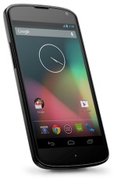

XAS in Social Networks
Mash-up Applications
Interconnected Services
Social Network
Desktop Applications
Third-party Mobile Clients

Slide 6

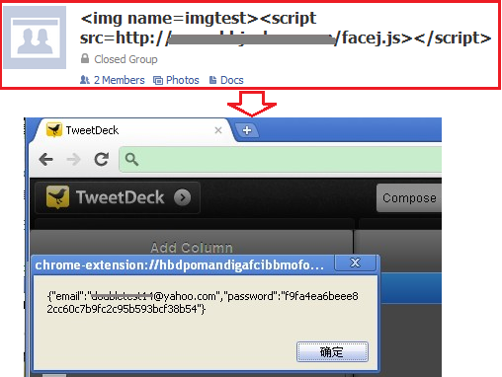
XAS in Mash-up Applications

Slide 7

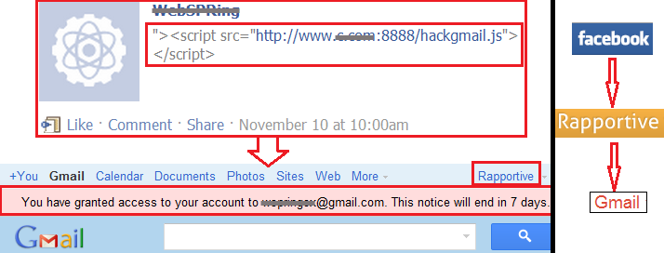



XAS in Interconnected Services
Facebook

Slide 8
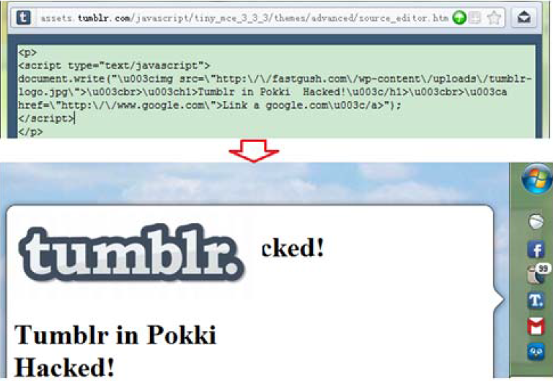

XAS in Desktop Applications

Slide 9
XAS in Third-party Mobile Clients
              Nine Twitter mobile Web applications
Vulnerable | Not Vulnerable
m.slandr.net dabr.co.uk m.tweete.net twetmob.com itweet.net www.tweetree.com | mobile.twitter.com twittme.mobi www.twittermobile.net

Slide 10

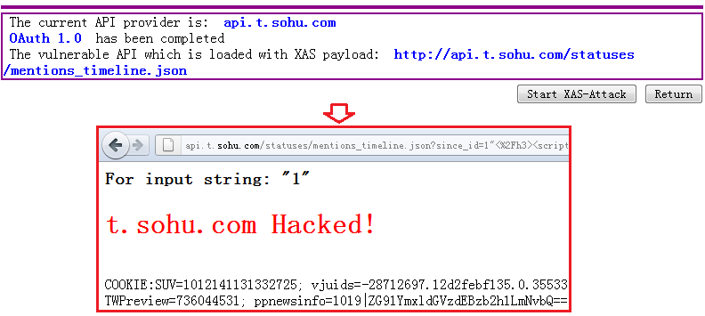
XAS in Social Networks

Slide 11
Differences from Traditional XSS
Malicious code transmitted through RESTful APIs.
Inherited social relationship.
Not limited by same-origin policy (SOP).
Affect multiple parties.

Slide 12
Fuzzing and Results
Commonly, there are two ways to escape user inputs:
  Scheme I : to escape user inputs when they are sent to the server and then stored in sanitized form in the database.
  Scheme II: to store user inputs as they are and to escape them when they are displayed.
Scheme II must be done by third-party websites.

Slide 13
Fuzzing and Results
Auth_Method = OAuth2.0 CallMethod = POST
API_Provider = dev.facebook.com ParamsCount = 1
API_Key = 191742207560268 Param0 = msg
API_Secret = af6ddd003cc0e2de697ace0406d4dfc8 Type0 = String
Response_Format = JSON Initial_value0 = Test
Scope = publish_stream, create_event, … DoTest0 = true
Authorization_URI = https://www.facebook.com/dialog/oauth
Access_Token_URI= https://graph.facebook.com/oauth/access/token
API_ URI=https://graph.facebook.com/***/comments?message=Test
RESTful API Calling Method
http://api.twitter.com/1/statuses/retweet/:id.json? text=testMsg POST
https://graph.facebook.com/130***041/comments?message=Test GET
Architecture overview of our tool identifying Web API flaws

Slide 14
Fuzzing and Results
Our tool identified ill-formed API responses:
  (1) Content-Type Header is incorrectly configured, e.g. “Content-Type: text/html”;
  (2) The response is in HTML format rather than expected JSON or XML.
Our tool also identifies tainted API responses.

Slide 15
Tainted API Response
The API response contains the JavaScript code we inject as API parameters.
The API response contains simple-escaped test vectors.
e.g. the character “/” is converted into “\/” and “"” into “\"”.
The API response contains the Unicoded or the Hex-encoded form of the test vectors.
e.g. “\u003Cscript\u003E alert(131425);
\u003C\/script\u003E” and “\x3c iframe onload=alert
(/xas/)>\x3e”.

Slide 16
Challenges
URI path parameters.
“(/:\w+(-\w+)*)[/|\?|\.]
Rate limiting.
Multiple OAuth versions.

Slide 17
Fuzzing and Results
11 popular social networks were selected:
Twitter, Facebook, Foursquare, LinkedIn, Flickr, Tumblr, Renren, Weibo, t.qq.com, t.163.com, t.sohu.com
143 web-based applications were probed.
107 were found vulnerable to XAS.

Slide 18
Fuzzing and Results
API flaws and valid HTML tags discovered
 |  | Tumblr | Renren | Weibo | Flickr | t.163.com | t.sohu.com
The API Flaws | ISSRF | × | √ | × | √ | √ | ×
 | ISDRF | - | √ | √ | × | × | ×
 | ICT | × | √ | × | √ | √ | √
 | ICF | × | × | × | × | √ | √
 | VHT | - | <p> | - | <a> | <a> | -
 |  | Twitter | Facebook | Foursquare | LinkedIn | t.qq.com
The API Flaws | ISSRF | √ | × | × | × | √
 | ISDRF | × | √ | - | × | ×
 | ICT | √ | √ | × | × | √
 | ICF | √ | × | × | × | ×
 | VHT | <p>, <a> | <p> | - | - | <a>
ISSRF: Inconsistent HTML-escape Schemes for the Same Response Format ISDRF: Inconsistent HTML-escape Schemes for Different Response Format (JSON and XML). ICT: Incorrect Content-Type in API responses. ICF: Incorrect Content Format in API responses. VHT: Valid HTML Tags in normal API responses (VHT is not a flaw but a feature of tested APIs).
“√” denotes the corresponding flaw exists. “×” denotes the corresponding flaw doesn’t exist. “-” for the API flaws denote XML response format is not supported. “-” for VHT denotes no valid HTML tags exist in the normal API responses.

Slide 19
Fuzzing and Results
The ratios for adopted HTML-escape schemes in tested APIs

Slide 20
Fuzzing and Results
The ratios of XAS flaws due to different causes
 | Tumblr | Renren | Weibo | Flickr | t.163.com | t.sohu.com
Scheme I | - | - | - | - | 1/11 | 4/11
Scheme II | 3/5 | 11/12 | 17/21 | 9/11 | 5/11 | -
API Response | - | - | - | - | - | 1/11
 | Twitter | Facebook | Foursquare | LinkedIn | t.qq.com
Scheme I | - | - | - | - | 1/15
Scheme II | 13/21 | 17/19 | 7/8 | 8/9 | 9/15
API Response | - | - | - | - | 1/15
“-” denotes the website does not contain corresponding flaws of a certain cause. “A/B” denotes the ratio of XAS flaws due to a certain cause where “B” represents the total number of third-party applications we checked in the website and “A” represents the number of third-party applications containing XAS flaws of a certain cause.

Slide 21
Mitigation
For Social Networks
All the API responses should be set with proper Content-Type headers.
User-input data from APIs should be sanitized.
Data should be loaded dynamically on the client side via JSONP rather than statically on the server side.
Scheme I should be applied.

Slide 22
Mitigation
For Third-Party APP Developers
The characters “<”, “>” and their valid encoding expressions including the Hex-encoded and Unicoded ones in API responses are all HTML-escaped.
The tags in the white list are once again unescaped to meet the intention of normal API responses.

Slide 23
Conclusions
XSS in RESTful API (XAS) spreads widely and is different from traditional XSS.
143 web-based applications in 11 popular social networks were detected and 107 were found vulnerable to XAS.
Steps must be taken to mitigate problems.

Slide 24

Thank You

