Slide 1

Why distributed security policy requires secure introduction
Joseph Bonneau
Web 2.0 Security & Privacy
San Francisco, CA
May 24 2013

Slide 2
Talk Outline
Threat model
Improved security policies
S-links

Slide 3
Cryptographic attacks on HTTPS
RSA timing leaks
CBC padding oracle attacks
  aka BEAST, Lucky13, etc.
Compression leaks
  aka CRIME
Downgrade to SSL v3
RC4 statistical leakage
Session resumption attacks
See Clark & van Oorschot [IEEE SP '13]

Slide 4
HTTPS vulnerabilities in practice
Inconsistent and incomplete deployment
  stripping attacks
Failures by Certificate Authorities
  rogue certificates

Slide 5
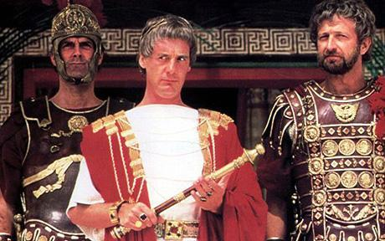

Threat model
Control a CA:
RomeTrust
Control an ISP:
RomeCast
Malicious government
Limitations:
Don't control all servers
Don't control browser

Slide 6


HTTPS stripping
GET http://pfj.org
GET https://pfj.org
GET http://pfj.org
✕
200 ... content
301 Moved Permanently
https://pfj.org
200 ... content

Slide 7
Rogue certificates
GET https://pfj.org
GET https://pfj.org
CN: pfj.org
Issuer: RomeTrust
SPKI: K'
CN: pfj.org
Issuer: Verisign
SPKI: K

Slide 8

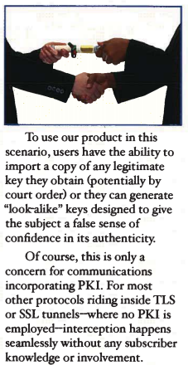
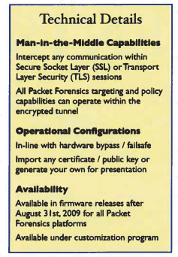
Rogue certificates in the wild
March 2011: Comodo registrar hacked
  9 certs: mail.google.com, login.live.com, www.google.com, login.yahoo.com, login.skype.com, addons.mozilla.org
July 2011: DigiNotar hacked
  531+ certs issued: *.google.com detected first
~2011: TürkTrust issues 2 intermediate CAs
  One returned, one used in 2012 to proxy traffic...

Slide 9
Talk Outline
Threat model
Improved security policies
S-links

Slide 10
Proposals to deal with rogue certs
No server changes
Convergence
Perspectives
Cert patrol
SSL Observatory
Certificate
Transparency
Detective
Preventive
DANE
HPKP
TACK
Sovereign Keys
HPKP-RO
CAA
Server changes

Slide 11
HSTS (Strict Transport Security)
proposed 2008 [Jackson/Barth]
final standard 2012
support in Chrome, FF, Opera
  No support in IE, Safari ☹
~150 preloaded domains in Chrome
  PayPal, Twitter, many Google subdomains
~15,000 domains setting or trying HSTS
~1,000 domains setting long-term HSTS

Slide 12
HPKP (aka PKP, key pinning)
Evans, Palmer, Sleevi 2011
  Standards track, IETF Web Security
MUST include at least 2 pins
Can request "report only" for errors
Remaining issues
  Domain bricking
5 early adopters!
  No browser support

Slide 13
Certificate Transparency (CT)
Laurie, Langley, Käsper 2013
  IETF experimental draft
Enter every issued cert in a global log
CT log is weakly trusted
  Publicly verifiable
  Append-only
Relied on for availability, fork consistency
Certs include "Signed certificate timestamp"
  This is all clients check!
Mis-issued certs detectable by scans

Slide 14
Security = policy distribution
a.com
Romecast
b.org
HSTS
c.net
HPKP
Browsers must know what to expect
prior to the initial connection
d.tv
CT

Slide 15
Browser preloads
{
"pinsets": [
{
"name": "tor",
"static_spki_hashes": [
"RapidSSL",
"DigiCertEVRoot",
"Tor1",
"Tor2",
"Tor3"
]
},
...
{ "name": "torproject.org", "mode": "force-https", "pins": "tor" },
transport_security_static.json (Chromium project)

Slide 16
Continuity-based policy
GET https://pfj.org
200 OK
Strict-Transport-Security: max-age=15768000 ; includeSubDomains
Public-Key-Pins: max-age=15768000;
pin-sha1="4n972...baXc="; pin-sha256="LPJN...LmCQ="
Could also use a well-known URI, TLS extensions, x.509 extensions, etc.

Slide 17
DNS(SEC) based proposals
Service Security Requirements
  Schechter 2007
  Expired RFC
DANE
  Hoffman, Schlyter 2012
  Standards track RFC
CAA
  Hallam-Baker, Stradling 2013
  Standards-track RFC

Slide 18
Channels to distribute security policy
☺
Browser preloads
  HSTS, HPKP (already in Chrome)
Continuity
  HSTS, HPKP, TACK, etc.
DNSSEC
Third parties
  Notaries, public logs, OCSP responders
?
☠

Slide 19
Out-of-band lookup is a non-starter
GET https://pfj.org
CN: pfj.org
Issuer: Verisign
SPKI: K
Was this okay
for pfj.org?
∅
Attackers can always simulate outage!

Slide 20
Talk Outline
Threat model
Improved security policies
S-links

Slide 21
Secure introduction
IDEA: for web navigation, a referring website can indicate security policy in-band in links
Already exists for HSTS!
Effects of an HTTPS link:
  mandatory
  ephemeral
  transparent to users
  easy to deploy

Slide 22
My proposal: s-links
<a link-security="expiry=1357849989;
pin-sha256=YWRm...cnF=;
pin-sha256=LPJN...mCQ=;"
href="https://pfj.org">secure link!</a>
secure link!

Slide 23
Why HTML?
Extensible
Backwards compatible
Easy to deploy
Challenges:
Redirects
Copy/paste

Slide 24
S-links directives
Key pins
CT mandatory
EV mandatory
Minimum TLS version
...
Expiry

Slide 25
Linked web navigation model
users only reach new domains via hyperlinks, beginning with a set of domains with preloaded security policies.

Slide 26
The end-to-end picture
s-link
s-link
Preloaded
domains
s-link
s-link

Slide 27
Malicious s-links?
Can only make security policy stricter
  Can never undermine ambient policy
No persistent effects
  No domain bricking
UI ≈ 404 (not found)
  Limit risk of "warning fatigue"

Slide 28
S-links and the same origin policy
secure.com
s-link
pfj.org
cross-frame navigation
script injection
cookie theft
pfj.org

Slide 29
S-links and the same origin policy
secure.com
s-link
pfj.org
HPKP
pfj.org

Slide 30
Upgrading security policy
Need to re-check ALL cached resources
  HTTP cache
  HTML5 localStorage/WebCache
  TLS saved sessions
  Cookies
  etc.
Need to do so atomically
No issues for non-framed content
  For example, script libraries

Slide 31





Who might set s-links?
Search engines
Social media sites
Link aggregators

Slide 32
Big-picture questions
Whom do we have to trust?
Can we change who we have to trust?
  Trust agility
Can users tell whom they're trusting?
  Trust affordance

Slide 33
5 predictions for the next 5 years
Multiple security protocols deployed
  At least HPKP & CT
Multiple distribution channels
  Preload/link/continuity paradigm will predominate
Policy specification will standardize
Preloads will expand, standardize
Web hubs will develop into security notaries

Slide 34
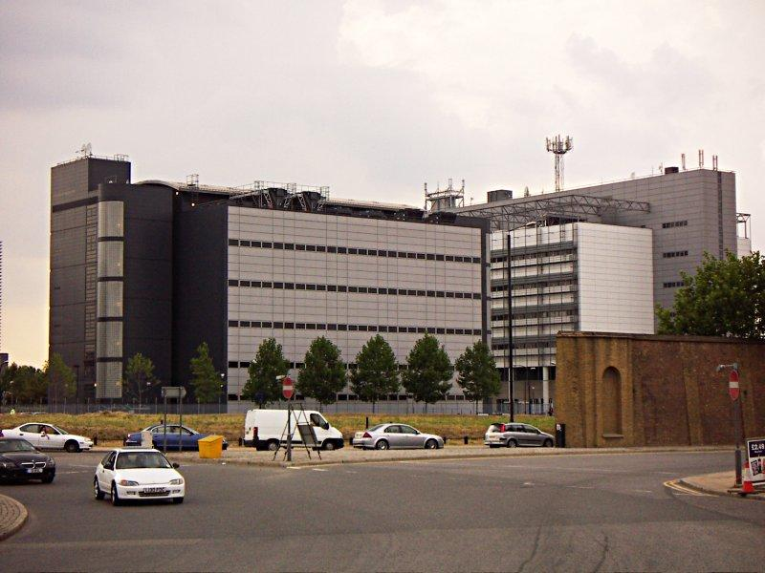

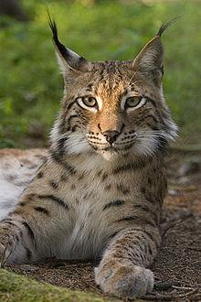
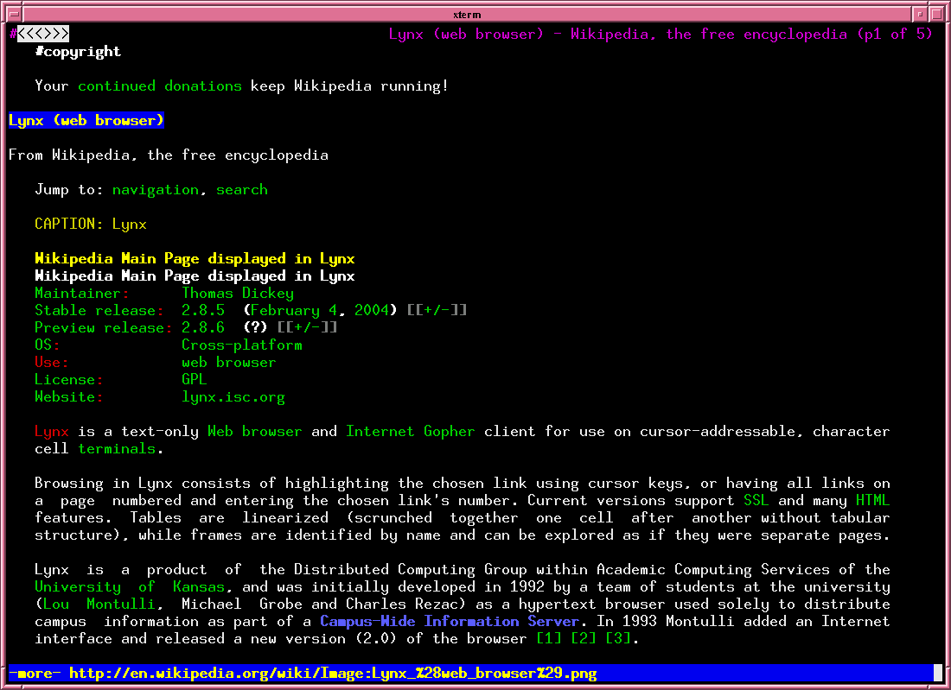

Think links!
jbonneau@gmail.com
www.secure-links.org

