Slide 1
Talking to Yourself for Fun and Profit
Lin-Shung Huang∗, Eric Y. Chen∗, Adam Barth†, Eric Rescorla‡ and Collin Jackson∗
∗ Carnegie Mellon University
† Google
‡ RTFM
WEB 2.0 SECURITY AND PRIVACY 2011

Slide 2
Bringing Sockets to the Web
Web applications need to talk to the cloud
But HTTP is inefficient
E.g. chat, multiplayer games
Plug-ins and HTML5 provide socket APIs
Modest amounts of security analysis…
Plug-ins:
Native:

Slide 3
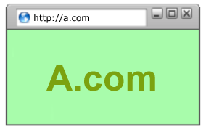
Existing Approaches
Flash Player: Authorizes by policy files
Java: Only talks to yourself
<policy-file-request />
B.com
<allow-access-from domain="*" />
01100111011101…
B.com
A.com
01100111011101…
What could possibly go wrong?

Slide 4
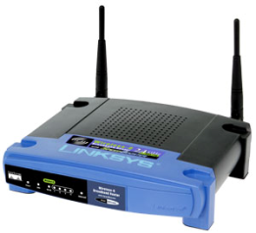
Beware of Transparent Proxies
Inspect and modify HTTP traffic
Content filtering
Web acceleration
A.com
GET / HTTP/1.0
Host: a.com
GET / HTTP/1.0
Host: a.com
HTTP 200 OK
Cache-Control: public
<html>…
HTTP 200 OK
Cache-Control: public
<html>…
Cache hit!
GET / HTTP/1.0
Host: a.com
HTTP 200 OK
Cache-Control: public
<html>…

Slide 5
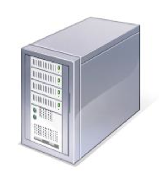
IP Hijacking [Auger '10]
Allows connection to unauthorized destinations if routing by Host header
Alice
attacker.com
IP: 2.2.2.2
Flash Player
To 2.2.2.2 port 843:
<policy-file-request />
Route by IP
To 2.2.2.2 port 843:
<policy-file-request />
attacker.swf
To 2.2.2.2 port 80:
GET / HTTP/1.1
Host: target.com
<allow-access-from domain="*" />
Route by Host
target.com
IP: 1.1.1.1

Slide 6
Cache Poisoning
Even worse if routing by IP, and caching by Host header
Alice
Proxy
attacker.com
IP: 2.2.2.2
Java VM
To 2.2.2.2 port 80:
GET /script.js HTTP/1.1
Host: target.com
Route by IP
attacker.class
Cache by Host
script.js
To 1.1.1.1 port 80:
GET /script.js HTTP/1.1
Host: target.com
target.com
IP: 1.1.1.1
Bob
Cache hit!
Cache
script.js

Slide 7
How bad is it?
Advertising network experiments
$100 = 174,250 impressions
Observe browsers in the wild
Mount proof-of-concept attacks against our servers

Slide 8
Observed Vulnerabilities
IP hijacking
Java: 3,152 of 51,273 (6.1%)
Flash Player: 2,109 of 30,045 (7%)
Cache poisoning
Java: 53 of 30,045 (0.18%)
Flash Player: 108 of 51,273 (0.21%)
Less than $1 per exploitation!

Slide 9
Designing HTML5 WebSockets
Strawman “consent” protocols
POST-based handshake
Upgrade-based handshake
CONNECT-based handshake
Proposed modifications
Mask attacker-controlled bytes

Slide 10
Strawman #1
POST-based handshake
For HTML form elements
IP hijacking: 1,376 of 49,218
Cache poisoning: 15 of 49,218
Client → Server:
POST /path/of/attackers/choice HTTP/1.1
Host: host-of-attackers-choice.com
Sec-WebSocket-Key: <connection-key>
Server → Client:
HTTP/1.1 200 OK
Sec-WebSocket-Accept: <connection-key>

Slide 11
Strawman #2
Upgrade-based handshake
For layering TLS over HTTP
IP hijacking: 174 of 47,388
Cache poisoning: 8 of 47,388
Client → Server:
GET /path/of/attackers/choice HTTP/1.1
Host: host-of-attackers-choice.com
Connection: Upgrade
Sec-WebSocket-Key: <connection-key>
Upgrade: WebSocket
Server → Client:
HTTP/1.1 101 Switching Protocols
Connection: Upgrade
Upgrade: WebSocket
Sec-WebSocket-Accept: HMAC(<connection-key>, "...")

Slide 12
Strawman #3
CONNECT-based handshake
For tunneling TLS through proxies
2 spoofed HTTP requests routed by IP
Client → Server:
CONNECT websocket.invalid:443 HTTP/1.1
Host: websocket.invalid:443
Sec-WebSocket-Key: <connection-key>
Sec-WebSocket-Metadata: <metadata>
Server → Client:
HTTP/1.1 200 OK
Sec-WebSocket-Accept: <hmac>

Slide 13
Frame Masking
Mask attacker-controlled bytes
Raw bytes on the wire should not be chosen by attacker
Stream cipher e.g. AES-CTR-128
Per-frame random nonce
XOR cipher as alternative

Slide 14
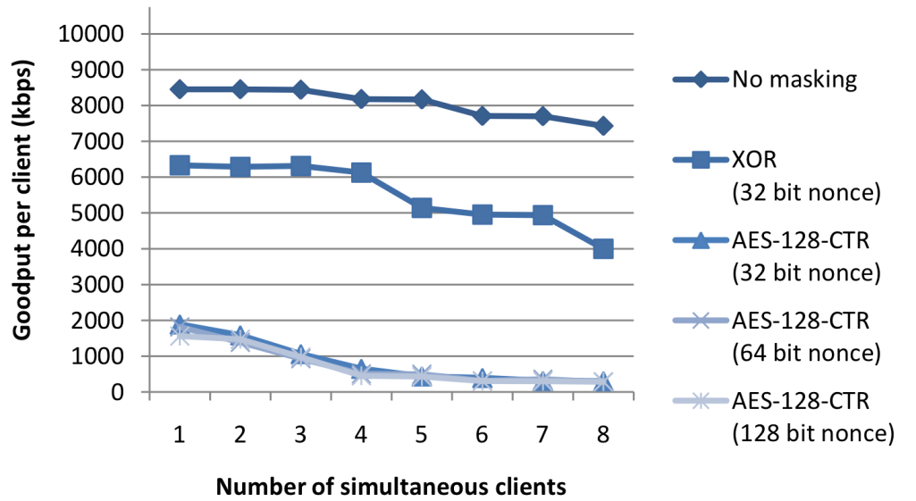
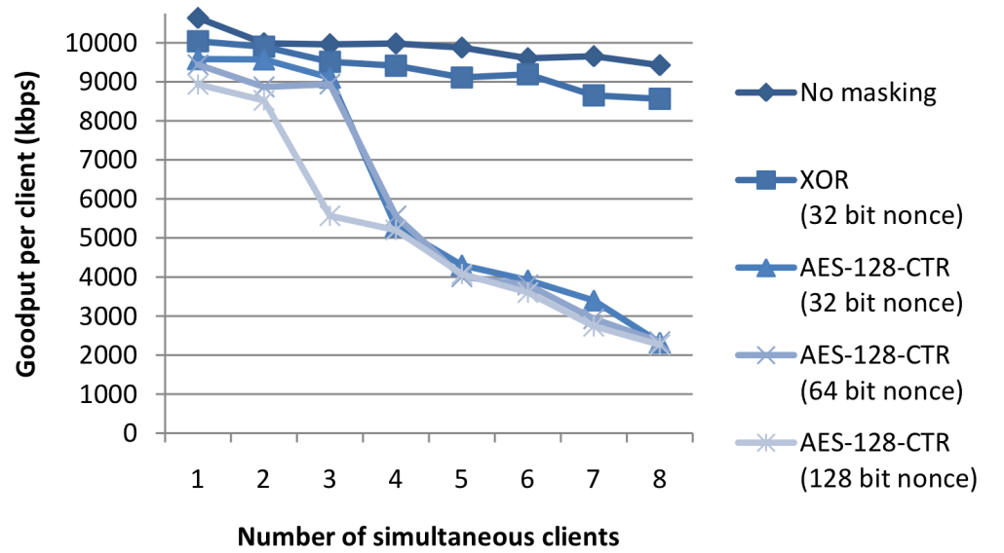
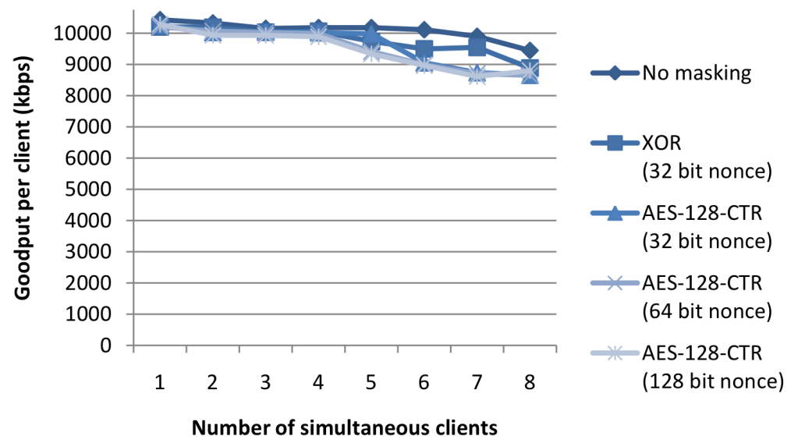
Performance
(a) 10 byte data frames
(b) 100 byte data frames
(c) 1000 byte data frames

Slide 15
Reaction
Firefox and Opera temporarily disabled HTML5 WebSockets
The WebSocket Protocol working group adopted a variant of our proposal, requiring XOR-based frame masking
Firefox dev build
Microsoft WebSockets prototype

Slide 16
Conclusion
Roughly 7% browsers are behind proxies with implementation errors
Protocols designers should consider how attackers can manipulate data to fool network intermediaries
HTML5 WebSocket protocol is work in progress, we also recommend Java and Flash Player to address this issue

Slide 17
Thanks!

