Slide 1
Bootstrapping Mobile PINs Using Passwords
Markus Jakobsson
Debin Liu
Information Risk Management
PayPal

Slide 2
A Bit about Authentication
Difficulty
authenticating
Lack of coverage
Small
screen
size
Short battery life
1 2 3 4 5
Slow Web connection
Difficulty
customizing
settings
Poor voice quality

Slide 3
Commercial Four-Letter Word
“Friction”

Slide 4
A Bit About Human Memory
Not so amazing

Slide 5
Common PIN
Your spouse’s birthday

Slide 6
Love/Hate
PINs

Slide 7
What will users see

Slide 8
Example User Mapping
“Blu2thRules” “2582”

Slide 9
Opportunistic Derivation
Access; Truncate; Map; Store

Slide 10
Special Characters
~1.5%
Can be reduced

Slide 11
Special Phones
Need numeric pad

Slide 12
Strong password, weak PIN
“1234Brew$g”, “1begHELP”

Slide 13
Password change?
Dual Universes

Slide 14
Measuring Security
Raided Dropboxes

Slide 15
Entropy of Derived PINs

Slide 16
Special Characters

Slide 17
Imagine PIN Theft

Slide 18
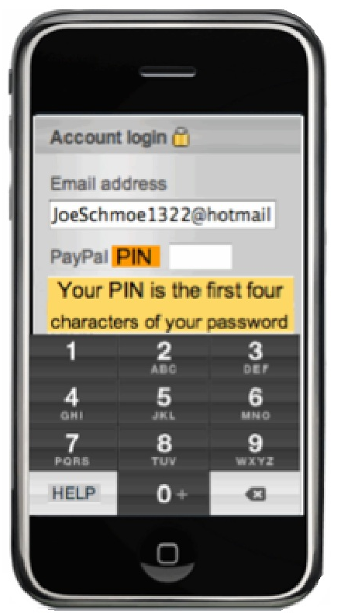
Experiment
What is Joe’s PIN?
Joe uses a PIN to access his PayPal account from his phone. But he does not want to have to remember another number, and he does not want to reuse his banking PIN. So he uses PayPal’s new “password to PIN” feature so that he only has to remember his password. Joe’s password is “Blu2thrules”. Look at the screen-shot below and let us know what PIN he should enter.

Slide 19
Usability of Derived PINs 25-subject Qualitative study

Slide 20
Usability of Derived PINs 100-subject Quantitative study

Slide 21
Other things I pitch
Address web/app spoofing: www.SpoofKiller.com
Mobile-friendly passwords: www.fastword.me
Mobile malware detection: www.fatskunk.com
Etc: www.markus-jakobsson.com

