Slide 1
Analyzing Crossdomain Policies of Flash Applications
Don Jang
Aishwarya Venkataraman
Hovav Shacham
UC San Diego
Michael Sawka
Topix

Slide 2
Same-origin Policy For JS
JS on a site can read data only from the same site
Protects a user’s confidential data from other sites

Slide 3
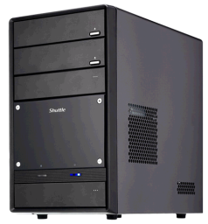
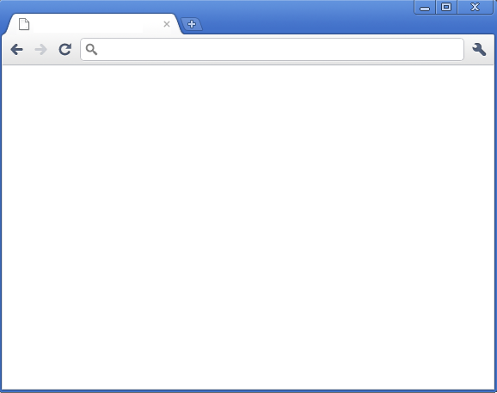

Under the SOP, this attack is impossible
If there wasn’t the same-origin policy…
evil.com
evil.com
JS
✗
secret.com

Slide 4

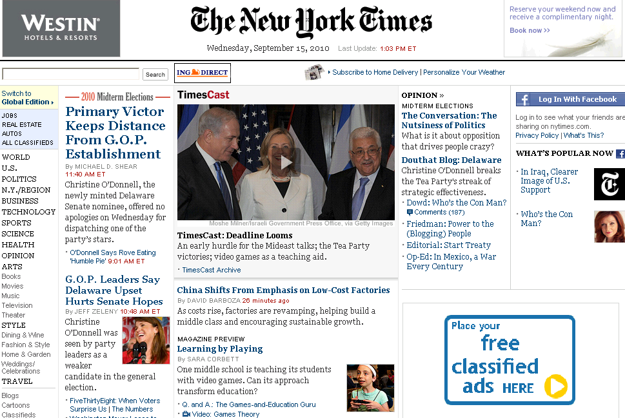



Slide 5
Same-origin Policy for Flash
http://b.com/index.html
...
<object>
<param name=“movie” ...>
<embed src=“http://a.com/mov.swf”></embed>
</object>
...

Slide 6

Same-origin Policy for Flash
Origin : not embedding site, but hosting site
http://b.com/index.html
http://a.com/mov.swf
Origin: a.com

Slide 7
Same-origin Policy for Flash
Enforced by Flash Player, not browser
✓
a.com
a.com
✗
b.com
Flash Player

Slide 8

We trust the Flash on a.com.
Can we allow it to read data from us?
We can “opt out” of the standard SOP
a.com
Admin of b.com
✗
b.com
Flash Player

Slide 9
http://b.com/crossdomain.xml
<cross-domain-policy>
<allow-access-from domain=“a.com”/>
</cross-domain-policy>
Crossdomain Policy
CDX
b.com

Slide 10
Crossdomain Request
✓
a.com
CDX
b.com
Flash Player

Slide 11
Crossdomain Policies Can Be Unsafe
When unsafe, crossdomain attacks are possible

Slide 12

http://secret.com/crossdomain.xml
<cross-domain-policy>
...
<allow-access-from domain=“evil.com”/>
...
</cross-domain-policy>
CDX
evil.com
secret.com

Slide 13
GET /profile.php
✗
Cookie : SID=qqem7fe6123e
Cookies are attached to crossdomain requests
Stealing Confidential Data
Protected by Cookies
Confidential information
Protected by
Cookies
CDX
evil.com
secret.com

Slide 14
Crossdomain Policies Must Be Carefully Used
Exploitable to circumvent the same-origin policy

Slide 15
What Crossdomain Policies Are Deployed?
How Are Flash Apps Using Xdomain Requests?

Slide 16
Motivation
Crossdomain Policy
Policies on Popular Sites
XDomain Requests In the Wild
Mitigation
Conclusions

Slide 17
Crossdomain Policies
Specify trusted websites
& what they can do with the host

Slide 18
Policies:Example
http://a.com/crossdomain.xml
<cross-domain-policy>
<allow-access-from domain=“b.com”/>
<allow-access-from domain=“safe.com”/>
</cross-domain-policy>

Slide 19
Policies:Example
http://a.com/crossdomain.xml
<cross-domain-policy>
<allow-access-from domain=“*.a.com”/>
</cross-domain-policy>

Slide 20

Policies:Example
http://a.com/crossdomain.xml
<cross-domain-policy>
<allow-access-from domain=“*”/>
</cross-domain-policy>
✗
Complete Loss of Protection by SOP
cdx
*
a.com

Slide 21
Motivation
Crossdomain Policy
Policies on Popular Sites
Xdomain Requests In the Wild
Mitigation
Conclusions

Slide 22
Surveyed Sites
Alexa Top 50,000 sites (Jan 2011)
robots.txt was respected
For each Alexa entry “a.com”
we queried “http://a.com:80/crossdomain.xml”
48,951 sites were left to survey

Slide 23
Sites with crossdomain.xml
17% had crossdomain.xml (8,264 websites)

Slide 24
Sites with Unrestricted Policy
6.0% sites had unrestricted policy (2,993 websites)
<allow-access-from domain=“*”/>

Slide 25
Sites with Unrestricted Policy
Rank | Site | Description
9 | qq.com | Chinese news
47 | youku.com | Chinese video
48 | tudou.com | Chinese video
51 | xvideos.com | adult video
61 | pornhub.com | adult video
65 | about.com | search
68 | zedo.com | advertising
77 | youporn.com | adult video
81 | ifeng.com | Chinese news
87 | imagesshack.us | media hosting
+ 36 more sites…

Slide 26
Sites with Unrestricted Policy
Rank | Site | Description
9 | qq.com | Chinese news
47 | youku.com | Chinese video
48 | tudou.com | Chinese video
51 | xvideos.com | adult video
61 | pornhub.com | adult video
65 | about.com | search
68 | zedo.com | advertising
77 | youporn.com | adult video
81 | ifeng.com | Chinese news
87 | imagesshack.us | media hosting
+ 36 more sites…

Slide 27
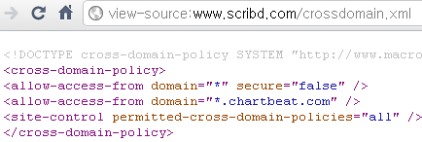
Case Study: Scribd.com
scribd.com and www.scribd.com had unrestricted crossdomain policy

Slide 28
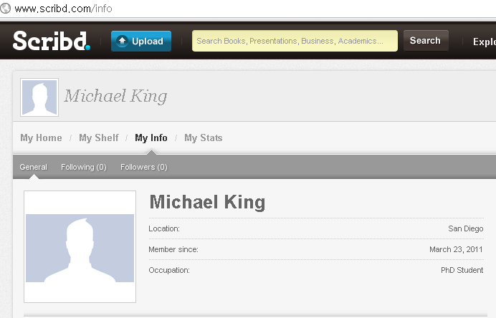
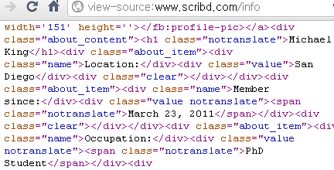
Case Study: Scribd.com
Logged-in user’s profile is available to Flash on any other websites
www.scribd.com/info

Slide 29
Sites Allowing Many Other Domains
1.6% of the sites allow 10 or more other sites for crossdomain access
http://nissan.co.jp/crossdomain.xml
<cross-domain-policy>
<allow-access-from
domain=“www.n-23.com"/>
//+ 199 more allow-access-from elements
</cross-domain-policy>

Slide 30
Sites Granted Access To Many Other Sites
Some websites are granted crossdomain access to many other websites
attractive targets for attackers

Slide 31

Sites Granted Access To Many Other Sites
Some websites are granted crossdomain access to many other websites
CDX:
x.com
CDX:
x.com
a.com
x.com
b.com
CDX:
x.com
CDX:
x.com
c.com
d.com

Slide 32
Sites Granted Access To Many Other Sites
Domain | Desc | Allowed to access
*.brightcove.com | online ad | espn.go.com, nytimes.com,+ 191
*.cooliris.com | content | cnet.com, + 144
*.doubleclick.net | online ad | cnn.com, espn.go.com +141
*.2mdn.net | online ad | cnn.com, espn.go.com, + 113
localhost | - | kooora.com, enet.com, +103
*.facebook.com | social | nba.com, tripadvisor.com, +64
*.doubleclick.com | online ad | wsj.com, espn.go.com, +56
*.aol.com | content | cnn.com, wsj.com, +55
*.floq.jp | fun | msn.com,sony.jp,+51
*.livedoor.com | content | Ldblog.jp,2chblog.jp, +47

Slide 33
Sites Granted Access To Many Other Sites
Domain | Desc | Allowed to access
*.brightcove.com | online ad | espn.go.com, nytimes.com,+ 191
*.cooliris.com | content | cnet.com, + 144
*.doubleclick.net | online ad | cnn.com, espn.go.com +141
*.2mdn.net | online ad | cnn.com, espn.go.com, + 113
localhost | - | kooora.com, enet.com, +103
*.facebook.com | social | nba.com, tripadvisor.com, +64
*.doubleclick.com | online ad | wsj.com, espn.go.com, +56
*.aol.com | content | cnn.com, wsj.com, +55
*.floq.jp | fun | msn.com,sony.jp,+51
*.livedoor.com | content | Ldblog.jp,2chblog.jp, +47

Slide 34
Policies on Popular Sites: Upshot
Without crossdomain.xml
With crossdomain.xml

Slide 35
Policies on Popular Sites: Upshot
778
(1.6%)
Unrestricted policy
2993
(6.0%)
Allowing 10+ other sites

Slide 36
Motivation
Crossdomain Policy
Policies on Popular Sites
Xdomain Requests In the Wild
Mitigation
Conclusions

Slide 37
Crossdomain Requests In the Wild
1. Modified Firefox browser
to log Xdomain requests from Flash apps
2. Ran the browser over sites
the frontpages of Alexa top 50,000
3. Analyzed the logged data

Slide 38
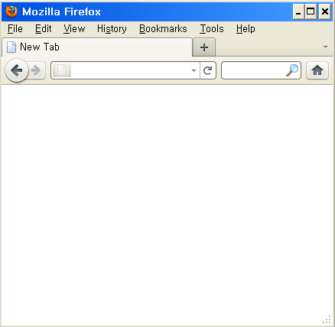

Modified Browser: Flash Player
a.com
Flash Player
Flash Player
Browser
Browser

Slide 39
Modified Browser: Flash Player
ActionScript
Flash Player
NPAPI
Browser

Slide 40
Modified Browser: NPAPI Logger
http://a.com/safe.swf
loader.load(“http://a.com/data.txt”)
Flash Player
NPN_GetURL(“http://a.com/data.txt”)
Logger for NPAPI Calls
Browser

Slide 41
Modified Browser: Allowed Xdomain Request
http://b.com/ad.swf
Logged NPAPI
✓
...load(http://a.com/data.txt)
http://a.com/crossdomain.xml
http://a.com/data.txt
Flash Player
NPN_...(http://a.com/data.txt)
NPN_...(http://a.com/crossdomain.xml)
Browser

Slide 42
Modified Browser: Allowed Xdomain Request
Logged NPAPI
crossdomain.xml is followed by “real” resources
→ the crossdomain request was allowed
http://a.com/crossdomain.xml
http://a.com/data.txt

Slide 43
Modified Browser:Disallowed Xdomain Request
http://b.com/ad.swf
Logged NPAPI
✗
...load(http://a.com/data.txt)
http://a.com/crossdomain.xml
// not followed by any request to a.com
Flash Player
NPN_...(http://a.com/crossdomain.xml)
Browser

Slide 44
Modified Browser:Disallowed Xdomain Request
Logged NPAPI
crossdomain.xml is NOT followed by “real” resources
→ 1+ crossdomain requests were disallowed the crossdomain policy
http://a.com/crossdomain.xml
// not followed by any request to a.com

Slide 45
Surveyed Flash Applications
Alexa Top 50,000 sites (Jan 2011)
For each site, Flash applications on the frontpage were inspected
74 hours (5.3 sec / site)
17.5% of the sites hosted Flash apps (8,746 sites)

Slide 46
Crossdomain Requests: Figures
102,169 HTTP/HTTPS requests
21% of them : crossdomain requests preceded by a request to crossdomain.xml

Slide 47
Target Sites of Xdomain Requests
Ref Count | Site
674 | i.ytimg.com
601 | I2.ytimg.com
580 | I4.ytimg.com
578 | I3.ytimg.com
550 | I1.ytimg.com
407 | brightcove.vo.llnwd.net
387 | c.brightcove.com
344 | Images.kontera.com
288 | newschool.slideshowpro.com
261 | api.dimestore.com

Slide 48
Disallowed Crossdomain Requests
10,565 requests to crossdomain.xml
1,545 were not followed by any subsequent request to their target sites
1,545 is a lower bound on the # of disallowed crossdomain requests
The fraction of disallowed requests :
≥ 1,545/(1,545 + 21,430)
The fraction of disallowed requests :
≥ 1,545/(1,545 + # of allowed requests)
Disallowed requests : ≥ 6.7%

Slide 49
Motivation
Crossdomain Policy
Policies on Popular Sites
Xdomain Requests In the Wild
Mitigation
Conclusions

Slide 50
Mitigation
Prevalence of Overly Permissive Policies
Frequent Use of Crossdomain Requests

Slide 51
Mitigation
Auditing tool for crossdomain.xml raises warning when encountering dangerous policies
Stripped cookies by default allow Flash apps for public content only
Stripped cookies as an option controls whether or not cookie is attached in policies
“Taint mode” for crossdomain data prevents Flash from hijacking data from other domain

Slide 52
Motivation
Crossdomain Policy
Policies on Popular Sites
Xdomain Requests In the Wild
Mitigation
Conclusions

Slide 53
Conclusions
Surveyed crossdomain.xml on 50k sites possibly overly-permissive policies are common
Studied the actual crossdomain requests crossdomain requests are frequently used
Steps must be taken to mitigate problems

Slide 54
Future Work
Study larger number of crossdomain.xml larger number of websites
Extensive monitoring of Flash Player instrumentation of Flash Player for extensive logging
Find vulnerabilities of websites sensitive information protected by session-cookie

Slide 55
Thank you!

Slide 56
Sub-path Crossdomain Policy

Slide 57
Sub-path Crossdomain Policy
I’d like to use different policies for sub-paths
Admin of a.com
/
/crossdomain.xml
a.com
/sub
/sub/crossdomain.xml

Slide 58
Sub-path Crossdomain Policy
http://a.com/crossdomain.xml
<cross-domain-policy>
<site-control
permitted-cross-domain-policies="master-only"/>
...
</cross-domain-policy>
Consult root policy only

Slide 59
Sub-path Crossdomain Policy
http://a.com/crossdomain.xml
<cross-domain-policy>
<site-control
permitted-cross-domain-policies=“by-content-type"/>
...
</cross-domain-policy>
Consult sub-path policy files served with text/x-cross-domain-policy Content- Type

Slide 60
Sub-path Crossdomain Policy
http://a.com/crossdomain.xml
<cross-domain-policy>
<site-control
permitted-cross-domain-policies=“all"/>
...
</cross-domain-policy>
Consult http://a.com/sub/crossdomain.xml for http://a.com/sub/

Slide 61
Sub-path Crossdomain Policy
http://a.com/crossdomain.xml
<cross-domain-policy>
<site-control
permitted-cross-domain-policies=“all"/>
...
</cross-domain-policy>
/
/crossdomain.xml
a.com
/upload
crossdomain.xml

Slide 62
Sub-path Crossdomain Policy
896 sites have set the sub-policy attribute to “all”
402 sites have set it to “by-content-type”

Slide 63
Policies on Popular Sites: Upshot
402
(0.82%)
“all” sub-path policy
896
(1.83%)
“content-type” sub-path policy

Slide 64
Same-origin Policy For JS
JS on a origin can only read from the same origin
Origin
(scheme, hostname, port)
http:// a.com :80

