Slide 1
Empowering Browser Security for Mobile Devices Using Smart CDNs
Ben Livshits and David Molnar
Microsoft Research

Slide 2
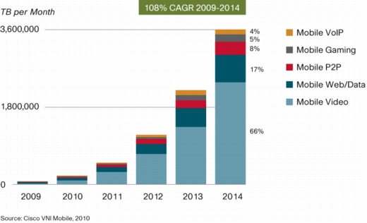
Mobile Web Growth

Slide 3
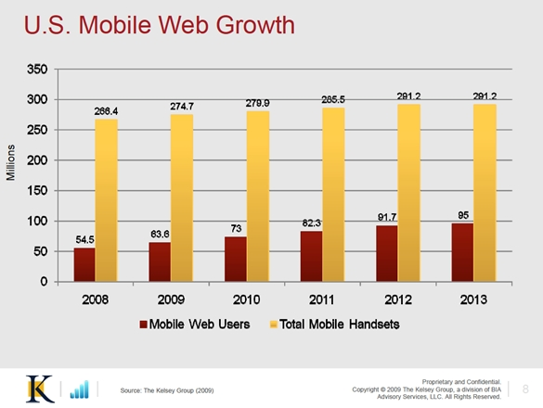
US Mobile Web Growth

Slide 4
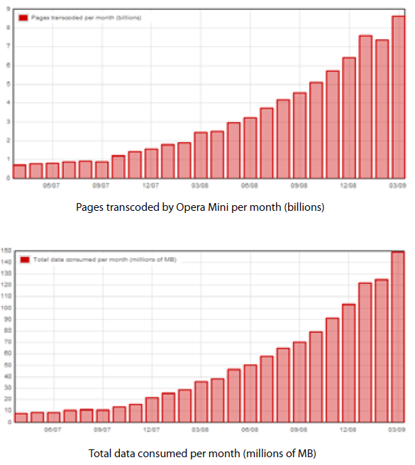
Opera Mobile Study
http://www.opera.com/media/smw/2009/pdf/smw032009.pdf

Slide 5
Research in Desktop Browser Security

Slide 6
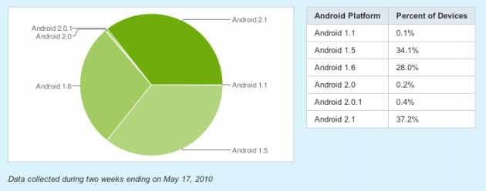
Mobile: Difficulties of Adoption
http://developer.android.com/resources/dashboard/platform-versions.html

Slide 7
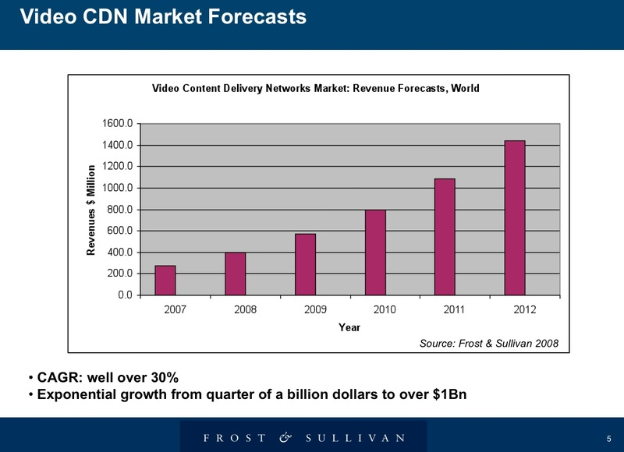
CDNs are Growing

Slide 8
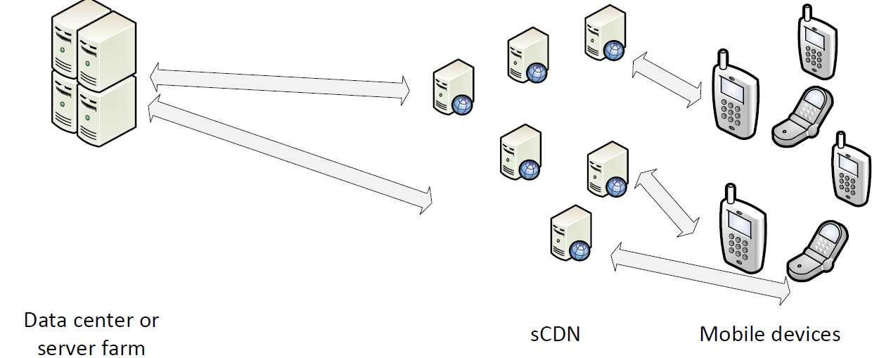
Consequence: Fat Middle Tier
Rise of “smart CDN” (sCDN)
What does this mean for security?

Slide 9
Two Research Directions
What if the middle tier is not trustworthy?
What new security services can we provide?

Slide 10
Two Research Directions
What if the middle tier is not trustworthy?
What new security services can we provide?
Let’s do the easiest one first…

Slide 11
Example Service: Nozzle in Mobile
Nozzle is a heap spraying prevention system that protects desktop browsers [UsenixSec’09]
How to deploy Nozzle on mobile browsers?
Software updates on all handsets..?
Same problem for any browser based mitigation – StackGuard, RandomHeap, your paper at W2SP20XX…

Slide 12
Example Service: Nozzle in Mobile
Run Nozzle in sCDN!
Catch heap sprays,
pre-render benign pages,
ship renders to mobile.

Slide 13
More sCDN Security Services
Real Time phish tracking
  “Why is everyone suddenly going to whuffo.com?”
URL reputation
  “15 other people were owned by this URL”
XSS filters
Fuzz testing seeded with real traces

Slide 14
Untrustworthy Infrastructure?
Multiple vendors
  Linksys, Cisco, Akamai, Limelight, …
Multiple operators
  Comcast, Sprint, AT&T, T-Mobile, Joe Sixpack, …
Multiple web applications
How do these parties work together?
What about privacy?

Slide 15
Two Research Directions
What if the middle tier is not trustworthy?
What new security services can we provide?

