Slide 1
What You See Is What They Get Protecting users from unwanted use of microphones, cameras, and other sensors
Jon Howell & Stuart Schechter
Microsoft Research

Slide 2
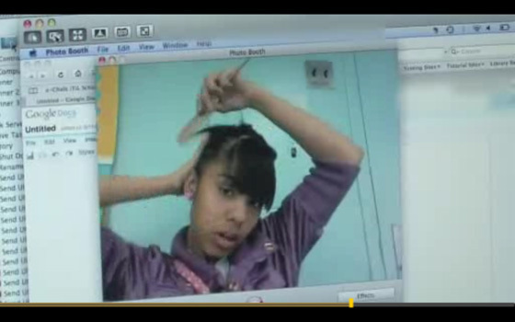
Who’s watching you?

Slide 3
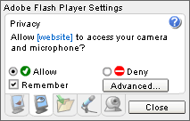

Slide 4
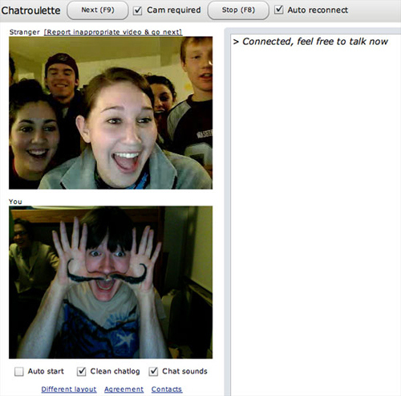

Slide 5
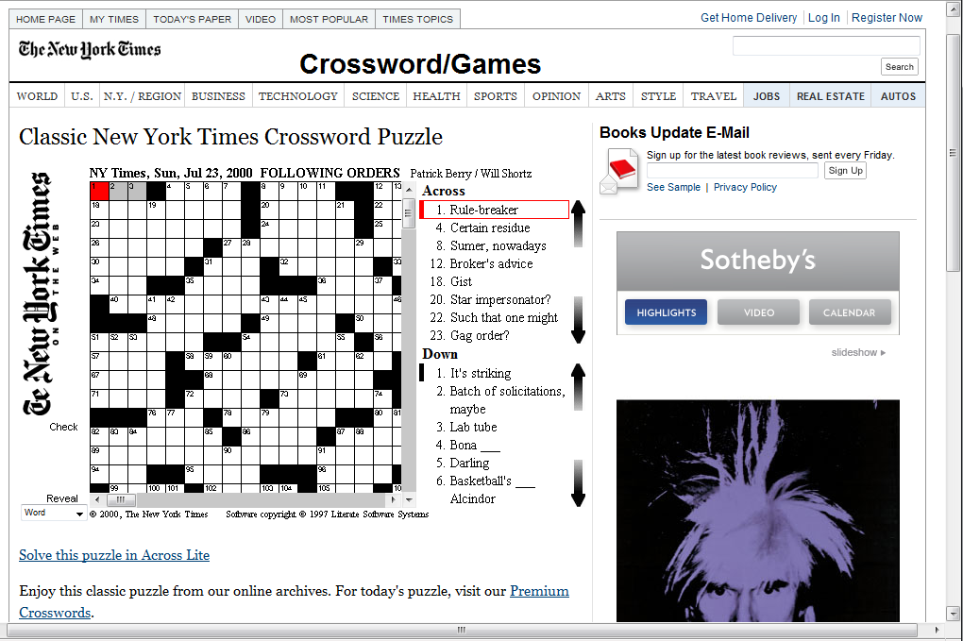

Slide 6
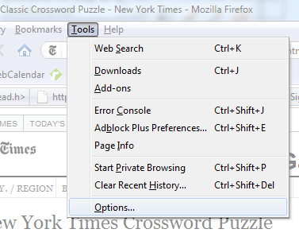
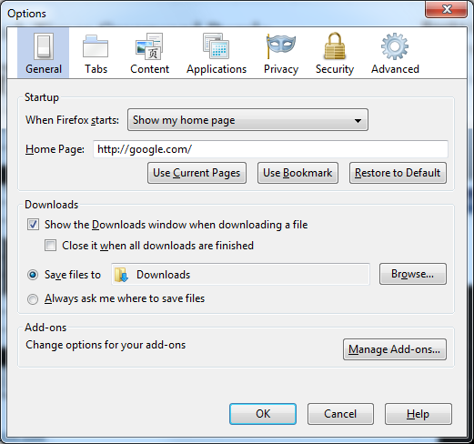
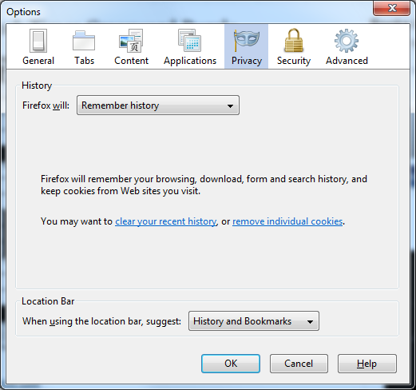

Slide 7
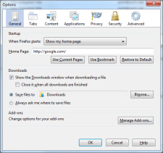
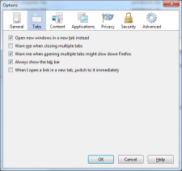
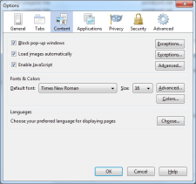
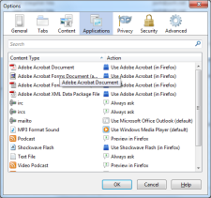
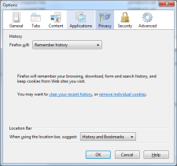
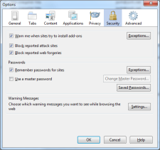
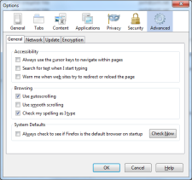
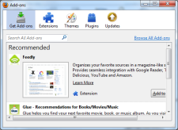
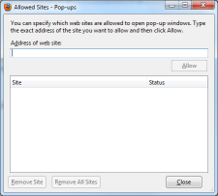
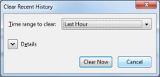
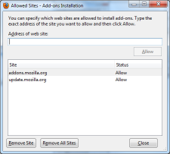
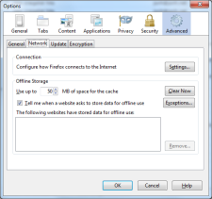
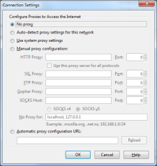
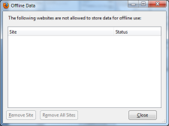
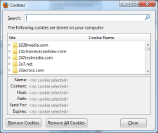
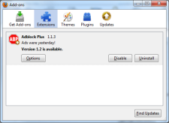
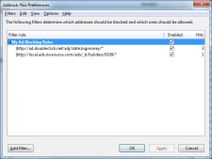
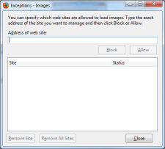
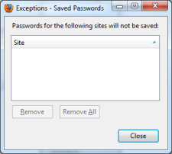
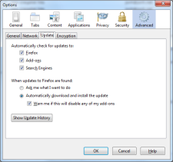
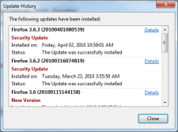
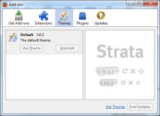
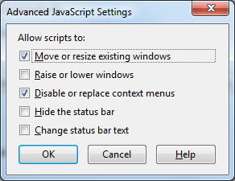
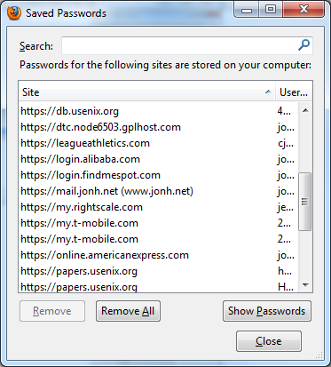
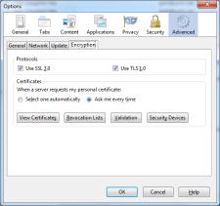
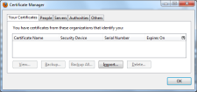
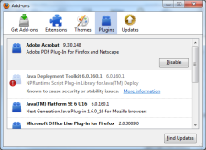
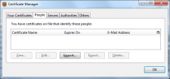
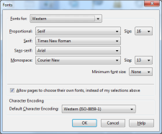
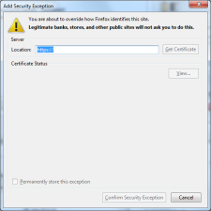
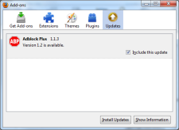
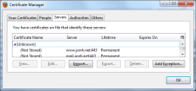
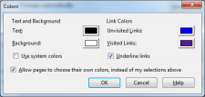
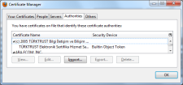
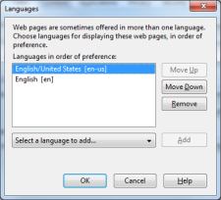
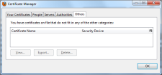

Slide 8
user’s model is not “I trust chatroulette”, but
I don’t mind chatroulette taking my picture when I know I’m chatting.
can’t trust app to describe activity ⇒ must rely on user
display effective access policy [Reeder]

Slide 9
strawpersons
dialog box every time
annoying
LED / static icon
fades into visual clutter
too late

Slide 10
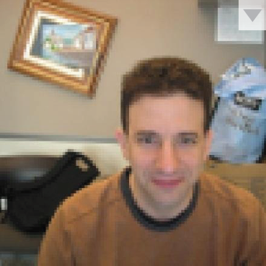
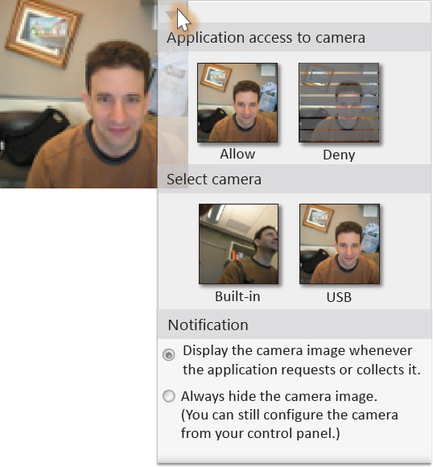
the Sensor-Access Widget
live feedback
absence implies privacy
shows effective access policy
access control point
configuration control point

Slide 11
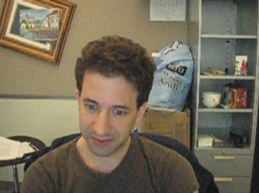
What You See Is What They Get

Slide 12
Policies
Hide Widget and Allow (HWA)
Show Widget and Allow (SWA)
Show Widget and Allow After Input and Delay (SWAAID)
Show Widget and Deny (SWD)
Hide Widget and Deny (HWD)

Slide 13
SWAAID Show Widget and Allow After Input and Delay
Show Widget:
The widget appears unobstructed in the requesting application’s display
Input:
The user has directed a click or keystroke at the requesting application
Delay
A five-second waiting period since visibility and input were satisfied
5
4
3
2
1
Notes:
Passive -> active device model

Slide 14
Policies
Hide Widget and Allow (HWA)
Show Widget and Allow (SWA)
Show Widget and Allow After Input and Delay (SWAAID)
Show Widget and Deny (SWD)
Hide Widget and Deny (HWD)
data accessible
without
user veto
access
requires
hassling user

Slide 15
other devices
microphone
accelerometer
location

Slide 16
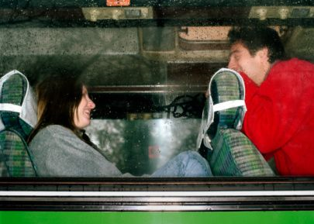
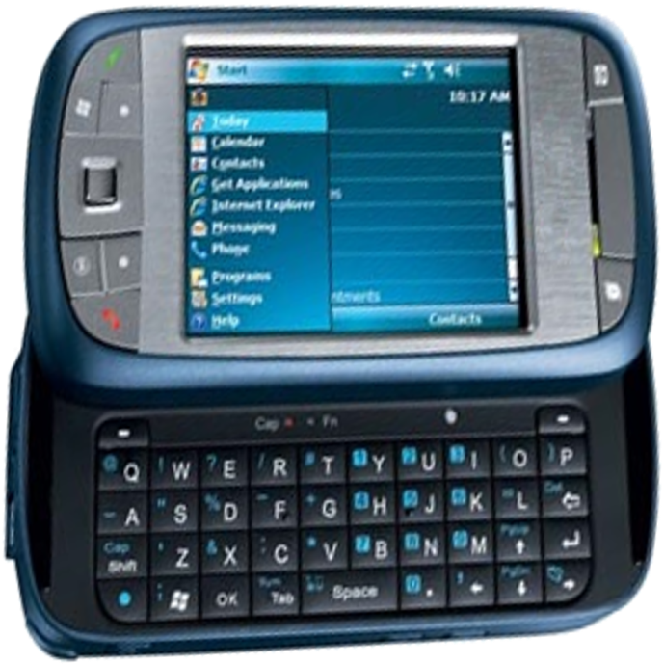
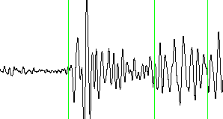
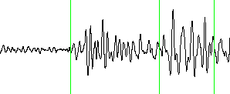
limitations
conveying subtle threats
inadequate fidelity
display crowding
accidental input

Slide 17
Summary
the Sensor-Access Widget mechanism
live data stream of your environment
what you see is what they get
Show Widget and Allow After Input and Delay (SWAAID) policy
a good default:
doesn’t hassle user
avoids inadvertent privacy leaks

