Slide 1



MOBILE SECURITY TECHNOLOGIES (MOST) 2017
Thursday, May 25, 2017
The Fairmont Hotel, San Jose, CA
HybridGuard: A Principal-based Permission and Fine-Grained Policy Enforcement Framework for Web-based Mobile Applications
Phu H. Phung
University of Dayton
Abhinav Mohanty, Rahul Rachapalli and Meera Sridhar
University of NC at Charlotte

Slide 2



Web-based (Hybrid) Mobile Apps
Business core code is developed in the Web technologies, i.e., HTML/JavaScript
  Run in a web container in a native mobile app
Core code
(HTML/JavaScript)
Core code
(HTML/JavaScript)
Core code
(HTML/JavaScript)
Core code
(HTML/JavaScript)

Slide 3
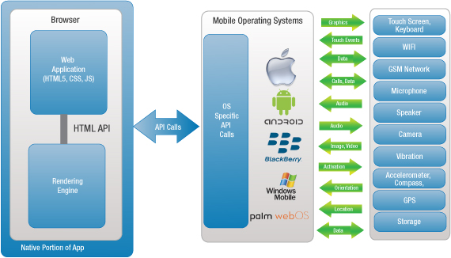
Hybrid Apps –
Interaction with Mobile Device
Credit: http://www.xrgsystems.com/

Slide 4
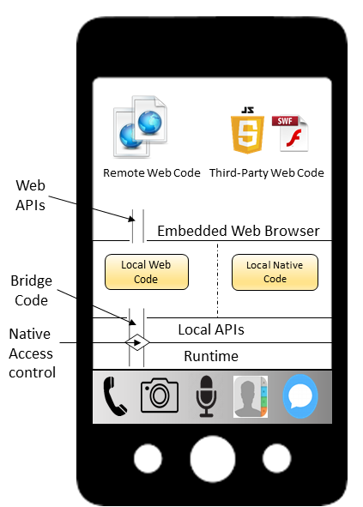
Hybrid App
Architecture
Bridge code is
provided to allow
the access from
the web code
to the device

Slide 5
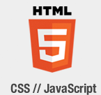

JavaScript Bridge in Web-based Apps
//implemented in a native language,
// e.g., Java for Android
addJavascriptInterface(
new MyObject(),
"myinterface");
//core code in JavaScript
myinterface.sendSMS(..);
myinterface
MyObject()

Slide 6
Hybrid Mobile Frameworks
The JavaScript Bridge is typically provided automatically by hybrid mobile development frameworks
  E.g., Cordova (PhoneGap), Ionic, Onsen, React Native, and more than 70 others
JavaScript Bridge APIs are provided through plugins
  Native implementations and JavaScript interfaces

Slide 7
Permission Model in Mobile Apps
Users can grant permissions for a mobile app
  to access the device resources such as geolocation, SMS, …
Once a permission is granted (either static or dynamic), there is no way to control how the app uses the permissions

Slide 8

Permission in Web-based Mobile Apps
Any JavaScript code can access the exposed JavaScript bridge APIs
Third-party JavaScript
Local JavaScript
myinterface
MyObject()

Slide 9
Security in Web-based Mobile Apps
Domain Whitelisting, e.g., in Cordova
  Allow code from some whitelisted domains can access
Content Security Policy
  Limit the access of JavaScript code based on domain
These mechanisms are coarse-grained: Once an access is granted, no more control on that

Slide 10
A Running Attack Scenario
Third-party JavaScript code might misuse the devices resources or leak sensitive information via phone-based channels, e.g., SMS
  These cannot be enforced by whitelisted
  or CSP
//Third-party JavaScript
var g = geolocation.getLocation();
sms.send(..,g);
Allowed in whitelisted domains and CSP
geolocation, sms

Slide 11
The state-of-the-art
Existing JavaScript security solutions
  Do not cover phone-related channels, e.g., sms
Some hybrid app security solutions focus on a specific platform, e.g., WebView in Android [Georgiev et al., WWW’15], [Tuncay et al., CCS’16]
Some approaches modify the hybrid framework, e.g., PhoneGap [Georgiev et al., NDSS’15], [Jin et al., ISC’15]
Few work can enforce principal-based policies for mobile apps but do not protect the web environment, e.g., [Georgiev et al., WWW’15]
Notes:
, [Franzen et al., IMPS’11]

Slide 12
Our Motivation
Provide a framework to allow hybrid app developers to define and enforce principal-based access control and fine-grained policies
  Do not depend on a specific mobile platform
  Work with any hybrid frameworks

Slide 13
Outline
Motivation
Our Approach - HybridGuard
Implementation
Evaluation
Concluding Remarks

Slide 14
Threat Model
Hybrid Apps are legitimate and trusted by the users
  Permissions are granted
  Content Security Policy (CSP) is deployed to e.g., present Cross-site Scripting Attacks
In-scope threats - third-party JavaScript code, e.g., advertisements, allowed by the developers in CSP:
  Benign but under the control of an attacker
  Malicious by intentions

Slide 15
Our Approach
Load a piece of JavaScript code under a principal name, i.e.,:
  Replace the original JavaScript inclusion
  <script src="http://third-party.com/script.js">
  by our interface:
  loadJSwithPrincipal("principal","http://third-party.com/script.js")
Wrap critical JavaScript APIs (Web APIs + JavaScript Bridge APIs)
  Enforce policies based on caller’s principals

Slide 16
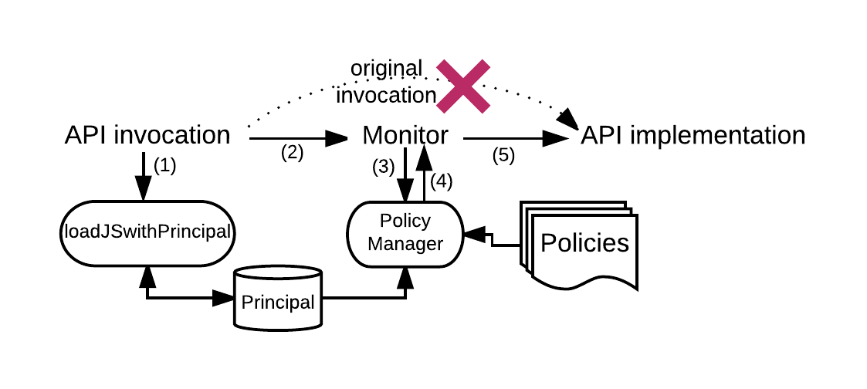
JavaScript Invocation

Slide 17
Our Approach –
Wrapping JavaScript APIs

Slide 18
Our Approach - HybridGuard

Slide 19
HybridGuard

Slide 20
Wrapping JavaScript (Web/Bridge) APIs
orig_sms_send=sms.send;
1. Keep the original reference
sms.send = function(){
}
2. Redefine the reference
if (policyCheck(..))
execute(orig_sms_send,..);
else{..}
3. Check policy to control the execution
Security code is injected before any other JavaScript code to monitor them
sms.send(…);

Slide 21
Principal Management and Tracking
Based on “run-to-completion” execution model of JavaScript
  We maintain a shadow stack to track the execution of each principal
  We catch dynamic generated code and event handlers
    Load these code under the same principal that generates them

Slide 22
Load and Run JavaScript Code under A Principal
var code=get{JavaScriptcode};
var f=makeFunction(code);
runAs(“google”,f);
shadowStack.push(“google”);
run(f);
shadowStack.pop();
flush_dynamic_content(“google”);

Slide 23
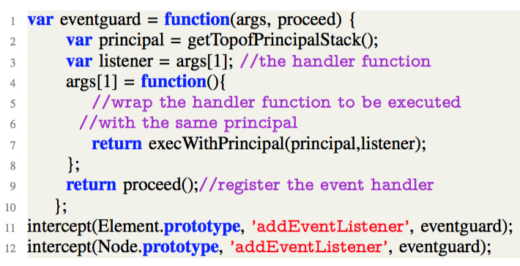
Principal Tracking Example

Slide 24
Principal-based Permission
Wrap the JavaScript Bridge APIs
  Grant access to these APIs based on principal
E.g.:
  "trusted" principal can have full access to all resources
  "local" principal can have access to resources A, B
  "remote" principal can have access to resources C

Slide 25
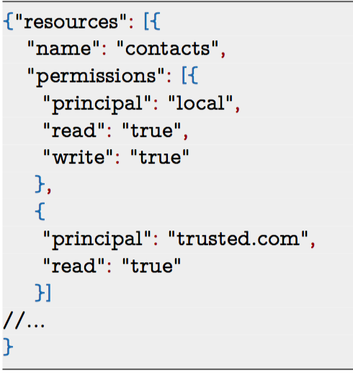
Principal-based Permission Example
Each resource
  Principal access
  control
    Read
    Write
    Create

Slide 26
Stateful and Fine-grained
Security Policies
Based on
  Behavior of the code
  Principal of the code
E.g.:
  Disallow the sms.send if the untrusted principal has accessed the geolocation API

Slide 27
More Fine-grained Policy Patterns
Resource bounds Policy
  Limit the number of accesses to a resource
    E.g.,: limit the number of sms send
Whitelist Policies
  A resource access is allowed only under some conditions
    E.g.,: allow sms send to some predefined receipts
History-based Policies
  Policies depending on the previous execution status
    E.g.,: no SMS sending after contact list is read
Any custom policies, e.g., preventing UI attacks

Slide 28
Complete Mediation
Web APIs: We apply the secure wrapper implementations for JavaScript in the literature
  Ensure that our monitor implementation is tamper-proof from potentially malicious code
JavaScript bridge APIs
  Direct access to native APIs is disallowed
  We rely on app developers to identify bridge APIs and wrap them with our interface

Slide 29
HybridGuard Security
Labeling all
dynamically written content with the authoring principal
Keeping original APIs with a protected lexical scope; wraps all channels generating JS code at runtime
By lexical scoping

Slide 30
HybridGuard Security
Unlabeled code always runs at the lowest privilege level
A principal-tracking failure could lead to conservative rejection, but never a policy violation

Slide 31
Evaluation
We have performed a small-scale evaluation on around 10 Android hybrid apps from Google Play
  Decompile the code and inject our framework manually
We developed several hybrid apps invoking various plugins
  Our framework is integrated and tested on Android and iOS

Slide 32
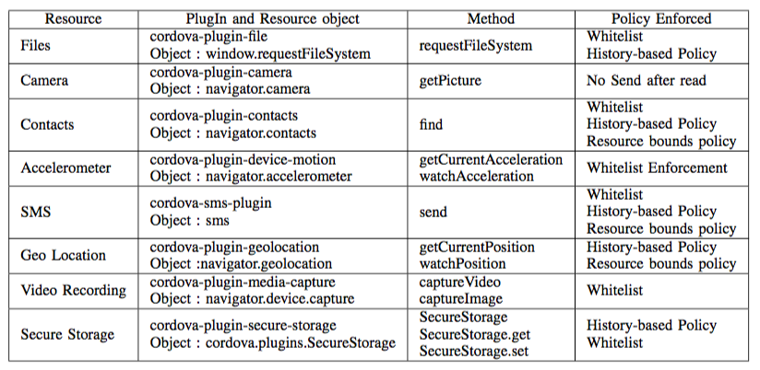
Policy Examples on Resources

Slide 33
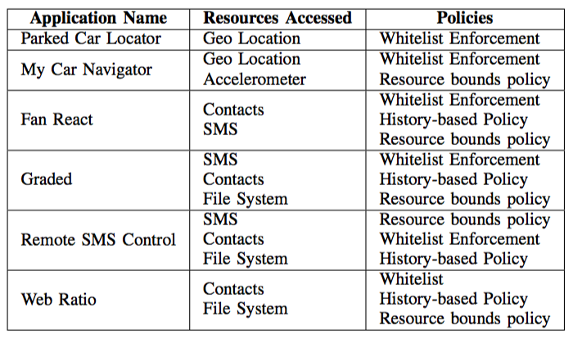
Tested Hybrid Apps and Policies

Slide 34
Concluding Remarks
We present HybridGuard
  A robust framework to specify and enforce principal- based and fine-grained security policies
HybridGuard is developed in JavaScript
  can be deployed on various mobile platforms and hybrid development frameworks without modifying them
We provide a wide range security policies that the app developer can use to mitigate potential attacks

Slide 35
MOBILE SECURITY TECHNOLOGIES (MOST) 2017
Thursday, May 25, 2017
The Fairmont Hotel, San Jose, CA
Thank you!
Phu H. Phung
phu@udayton.edu
http://academic.udayton.edu/PhuPhung

