Slide 1
Sensor-based Mobile Web Fingerprinting and Cross-site Input Inference Attacks
IEEE Workshop on Mobile Security Technologies (MoST), 2016
Chuan Yue, chuanyue@mines.edu

Slide 2
Outline
Introduction and Background
Attacks
Potential Defense Mechanisms
Conclusion and Discussions

Slide 3
Smartphone Sensors
Sensors | Measurement | Category
Accelerometer | acceleration forces | Motion Sensors
Gyroscope | rotation rates
Barometer | atmospheric pressure | Environmental Sensors
Thermometer | temperature
Ambient Light Sensor | light intensity
Magnetometer/Compass | strength and direction of the magnetic field | Position Sensors
Proximity Sensor | presence of nearby objects
They have enabled mobile apps to have richer functionality and better interactivity.

Slide 4
Related Important Research Areas
design new security mechanisms (e.g., sensor-based multi-factor user authentication)
analyze and protect against potential security/privacy risks
(e.g., our work)

Slide 5
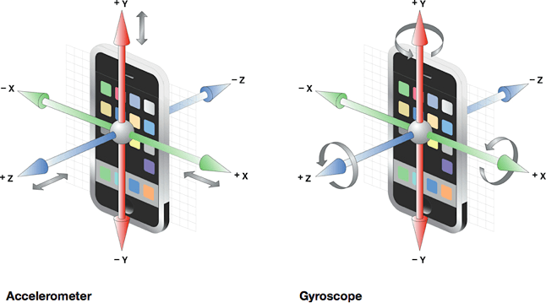
Motion Sensors
Device acceleration forces (in meters per second squared: m/s²) along three axes.
Device rotation rates alpha, beta, and gamma (in degrees per second) around the three axes z, x, and y, respectively.
(figure source: developer.apple.com)
Motion sensors provide high-entropy data, and are inherently pertinent to the behaviors of users. Meanwhile, apps have unrestricted motion sensor data access on both iOS and Android smartphone platforms.

Slide 6
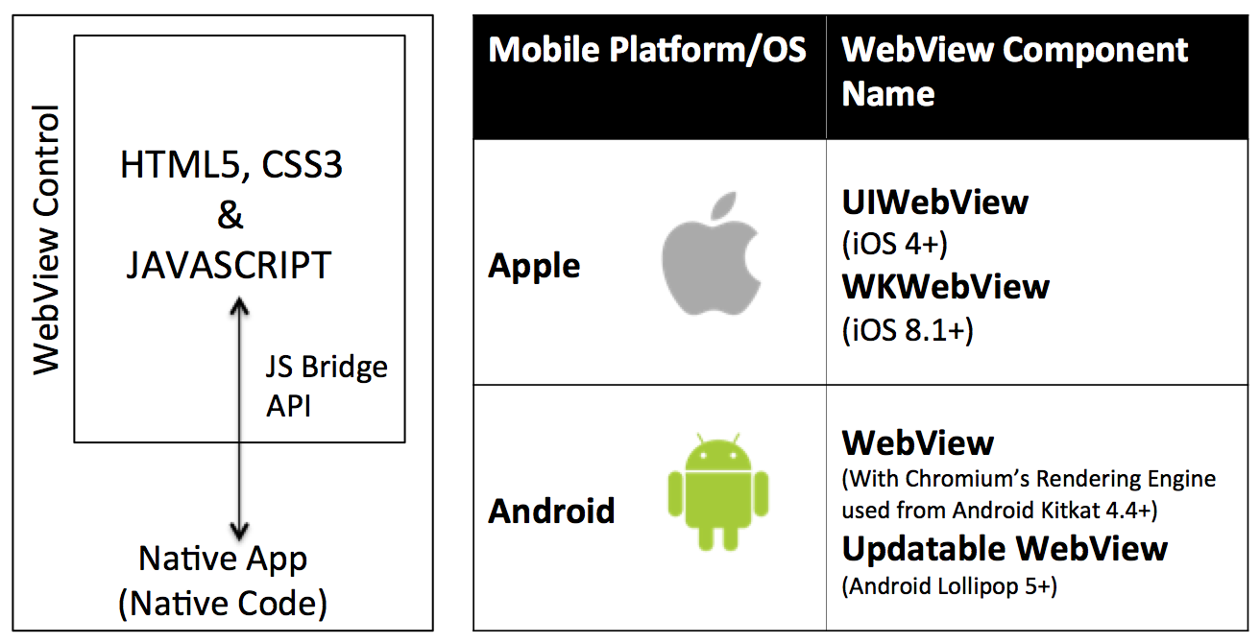
Motion Sensor Data Collection from Mobile Web Users
(figure source: appsonmob.com)
Browsers and WebView components have further extended the unrestricted motion sensor data access to regular webpages.
Mobile Web Users include browser users and app users (through WebView) –attacks can potentially affect almost all the smartphone users!

Slide 7
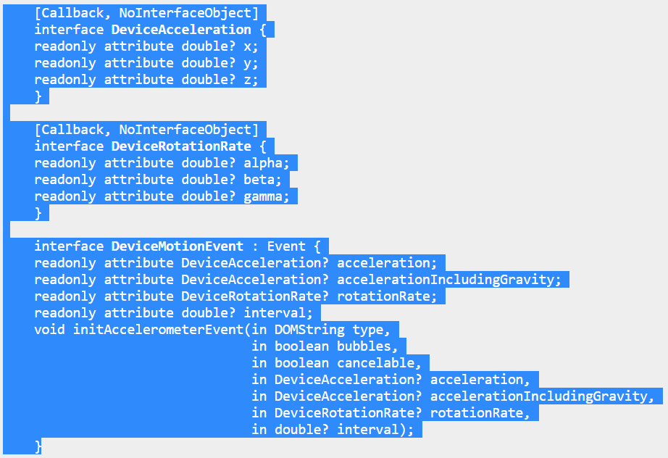
HTML5 DeviceMotionEvent Interface (www.w3.org specification)
User agents implementing this specification must provide a new DOM event, named devicemotion. The corresponding event must be of type DeviceMotionEvent and must fire on the window object.

Slide 8
JavaScript Code for Registering to Receive devicemotion Events
window.addEventListener("devicemotion", function(event) {
// Process event.acceleration, event.accelerationIncludingGravity,
// event.rotationRate and event.interval, e.g.:
var acc_values = event.acceleration.x + “:” +
event.acceleration.y + “:” +;
event.acceleration.z;
var rot_values = event.rotationRate.alpha + “:” +
event.rotationRate.beta + “:” +;
event.rotationRate.gamma;
var interval_value = event.interval;
}, true);

Slide 9
JavaScript Security Model in Browsers and WebView
Web Browser
Sandbox
Sandbox
Same Origin Policy (SOP)
http://www.domainA.com:8080/pageA.htm
Motion sensor data collection can create a powerful side-channel and bypass SOP!
<script> JavaScript code in pageA </script>
http://www.domainB.com/pageB.htm
<script> JavaScript code in pageB </script>
Notes:
9

Slide 10
Outline
Introduction and Background
Attacks
Potential Defense Mechanisms
Conclusion and Discussions

Slide 11
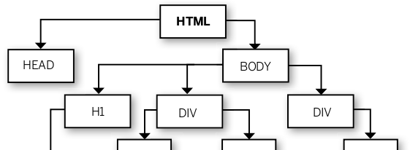
User Fingerprinting Attacks - Privacy
domainA.com
domainA.com
domainB.com (in an iframe)
DOM
events
window
events
window
events
first-party user fingerprinting attacks
third-party user fingerprinting attacks

Slide 12
Cross-Site Input Inference Attacks - Security
domainA.com
domainA.com
username A
window
events
DOM events
password A
domainB.com (in an iframe)
domainB.com (in an iframe)
window events
username B
password B
parent-to-child cross-site input inference attacks
child-to-parent cross-site input inference attacks

Slide 13
First-Party User Fingerprinting Attacks - Privacy
domainA.com
Can raise severe privacy concerns:
A first-party website may purposefully authorize a third-party website to learn about its users.
A first-party website may accidentally allow a third-party website to do so due to insecure JavaScript inclusion practices.
Users may not want to be tracked by a first-party website in the first place.
DOM
events
window
events
All the popular web browsers provide the privacy configuration features such as disabling first-party cookies and sending the “Do Not Track” requests to websites [22].

Slide 14
Third-Party User Fingerprinting Attacks - Privacy
domainA.com
Can directly and severely compromise the privacy of mobile web users, and can indeed be pervasively performed, e.g., third-party advertisements are often included in iframes on millions of first-party websites:
Malicious or compromised advertising websites [9], [20] definitely have the strong motivations to perform such attacks.
Legitimate behavioral advertising websites that infer user privacy for profit [16], [17] also have the strong motivations to do so.
domainB.com (in an iframe)
window
events

Slide 15
Related Work on Web Fingerprinting Attacks
Fingerprinting is the most challenging type of web tracking attacks (the Panopticlick study by Eckersley [8])
Avoiding basic stateful techniques such as HTTP cookies is tricky (e.g., need to configure the appropriate settings in browsers)
Avoiding advanced stateful techniques such as supercookies and HTML5 local storage ([1, 3, 11, 12, 15]) is harder (e.g., need to find ways to disable them)
Avoiding stateless fingerprinting techniques will be most challenging
browser fingerprinting (e.g., characteristics of the browsers) [8]
smartphone fingerprinting (e.g., hardware manufacturing imperfections) [4,6,7]
Ours are more about user fingerprinting
behavioral biometrics
across browsers and devices

Slide 16
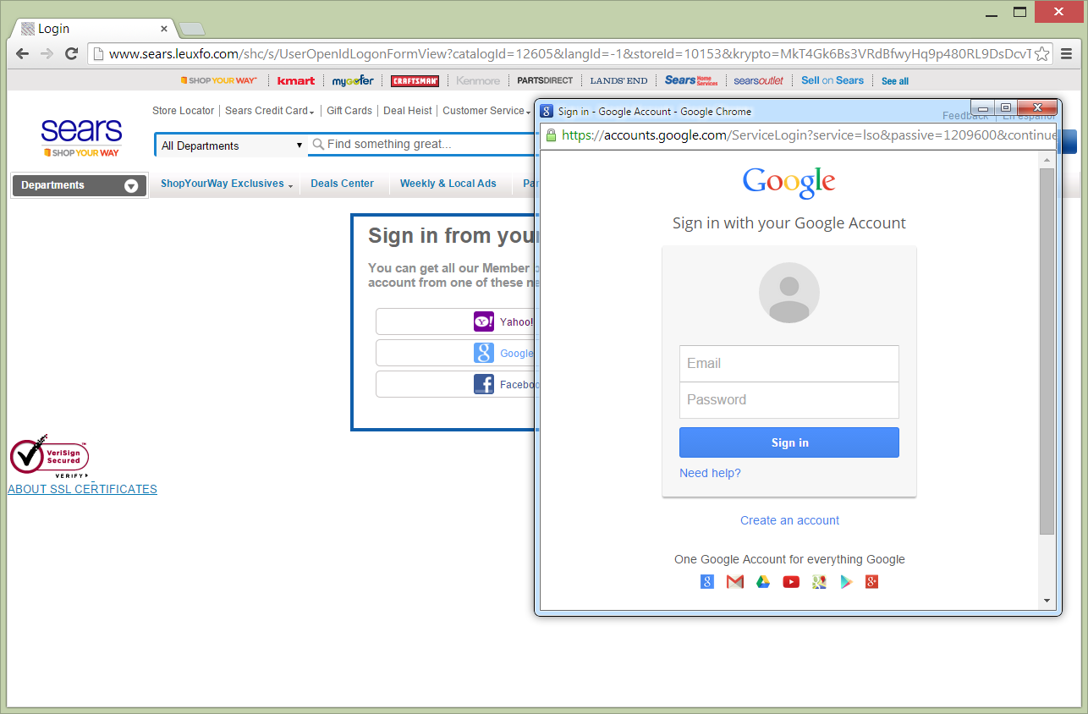
Parent-to-Child Cross-Site Input Inference Attacks - Security
domainA.com
Can cause severe consequences. One representative scenario is for insecure or even malicious Web Single Sign-On (SSO) relying party websites [19] to infer users’ highly valuable SSO identity provider accounts (e.g., Gmail, Facebook, and Yahoo) typed in iframes.
window
events
DOM events
domainB.com (in an iframe)
username B
password B
A parent document directly has the URL (context) information of its child documents.

Slide 17
Child-to-Parent Cross-Site Input Inference Attacks - Security
domainA.com
Similar to the third-party user fingerprinting attacks on data collection, not on goal.
Can directly and severely compromise the security of mobile web users, and can be pervasively performed, e.g., prevalence of using iframes to include advertisements into millions of first-party websites.
Malicious or compromised advertising websites [9], [20] can be the main threat sources.
username A
password A
domainB.com (in an iframe)
window events
A child document can use the document.referrer value to obtain the URL (context) information of its parent document.

Slide 18
Related Work on Input Inference Attacks
Based on behavioral biometrics of smartphone users [2, 5, 10, 13, 18]
assume a malicious app is installed on a smartphone
often use both touch-screen and motion sensor data
focus on touchscreen lock PINs or passwords (that could be valuable only if they are reused by the smartphone owner on some online services or if the smartphone itself is also stolen)
Ours are much broader and severer
Infer highly valuable user inputs (e.g., passwords) on any website
no malicious app needs to be installed

Slide 19
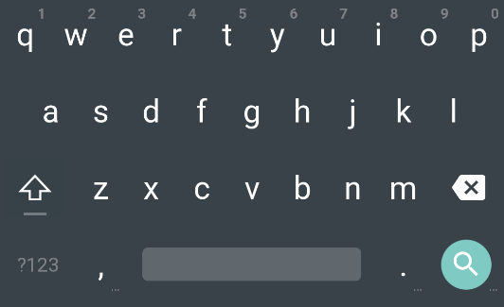
Effectiveness of the Attacks
Our user fingerprinting attacks and cross-site input inference attacks can be modeled as multi-class classification problems:
The former: n users are n different
classes with n unique fingerprints
The later: different soft-keyboard keys
are different classes
Train and use machine learning classifiers
Basic and statistical features

Slide 20
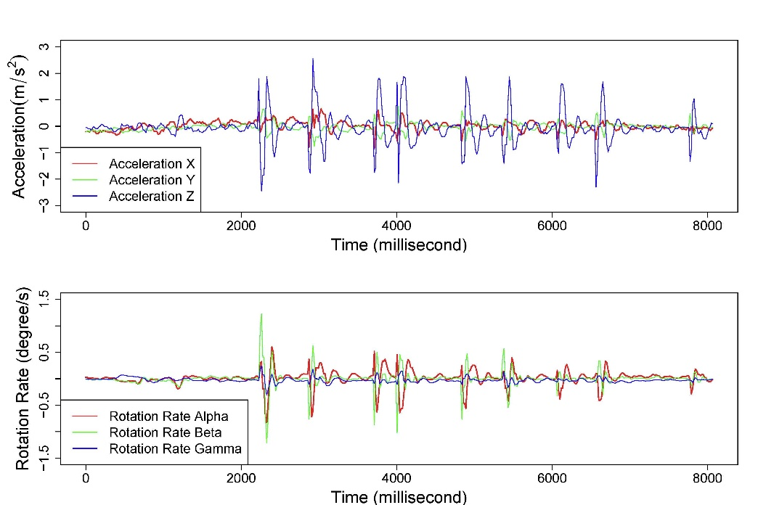
Challenges in Feature Extraction
One main challenge is on segmenting (or aligning) the motion sensor data for individual user actions.
Touch events and keyboard events are associated with DOM elements, protected by SOP, and cannot be directly used by a third-party for segmentation.

Slide 21
More Challenges in User Fingerprinting
Accuracy and Scalability Considerations
Feature value distribution, e.g., high between-subjects entropy and low within-subjects entropy indicate relevancy.
Impacts of multiple factors including different gestures (e.g., touch/long press), touch activities (e.g., select/scroll), DOM element types (e.g., button/link), and rendering locations (e.g., top/ right/bottom) on the selection of features.
Number of bits of fingerprint distribution entropy
Attack Strategies

Slide 22
More Challenges in Input Inference
Accuracy, Context Information
Attack Strategies
username
hot area
password
device orientation
input
field
keyboard layout
keystroke

Slide 23
Outline
Introduction and Background
Attacks
Potential Defense Mechanisms
Conclusion and Discussions

Slide 24
Toward Usable Defense Mechanisms
always ask a user to grant or deny motion sensor data access requests on individual webpages
completely block webpages’ access to
the motion sensor data
It is important to design fine-grained defense mechanisms that could be more usable and effective in practice.

Slide 25
Element-based Sensor Data Access Control
Add a new boolean attribute, e.g., “disable-motion-sensor-data” for HTML input elements
Sufficiently protect against both parent-to-child and child-to-parent cross-site input inference attacks
Need browser (browser extension) support
Need individual websites opt in to the protection (compatibility and freedom)
Completely transparent to end users
Can be extended to HTML form elements
username
password

Slide 26
Frame-based Sensor Data Access Control
Add a new value “allow-sensor-data” for the iframe sandbox attribute in HTML5
Sufficiently protect against both third-party user fingerprinting and child-to-parent cross-site input inference attacks
Need browser (browser extension) support, and need to carefully delimit the scope of the new attribute value
Need individual websites opt in to the protection (compatibility and freedom)
Completely transparent to end users
<iframe src="demo_iframe_sandbox_origin.htm" sandbox="allow-same-origin allow-scripts"></iframe>

Slide 27
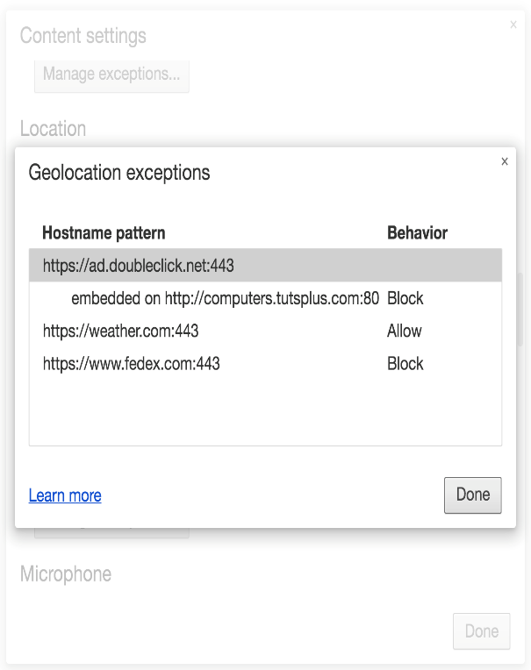
Domain-based Sensor Data Access Control
Similar to existing domain-based privacy and content settings in web browsers
Default-deny, default allow, ask users at the site level; managing exceptions
Sufficiently protect against all the four types of attacks
Need browser (browser extension) support
No change to any website
Not transparent: users need to be aware of this mechanism and properly use it

Slide 28
Domain and Attack Specific Data Perturbation
Browser (browser extension) detect the specific attacks that may occur, and then perturb the sensor data
e.g., adding noise or decreasing collection frequency
Should leverage the research results on attacks
Should not affect the functionality of apps
Protect against all the four types of attacks
Need browser (browser extension) support
No change to any website
Transparent to end users
Protection is only statistical rather than deterministic

Slide 29
Summary of the Four Potential Defense Mechanisms
Mechanism | Main Defense Targets | Deployment | User Transparency
Element-based sensor data access control | Both types of cross-site input inference attacks | Browser and individual websites | Yes
Frame-based sensor data access control | Third-party user fingerprinting attacks and child-to-parent cross-site input inference attacks | Browser and individual websites | Yes
Domain-based sensor data access control | All the four types of attacks | Browser | No
Domain and attack specific data perturbation | All the four types of attacks (statistical) | Browser | Yes

Slide 30
Conclusion and Discussions
Motion sensor based attacks to web users
user fingerprinting attacks
cross-site input inference attacks
Four potential defense mechanisms
Hope to raise researchers’ and developers’ attention
Welcome your questions and discussions
Thank You!

