Slide 1
A Study of Grayware on Google Play
Benjamin Andow*, Adwait Nadkarni*, Blake Bassett†, William Enck*, Tao Xie†
*North Carolina State University
†University of Illinois at Urbana-Champaign

Slide 2
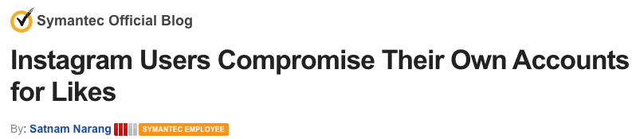
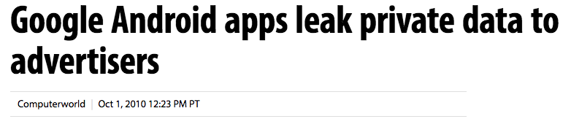
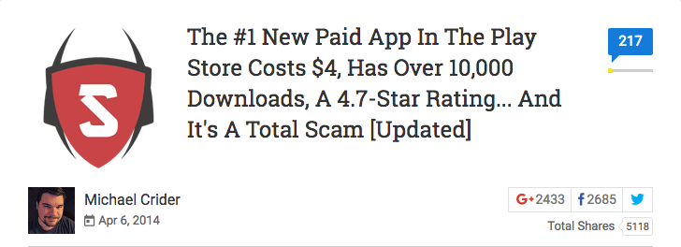

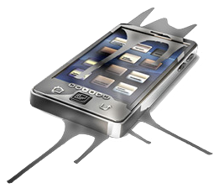
What is Grayware?
Definition: applications containing annoying, undesirable, or undisclosed behaviors that cannot be classified as malware.
Whom is the behavior undesirable to?
  Multi-stakeholder environment
    Benign applications must satisfy the security requirements of all stakeholders
    Presence of different stakeholders may change classification
Distinction between grayware and malware is the clarity of intention
  Malware:
    Intentionally damaging or disrupting the system, harms the user, or bypasses/disables security mechanisms

Slide 3
Prior Works
PC Grayware Classification - [Chen et al. 2011]
Mobile Threats - Google Annual Security Report 2014, Symantec Internet Security Threat Report 2015
Malware Classification - [Felt et al. 2011], [Zhou et al. 2012]
Malware Detection - [RiskRanker 2012], [Zhou et al. 2012], [Drebin 2014], [MAST 2013]
Application Certification and Risk Ranking - [Kirin 2009], [ScanDroid 2009], [Peng et al. 2012]
Sensitive Data Leaks - [TaintDroid 2010], [FlowDroid 2014], [BayesDroid 2014]
User Expectation and Program Behavior Fidelity - [WHYPER 2013], [CHABADA 2014], [AsDroid 2014]

Slide 4

Research Questions
RQ1: What categories of grayware are relevant for mobile device stakeholders?
RQ2: What analysis techniques can triage grayware in application markets?

Slide 5
Outline
Survey Methodology
Categories of mobile grayware
Triaging heuristics
Experiments and Findings

Slide 6
Surveying Categories of Mobile Grayware
Goal:
  Broad understanding for the types of mobile grayware that exist, as opposed to an exhaustive classification
Survey Methodology:
  Metadata from 40k applications from Google Play
    Titles, descriptions, user reviews, user star ratings, etc…
  Keyword search results (e.g., “scam”), and filter by using average user ratings
  Supplement with various news articles

Slide 7
Categories of Mobile Grayware

Slide 8
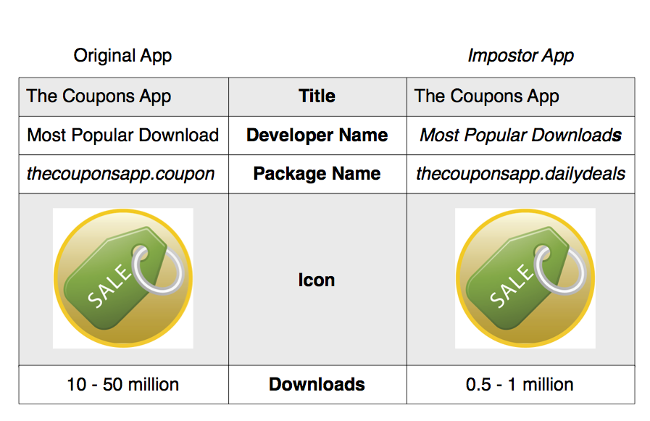
Gray Installation Tactics
(1) Impostors impersonate other applications to gain installation, such as by their spoofing title, icon, developer name, and description
(2) Misrepresentors falsely claim to provide functionality to the user to gain installation
  2 subcategories:
    2(a) Viable Misrepresentors
    2(b) Fictitious Misrepresentors

Slide 9
Less Pertinent Grayware Categories
(10) Droppers retrieve and install additional undesired applications in the background without user consent
  Why?
    INSTALL_PACKAGES permission
(11) Hijackers manipulate system or application settings to reroute the user
  Why?
    Application sandboxing

Slide 10
Outline
Survey Methodology
Categories of mobile grayware
Triaging heuristics
Experiments and Findings

Slide 11
Triaging Heuristics
RQ2: What analysis techniques can triage grayware in application markets?
Goal: Survey the landscape of mobile grayware on Google Play to gauge the scope of the problem
Note that we do not design triaging heuristics for:
  Spyware
    [TaintDroid 2010], [FlowDroid 2014], [BayesDroid 2014]
  Scareware
    [HelDroid 2015]

Slide 12
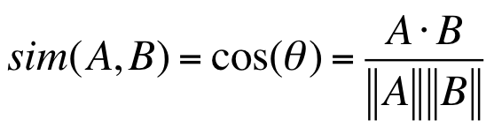
Impostors Heuristic
Rationale: Impostors more likely to masquerade as popular or well-known applications to increase visibility
Approach:
  Search for applications with similar titles, and icons to other popular or well-known applications
  Title Scoring
    Create vectors with word counts by treating titles as a bag of words, and calculate the cosine similarity between the vectors
  Icon Scoring
    Context triggered piecewise hashing (Fuzzy hashing)
      Piecewise hashing + rolling hash
Rationale: Impostors more likely to masquerade as popular or well-known applications to increase visibility
Approach:
  Search for applications with similar titles, and icons to other popular or well-known applications
  Title Scoring
    Create vectors with word counts by treating titles as a bag of words, and calculate the cosine similarity between the vectors
  Icon Scoring
    Context triggered piecewise hashing (Fuzzy hashing)
      Piecewise hashing + rolling hash
Titles | the | coupons | app
“The Coupons App” | 1 | 1 | 1
“The Coupons App” | 1 | 1 | 1

Slide 13
Fictitious Misrepresentors Heuristic
Rationale: Requires understanding the types of functionality provided by applications that is not possible to implement
Approach:
  Extract semantic topics from application descriptions that claim to be for “entertainment purposes”, “pranks”, etc
  Identify the topics that appear to represent impossible functionality
  Flag applications that fit within these topics.

Slide 14
Latent Dirichlet Allocation (LDA) Pipeline
  Latent Dirichlet Allocation: Generative probabilistic model that discovers latent topics within a set of documents
  A topic is a set of words that have different probabilities that they will appear in documents that discuss the topic
  Parameters for training LDA:
    α = 50/n where n = number of topics, β = 0.01, and the number of iterations to 1000
  LDA is sensitive to noise, so text preprocessing is required

Slide 15
Latent Dirichlet Allocation (LDA) Pipeline
  Text Preprocessing:
  Stemming: Reduces words to a stem word to allow for multiple word inflections to be treated as one unit
    E.g., “argue”, “argues”, “arguing” are reduced to the stem “argu”
  Stopword Removal: Strips frequently occurring words from the text to allow focus to be placed on the important words
    E.g., ‘the’, ‘a’, ‘and’, ‘but’

Slide 16
Latent Dirichlet Allocation (LDA) Pipeline
  Topic Selection:
  Select the topics output by LDA that represent the topics of applications that they want to analyze
  Excerpt from LDA Engine:
    4: fingerprint, scan, unlock, lock, access
    17: hair, shaver, vibrat, razor, clipper
    154: scanner, mood, scan, fingerprint, thumb

Slide 17
Latent Dirichlet Allocation (LDA) Pipeline
  Topic Fitter:
  Selected topics passed back to the topic fitter
  For each preprocessed description, LDA infers topic membership (i.e., probability of topic memberships)
  Topic fitter outputs package names of descriptions whose probability is at least 25% for the selected topics

Slide 18

Viable Misrepresentors Heuristic
Rationale: Applications that perform the same tasks should invoke similar framework APIs
Approach:
  Extract API class names from method invocations, and apply filtering techniques (e.g., remove obfuscated class names)
  Cluster applications using k-means
  Outlier detection using the standard deviation from centroid

Slide 19
Outline
Survey Methodology
Categories of mobile grayware
Triaging heuristics
Experiments and Findings

Slide 20
Impostors Findings
Dataset:
  Popular applications: 2,500 titles, developer names, and icons from the top paid and free applications for each Google Play category
  Search for impostors in 1 million Google Play applications
Triage Reduction: 1M → 22
Results: 8 impostors

Slide 21
Viable Misrepresentors Findings
Dataset:
  214 antiviruses, 236 performance boosters, and 224 signal boosters selected by keyword searching Google Play
  We select applications whose core functionality occurs in the background, as users are less likely to notice if the functionality is not provided.
Triage Reduction: 214→ 10 antiviruses
236→ 5 performance boosters
224 → 39 signal boosters
Results: 3 antiviruses
1 performance booster
20 signal boosters

Slide 22
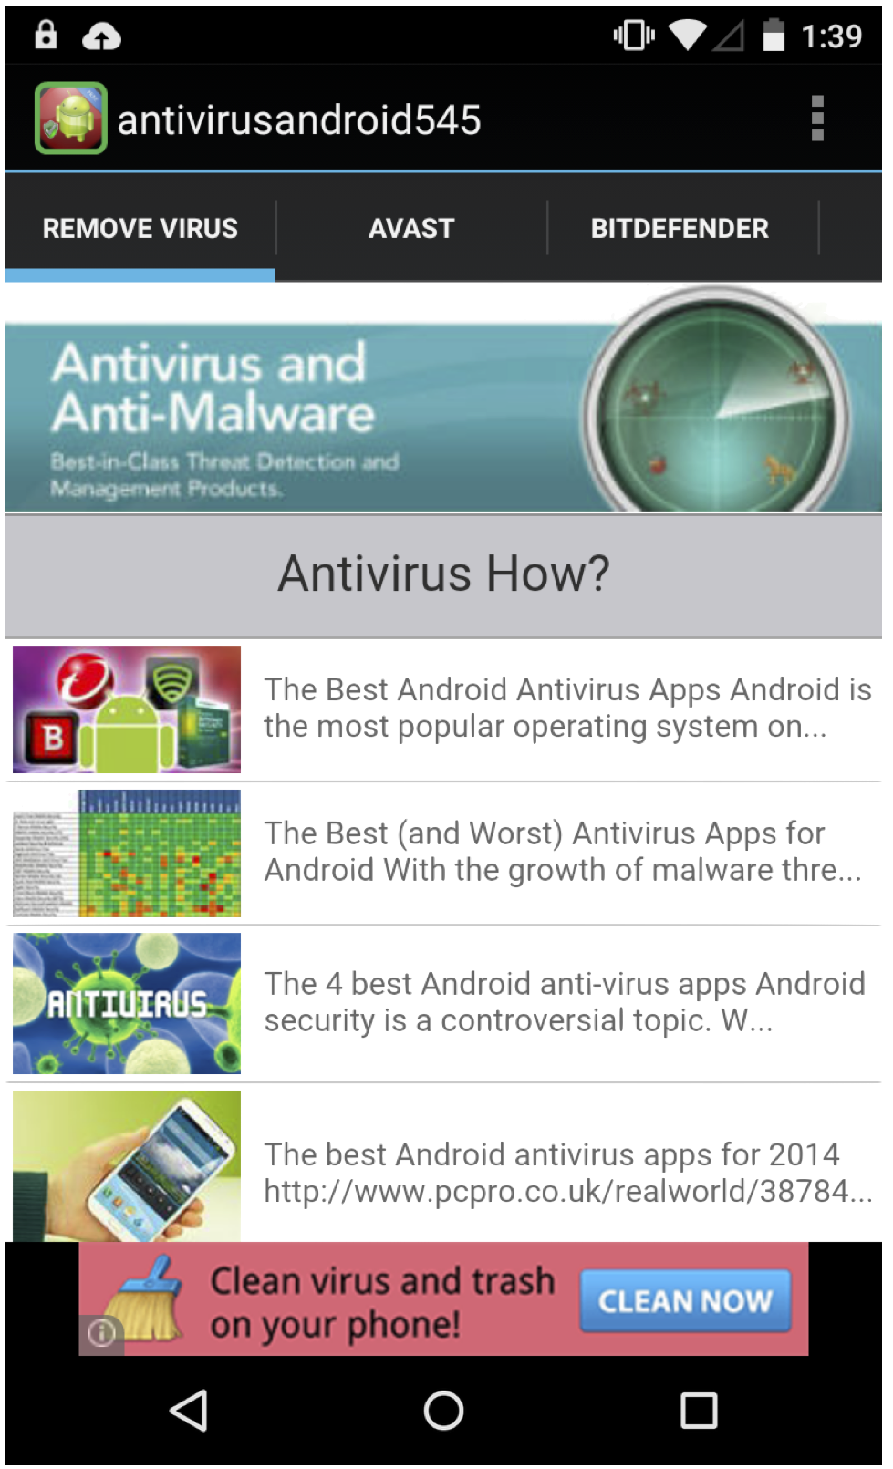
Viable Misrepresentors Findings
Title (Package Name) | Description
Anti Virus & Mobile Security! (com.suzyapp.anti.virus.app.security) | “It checks for malware, vulnerabilities, and even cleans up trash.”
Anti Virus Android (com.viruskiller.antivirusandroid545 | “This app provides comprehensive protection for your Android phone or tablet.”
Antivirus for Android (com.yoursite.afa1) | “… protects your android device from harmful viruses, malware, spyware…”

Slide 23
Fictitious Misrepresentors Findings
Dataset:
  Training: 2,938 applications based on keyword searching 1-million Google Play applications
  Inference: 100K randomly chosen Google Play apps
Topic Selection: 32 topics out of 650
Triage Reduction: 100K → 311
Results: 18 fictitious misrepresentors
  Most overstate the capabilities of hardware
    10 claim to reading fingerprints from the touchscreen
    4 overstate the camera’s functionality
    3 claim the magnetometer can use to detect paranormal activity
    1 claims to detect intoxication based on gyroscope readings

Slide 24
Lessons from Triage
Grayware is present within some of the top-ranked applications on Google Play
    Potential to impact a large number of users
      Antivirus misrepresentor found has around 100K-500K downloads
    Highly rated by users
      Not much confidence cannot be placed in user reviews
Grayware (i.e., imposters) may also negatively impact the developer’s brand and user experience
Grayware may adversely impact the user’s health and well-being (e.g., fake blood pressure readers)
Grayware is a problem that warrants further exploration

Slide 25

Thank You!

