Slide 1
Target Fragmentation in
Android Apps
Patrick Mutchler
John Mitchell
Yeganeh Safaei
Adam Doupe

Slide 2
Takeaways
Android apps can run using outdated OS behavior - The large majority of Android apps do this - Including popular and well maintained apps
Outdated security code invisibly permeates the app ecosystem - “Patched” security vulnerabilities still exist in the wild - “Risky by default” behavior is widespread

Slide 3
Roadmap
What is target fragmentation?
Target fragmentation statistics
Security consequences
Notes:
Outline

Slide 4
Roadmap
What is target fragmentation?
Target fragmentation statistics
Security consequences

Slide 5
“If the device is running Android 6.0 or higher… [the app] must request each dangerous permission that it needs while the app is running.
Android Developer Reference
Notes:
Story to explain why targetSdkVersion exists.
Requiring code changes to run on new OS versions hurts forwards compatibility.

Slide 6
“If the device is running Android 6.0 or higher and your app's target SDK is 6.0 or higher [the app] must request each dangerous permission that it needs while the app is running.
Android Developer Reference
Notes:
Story to explain why targetSdkVersion exists.
Requiring code changes to run on new OS versions hurts forwards compatibility.

Slide 7
“If the [operating system version of the device] is higher than the version declared by your app’s targetSdkVersion, the system may enable compatibility behaviors to ensure that your app continues to work the way you expect.”
Android Developer Reference
Notes:
Describe targetSdkVersion design
Not all old code is used.

Slide 8
Roadmap
What is target fragmentation?
Target fragmentation statistics
Security consequences
Notes:
Set up outdatedness here!

Slide 9
Dataset
1,232,696 Android Apps
Popularity, Category, Update, and Developer metadata
Collected between May 2012 and Dec 2015
Broken into five datasets by collection date

Slide 10
How do we measure outdatedness?
Notes:
Describe targetSdkVersion design
Not all old code is used.

Slide 11
Outdatedness
Android 5.0 Released
Android 5.1 Released
Android 6.0 Released
App Collected
Notes:
We aren’t just concerned with whether an app is out of date. We are concerned with how out of date that app is.
Define outdatedness.

Slide 12
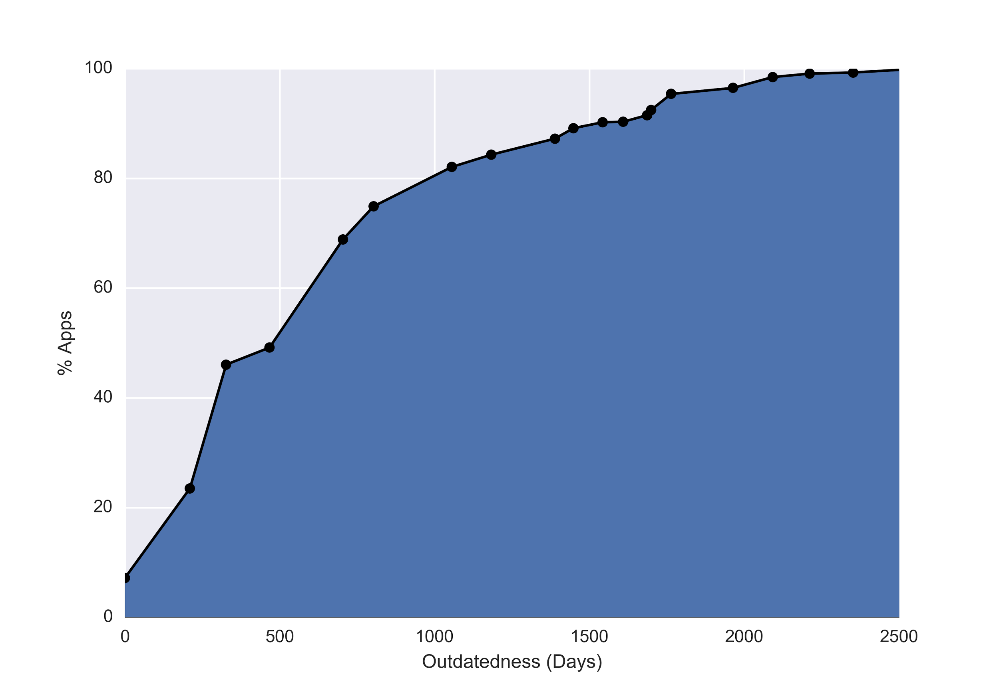
Notes:
Cumulative distribution of outdatedness for apps collected in December 2015
8% of apps target the most current version (6.0, released in October)
50% of apps target versions at least 500 days out of date
20% of apps target versions at least 1000 days out of date

Slide 13
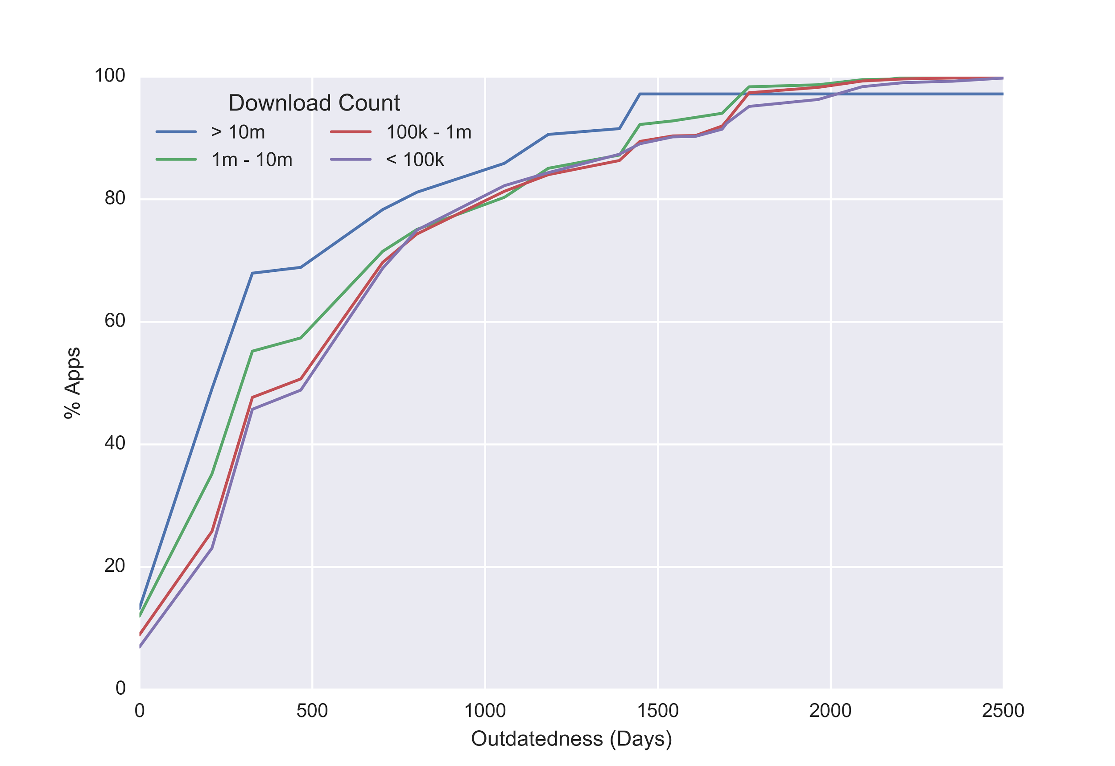
Notes:
Cumulative distributions for different install counts.
Apps installed 10m times are a bit better but target fragmentation is still a severe problem.
Fewer than 20% target 6.0. 80th percentile is still about two years out of date.

Slide 14
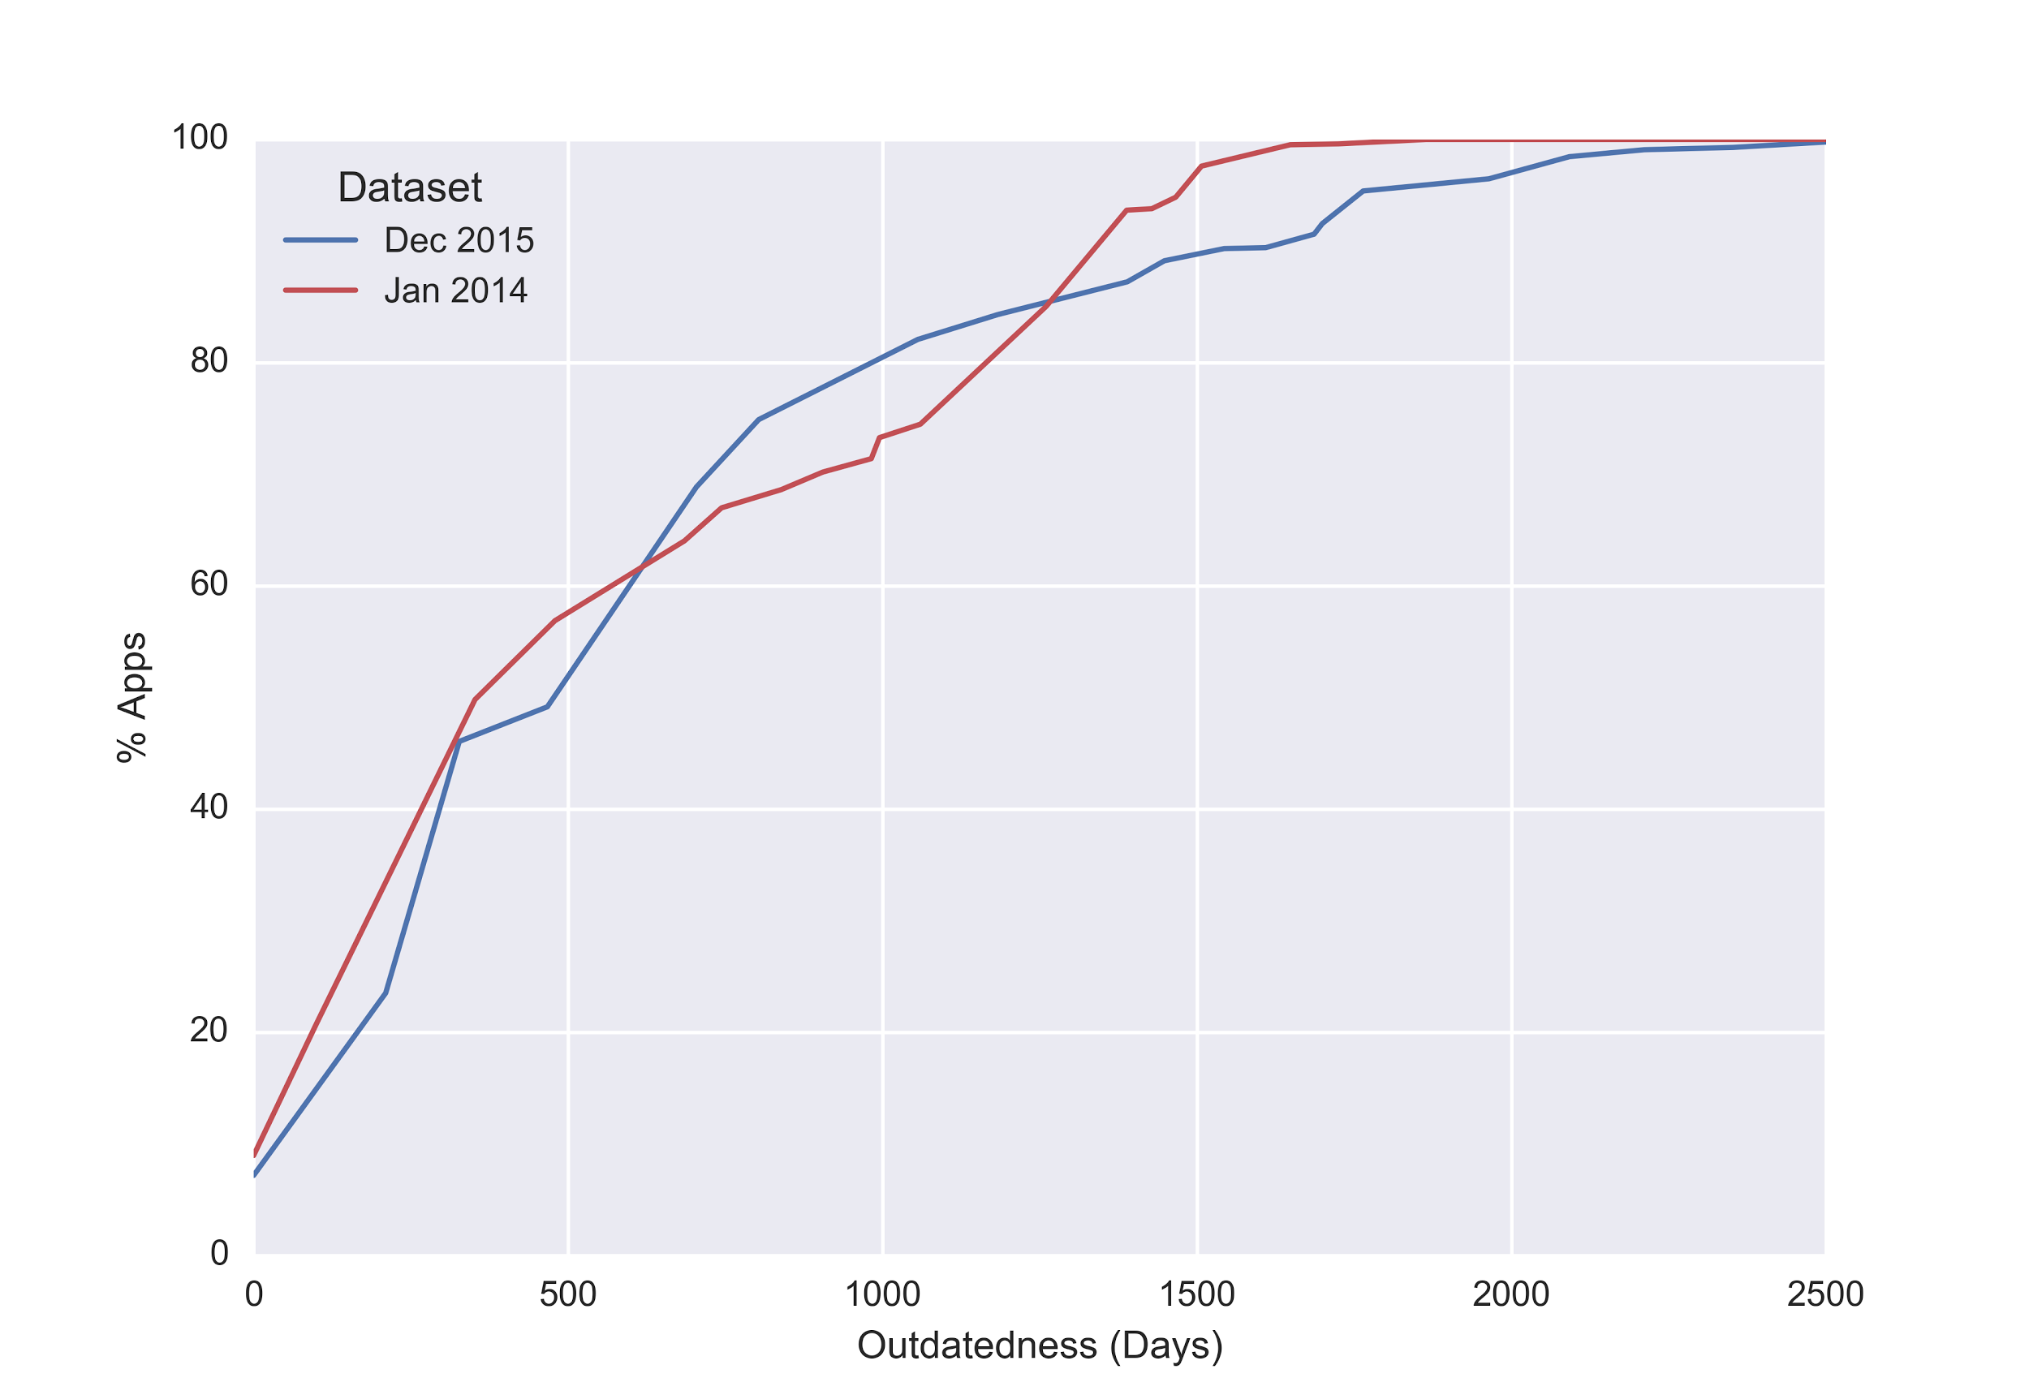
Notes:
Compare two datasets, each collected two months after an OS release.
Curves track pretty closely, suggesting that we aren’t just seeing weird behavior with 6.0 right now.
TODO - relabel dataset names in the legend

Slide 15
What causes outdatedness?
Notes:
Describe targetSdkVersion design
Not all old code is used.

Slide 16
Negligent Outdatedness
Outdatedness
Android 5.0 Released
Android 5.1 Released
App Updated
Android 6.0 Released
App Collected
Notes:
Lets be even more generous and account for stale apps on the app store.
Define negligent outdatedness

Slide 17
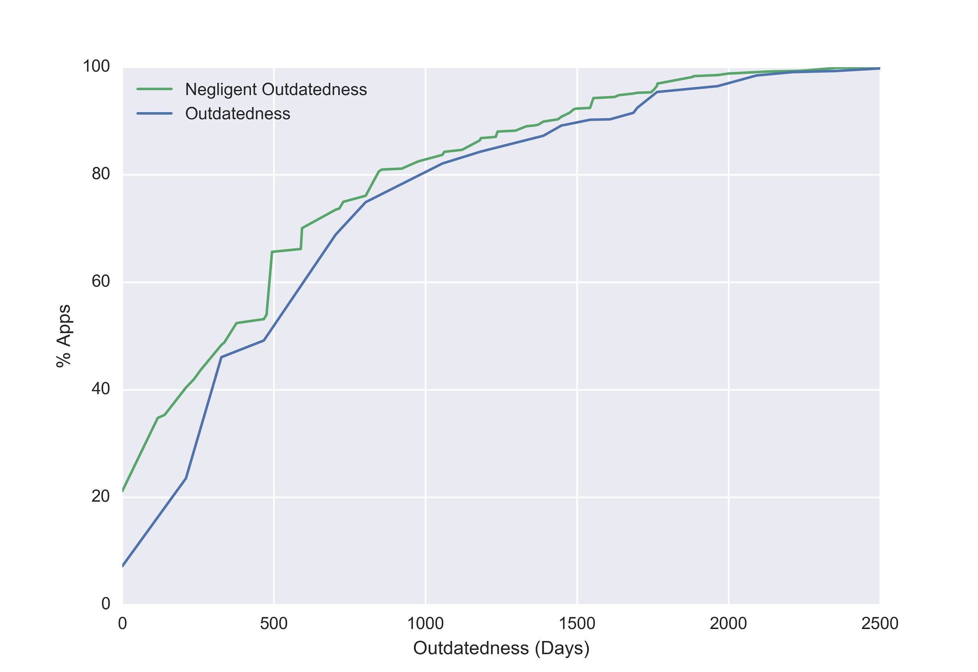
Notes:
Compare negligent outdatedness and outdatedness curves. Shows that stale apps are not the primary cause of outdatedness.

Slide 18
Silver Lining
Notes:
Describe targetSdkVersion design
Not all old code is used.

Slide 19
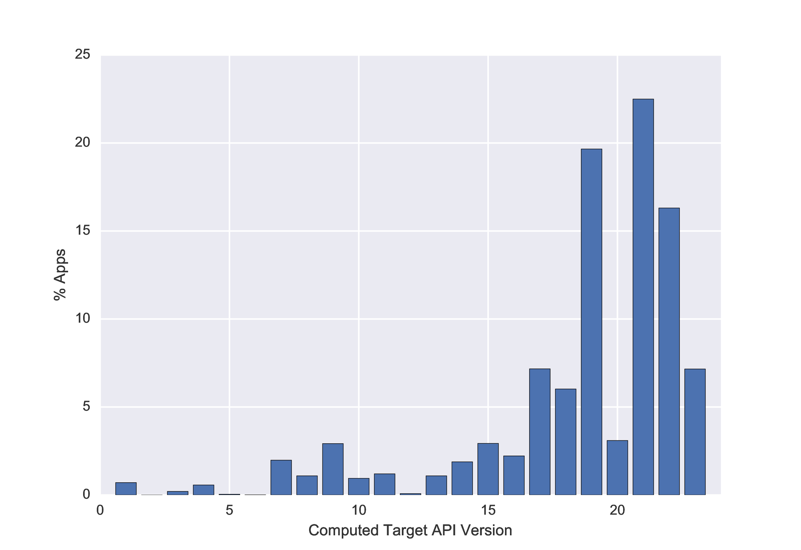
A small silver lining
Notes:
Describe targetSdkVersion design
Not all old code is used.

Slide 20
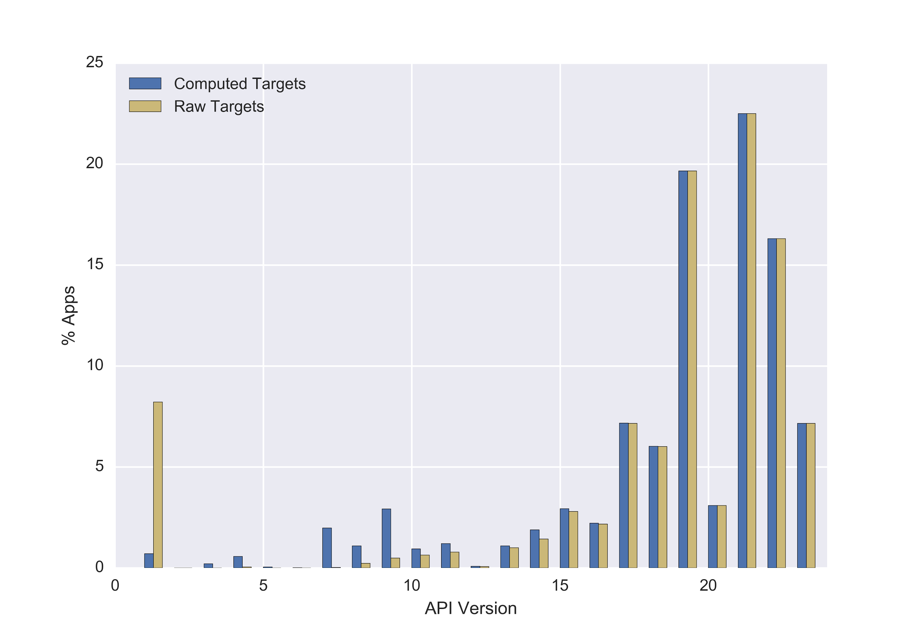

Slide 21
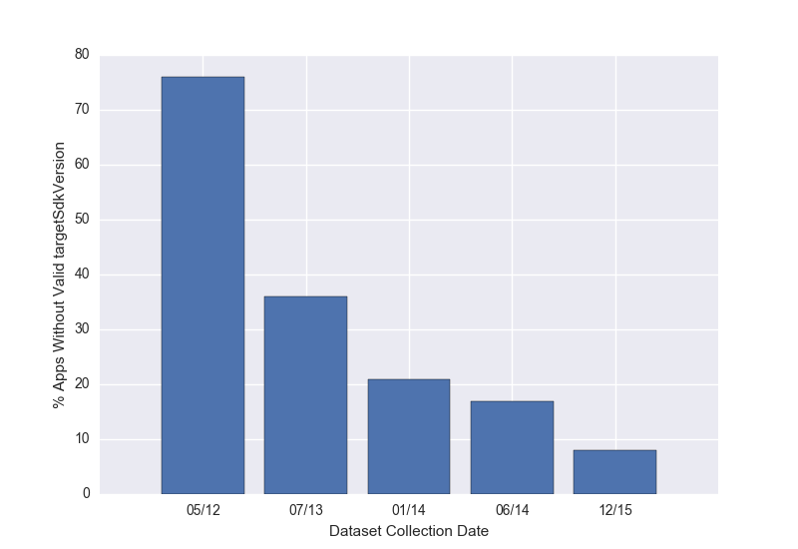

Slide 22
Roadmap
What is target fragmentation?
Target fragmentation statistics
Security consequences
Notes:
Outline

Slide 23
Fragment Injection
Vulnerable App
Malicious Intent
PreferenceActivity
Extra.SHOW_FRAGMENT “Attacked Fragment”
Extra.SHOW_FRAG_ARG
Attacked
Fragment
Data
Other
Extras
securityintelligence.com/new-vulnerability-android-framework-fragment-injection/
Notes:
Introduce and explain fragment injection attack

Slide 24
Fragment Injection
Fixed in Android 4.4
Developers implement isValidFragment to authorize fragments
// Put this in your app protected boolean isValidFragment(String fName){ return MyFrag.class.getName().equals(fName); }
Notes:
Describe the solution for fragment injection. Fixed on Sep 3rd 2013.
But what happens when you don’t implement isValidFragment?

Slide 25
Fragment Injection
Vulnerable if: - Targets 4.3 or lower (31%) - Some class inherits from PreferenceActivity (4.8%) - That class is exported (1.1%) - That class does not override isValidFragment (0.55%)
4.2% of apps vulnerable if no fix was ever implemented
Notes:
Vulnerability rates.
The “fix” has only reduced the vuln rate to 20% of what it would be if no fix was ever implemented.

Slide 26
Mixed Content in WebView
Notes:
Define mixed content and explain what webview is.

Slide 27
Mixed Content in WebView
Major web browsers block Mixed Content
In Android 5.0, WebViews block Mixed Content by default
Can override default with setMixedContentMode()
Notes:
Explain mixed content changes

Slide 28
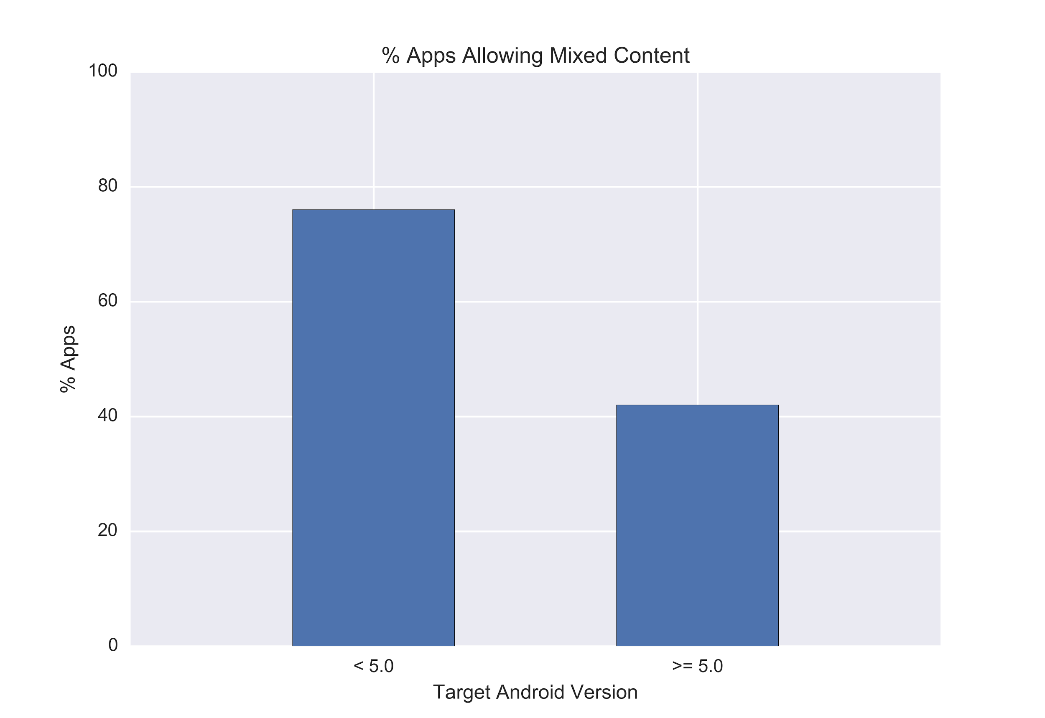
Notes:
We cannot directly measure the number of “vulnerable” apps that allow mixed content because it is possible to do so safely.
Instead we try to understand the number of apps that “accidentally” allow mixed content.

Slide 29
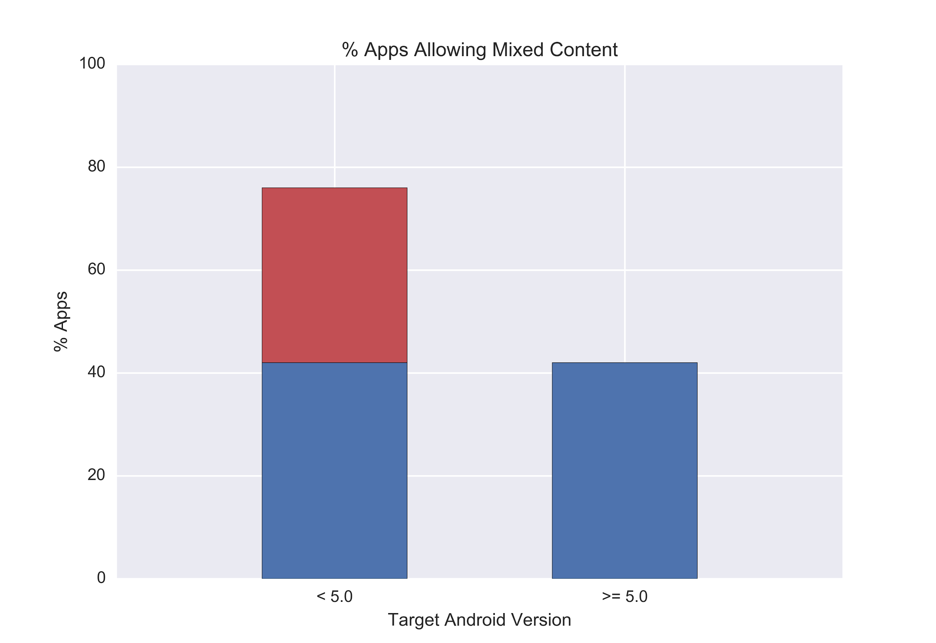
Notes:
Assume that the % of apps that want to allow mixed content is constant
Red bar are apps that allow mixed content unnecessarily
Red bar represents 18% of apps from December

Slide 30
Recap
Android apps can run using outdated OS behavior - The large majority of Android apps do this - Including popular and well maintained apps Outdated security code invisibly permeates the app ecosystem - “Patched” security vulnerabilities still exist in the wild - “Risky by default” behavior is widespread
Notes:
Big takeaways from this paper
Make third point into a sentence
Make this last point punchier

Slide 32
SOP for file: URLs in WebView
In Android 4.1 separate file: URLs are treated as unique origins
Can override with setAllowFileAccessFromFileURLs()

Slide 33
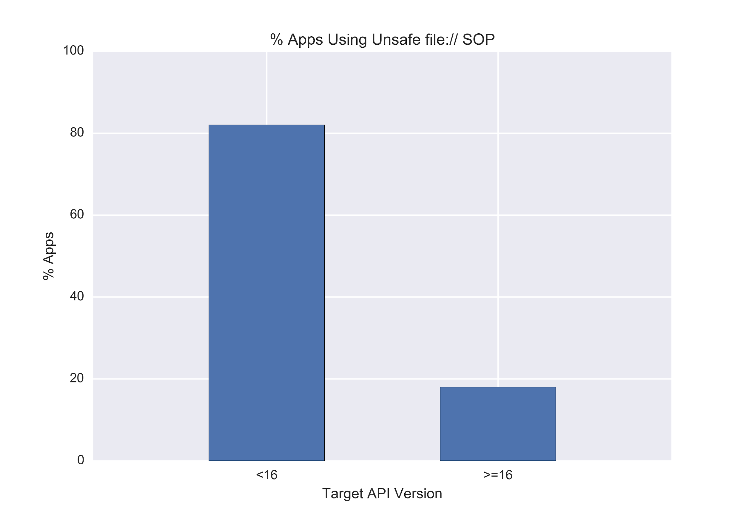
Notes:
Difference is 64%.
15% of apps target <16
9.6% of all apps

Slide 34
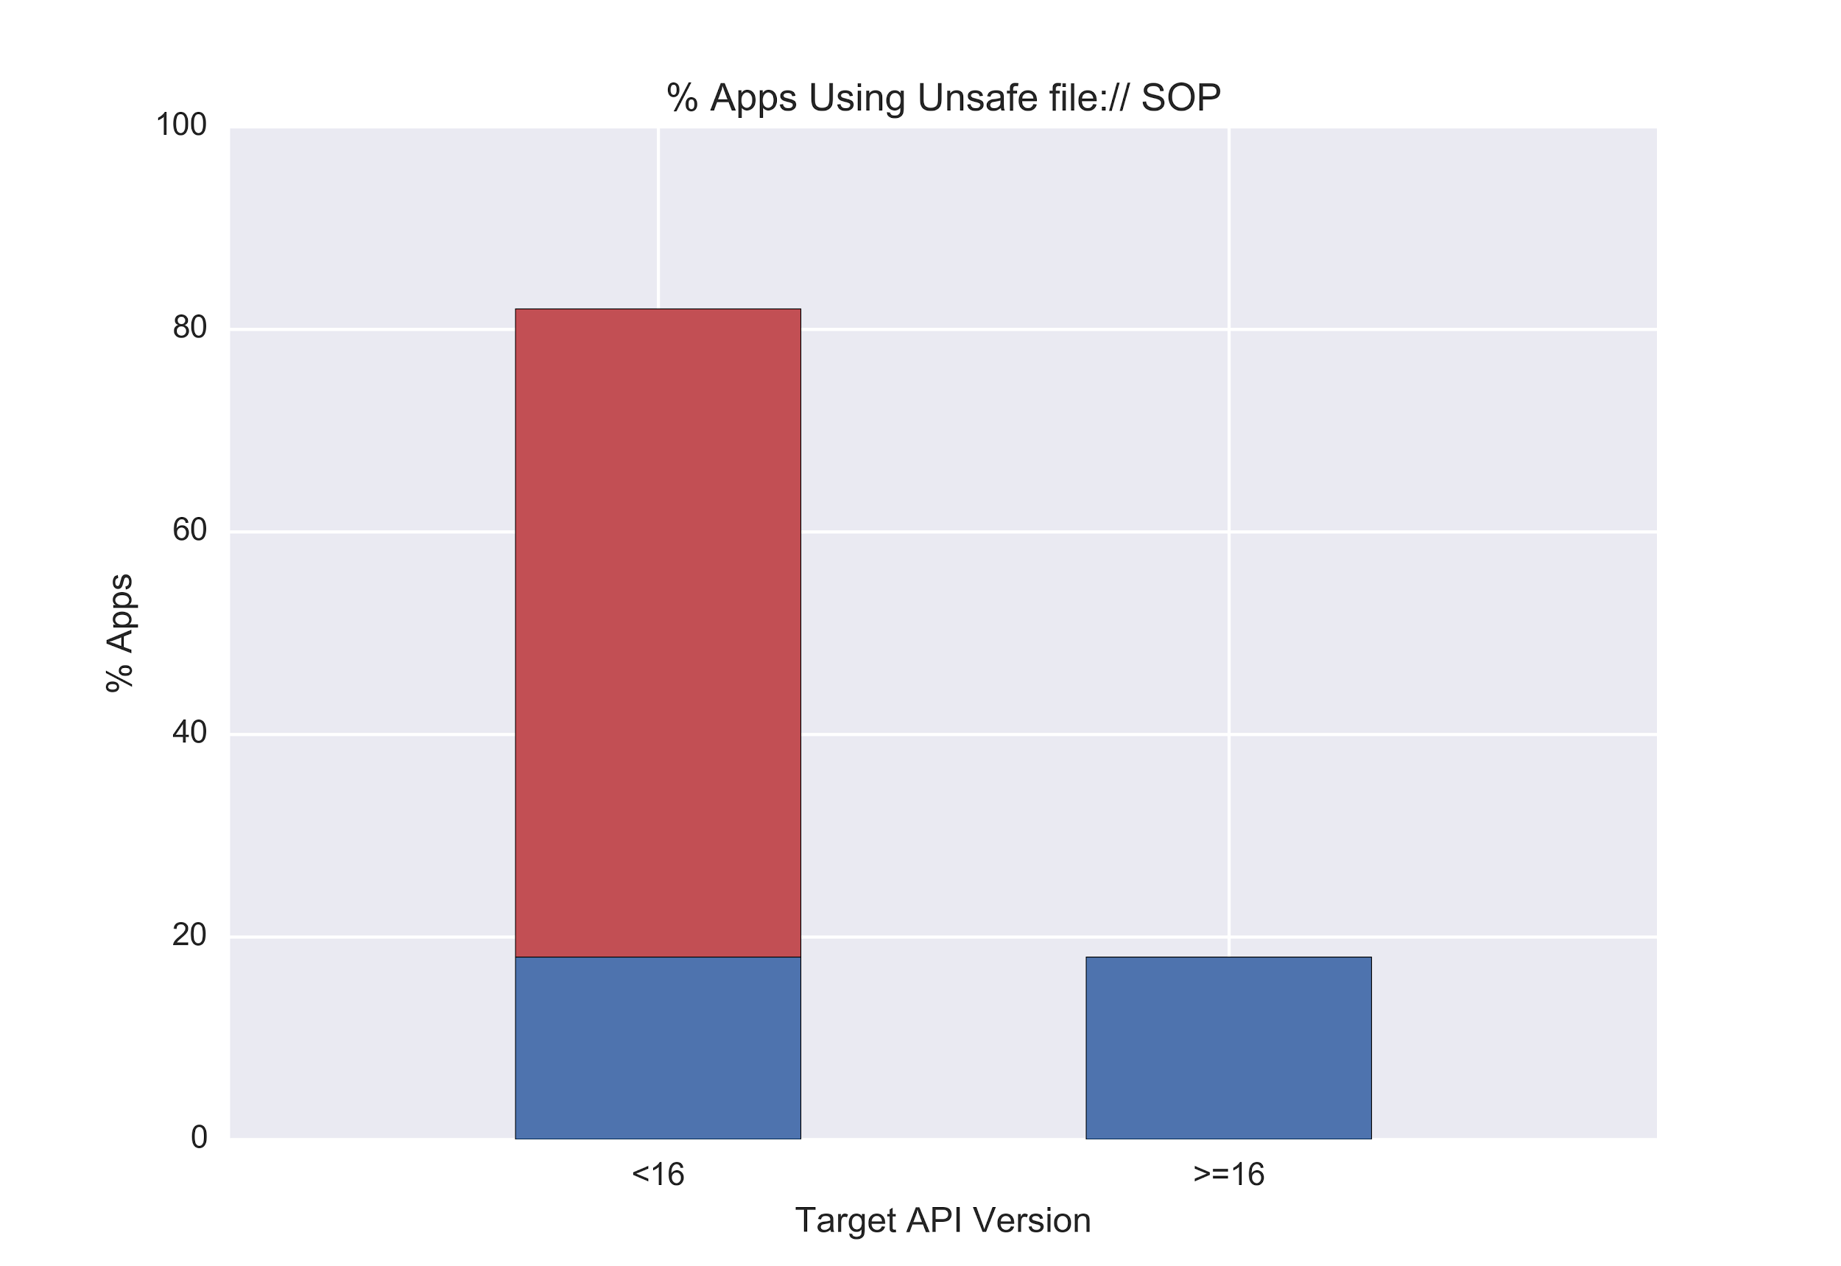
Notes:
Difference is 64%.
15% of apps target <16
9.6% of all apps
You can see this going two ways:
One is that developers who use Feature X are more likely to retarget when a security change comes to Feature X
One is that developers who use Feature X are *less* likely to retarget when a change comes to Feature X because it breaks their code
Apps that use PreferenceActivity target 19+ 66% of the time while the general population targets 19+ 69% of the time.
Apps that use WebView...
Apps that export Content Providers

