Slide 1



A Large-Scale Study of
Mobile Web App Security
Patrick Mutchler, Adam Doupe,
John Mitchell, Chris Kruegel, Giovanni Vigna
Notes:
30 seconds

Slide 2
The big picture

Slide 3
Hundreds of thousands of vulnerable apps

Slide 4
Definitions

Slide 5
A Large-Scale Study of
Mobile Web App Security

Slide 6
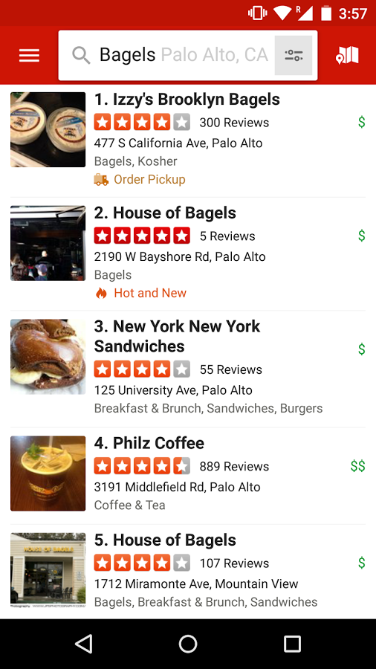

Slide 7
A mobile web app is…
… an app that embeds a fully functional web browser as a UI element.

Slide 8
A Large-Scale Study of
Mobile Web App Security
Notes:
30 seconds

Slide 9
1,172,610
Android apps

Slide 10
998,286 w/ WebViews

Slide 11
A Large-Scale Study of
Mobile Web App Security
Notes:
2 min

Slide 12


Slide 13
Loading untrusted web content
Leaking URLs to foreign apps
Exposing state changing navigation to foreign apps

Slide 14
Loading untrusted web content
Leaking URLs to foreign apps
Exposing state changing navigation to foreign apps

Slide 15
“You should restrict the web-pages that can load inside your WebView with a whitelist.”
- Facebook

Slide 16
“…only loading content from trusted sources into WebView will help protect users.”
- Adrian Ludwig, Google

Slide 17
Goal:
Find apps that load untrusted content in WebViews
Notes:
Avoid false positives. Be able to scale to one million apps.

Slide 18
1. Navigate to untrusted content
Notes:
5 minutes

Slide 19
// In app code
myWebView.loadUrl(“foo.com”);

Slide 20
// In app code
myWebView.load(“foo.com”);
<!-- In HTML -->
<a href=“foo.com”>click!</a>

Slide 21
// In app code
myWebView.load(“foo.com”);
<!-- In HTML -->
<a href=“foo.com”>click!</a>
<!-- More HTML -->
<iframe src=“foo.com”/>

Slide 22
// In app code
myWebView.loadUrl(“foo.com”);
<!-- In HTML -->
<a href=“foo.com”>click!</a>
<!-- More HTML -->
<iframe src=“foo.com”/>
// In JavaScript
window.location = “foo.com”;

Slide 23
public boolean shouldOverrideUrlLoading(
WebView view, String url){
// False -> Load URL in WebView
// True -> Prevent the URL load
}

Slide 24
public boolean shouldOverrideUrlLoading(
WebView view, String url){
String host = new URL(url).getHost();
if(host.equals(“stanford.edu”))
return false;
log(“Overrode URL: ” + url);
return true;
}

Slide 25
public boolean shouldOverrideUrlLoading(
WebView view, String url){
String host = new URL(url).getHost();
if(host.equals(“stanford.edu”))
return false;
log(“Overrode URL: ” + url);
return true;
}

Slide 26
public boolean shouldOverrideUrlLoading(
WebView view, String url){
String host = new URL(url).getHost();
if(host.equals(“stanford.edu”))
return false;
log(“Overrode URL: ” + url);
return true;
}

Slide 27
What does untrusted mean?
Notes:
30 seconds

Slide 28
2. Load content with HTTP
Notes:
30 seconds

Slide 29
3. Use HTTPS unsafely
Notes:
1.5 minutes

Slide 30
public void onReceivedSslError(
WebView view, SslErrorHandler handler,
SslError error){
// handler.cancel() -> cancel the load
// handler.proceed() -> ignore the error
}

Slide 31
public void onReceivedSslError(
WebView view, SslErrorHandler handler,
SslError error){
handler.proceed();
}
Notes:
Report vulnerability if app calls proceed on all code paths

Slide 32

public void onReceivedSslError(
WebView view, SslErrorHandler handler,
SslError error){
handler.proceed();
}
Notes:
117 apps of 128

Slide 33
Results
Notes:
1:30

Slide 34
Vulnerability | % Relevant | % Vulnerable
Unsafe Nav | 15 | 34
HTTP | 40 | 56
Unsafe HTTPS | 27 | 29

Slide 35
Popularity

Slide 36
Outdated Apps

Slide 37
29% unsafe nav
Libraries
Notes:
29% unsafe nav
51% http
53% https

Slide 38
29% unsafe nav
Libraries
51%
HTTP
Notes:
29% unsafe nav
51% http
53% https

Slide 39
29% unsafe nav
Libraries
51%
HTTP
53%
unsafe HTTPS
Notes:
29% unsafe nav
51% http
53% https

Slide 40
Takeaways

Slide 41
Takeaways
Apps must not load untrusted content into WebViews

Slide 42
Takeaways
Apps must not load untrusted content into WebViews
Able to identify violating apps using static analysis

Slide 43
Takeaways
Apps must not load untrusted content into WebViews
Able to identify violating apps using static analysis
Vulnerabilities are present in the entire app ecosystem

Slide 44
Questions?
Notes:
5 minutes

