Slide 1
SoK: Everyone Hates Robocalls:
A Survey of Techniques against Telephone Spam
Huahong Tu, Adam Doupé, Ziming Zhao, Gail-Joon Ahn
Arizona State University
Notes:
Hi everyone, I’m Huahong Tu, this paper was made with collaboration with Adam Doupe, Ziming Zhao, and Gail-Jooh Ahn
I’m a PhD student at ASU. It’s a great honor to be here sharing my work with you.
I want to talk about robocalls because it’s something that affects all of you.
Has a robocall ever annoyed you?

Slide 2

Notes:
They waste way too much time, and because of that, I no longer answer calls from unknown numbers. But that become a problem for legitimate callers like a bank.

Slide 3

~200,000 robocall complaints every month
Data source: National do not call registry data book FY2015
Notes:
Telephone spam is now a serious and widespread issue.
In the US, the national do not call registry receives about 200 thousand robocall complaints every month.
And those are only the ones that complained.

Slide 4
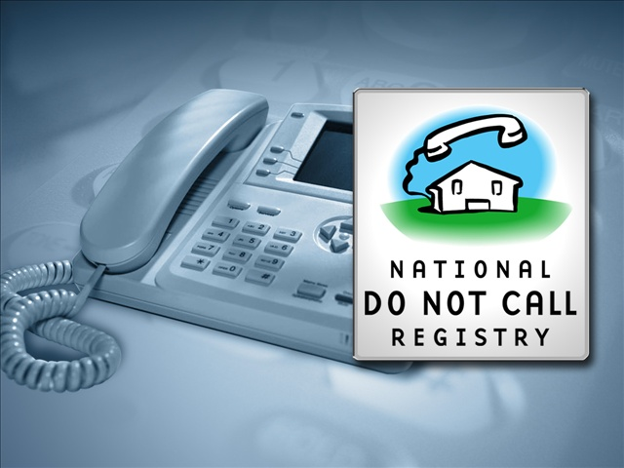



Telephone Consumer Protection Act of 1991
Notes:
In order to deal with this issue, the government already started regulating against unwanted phone calls since the 1990s.
Starting with 1991, a law was enacted to restrict most forms of robocalls.
And in the 2000s, the government set up the national do not call registry that opts consumers out of telemarketing calls.
And more recently in the last few years, the government started hosting annual competitions aimed at stopping robocalls.

Slide 5
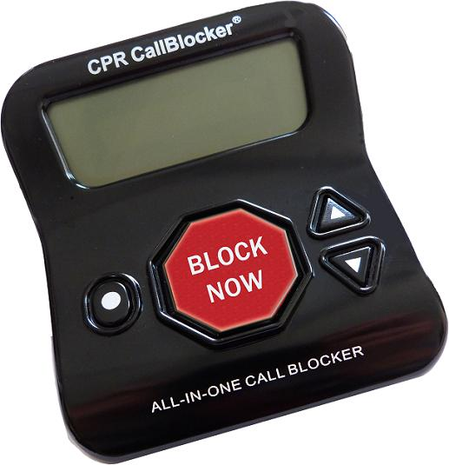
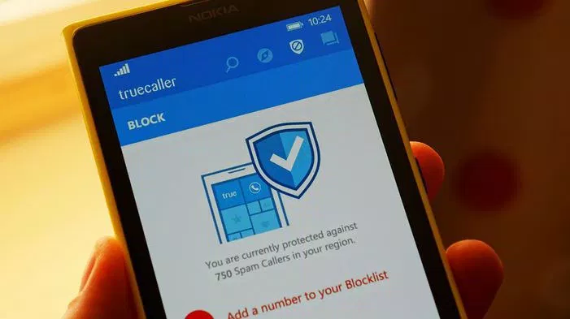
Notes:
In addition to government efforts, we also saw some consumer products that made its way into the market.
For example, the standalone call blocker devices for landlines and the various smartphone apps that block unwanted callers.

Slide 6
Data source: Consumer sentinel data book CY2015
Notes:
Unfortunately, all these efforts have so far failed at stopping the growth of telephone spam.
Using a statistic from last year’s government report, the number of phone fraud complaints more than doubled in a matter of just 2 years.

Slide 7
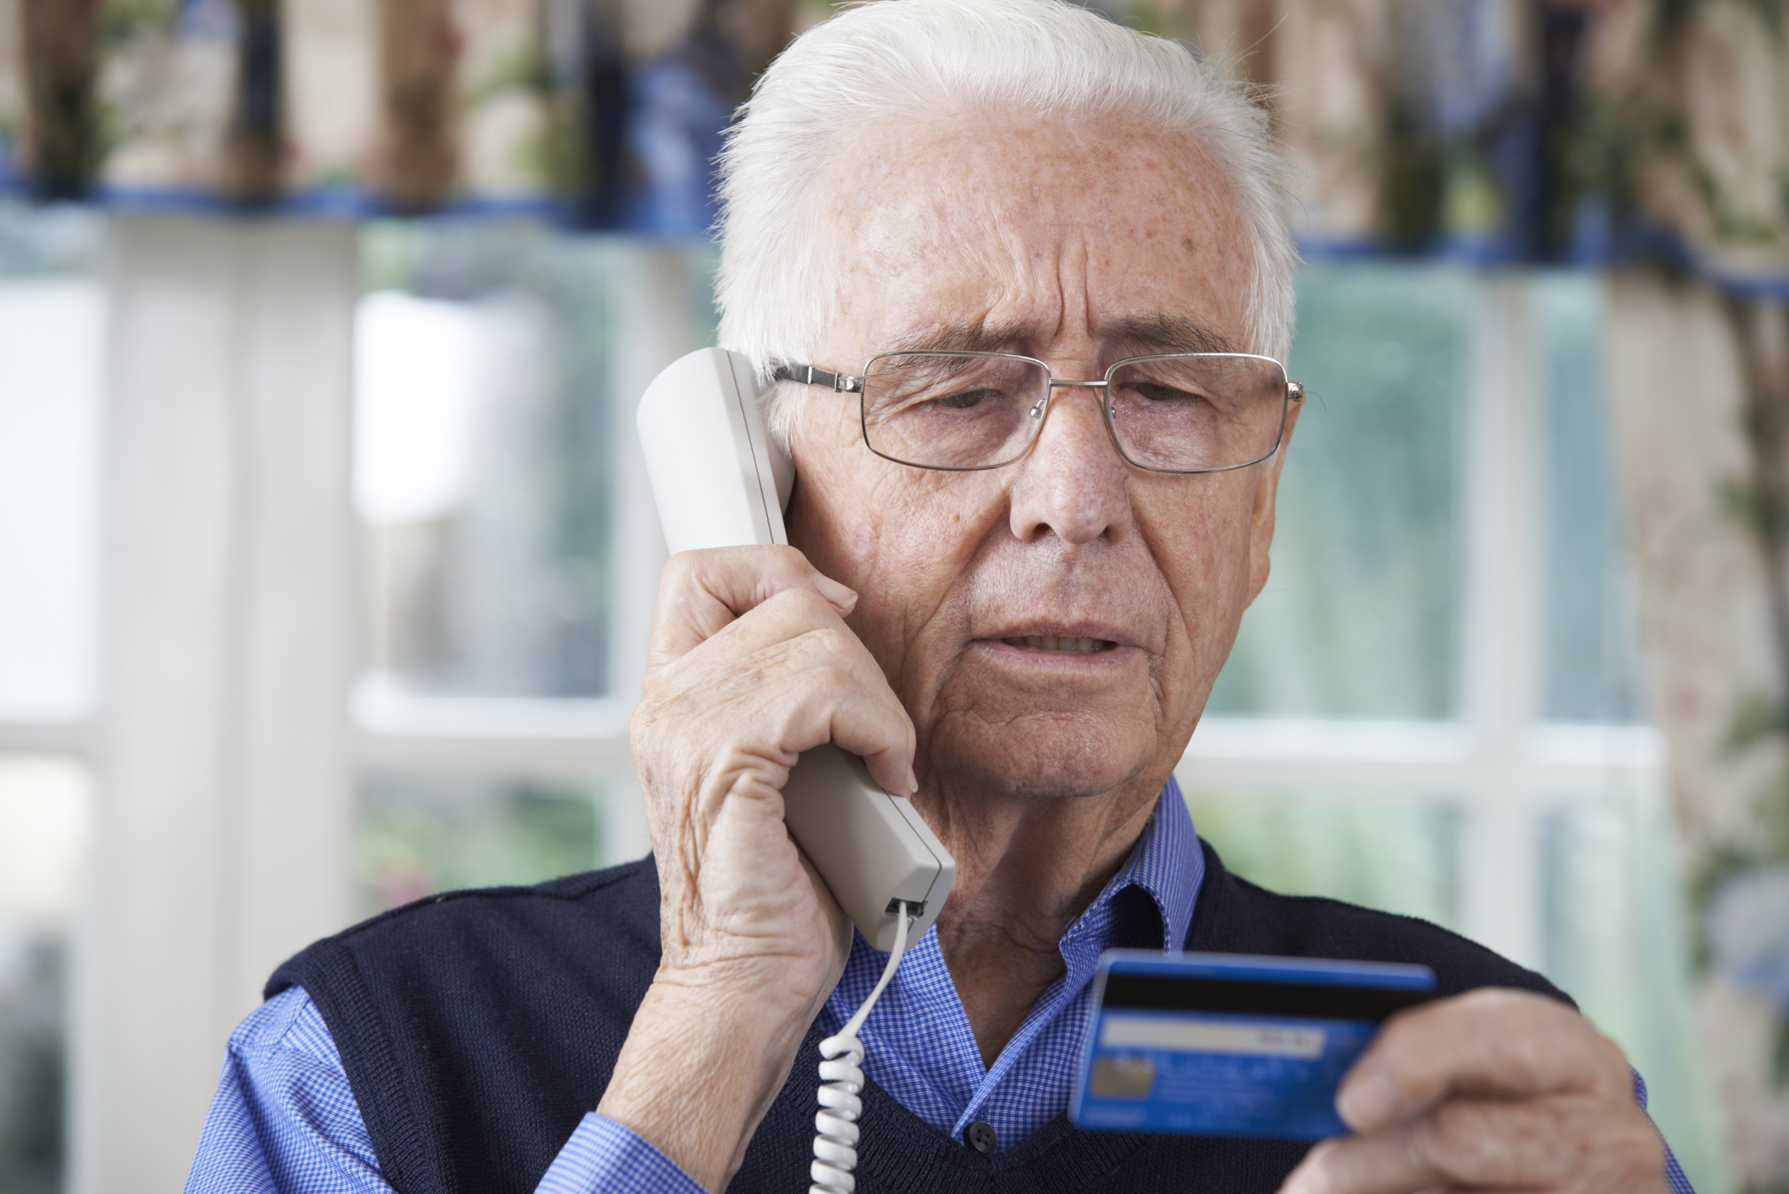
Notes:
One type of phone fraud that comes up frequently is the credit card verification scam, where the spammer would spoof the caller ID and make the audio sound like it came from the credit card issuing bank.
The audio recording would tell recipients that their credit card has been deactivated and they would need to verify personal information in order to get reactivated, of course the true motive of this scam is get their credit card and personal information.
This trend is deeply troubling, as billions have been lost to phone scams, so we asked, why is telephone spam still growing?

Slide 8
US Population
Data source: CTIA 2013, ITU 2013, Statistica 2013
Notes:
First, we believe a key factor of this growth is the high reachability of telephones. According to 2013 statistics, mobile telephone subscribership has already surpassed 100% of US population.

Slide 9
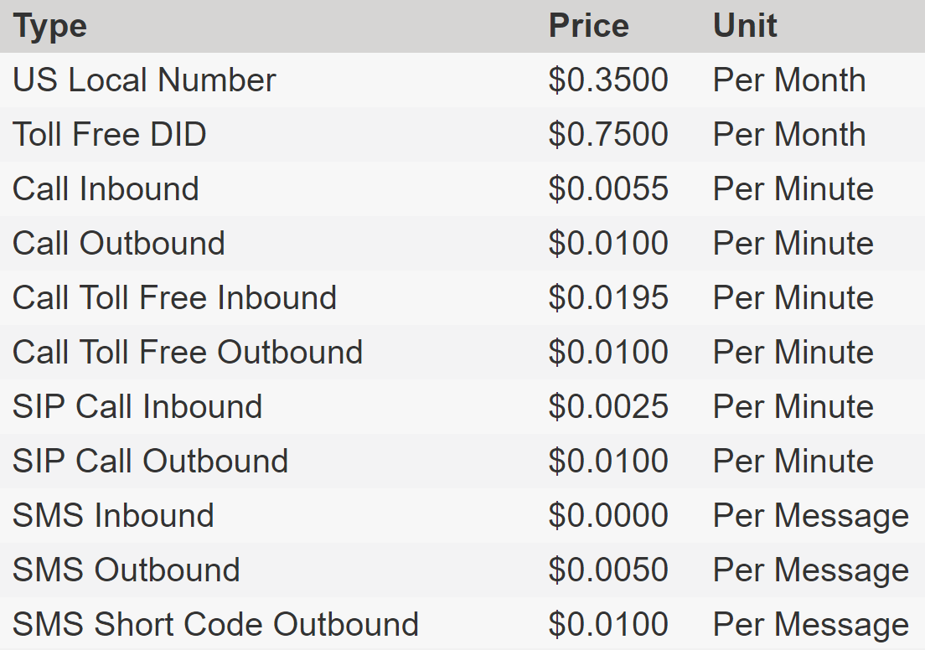
Data source: Bandwidth Voice & Messaging API Platform
Notes:
Second, the cost of telephone communication has dramatically decreased. With just a penny per call, spammers are now spending almost next to nothing when trying to profit from their victims.

Slide 10



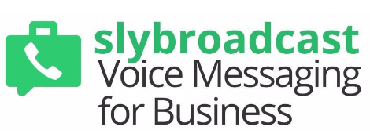







Notes:
Today spam distribution technology has become more advanced and more accessible than ever. With the rise of cloud computing, there are now hundreds of autodialer services that are accessed over the internet, with advance features such as simultaneous calling, interactive voice response and customizable caller ID.
In order to better understand telephone spam from the spammer’s perspective, we also asked, how does a spammer operate?

Slide 11
Recipients
Mass
Distribution
Content
Notes:
For every spamming operation, you need a list of recipients, the spam content and a mass distribution channel.

Slide 12
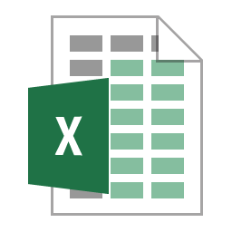
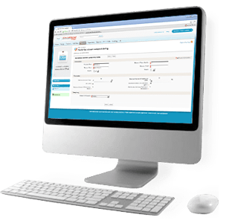
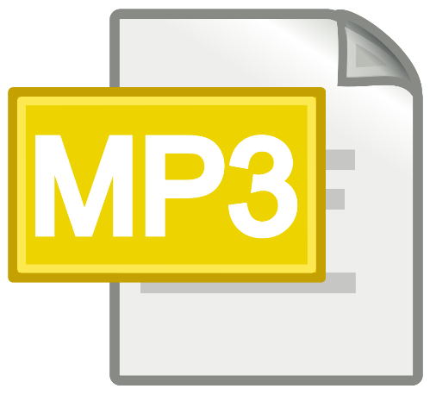
Phone number list
Autodialer
+
VoIP Carrier
Audio content
Notes:
Imagine if you are a telephone spammer, first you would need to acquire a list of phone numbers. This could be easily obtained from a lead seller that sells access to millions of curated phone number at a cost of less than $100.
The content of telephone spam is audio. This can be easily created by recording human voice, or using a text-to-speech synthesizer or simply duplicating the audio from existing sources.
For mass distribution, all you need is an autodialer with access to a VoIP carrier.
However, due to the prevalence of spam, some recipients may be using call blocker or simply won’t answer calls from certain numbers, and therefore a spammer may also consider circumventing these defenses.

Slide 13
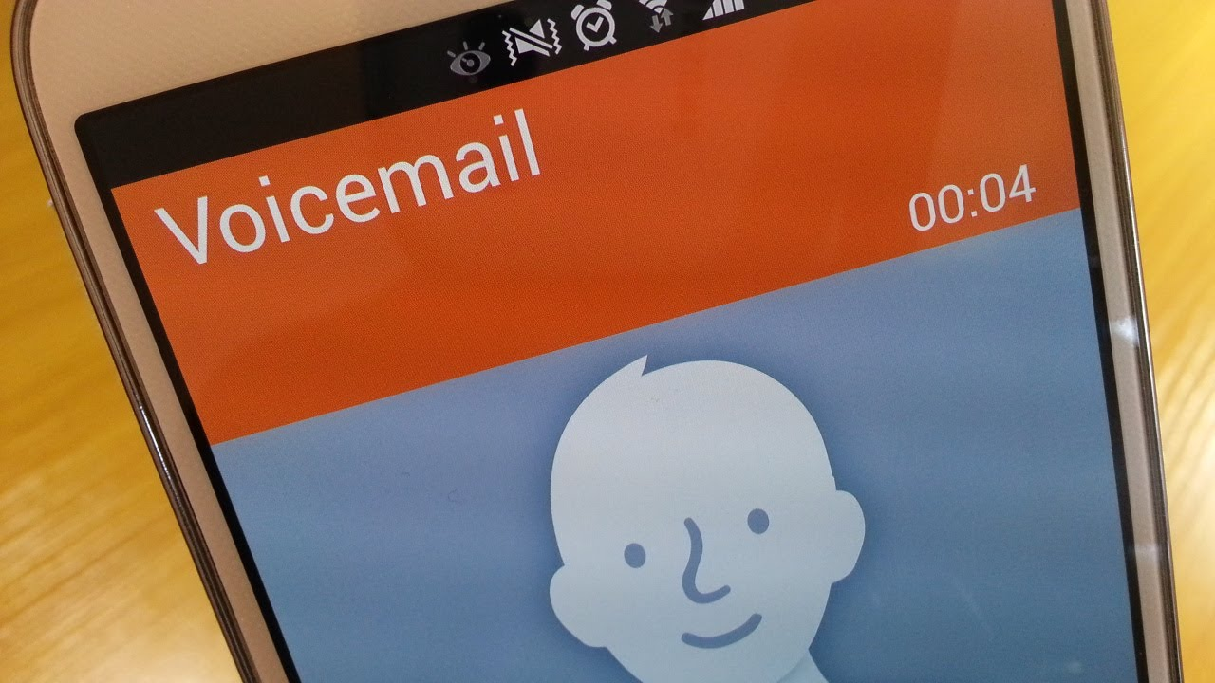
Notes:
One way to do this is to use voicemail injection. With many autodialers today, the spammer could configure the autodialer to inject the spam message into the recipient’s voicemail inbox even if the call is declined or unanswered.
Not only that, some autodialer can even inject a voicemail without ringing the phone.

Slide 14
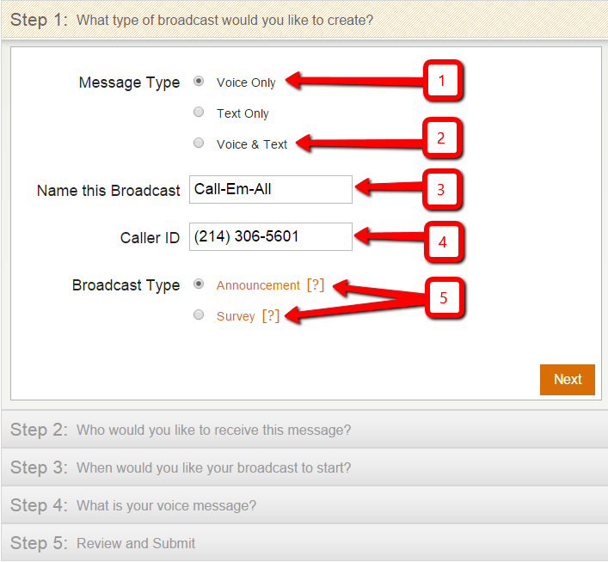
Notes:
Another way is to defeat call blockers and make the call seem more legitimate is to use a fake caller ID number. With most autodialers, The caller ID number can be easily spoofed because current call protocols do not have a built-in authentication mechanism. The carriers also do not have a legal obligation to ensure that the caller ID number is verified. In fact, some VoIP carriers sell customizable caller ID as a service feature.
So you might ask what about law enforcement?

Slide 15
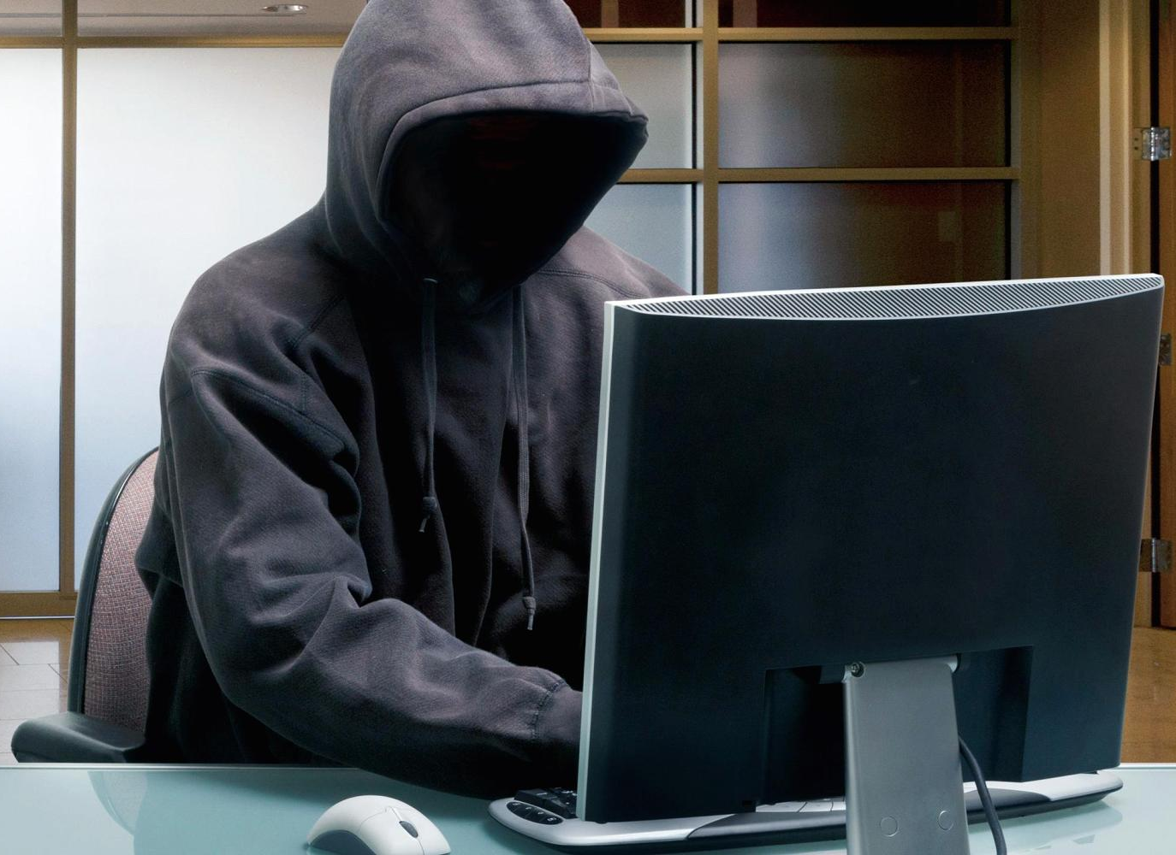

PSTN
Notes:
This is what the PSTN used to look like.

Slide 16
IP
PSTN
Notes:
However, With introduction of IP access to the PSTN, the spammer is now further insulated from law enforcement.

Slide 17
IP
+ VPN
+ TOR
PSTN
Notes:
And with IP access, the spammer could now further evade law enforcement by hiding behind VPNs and Tors.

Slide 18
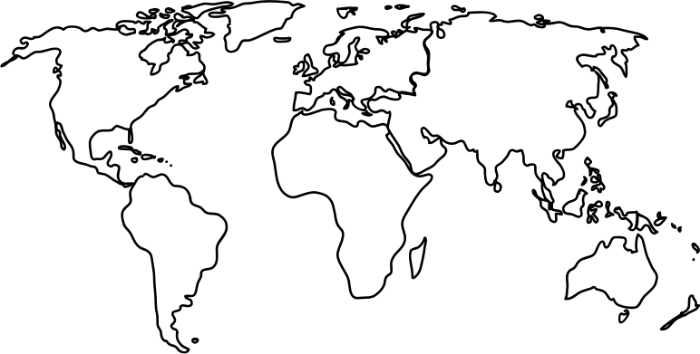
IP
+ VPN
+ TOR
PSTN
Notes:
To make matters worse, the spammer could reside anywhere in the world beyond the jurisdiction of the law enforcement.

Slide 19

Notes:
We know that anti-spam techniques in the email space have largely been successful at stopping email spam. So could we bring these techniques to deal with telephone spam?
Unfortunately, this is not as easy as it seems. There are unique challenges in dealing with telephone spam that are not easy to solve.

Slide 20
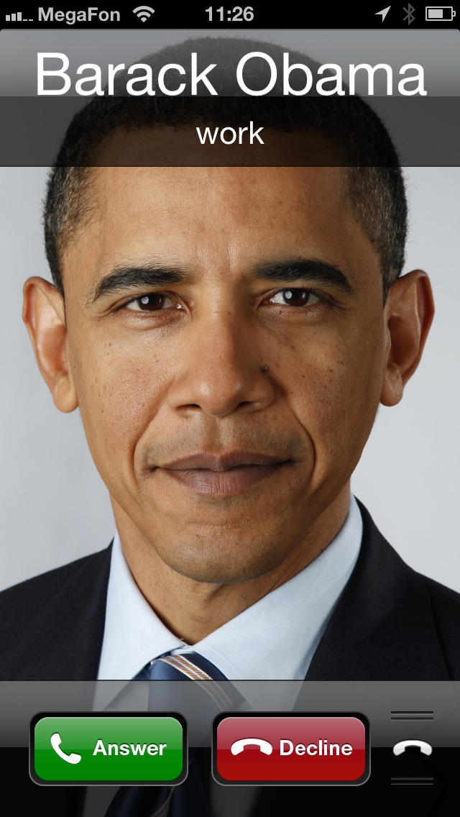
Notes:
The first challenge is immediacy. A phone call is immediate and has to be analyzed as soon as it appears. This is in stark contrast to email, which could be put in a queue for time consuming analysis.

Slide 21
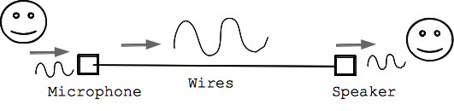
Notes:
Another problem in dealing with phone spam is the content. The content of telephone spam is a live audio stream, which is much harder to analyze compared to text.
To make matters worse, the content is only accessible when the phone call is answered
Therefore any solution that performs content analysis would need to answer the call, which could disrupt communication and cause privacy issues.

Slide 22
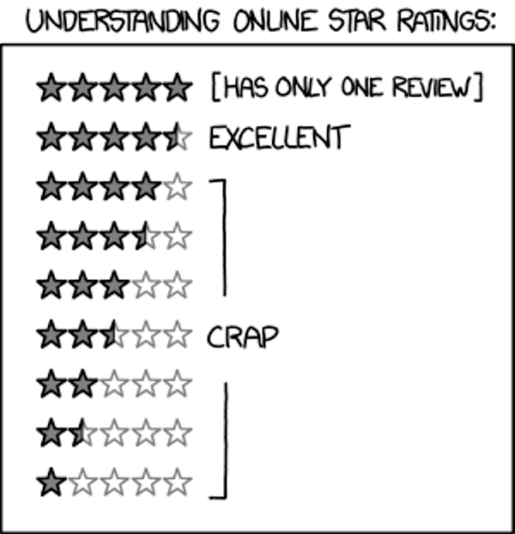
Notes:
Another challenge in dealing with telephone spam is the high bar for user acceptance. A telephone call is arguably more important and urgent compared to email.
What if the call that was blocked was for an emergency?

Slide 23

Notes:
Furthermore, due to way telcos are regulated, there is little hope expecting the carriers to reduce the traffic of telephone spam in their networks.
In the US, a law require telephone carriers to move all telephone traffic equally without exception.
In fact, due to the billing regulations, telephone carriers profit from receiving more traffic in their network.

Slide 24
3 types of defenses
Notes:
Now we let’s briefly talk about existing defenses and see if they are able to overcome those challenges.
We’ve gathered various techniques from a variety of sources, and was able to systematically group them into 3 categories.

Slide 25
Call Request Header Analysis
Blacklisting
Caller behavior monitoring
Reputation system
…
Notes:
The first category is call request header analysis. These techniques analyze a call based on the header information associated with a call request. For instance, the caller ID number is a popular type of header information that could be used to analyze a call. However, using the caller ID also makes them vulnerable to caller ID spoofing.
Examples of call request header analysis include caller ID blacklisting, caller behavior monitoring and reputation system of the caller ID.

Slide 26
Voice Interactive Screening
Audio fingerprinting
Speech content analysis
CAPTCHA / Turing test
…
Notes:
Another category is Voice interactive screening. These techniques analyze a call using the voice stream or voice interaction of the caller. However, all these techniques have the downside of requiring the call to be answered in order to analyze the audio.
Examples of voice interactive screening include audio fingerprinting which create audio profiles of spams, speech content analysis which converts the voice to text to analyze for spam, and CAPTCHA that interactively tests the caller using a reverse turing test to check if the caller is human.

Slide 27
Caller Compliance
Do-not-call registry
Call back verification
Proof of identity
…
Notes:
Last but not least, we have caller compliance. These techniques require the caller to first satisfy a compliance requirement prior to being allow to communicate with the recipient. The compliance requirement would be easy for the legitimate caller but difficult or costly for the spammer.
Example of caller compliance techniques include do-no-call registry which legally prohibits the spammer from calling a list of numbers or potentially face substantial fines,
Call back verification which reject all initial calls, and forces the caller to wait for the recipient to call back,
and also proof of identity, which require the caller to provide an unforgeable identity token such that the caller could be held responsible for making illegal calls.

Slide 28



Assessment Criteria
Usability
Deployability
Robustness
Notes:
Next we’ll talk about how we provided our assessment to these techniques.
In the paper, we proposed a large set of assessment criteria.
And The set of assessment criteria can be grouped into three categories.
First we have usability, which evaluates the ease-of-use from both the caller and recipient’s perspective.
The second category is deployability, which evaluates the ease of deployment, development and operation.
Finally, we have robustness, which evaluates the techniques’s resilience against errors and circumvention.
Now let put the techniques and assessment criteria together and see how they match up to each other.

Slide 29
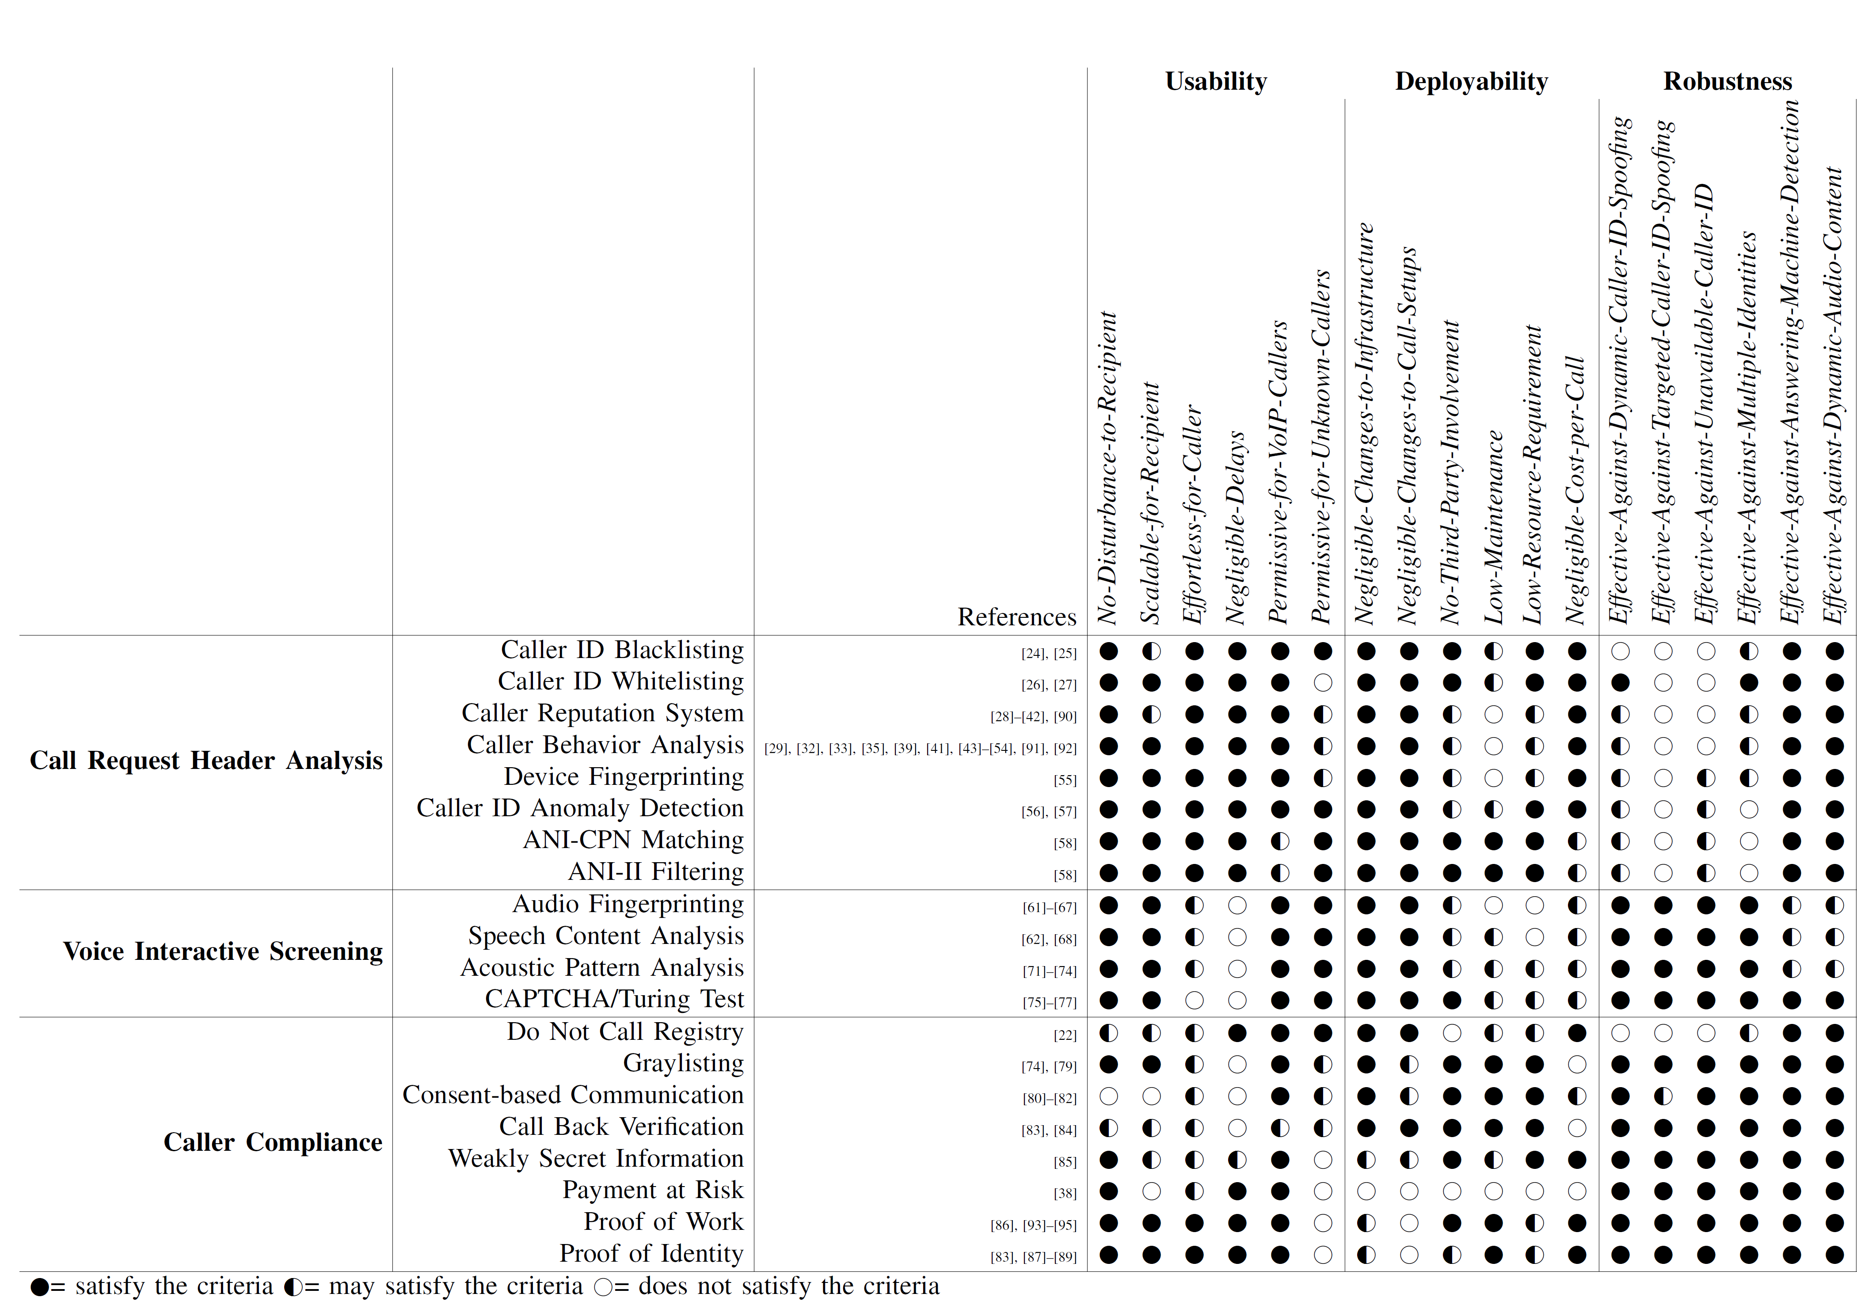
Notes:
This is the evaluation of the techniques in the paper

Slide 30

Call Request Header Analysis
Voice Interactive Screening
Caller Compliance
Usability
Deployability
Robustness
Notes:
In short, I will provide you with a general idea of how the techniques fair against the assessment criteria.
In general, Call Request Header Analysis do very well in term of usability and deployability, but they also do poorly in terms of robustness mainly due to caller id spoofing.
Voice interactive screening do poorly in term usability, due to delays and intrusiveness of voice analysis, but in terms of deployability and robustness, they are decent but not without flaws.
Caller compliance can be either good or bad in usability and deployability depending on the technique, but most of them do very well in robustness.
Unfortunately, no standalone technique is able to satisfy all of the assessment criteria.

Slide 31
3 ways to combine techniques
Notes:
And therefore, some solutions combine several technique together to improve the overall effectiveness.
And we are able to systematically categorize the ways to combine techniques into 3 categories.

Slide 32
Phased Decisions
Notes:
First we have phased decisions, which combine several techniques into a linear sequence of decision stages. If an earlier technique determines that the call is spam, then it may not be necessary to run the later stages.

Slide 33
Weighted Scoring
Weighted
Score
Notes:
Another approach is to use weighted scoring, Where different techniques analyse the call simultaneously, and the outputs are combined to make a weighted score, which determines the final decision of the call.

Slide 34
Conditional Procedures
Notes:
Finally, we have conditional procedures, arguably the most advance way of combining techniques. Conditional procedures combine several techniques based on a set rules. This allows different set of techniques to be used based on certain conditions, such the preference of the recipient or the reputation of the caller.

Slide 35
Notes:
In the paper, This is a summary of existing works using combined technique.

Slide 36
Combining techniques create synergy
However…
Notes:
In general, combining several techniques together can create synergy when advantages one technique can overcome the weaknesses of other techniques.

Slide 37

Notes:
However, due to the immediacy constraints of telephone calls, care must be taken such that the higher complexity of combining techniques does not degrade the user experience.

Slide 38
Conclusion
Notes:
This bring us to our conclusion. And what we believe the future direction should be.

Slide 39
POTS
POTS
ISDN
PSTN
SIP
GSM
LTE
CDMA
…
Notes:
As more and more protocols extend its reach into the PSTN

Slide 40
Core robustness
=
Effective prevention of
caller ID spoofing
Notes:
we believe that the PSTN would need to improve its core robustness.
One glaring issue that continually reoccurs is caller ID spoofing. If caller ID spoofing could be prevented effectively, simple techniques such as Call Request Header Analysis would satisfy all of our evaluation criteria.
Preventing caller ID spoofing would not only be useful in reducing telephone spam, many other apps and services that rely on the caller ID would also benefit from the improved robustness.

Slide 41

Notes:
In this paper, we provided an assessment framework to help guide and shape future telephone spam defenses. But our work does not end here.
As mentioned, we believe the next direction should be to fundamentally tackle the issue of caller id spoofing.

Slide 42

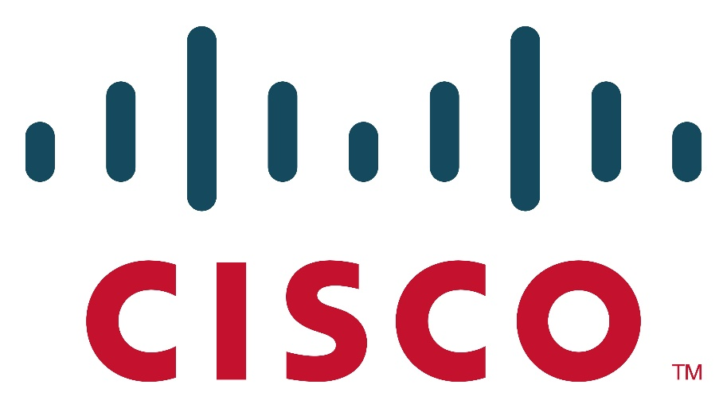

Acknowledgments
Notes:
I would like to thank our sponsors.

Slide 43
Thank you!

Slide 44
Questions?
Huahong Tu (Raymond)
tu@asu.edu
PS: We’re looking for shared access to SS7/SIGTRAN.
Notes:
I am happy to take any questions.

