Slide 1
Users Really Do Plug in USB Drives They Find
Matthew Tischer, Zakir Durumeric,
Sam Foster, Sunny Duan, Alec Mori,
Elie Bursztein, Michael Bailey

Slide 2
The Anecdote
“Of the 20 USB drives we planted, 15 were found by employees, and all had been plugged into company computers. The data we obtained helped us to compromise additional systems... We never broke a sweat.”
Notes:
S. Stasiukonis, “Social engineering, the usb way,” Dark Reading. http://www.darkreading.com/attacks-breaches/social-engineering-the-usb-way/d/d-id/1128081

Slide 3
…Now on Mr. Robot!
Notes:
Image from: http://www.geekwire.com/2015/mr-robot-rewind-hunting-for-flaws-in-an-intense-episode-6/

Slide 4
Research Questions
Do users plug in USB drives they find?
Can we increase the effectiveness of this attack?
Why do people plug in the flash drives and open files?

Slide 5
Research Questions
Do users plug in USB drives they find?
Can we increase the effectiveness of this attack?
Why do people plug in the flash drives and open files?

Slide 6
Experiment
Dropped, photographed, and geolocated 297 drives on the University of Illinois campus.
30 different locations, 5 types of drives, 2 times of day.
Periodically revisited locations and recorded when drives were moved.
Recorded when users opened files on the flash drive.
Presented users with a voluntary survey.

Slide 7
Ethics
Project vetted and approved by the Illinois Institutional Review Board (IRB #15445).
Worked with various stakeholders, including campus police, legal counsel, and Technology Services, in advance of the experiment.
Participants were debriefed as soon as they clicked on a file on the flash drive.
Files loaded a remote image (were masquerading as HTML files).
We require a click—we don’t run any code when they plug the drive in.

Slide 8
Do users plug in USB drives they find?
Drives dropped on ground (n = 297)
Drives taken from ground (n = 290)
Drives with files opened (n = 135)
45 – 98% success rate.

Slide 9
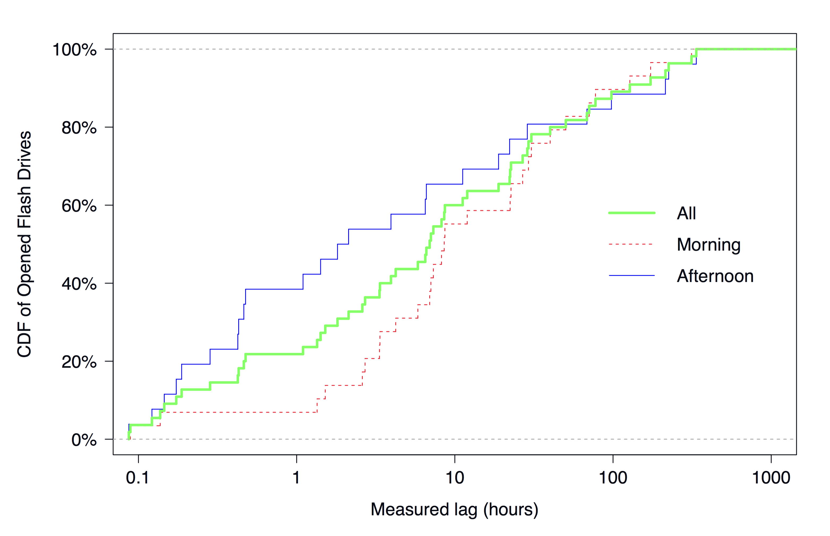
Speed of the Attack
Most drives were picked up and opened quickly—median time between drop and file open was 6.9 hours.

Slide 10
Research Questions
Do users plug in USB drives they find?
Can we increase the effectiveness of this attack?
Why do people plug in the flash drives and open files?

Slide 11
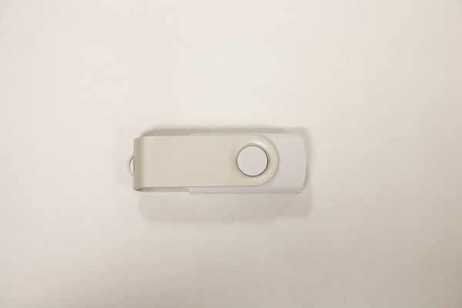
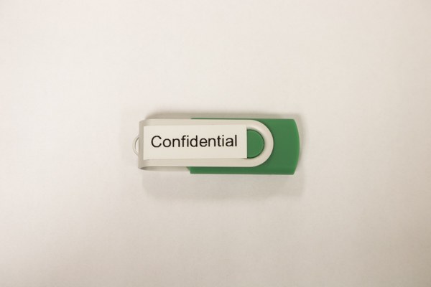
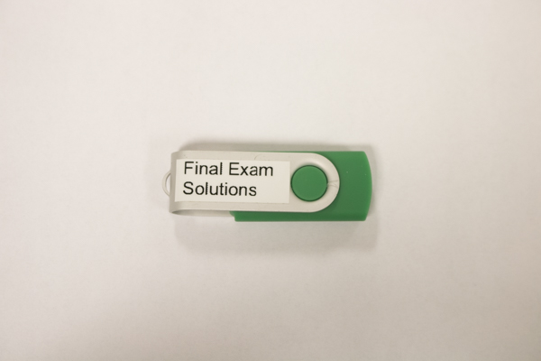
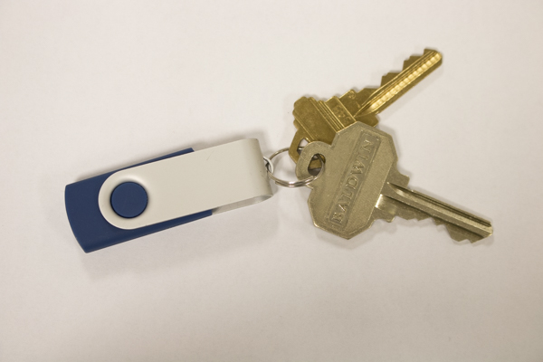
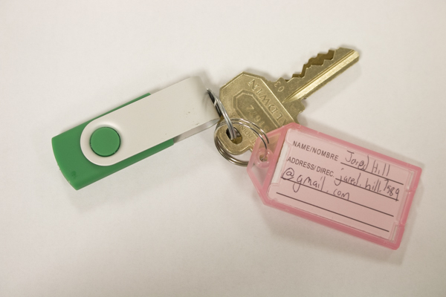
Drive Types
“Witnessed a student pick up the drive… he looked super happy... Also kind of jittery.”

Slide 12
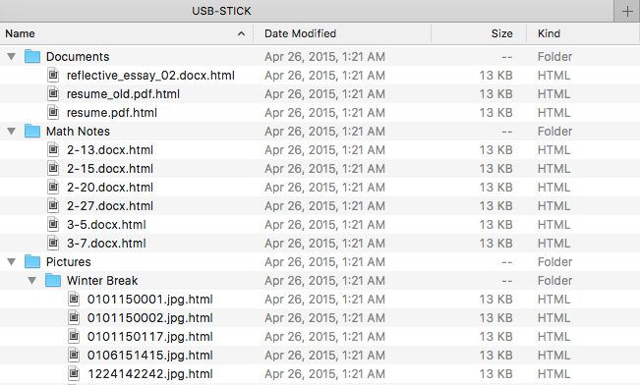
Drive Contents

Slide 13
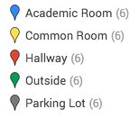
Locations

Slide 14
2. Can we increase the effectiveness of this attack?
No, cannot change the effectiveness by changing:
Type of drive.
Location category.
Time of day.
…but we can decrease it!
Drives with return labels opened significantly less frequently.

Slide 15
Research Questions
Do users plug in USB drives they find?
Can we increase the effectiveness of this attack?
Why do people plug in the flash drives and open files?

Slide 16
The Attack Funnel, Revisited
Drives dropped on ground (n = 297)
Drives taken from ground (n = 290)
Drives with files opened (n = 135)
Survey responses (n = 62)*
* We received 72 valid responses, but discarded 10 of the 11 responses associated with one of the drives.

Slide 17
USB Survey
DOSPERT: Domain-Specific Risk-Taking Scale
Willingness to perform risky activities across 5 domains.
SeBIS: Security Behavior Intentions Scale
Frequency of intentions for positive/negative security behaviors.
Demographic questions
Questions about the flash drive

Slide 18
3. Why do people plug in the flash drives and open files?
68% of participants wanted to return the drive…
...but many of them looked at winter break photos first!
Consistent with negative correlation with return label drives.
68% of participants didn’t take precautions...
“I would have [concerns about the flash drive], so I sacrificed a university computer.”
There is no particular type of participant, when compared to the University of Illinois population:
Demographically similar (gender, affiliation, age).
Similar security behavior intentions.

Slide 19
Summary
Users plugged in 45—98% of the USB drives they found.
Changing the appearance of the drive, the type of location in which it is dropped, or the time of day in which it is dropped does not make the attack more effective.
Participants claim to pick up drives to return them, but curiosity also appears to be a motivation.

Slide 20
Thank You!

