Slide 1
You Get Where You‘re Looking For
The Impact of Information Sources on Code Security
Yasemin Acar, Michael Backes, Sascha Fahl, Doowon Kim*, Michelle Mazurek*, Christian Stransky
Cispa, Saarland University; *University of Maryland, College Park

Slide 2
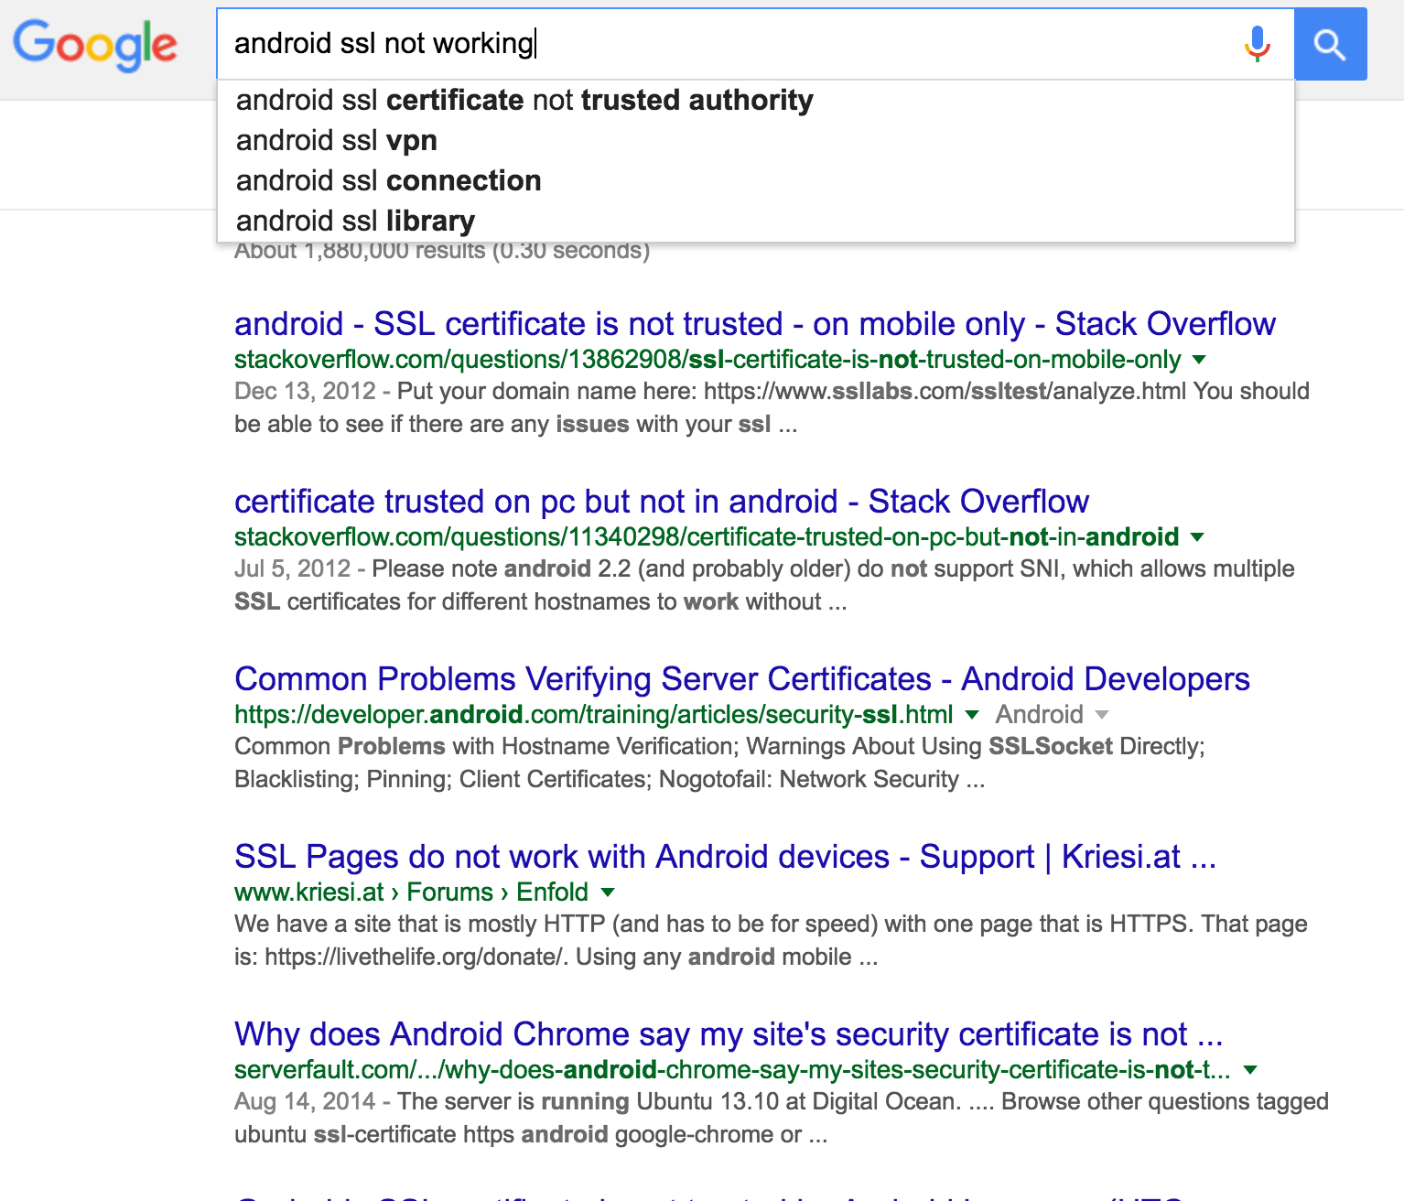
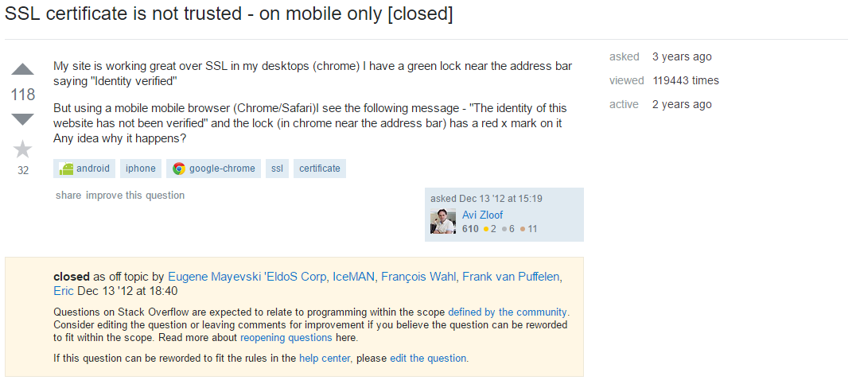
Have you ever had to look up something while writing code?

Slide 3
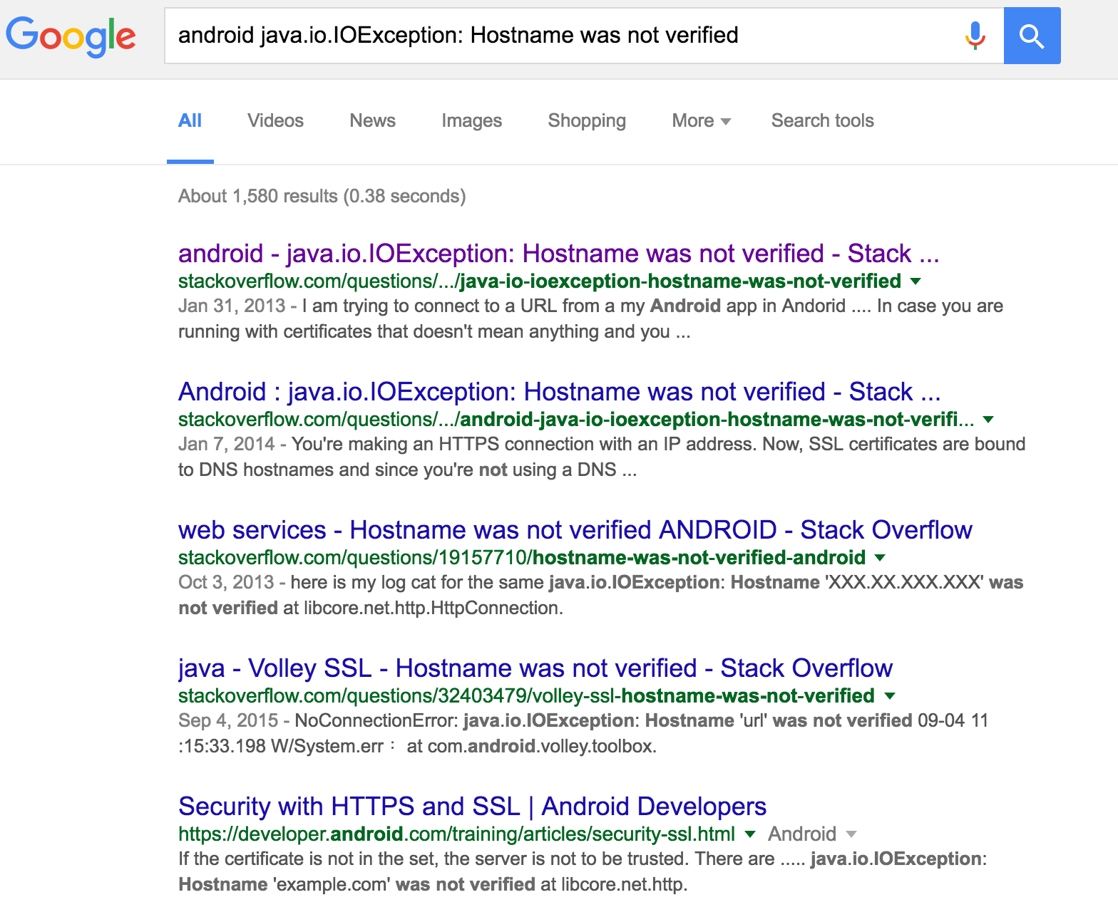
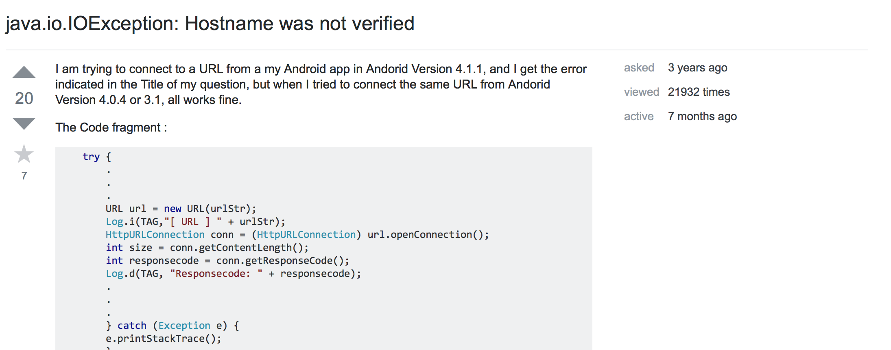
We’ve done the same thing..
Tried to write an Android app that uses SSL

Slide 4
..and it turned out to be a CCS paper in 2012.
Reverse engineered 13,500 Android apps
Call Graphs
Found custom trustmanagers
  1074 (17%!!) of all apps with HTTPS fail!
    790 accept all certificates
    284 accept all hostnames
Was this a unicorn flaw, or is this typical for Stack Overflow use?

Slide 5
Stack Overflow considered insecure?
“Everyone knows” copy & paste code from the Internet is bad.
Insecure workflows, probably from Stack Overflow, can be found in apps.
How does this happen?
Can we isolate this?
Does everyone just copy & paste stuff?

Slide 6
Talking to developers
What kind of resources do developers actually use?
  Only Stack Overflow?
Does this resource differ when the question is security-relevant?

Slide 7
Online developer survey
Extracted developer email addresses from Android Apps
Emailed 50,000 developers with a plea to participate in our survey (approved by the IRB of the University of Maryland, College Park)
Asked them which resource they use when they get stuck
69% Stack Overflow, 62% search engine; 27.5% official documentation
A small number also mentioned books, blogs..
Also asked them for demographic information

Slide 8
Isolate the conditions
Is it reasonable that Stack Overflow is so popular?
  Is it more helpful than other resources in finding solutions, fast?
Does using Stack Overflow make code insecure?
Do developers think about security when writing security-relevant code?

Slide 9
Isolate this – Lab study
Recruited 54 Android developers to come to our lab (approved by the IRB of the University of Maryland, College Park)
Recruitment in USA and Germany via mailing lists, poster advertisements, and, in the USA, Craigslist
Asked 5 screening questions
8 women, 48 students, ages 18-40 (mean 26, sd=4.7)
12 in the US, 42 in Germany
28 grew up in Germany, 6 in India, 5 in US
No differences in gender, ages, education across US and German recruits

Slide 10
Explained what they were going to do
Asked them to think aloud and practiced it with them
  with some of them, for quite a while!
Randomly assigned them to one in four conditions:
  Stack Overflow: Only use Stack Overflow for lookups
  Official Android Documentation: Start at developer.android.com, don’t leave the domain
  Books: Only use books (in pdf and print): Pro Android 4, Android Security Internals
  Free: Start with Google, do whatever

Slide 11
4 tasks
In randomized order, we asked them to solve 4 programming tasks
Cutoff after 20 minutes
Chose tasks that
  could be solved in those 20 minutes
  could be solved in a secure way or not using the given resources
  are relevant to security in real world Android apps
They had to complete code in a skeleton Android app

Slide 12
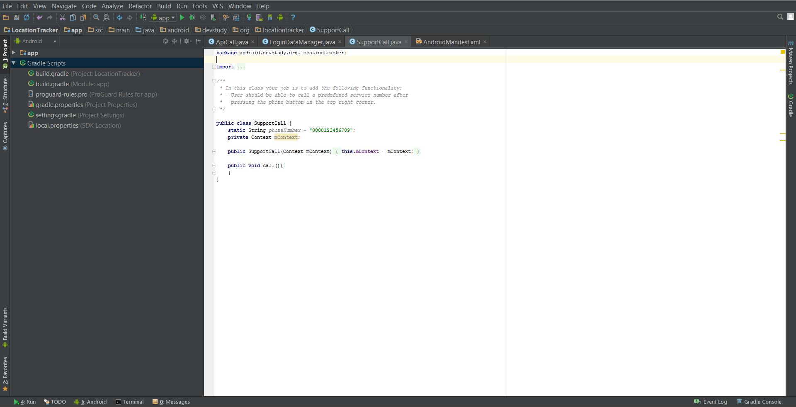
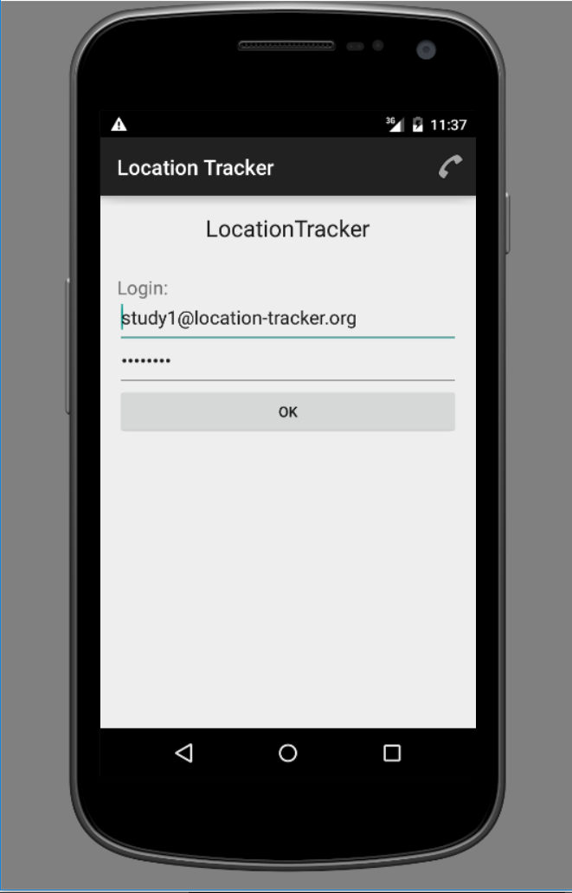
Android Studio & Emulator

Slide 13
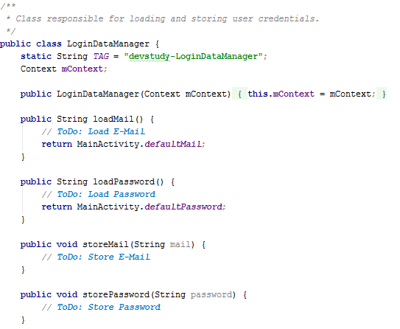
Storing Login credentials
Store user login credentials locally and persistently.

Slide 14
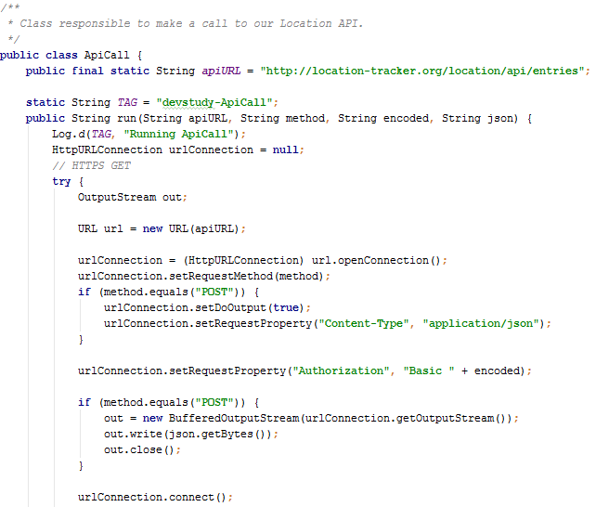
Networking
Change the HTTP connection to HTTPS
Added fun: The server certificate was issued for a subdomain instead of the top level domain
Hostname mismatch

Slide 15
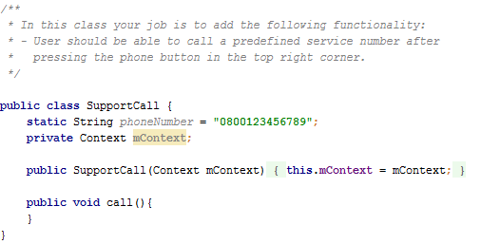
Least privilege / least permissions
When the phone button is clicked, call the hotline.

Slide 16
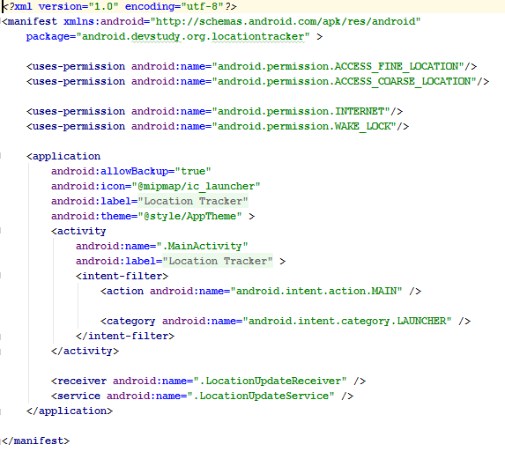
Inter Process Communication
Make an activity callable from Apps from the same developer

Slide 17
Exit Interview
Most of them enjoyed the study.
Free choice wins on confidence in having answered the task correctly.
Notes:
55% confident Free, 47 all others

Slide 18
Participant perception of resources
Free choice and Stack Overflow win in usability and helpfulness.
Books & Official Documentation win on trust in correctness.

Slide 19
Thinking about security.
When they thought aloud, we noted if they
  thought about security (16%)
  not at all (79% of all cases)
  or if they mentioned they did something less securely because of the study environment / time constraints (5%)
60% self-reported that they thought about security!
Highest number of mentions / self-reported mentions of security in book + official documentation conditions
Lowest in Stack Overflow condition
Notes:
Third case: mostly for ssl

Slide 20
Our rating – functional, even secure?
Login task was successful whenever login data were stored locally and persistently.
  Secure: Using SharedPreferences, mode private (default), local storage with mode private
  Insecure: world readable, either SharedPreferences in world readable mode or files, SD card..
Networking task was successful if the connection worked via HTTPS.
  Secure: Custom Hostname verifier that checks for subdomains, optional: saying “this certificate should be changed”, public key pinning
  Insecure: Accept all certificates, Null hostname verifier (return true), anything else that shuts off TLS

Slide 21
Our rating – functional, even secure?
Least permission task was successful when dial button worked.
  Secure: Adherence to least privileges, ACTION_DIAL
  Insecure: Least privilege violation, ACTION_CALL (requires permission)
ICC task was successful if AndroidManifest.xml was changed such that the activity was callable from apps by the same developers.
  Secure: Custom permission, protection level signature or signatureOrSystem
  Insecure: exported = true without permission or not manually setting the exported flag, but using Intent filter (exported = true automatically)

Slide 22
Results – Functional correctness
Functional correctness:
  67% Stack Overflow
  66% book
  52% Free choice
  40% official documentation
Notes:
Func: 87% least permission, 33% ssl
Secure: 38% ssl!

Slide 23
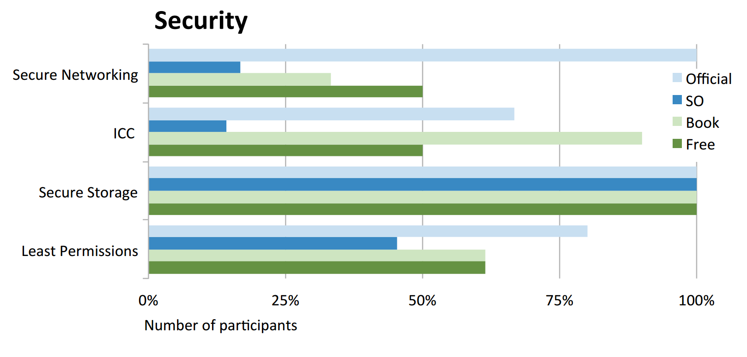
How about security?
Security:
  86% official documentation
  73% book
  66% Free choice
  52% Stack Overflow

Slide 24
Using Stack Overflow leads to more functional code!
Significantly more often the results were functional than with use of other resources.
Stack Overflow leads to insecure code!

Slide 25
Also, professional developers produced (statistically significant) slightly more functional code, but were no better at security.
The regression results can be admired in our paper.

Slide 26
Lookup behavior
Official Documentation: A lot of scrolling and clicking on (internal) links.
Books: Some read the actual books (scanning index), some used ctrl+F to search.
Stack Overflow: Often unhelpful results, many search resets.
Free choice:
  Everybody accessed official documentation!
  All but one person accessed Stack Overflow.
  One person even picked up a book!
  Results most closely resemble Stack Overflow.

Slide 27
Search Queries
With a browser extension, we collected their browsing history.
Went to all visited Stack Overflow sites.
  139 unique pages
  41 of them related to our tasks
  20 with code snippets
    7 with secure code only
    3 with both secure and insecure code
    10 with insecure code only!
      3 with warnings, (there’s a little hope)

Slide 28
External validity
200,000 Android apps
  Static code analysis
  Found all API calls that participants used in our lab study

Slide 29
Limitations
Both our studies suffer from an opt-in bias.
Our lab participants’ experience differed slightly from the developers we emailed.
Lab studies always sacrifice a little external validity with an unnatural environment in order to gain comparability.

Slide 30
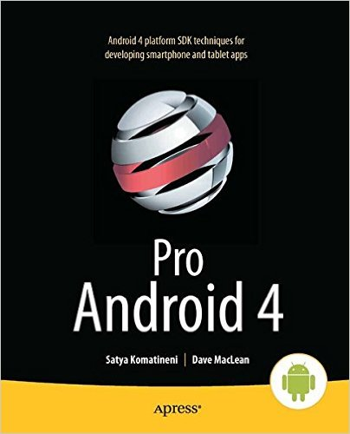
Take aways
If you want functional, secure code…
          Take your developers offline and give them a book!

Slide 31
Real take aways
Stack Overflow is usable and offers people quick fixes for their problems – but it is insecure!
Official Documentation is secure, but less usable.
We need to integrate both: Security and usability in one resource.
  Add a security rating to Stack Overflow that influences upvote
  New security-focused Q&A-site?
  Seamlessly integrate a Q&A feature into the official documentation
  Find trouble spots in code
    Provide secure code snippet that fix those in the official documentation!

Slide 32
Thank you for listening!
And thank you to Sven Bugiel, who helped with the study!
Thank you Marten Oltrogge for the static analysis results!
Thank you Jennifer DeSimone and Joseph Smith from UMD’s IRB for being super helpful (and quick)!
Thanks to Michelle Mazurek’s undergrads Andrew Lui and Yichen Qian who also helped with the study.
Thanks to BMBF, CISPA and NIST for funding.
I’m happy to take questions!

Slide 33
Real take aways
Stack Overflow is usable and offers people quick fixes for their problems – but it is insecure!
Official Documentation is secure, but less usable.
We need to integrate both: Security and usability in one resource.
  Add a security rating to Stack Overflow that influences upvote
  New security-focused Q&A-site?
  Seamlessly integrate a Q&A feature into the official documentation
  Find trouble spots in code
    Provide secure code snippet that fix those in the official documentation!
Interested?
Contact acar@cs.uni-saarland.de or mmazurek@cs.umd.edu !

