Slide 1
Program Chairs’ Welcome
Thorsten Holz
CISPA Helmholtz Center for Information Security
Thomas Ristenpart
Cornell Tech

Slide 2
Welcome!
Welcome to the 43rd IEEE Symposium on Security and Privacy
First hybrid version of the symposium after two virtual events
We are still in a pandemic…
We have three exciting days of talks and discussion ahead of us!
One day of workshops on Thursday (May 26)
Notes:
On behalf of my co-chair and myself, it is my greatest pleasure to welcome you to SP 2020!
Long tradition – 41 years of history
We have an exciting program in front of us, and let me tell you how the program for this year was selected.

Slide 3
Program Committee
Large and diverse Program Committee (170+ members)
Wide geographical distribution and broad expertise
Associate Chairs helped us manage submissions and reviews
PC members reviewed on average 20 papers in the entire year (6-8 papers per cycle)
Strived for positive and constructive reviews, communication, and online discussion
No virtual PC meeting, all decisions were reached online

Slide 4
Reviewing Process
Switch to three submission deadlines
Two rounds of reviews
Early reject notifications sent after about 1.5 months
New interactive rebuttal phase (about 1.5 weeks)
Second-round papers reviewed by at least 4 PC members
Notifications sent to all authors about 2.5 months after submission
Decisions: Accept (with Shepherding), Major Revision, or Reject
Major Revision papers
Specific requirements, revised paper can be submitted to next 2 cycles
Same PC members are expected to review the revised submission

Slide 5
Submission Statistics
Total Number of Submissions: 1,012

Slide 6
From Submissions to Program
1,012 Submissions
2022 Program
55 Direct Accept
92 Accept
147 papers
(14.5%)
104 MR
12 Reject
88.5% MR acceptance rate
144 MR decisions
…
Reject

Slide 7
Quarterly Submissions in 2019-2022
Consistent growth year-to-year, more submissions in the Fall and Winter cycles

Slide 8
Historical Statistics
1,012 (+6.3%)
952
841
Acceptance rate 14.5%

Slide 9
Research Ethics Committee
IEEE S&P’22 introduced Research Ethics Committee (REC)
CfP was updated to better reflect the expectations regarding ethical considerations and human-subjects research
Reviewers could flag submissions for REC review
Flagged papers were checked by REC members
Online discussions/meetings to decide on recommendations
Two cases where REC recommended to reject papers based on ethical grounds

Slide 10
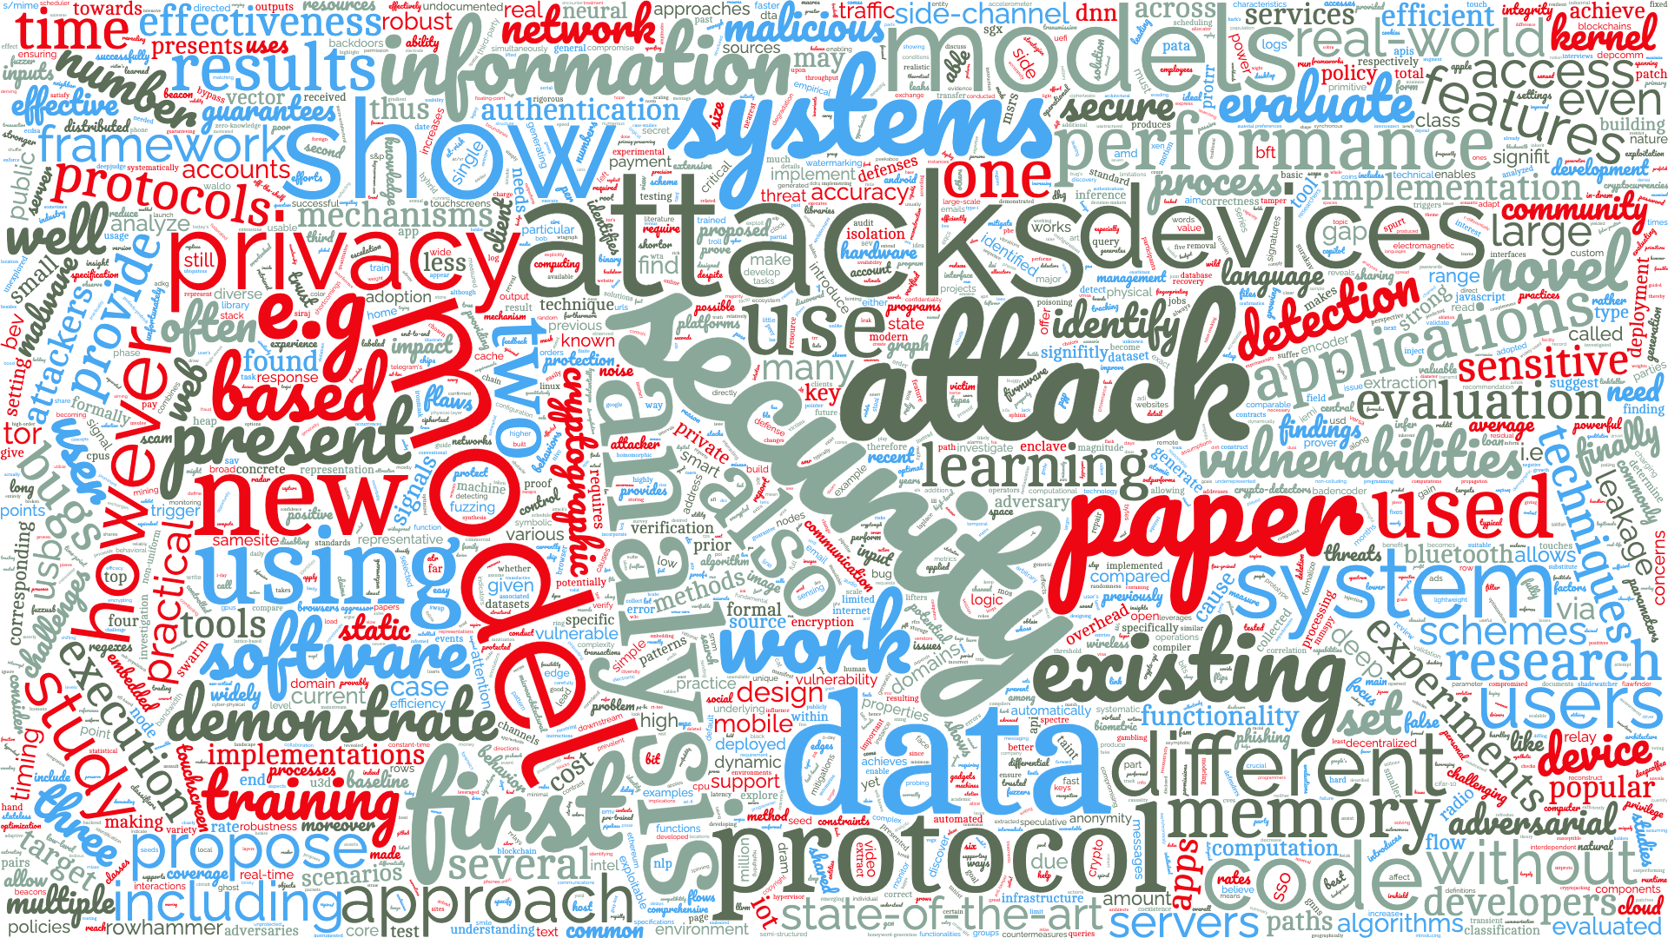

Slide 11
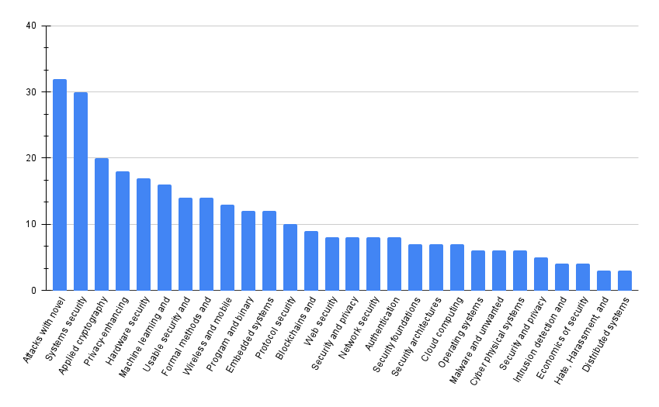
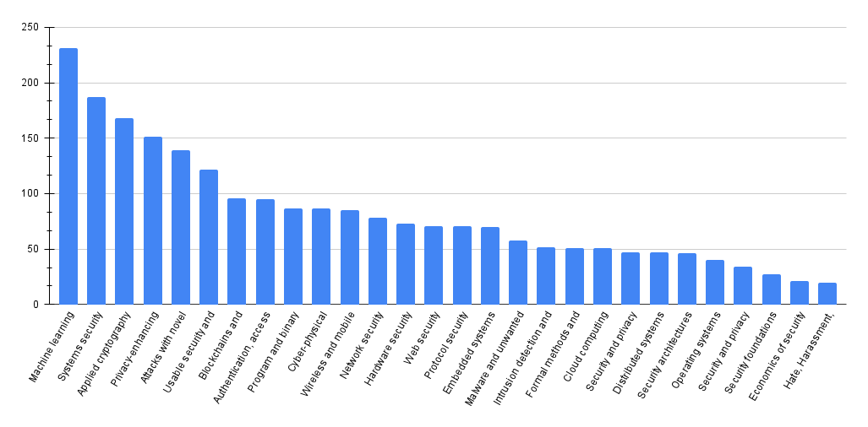
Paper Topics

Slide 12
Review Statistics
Reviewing is quite a bit of work
3,182 reviews written
1,978,199 words written
10,460 comments in total
…

Slide 13
Thanks!
Authors and speakers
Program committee and external reviewers
Organizing committee
General chair (Rakesh Bobba) and all other members
IEEE Computer Society's Technical Committee on Security & Privacy and its chair Bryan Parno and vice chair Gabriela Ciocarlie
IEEE S&P steering committee
Conference attendees (in-person and remote)
Many others responsible for making things run smoothly
Enjoy the Hybrid Conference!

Slide 14
AWARDS

Slide 15
Award Selection Process
Award selection committee
PC chairs: Thorsten Holz and Thomas Ristenpart
PC members: Emiliano De Cristofaro, Zakir Durumeric, Cristiano Giuffrida, Yongdae Kim, Jonathan McCune, Olya Ohrimenko, Andrei Sabelfeld
Shortlist of 16 top-ranked papers
Voting among the nine committee members
Four Distinguished Paper Awards

Slide 16
Distinguished Paper Award (1/4)
Four Attacks and a Proof for Telegram
Martin R. Albrecht (Royal Holloway, University of London), Lenka Mareková (Royal Holloway, University of London), Kenneth G. Paterson (ETH Zurich), Igors Stepanovs (ETH Zurich)
Session 1B: Formal Analysis I

Slide 17
Distinguished Paper Award (2/4)
Asleep at the Keyboard? Assessing the Security of GitHub Copilot's Code Contributions
Hammond Pearce, Baleegh Ahmad, Benjamin Tan, Brenden Dolan-Gavitt, Ramesh Karri (NYU Tandon School of Engineering)
Session 4B: Applications of Machine

Slide 18
Distinguished Paper Award (3/4)
Invisible Finger: Practical Electromagnetic Interference Attack on Touchscreen-based Electronic Devices
Haoqi Shan (University of Florida), Boyi Zhang (University of Florida), Zihao Zhan (University of Florida), Dean Sullivan (University of New Hampshire), Shuo Wang (University of Florida), Yier Jin (University of Florida)
Session 6C: Wireless Security

Slide 19
Distinguished Paper Award (4/4)
Committed to Trust: A Qualitative Study on Security & Trust in Open Source Software Projects
Dominik Wermke (CISPA), Noah Woehler (CISPA), Jan H. Klemmer (Leibniz University Hannover), Marcel Fourné (MPI-SP), Yasemin Acar (George Washington University), Sascha Fahl (CISPA, Leibniz University Hannover)
Session 9B: Usability Aspects II and ML Attacks

Slide 20
Test of Time Awards

