Slide 1

Program Chairs’ Welcome
Alina Oprea
Northeastern University
Hovav Shacham
The University of Texas at Austin

Slide 2
Welcome!
Welcome to the 41st IEEE Symposium on Security and Privacy
  Flagship security conference
  First virtual event!
We have three exciting days of online talks and discussion ahead of us!
We have one day of workshops on Thursday, May 21
Notes:
On behalf of my co-chair and myself, it is my greatest pleasure to welcome you to SP 2020!
Long tradition – 41 years of history
We have an exciting program in front of us, and let me tell you how the program for this year was selected.

Slide 3
Reviewing Process
Continued monthly submission deadlines introduced in 2018
  12 deadlines, from January 1, 2019 until December 1, 2019
Timely decisions
  Notifications sent to authors within two months from submission
  Every paper reviewed by at least 3 PC members (very few exceptions)
  Decisions: Accept (with Shepherding), Reject, or Revise option
Revised papers
  Revised papers are given specific requirements and three months to resubmit a revision that addresses them
  Same PC members are reviewing the revision
  The 2020 PC is still reviewing several revisions from 2020

Slide 4
Program Committee
Largest Program Committee to date (136 members)
  Large diversity (wide geographical distribution, broad set of topics, industry and government representation in addition to academia)
Every PC member participated in three reviewing cycles
Every PC member reviewed between 17 and 21 papers in total
Every month a selected set of papers discussed during online PC meeting
Strived for positive and constructive discussion

Slide 5
Number of Submissions by Month
Submissions
CDF
Total Number of Submissions: 841

Slide 6
Monthly Submissions in 2019 and 2020
Submissions
Similar monthly trend, but consistent growth
Notes:
There is growth month-by-month
Same trend in terms of monthly distribution

Slide 7
Historical Statistics
841
Statistics
Total Submissions: 841
Accepted Papers: 104
Acceptance Rate: 12.3%
Highlights:
23.8% yearly increase
Largest program to date
Steady acceptance rate
679

Slide 8
From Submissions to the Program
841 Submissions
2020 Program
41 Accept
104 papers
(12.3%)
12 Revised and Accepted (from 2019)
51 Accept
82.25% revision acceptance rate
86 Revise
24 Revise for 2021
11 Reject
714 Reject

Slide 9
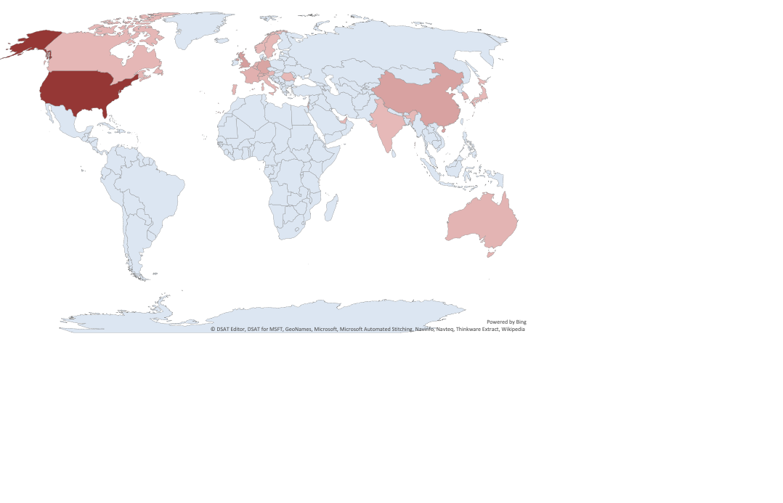
Author Geographical Representation
Number of Authors
1 240
More than 500 authors from 4 continents and 24 countries
Top countries: US, UK, China, Germany

Slide 10
Accepted Paper Topics

Slide 11
Reviewing Scores
Average: 2.68
Average: 4
Merit Scores for Rejected and Accepted Papers
Notes:
3085 total reviews

Slide 12
Changes to Submission Model
Starting in 2021, S&P is moving to quarterly submissions
  Community discussion and coordination with top-tier security conferences
  Deadlines: March 5, June 4, September 3, and December 3, 2020
  PC chairs: Thorsten Holz and Alina Oprea
Advantages
  Non-overlapping reviewing cycles
  Entire PC participation in every reviewing round
  Availability of expertise in all areas
  Consistency in the review process

Slide 13
Thanks!
Authors and speakers
Conference attendees
Organizing committee
  General chair: Gabriela Ciocarlie; Vice chair: Alvaro Cárdenas
  IEEE Computer Society's Technical Committee on Security & Privacy: Úlfar Erlingsson, Bryan Parno, and Sean Peisert
Program committee and external reviewers
Many others responsible for making things run smoothly
Enjoy the Virtual Conference!

Slide 14
Remembering our Colleagues
William Aiello 1959 - 2019
J. Douglas Tygar 1962 - 2020

Slide 15
AWARDS

Slide 16
Award Selection Process
Award selection committee
  PC chairs: Alina Oprea, Hovav Shacham
  PC members: Joe Calandrino, Henry Corrigan-Gibbs, Giulia Fanti, Mathias Payer, Konrad Rieck
Nomination of 12 papers
Voting among the 7 committee members
And the winners are….

Slide 17
Best Paper Award
TRRespass: Exploiting the Many Sides of Target Row Refresh
Pietro Frigo (Vrije Universiteit Amsterdam), Emanuele Vannacci (Vrije Universiteit Amsterdam), Hasan Hassan (ETH Zürich), Victor van der Veen (Qualcomm Technologies, Inc.), Onur Mutlu (ETH Zürich), Cristiano Giuffrida (Vrije Universiteit Amsterdam), Herbert Bos (Vrije Universiteit Amsterdam), Kaveh Razavi (Vrije Universiteit Amsterdam)
Sponsored by
Notes:
https://www.youtube.com/watch?v=tJpnb-Bvl0k&amp=&index=56&amp=&t=0s

Slide 18
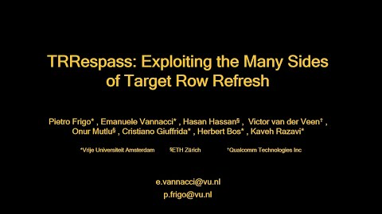

Slide 19
Best Practical Paper Award
An Analysis of Pre-installed Android Software
Julien Gamba (IMDEA Networks Institute, Universidad Carlos III de Madrid), Mohammed Rashed (Universidad Carlos III de Madrid), Abbas Razaghpanah (Stony Brook University), Juan Tapiador (Universidad Carlos III de Madrid), Narseo Vallina-Rodriguez (IMDEA Networks Institute, ICSI)
Sponsored by
Notes:
https://www.youtube.com/watch?v=wJ-nym0wIeE&amp=&index=76&amp=&t=0s

Slide 20
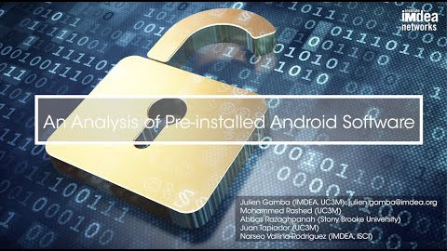

Slide 21
Best Student Paper Award
Can Voters Detect Malicious Manipulation of Ballot Marking Devices?
Matthew Bernhard (University of Michigan), Allison McDonald (University of Michigan), Henry Meng (University of Michigan), Jensen Hwa (University of Michigan), Nakul Bajaj (The Harker School), Kevin Chang (University of Michigan), J. Alex Halderman (University of Michigan)
Sponsored by
Notes:
https://www.youtube.com/watch?v=xbN3vfQd4YI&amp=&index=92&amp=&t=0s

Slide 22
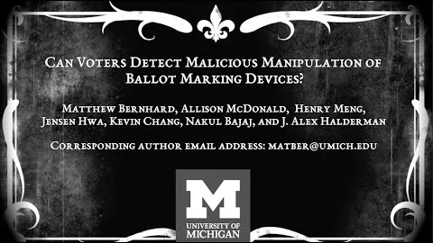

Slide 23
Best Reviewer Award
Joe Calandrino
Research Director
Office of Technology Research and Investigation
Federal Trade Commission

