Slide 1
Registration Chair’s Report Alvaro Cardenas, UC Santa Cruz
IEEE S&P 2020 Registration Chair

Slide 2
Registration Overview
Online conference changes:
No separate registration for Symposium and Workshops
No early bird registration
No difference in prices between IEEE members/non-members
Two new categories: Paper Presenter / General Attendee
ExecutivEvents continues to provide significant value in managing the registration process and now the online experience as well. Thank You!
Paid registrations were up by 187%
Total by 209% (donors)

Slide 3
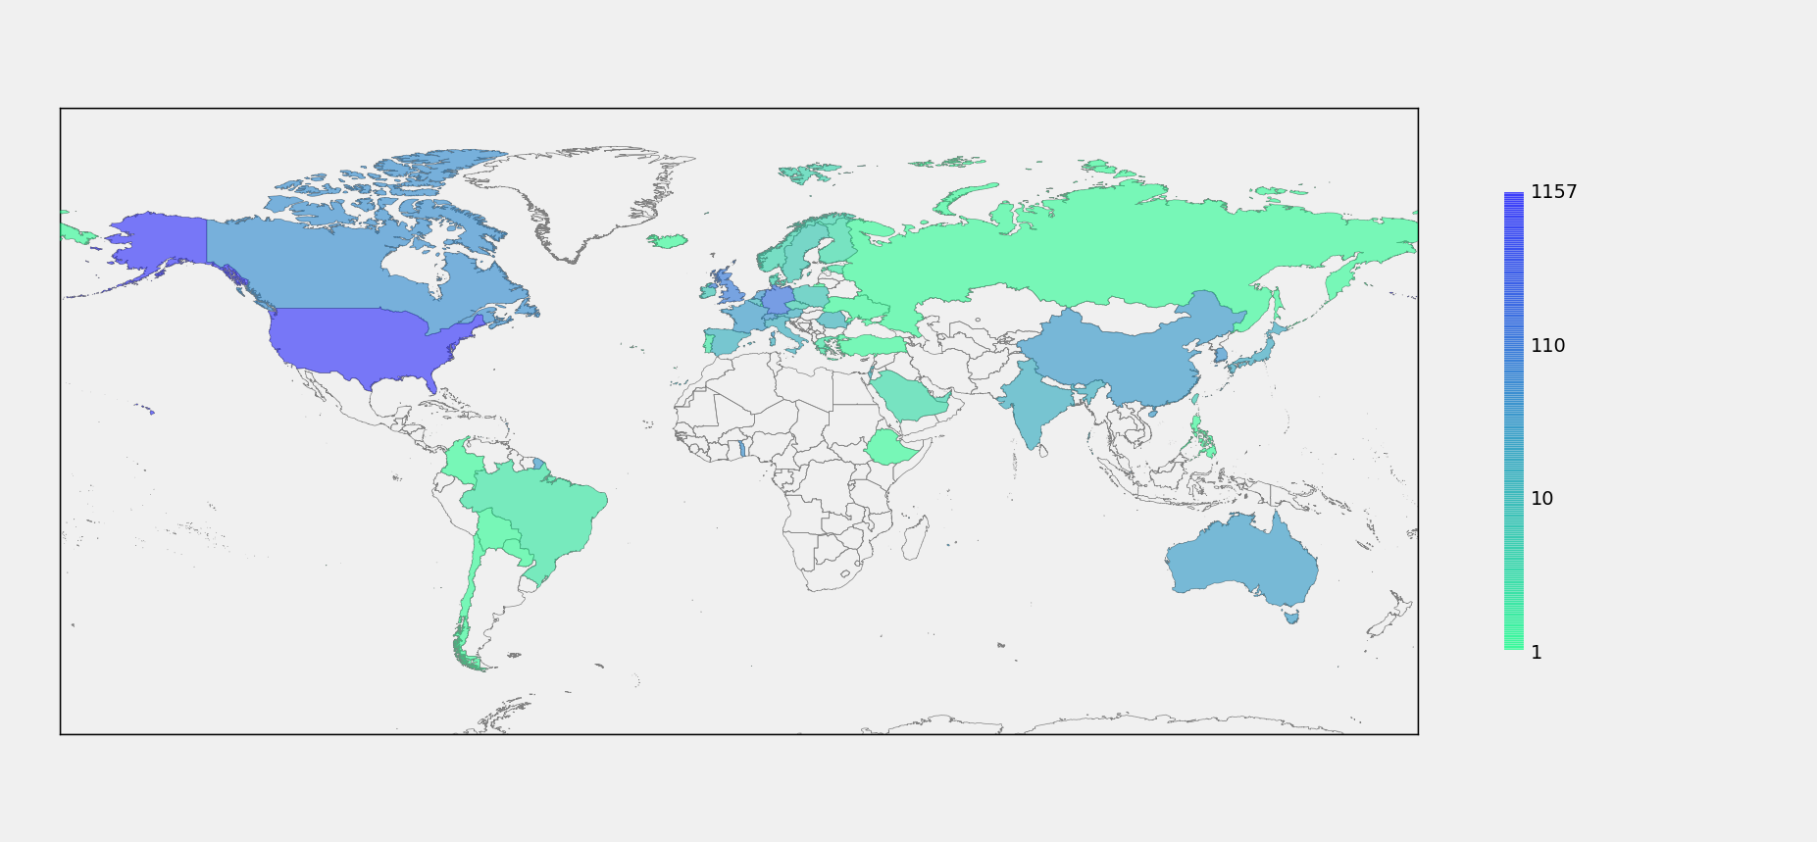
Attendance by Region

Slide 4
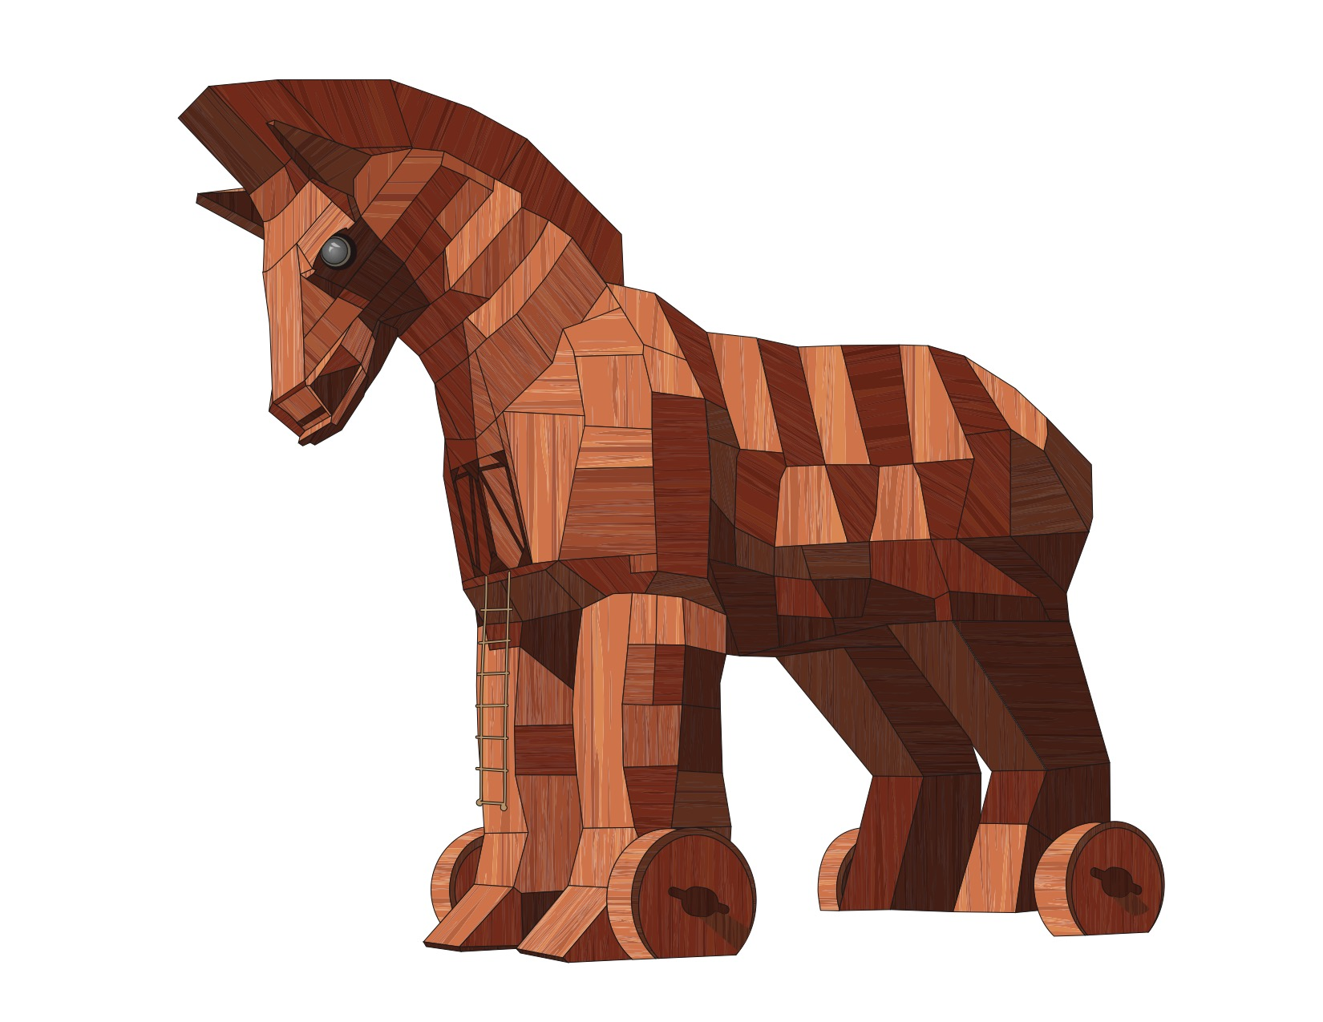
Registration: 1963 Total

Slide 5
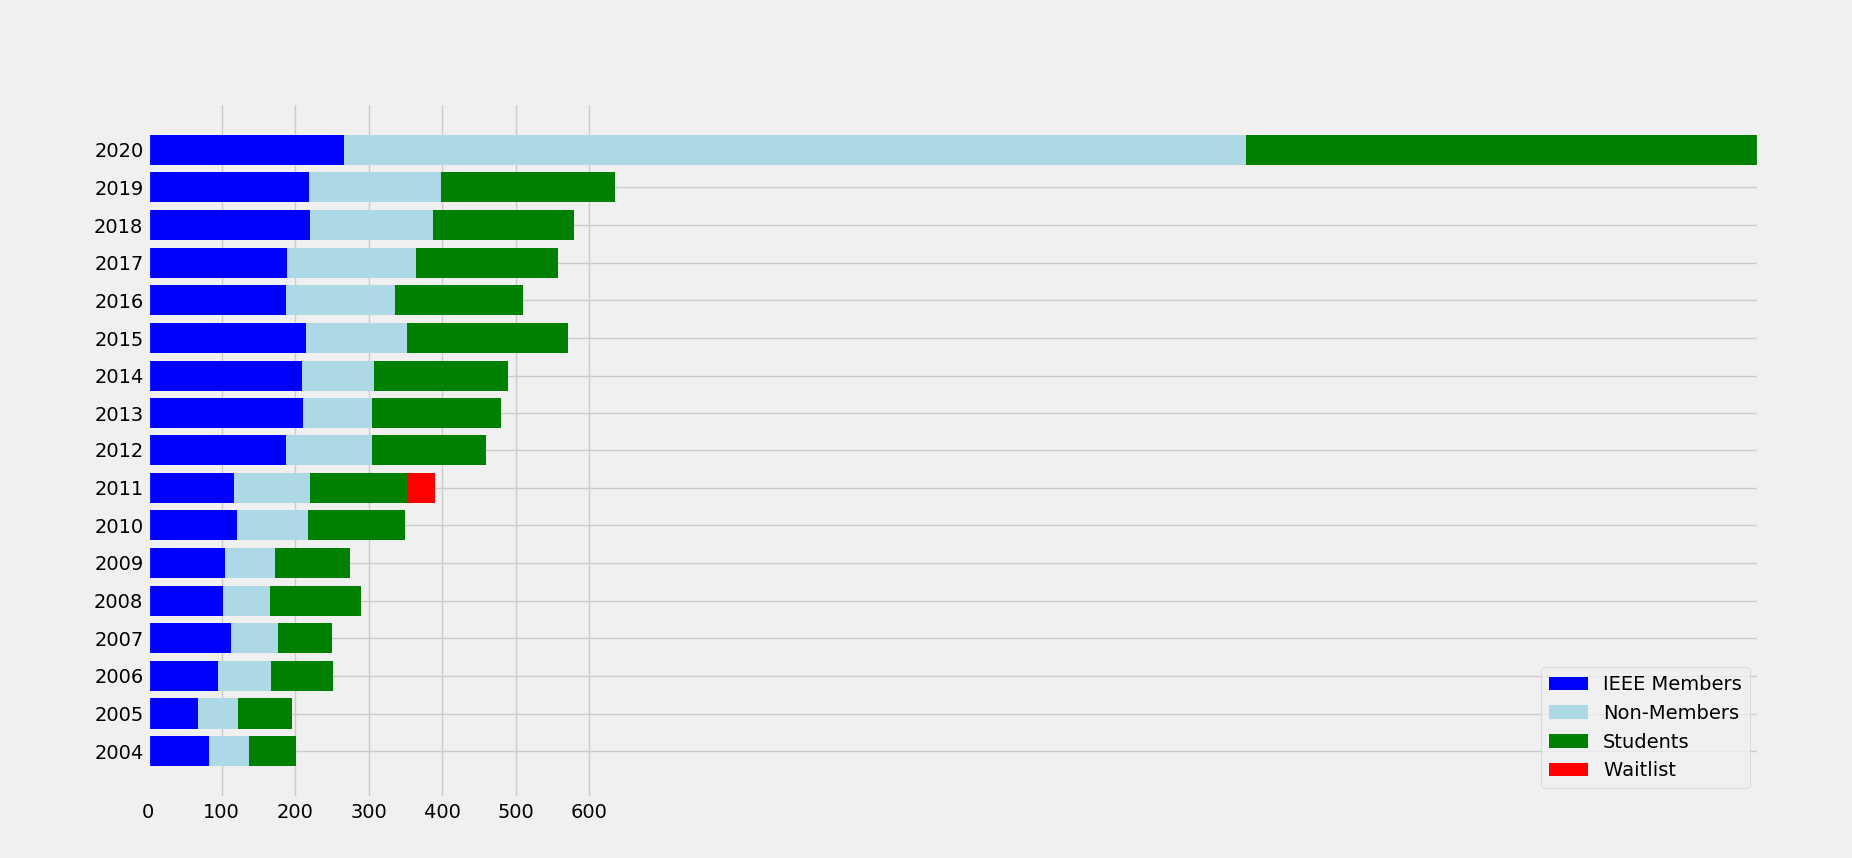
Registration “trends”

Slide 6
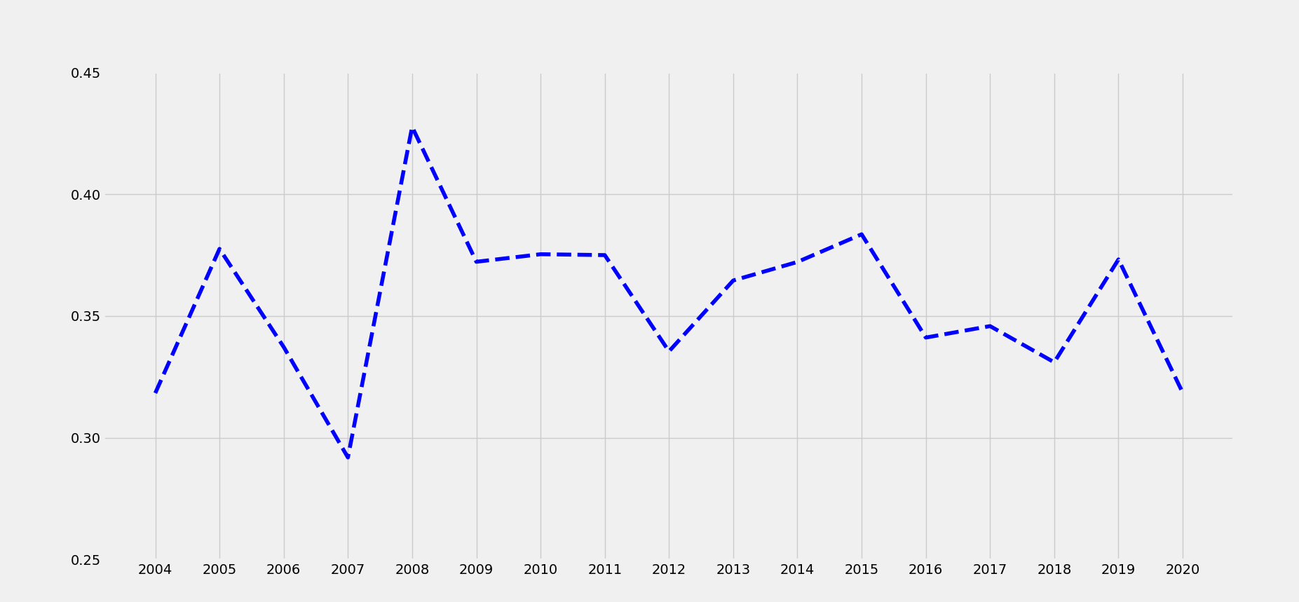
Student %

Slide 7
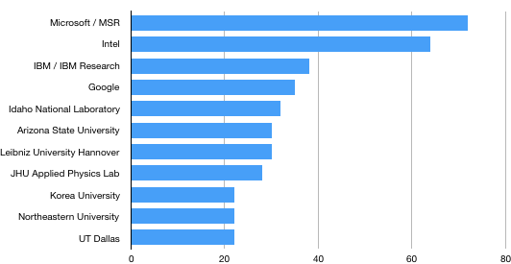
Top Institution Registrations

