Slide 1
Fuzzing SGX Enclaves via Host Program Mutations
Arslan Khan, Muqi Zou, Kyungtae Kim
Dongyan Xu, Antonio Bianchi, Dave (Jing) Tian
Purdue University
Notes:
What is SGX?

Slide 2









Software Guard Extensions (SGX)
0xFFFFFFFF
hypervisor…
kernel
Secrets
Source Code
libs
Code
Confidential
Computing
Host App
Enclave
EDL
0x00000000
DRM
Notes:
How can we find these vulnerabilities?

Slide 3

SGX == Secure Software?
0xFFFFFFFF
hypervisor…
kernel
libs
Memory unsafe language
Concurrency issues
Code
Host App
Enclave
0x00000000
Notes:
How can we find these vulnerabilities?

Slide 4
Fuzzing
Random Mutated
Inputs
No OS Services
No sanitizers..
Fuzzer
Enclave
Test Program
FuzzSGX Runtime
LibOS
Execution
Feedback
Emulates OS services
Provides Feedback
Enables Sanitizers
Notes:
Why is it hard to protect the kernel?

Slide 5
FuzzSGX
Notes:
Why is it hard to protect the kernel?

Slide 6
FuzzSGX
Notes:
Why is it hard to protect the kernel?

Slide 7
FuzzSGX
Notes:
Why is it hard to protect the kernel?

Slide 8
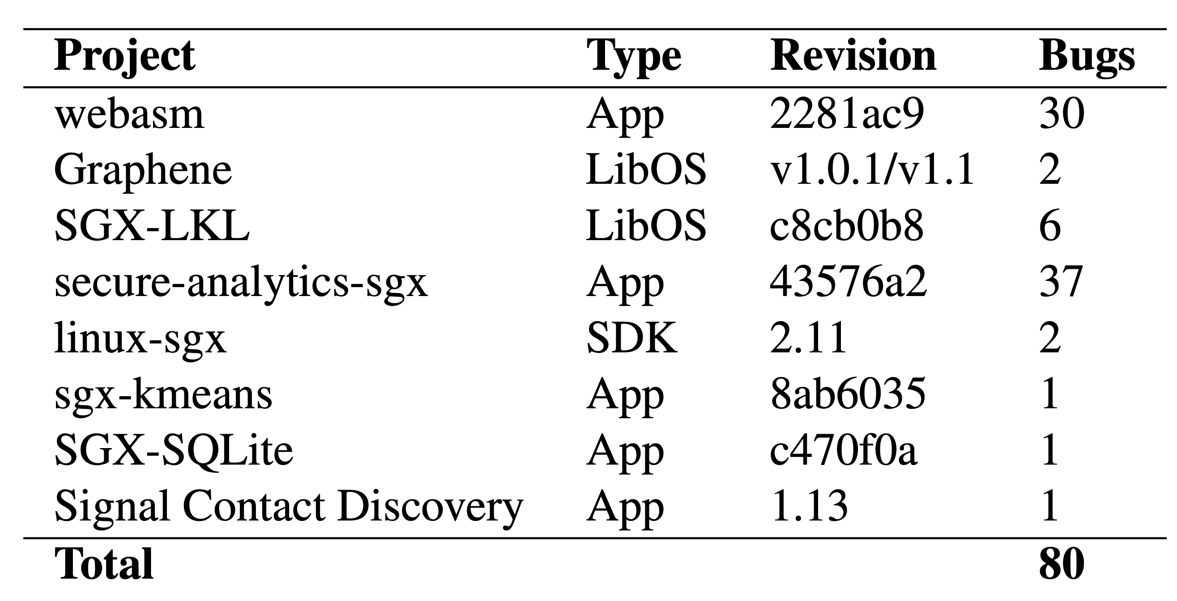
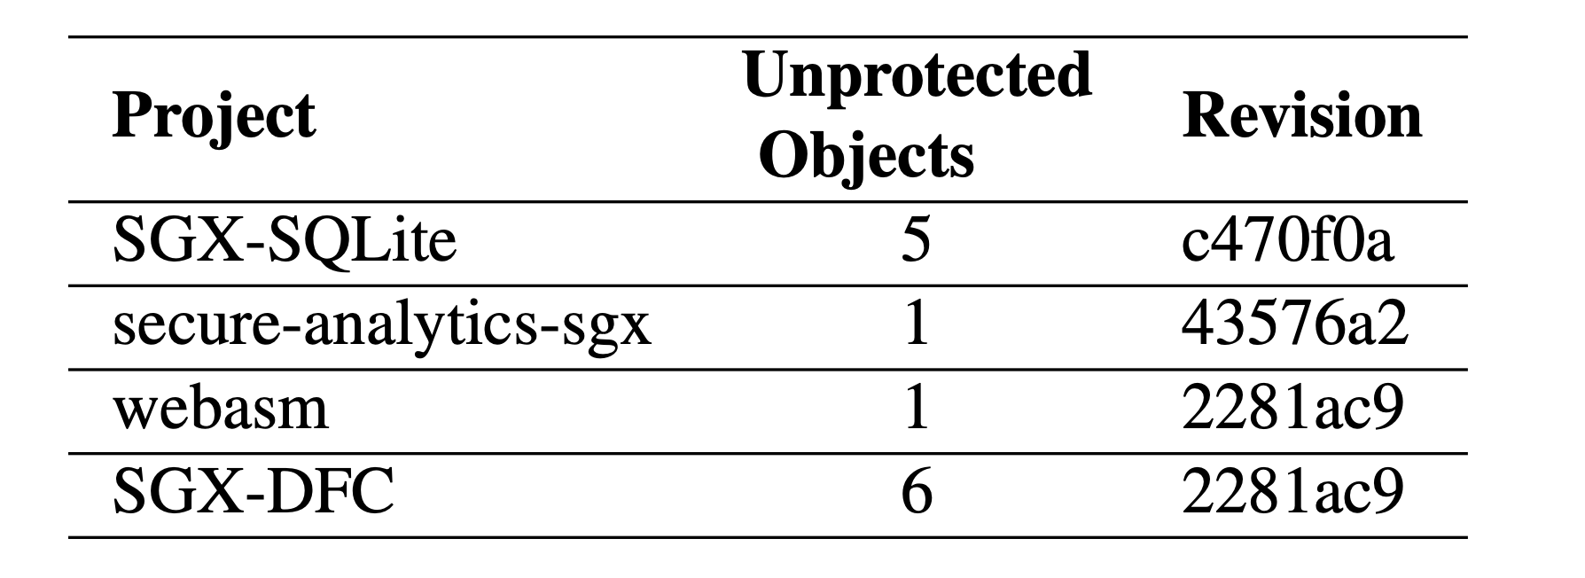
Evaluation - Vulnerabilities
Fuzzed 30 SGX applications
Found 93 previously unknown vulnerabilities

Slide 9

Case Study: SGX LKL
293 for (size_t i = 0;
i < enc->num_virtio_blk_dev;
i++)
294 {
295 enc->virtio_blk_dev_mem[i] =
host->virtio_blk_dev_mem[i];
296 const char* name =
host->virtio_blk_dev_names[i];
297 size_t name_len = oe_strlen(name) + 1;
298 enc->virtio_blk_dev_names[i] =
oe_calloc_or_die(
299 name_len,
300 sizeof(char),
301 "Could not allocate memory \n");
302 memcpy(enc->virtio_blk_dev_names[i],
name, name_len);
303 }
Null pointer dereference
Solution:
Add sanity checks

Slide 10

Case Study: SGX LKL
293 for (size_t i = 0;
i < enc->num_virtio_blk_dev;
i++)
294 {
295 enc->virtio_blk_dev_mem[i] =
host->virtio_blk_dev_mem[i];
296 const char* name =
host->virtio_blk_dev_names[i];
297 size_t name_len = oe_strlen(name) + 1;
298 enc->virtio_blk_dev_names[i] =
oe_calloc_or_die(
299 name_len,
300 sizeof(char),
301 "Could not allocate memory \n");
302 memcpy(enc->virtio_blk_dev_names[i],
name, name_len);
303 }
TOCTTOU

Slide 11
Evaluation – Coverage
3.2x higher code coverage compared to state-of-the-art fuzzers
Used AFL++ and SGXFuzz as the baseline.
Fuzzing campaign for 24-hours
SGX-MPI
SGX-webassembly
SGX-DFC

Slide 12
Takeaways
Don’t trust the untrusted app.
Consider concurrency issues.
Consider memory safe programming languages.

Slide 13
Conclusion
FuzzSGX: SGX Enclave fuzzer with support for sanitization for enclave programs.
Found spatial/temporal vulnerabilities in real-world SGX enclaves
Code @ https://github.com/purseclab/FuzzSGX
Thanks to NSF CNS-2145744.
Question?
Arslan Khan
khan253@purdue.edu
Notes:
Why is it hard to protect the kernel?

