Slide 1
Exploring Smart Commercial Building Occupants’ Perceptions and Notification Preferences of Internet of Things Data Collection in the United States
Tu Le, Alan Wang, Yaxing Yao, Yuanyuan Feng, Arsalan Heydarian, Norman Sadeh, Yuan Tian
Euro S&P 2023

Slide 2
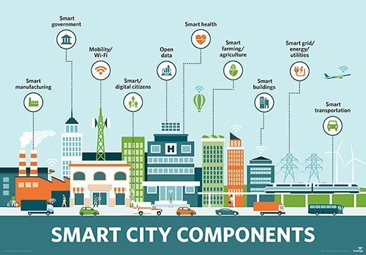
Smart buildings play an important role

Slide 3
Real-world issues

Slide 4
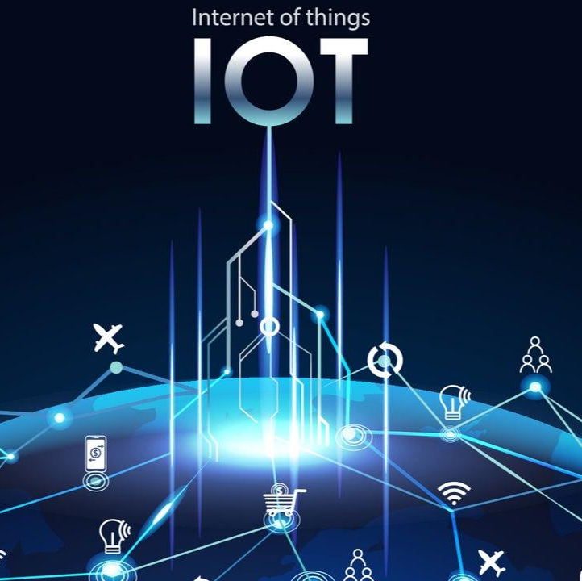
What could go wrong?
Physical interactions
Connected devices/apps
Pervasive data collections

Slide 5
How to help residents be aware of the risks?
Misunderstandings
Awareness
Complex systems in a public setting
Large scale
Complex privacy notifications
Challenges
Goals

Slide 6
Why studying privacy notifications for smart building?
Important but understudied.
The privacy notifications, if not well designed, will cause user apathy or misunderstanding.
Traditional notifications might overwhelm users because of the multi-modal, pervasive, and large-scale data collection.

Slide 7
User study
R1: Awareness and Perceptions of data collection
R2: Notification Preferences
R3: Factors influencing notification preferences

Slide 8
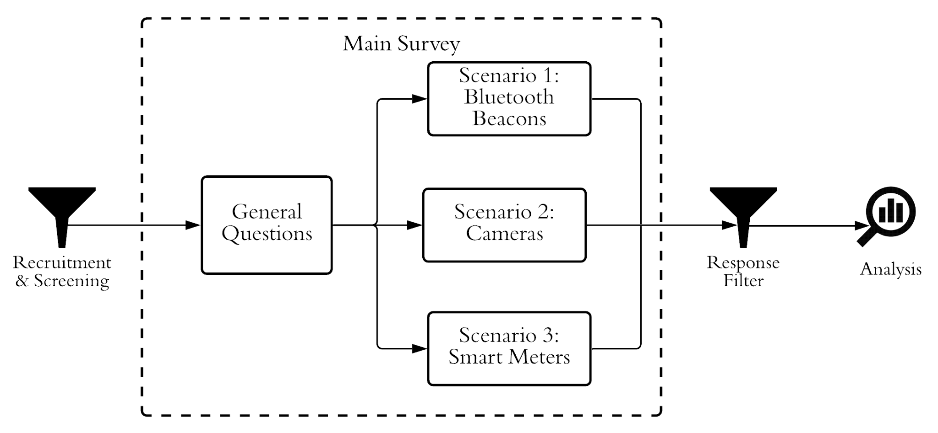
Approach – Study design
Chi-square/KW
492 occupants
US population
Thematic analysis
Perceptions
Preferences
Notes:
Suppose your employer installs bluetooth beacons (devices that wirelessly broadcast a unique identifier to nearby electronic devices) at your workplace. These beacons are used to collect location and movement information to understand how the space is being used.)
Suppose your employer installs video surveillance cameras at your workplace that collect photo/video footage to ensure workplace security.
Suppose your employer installs smart meters at your workplace that collect data about human activities and resource usage (e.g., energy consumption, bathroom usage) to monitor and optimize the building's resource consumption.

Slide 9
Awareness
Even though our participants noticed IoT devices at their workplace, they were not aware of these devices collecting data.
Notes:
Even though our participants noticed IoT devices at their workplace, they were not aware of these devices collecting data.

Slide 10
Data access
The majority (94.5%) thought their company would have access
53.5% felt comfortable with their company having access
Very few (11%) thought they would have access
15.4% thought that they would benefit

Slide 11
Perceived purposes of data collection
Misconceptions about the data purpose!
Bluetooth Beacon
(localization)
“I would assume the Bluetooth beacon might also be able to access my phone without me realizing” – P272
76.5%
enforcing policies
localization
the least selected!
71.6%
user profiling
Notes:
For most of the time, enforcing policies is not what the collected data is primarily used for.
Localization is the primary usage of bluetooth beacons but is the least selected purpose in that scenario.
One participant even wrongly assumed that Bluetooth beacon could get unauthorized access to his/her phone: ``I would assume the Bluetooth beacon might also be able to access my phone without me realizing (P272).''

Slide 12
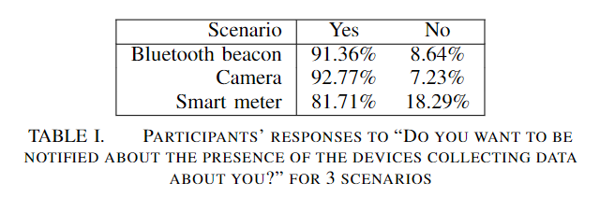
Notification Preferences
The majority of participants wanted to be notified about the data collection.
Fewer people are concerned about smart meter data collection.
“Data based on resource consumption is not really privacy related” – P7
Notes:
Across 3 scenarios, participants' desire for notification is consistent in Bluetooth beacon and camera scenarios. However, about 10% fewer participants wanted to be notified in the smart meter scenario, suggesting that fewer people are concerned about smart meter data collection.

Slide 13
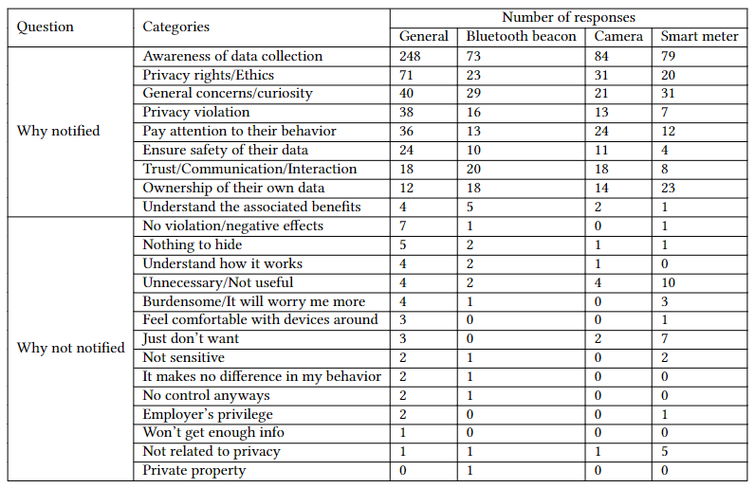
Notification Preferences

Slide 14
Notification Preferences
Presence
Access
Duration of retention
Practice
Purposes
78%
>89%

Slide 15
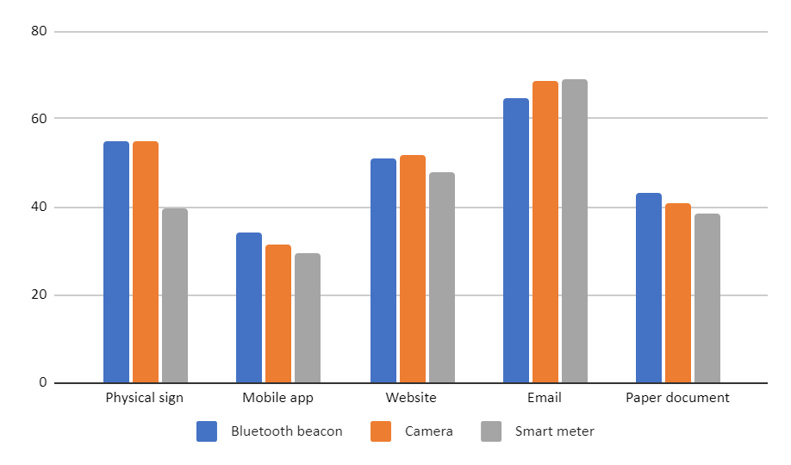
Notification Preferences
Notes:
Among different means of notification such as physical sign, mobile app, website, email, and paper document, email was the most preferred option (69%). A number of participants also selected physical sign (51%) and website (49%) methods. Only 33% selected mobile app.
Email is the most popular choice across all scenarios and in general.
Mobile App is surprisingly the least selected choice.

Slide 16
Notification Preferences
Physical Sign is significantly more preferred in Bluetooth Beacon and Camera.
“Consider notifying me in-person!”

Slide 17
Thank you!
Contact: Tu Le (tnl6wk@virginia.edu)
Key findings:
Misunderstandings of the smart building’s data collection.
Various opinions on data access and benefits.
Notifications about the data practices are important.
Notification preferences depending on context.

