Slide 1
Privately Evaluating Region Overlaps with Applications
to Collaborative Sensor Output Validation
@ Euro S&P 2023
Anrin Chakraborti
Duke University
Michael Reiter
Duke University

Slide 2



What is this paper about?
I see an object at (x1 , y1, z1). Do you?
Can we design protocols to privately compare regions (enclosing an object) in an arbitrary-dimension Euclidean space?

Slide 3
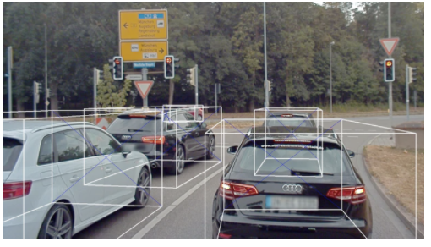
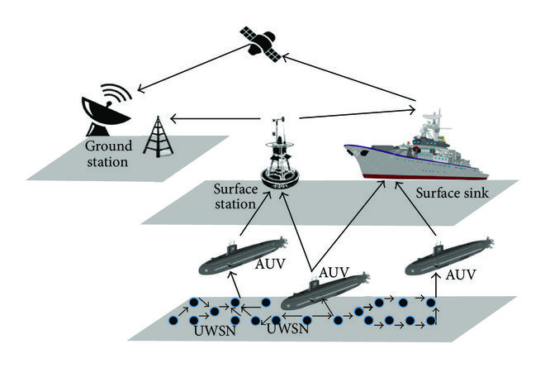
Applications
Connected autonomous vehicles (CAVs)
sharing info to validate sensors, detect obstacles
Collaborative obstacle detection
detect obstacles, limited view, terrain, covert
Why private protocols?
trust between different manufacturers,
maintaining covertness, location privacy
* image courtesy AUDI A2D2
**image courtesy US FORCENET
Notes:
Both applications need some notion of privacy while sharing info
military vehicles may not want to reveal precise location
CAVs use proprietary sensor tech and vision processing units and providing outputs in the plain can lead to model inference attacks

Slide 4
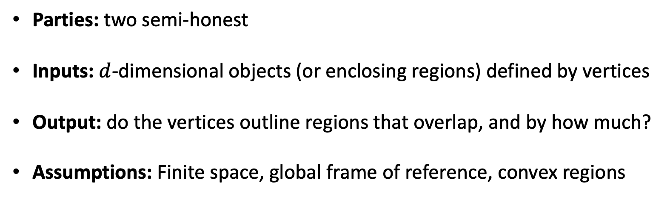
Problem setting
Parties: two semi-honest
Inputs: $d$-dimensional objects (or enclosing regions) defined by vertices
Output: do the vertices outline regions that overlap, and by how much?
Assumptions: Finite space, global frame of reference, convex regions

Slide 5


Challenges
Sensor outputs aren’t exact, variations in measurement possible
comparing vertices isn’t enough, need fuzzy matches
Detecting overlaps is not enough
computing region of overlap is expensive
I see an object at (x2, y2, z2)
I see an object at (x1 , y1, z1)

Slide 6

Our Idea
Use cheap primitives to detect overlaps
Approximate volume of overlap:
high volume of overlap $⇒$ objects are same

Slide 7
Existing works do not scale
Cryptographic matching (exact/fuzzy)
designed for point comparisons: scale to large (infinite) sets of points?
Secure computation geometry [Atallah & Du, 2001]
limited research, expensive primitives, 2D applications common
Generic secure computation (FHE/garbled circuits)
complex algorithms, slower than tailor-made tools

Slide 8
Our results
Detecting overlaps of axis-aligned boxes
in d-dimensional space
Approximating volume of overlap of axis-aligned boxes in d-dimensional space
Detecting overlaps of oriented boxes
in d-dimensional space
Approximating volume of overlap of
oriented boxes in d-dimensional space

Slide 9
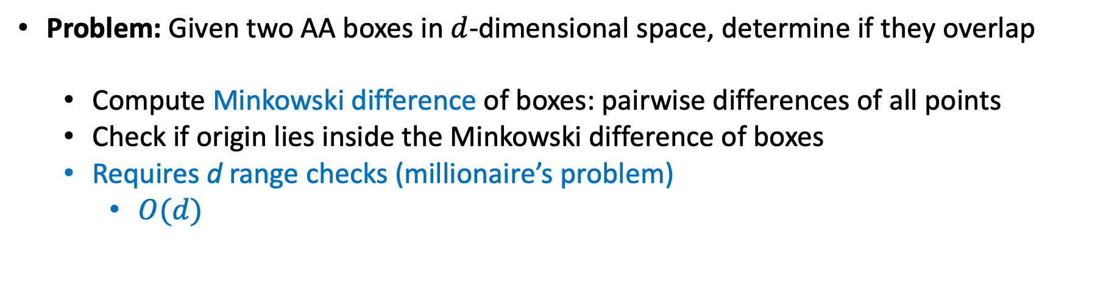
Detecting axis-aligned box overlaps
Problem: Given two AA boxes in $d$-dimensional space, determine if they overlap
  Compute Minkowski difference of boxes: pairwise differences of all points
  Check if origin lies inside the Minkowski difference of boxes
  Requires d range checks (millionaire’s problem)
    $O(d)$
A
B
A - B
Original boxes
Minkowski difference

Slide 10
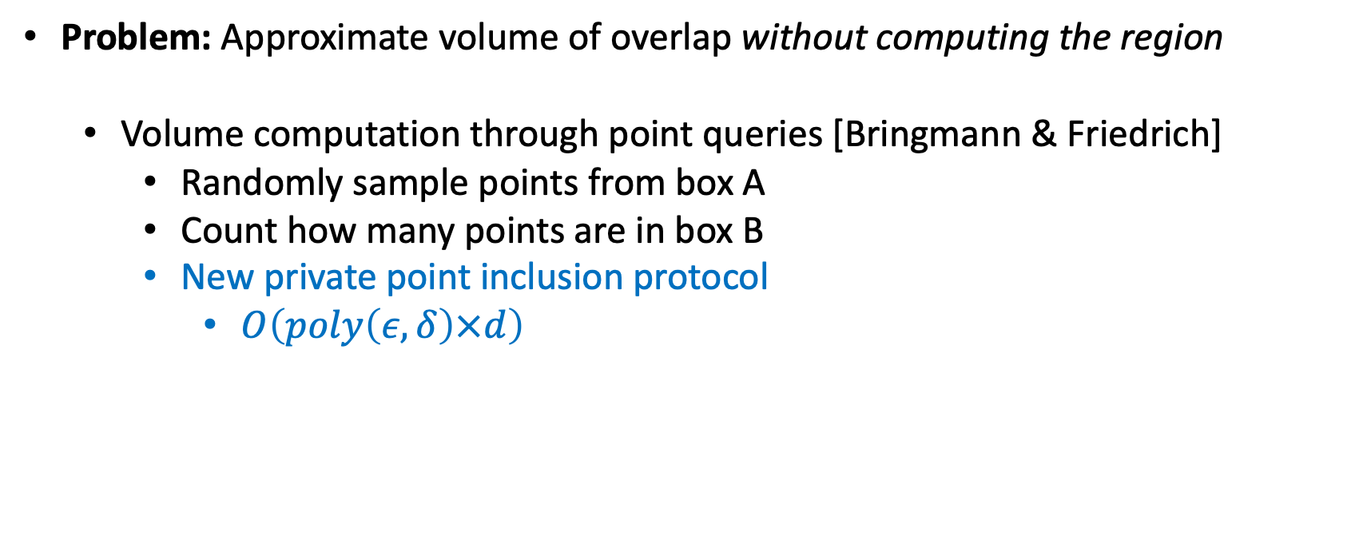
Approximating volume of overlap
Problem: Approximate volume of overlap without computing the region
  Volume computation through point queries [Bringmann & Friedrich]
    Randomly sample points from box A
    Count how many points are in box B
    New private point inclusion protocol
      $O\left(poly\left(ε, δ\right)×d\right)$
B
A
$$\operatorname{Pr}{[ApproxVol∈\left[OverlapVol −δ, OverlapVol+δ\right]]≥1 − ε}$$
Slack
Error probability

Slide 11
Benchmarks
Datasets:
  Randomly generated polytopes in 2D, 3D
  Axis-aligned boxes from CARLA driving simulator
  Axis-aligned boxes from Audi A2D2 dataset
  Oriented boxes from ScanNet
Metrics
  Communication volume
  Compute time
  Scaling with multiple objects

Slide 12
Detecting overlaps
Axis-aligned boxes
 | Comm. (KB) | Compute (ms) | Improvement
Our work | 42 | 2.8 | - , -
GC baseline | 51 | 11.6 | 21% less comm., 4.2x faster
(lower is better)
Oriented boxes
 | Comm. (KB) | Compute (ms) | Improvement
Our work | 26 | 211 | - , -
GC baseline | 30 | 280 | 15% less comm, 1.3x faster
(lower is better)

Slide 13
Approximating volume of overlap
4x
4.3x
Communication volume vs. number of boxes
(lower is better)
Compute time vs. number of boxes
(lower is better)
Slack = 0.1, Error = 0.001

Slide 14
Conclusion
New private protocols for secure computational geometry
Applications to autonomous vehicles
Benchmarks on real data shows feasibility

Slide 15

Thank you

Slide 16
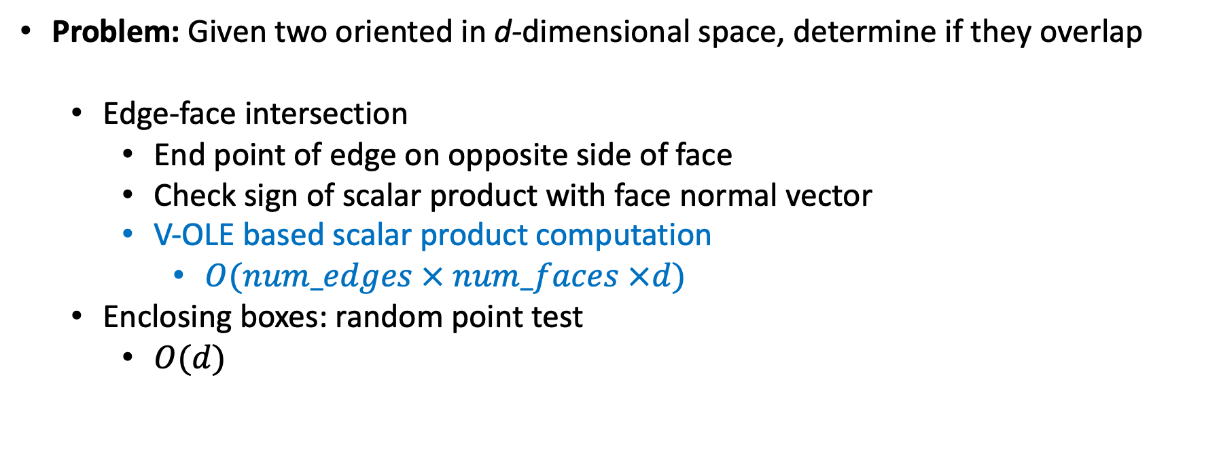
Detecting overlaps
Problem: Given two oriented in d-dimensional space, determine if they overlap
  Edge-face intersection
    End point of edge on opposite side of face
    Check sign of scalar product with face normal vector
    V-OLE based scalar product computation
      $O(num_edges × num_faces ×d)$
  Enclosing boxes: random point test
    $O(d)$
A
B
a
b
a and b are on opposite sides of the face
Random point in A lies in B

Slide 17
Scaling with number of boxes
5.1
6.1
Communication volume vs. number of boxes
(lower is better)
Compute time vs. number of boxes
(lower is better)

