Slide 1







MISO: Legacy-compatible Privacy-preserving Single Sign-on using Trusted Execution Environments
EuroS&P 2023
Rongwu Xu∗, Sen Yang†, Fan Zhang†, Zhixuan Fang∗
∗Tsinghua University
†Yale University

Slide 2
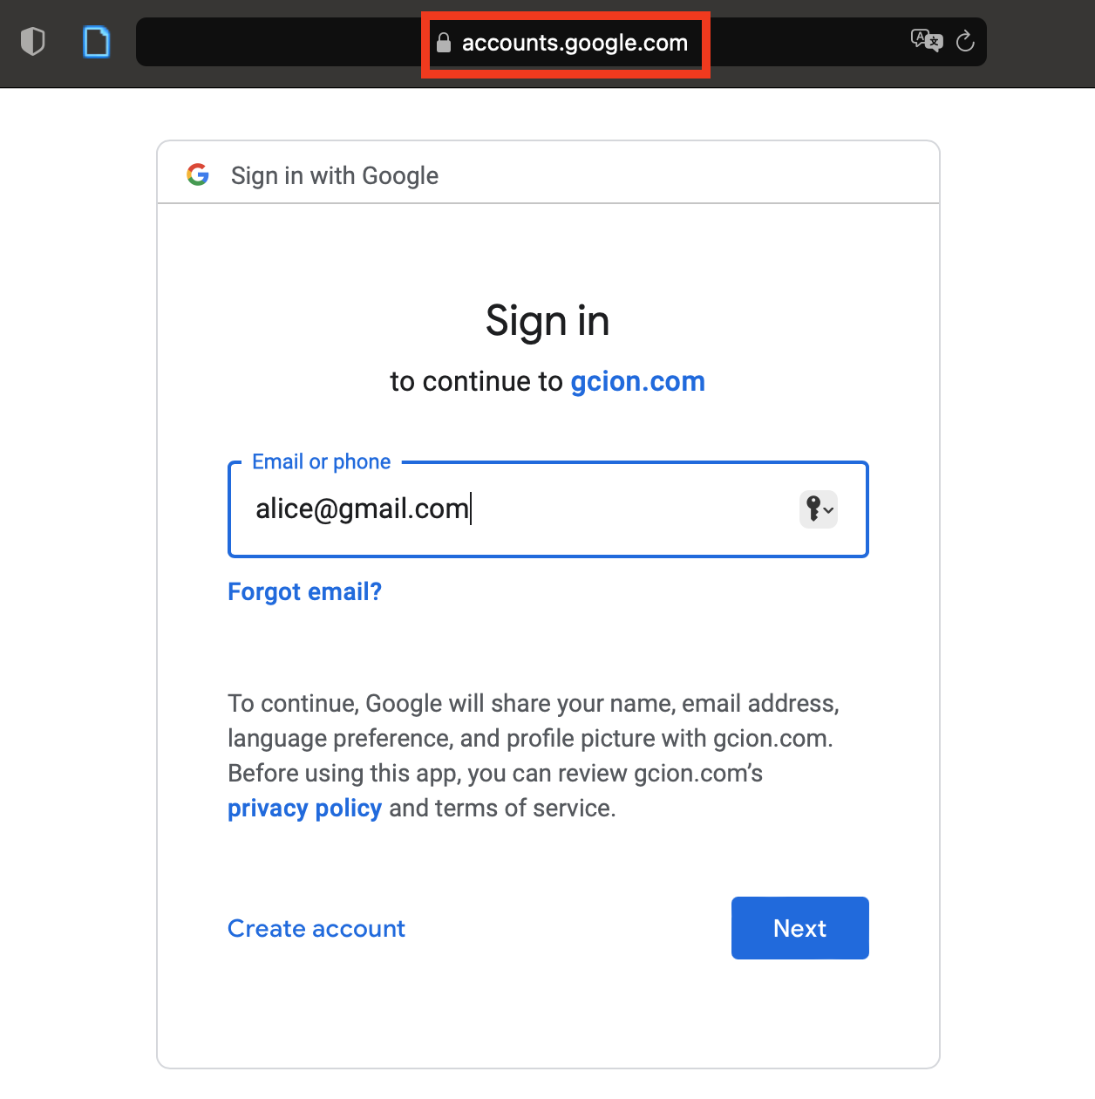
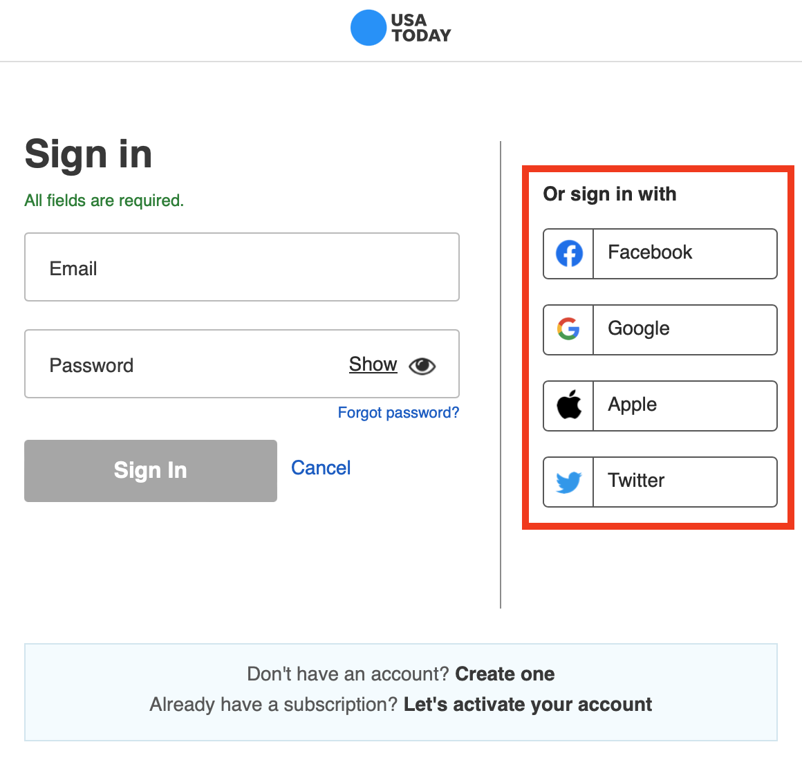

What is Single Sign-on (SSO)?
I do not want to CREATE a new account!
🤔️
3rd Party App (RP) you want to log in…
…just authenticate with the Identity Provider (IdP)

Slide 3
Pros & Cons of SSO
✅ Advantages
Convenient: a familiar user experience without extra account registration
Safety issues: fewer password reuses on such 3rd party apps
Well-supported: 84,000+ apps support Google
❌ Drawbacks
Many Security & Privacy issues!
  Account linkage by IdP
  Account linkage across RPs
  Unnecessary identity exposure
  Single-point failures of account security and availability

Slide 4





SSO in Details
Log in
End-user
Authentication
Redirect
Result
RP (3rd party app)
IdP (Identity Provider)

Slide 5
Issue I: Account Linkage (Tracking by IdP)
A curious IdP can track the user’s login activity!
…
client_id=40740871892
…
Log in
End-user
Authentication
🤔️
Redirect
This ID marks the identity of the RP on Google! (it is unique for any RP)
Result
RP (3rd party app)
IdP (Identity Provider)

Slide 6
Issue II: Account Linkage (Tracking across RPs)
If a group of colluding RPs learns the same uid, then they can locate the user’s activity on different apps!
…
uid=8944392163
…
Log in
End-user
Authentication
🤔️
Redirect
This ID marks the identity of the User on Google! (it is unique for any user)
Result
RP (3rd party app)
IdP (Identity Provider)

Slide 7
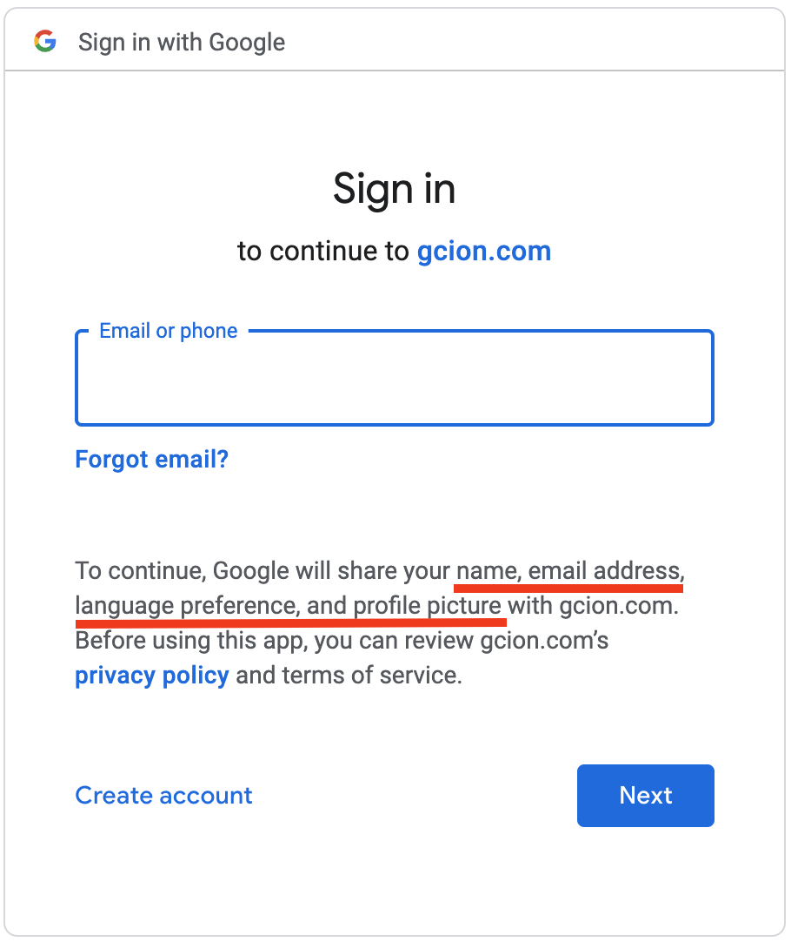
Issue III: Unnecessary Exposure to RP
Log in
End-user
Authentication
Redirect
Your other sensitive information (e.g., email, name, etc) may be shared with RP!
Result
RP (3rd party app)
IdP (Identity Provider)

Slide 8

Solution: MISO
Insert a proxy between the IdP and RP to block all direct messages
Log in
End-user
Authentication
🤔️
Redirect
Result
RP (3rd party app)
IdP (Identity Provider)

Slide 9

Solution: MISO
A mixer serves multiple IdPs and multiple RPs. It mixes the SSO flows
(MISO stands for a mixer of SSO)
Authentication
End-user
Log in
client_id
Blinded client_id
Blinded uid
uid
RP (3rd party app)
Sensitive info:
email, name, …
IdP (Identity Provider)
Sensitive info:
email, name, …
Mixer

Slide 10
MISO: Two Nested SSO
Authentication
The mixer is a normal IdP to me…
End-user
IdP (Identity Provider)
Log in
Redirect
The mixer is a normal RP to me…
Result
Redirect
Result
RP (3rd party app)
Mixer

Slide 11
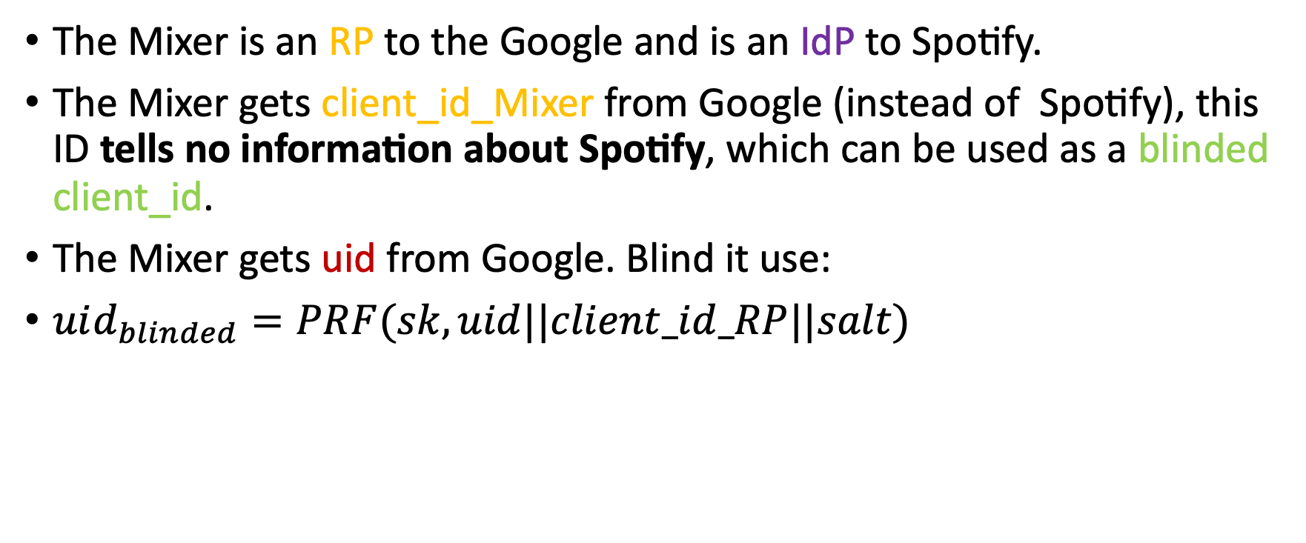
Feature I: Privacy-preserving using Blinded Identifiers
The Mixer is an RP to the Google and is an IdP to Spotify.
The Mixer gets client_id_Mixer from Google (instead of Spotify), this ID tells no information about Spotify, which can be used as a blinded client_id.
The Mixer gets uid from Google. Blind it use:
$uid_{blinded}=PRF(sk,uid||client_id_RP||salt)$
Pseudo-random function
Fixed random key
RP’s client_id at the Mixer
Salt to prevent Rainbowtable attack
This blinded uid tells no information about the User.

Slide 12
Feature II: MISO is Backward Compatible
The system is completely backward compatible with deployed SSO systems.
We retrofit the mixer to the existing SSO architecture in a fully transparent way, thanks to the nested SSO design.
Unaware of the mixer…
?
Redirect
Redirect
🤔️
Result
Result
RP (3rd party app)
IdP (Identity Provider)
Mixer

Slide 13
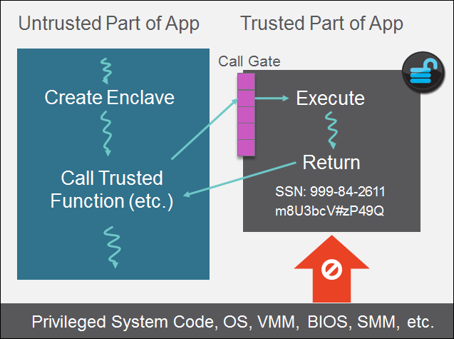
Feature III: MISO is Trustworthy
The Mixer is fully trusted
The Mixer can keep the confidentiality and integrity of its code and data
The Mixer can complete its duty (described in code) without missing a beat.
Trusted Execution Environment, e.g.,
Intel SGX, can be used to
safeguard the Mixer

Slide 14


Feature III: Using TEE to Safeguard the Mixer
Physical Machine (Server)
Intel SGX
load
The Mixer’s code
Physical Machine (Server)
Intel SGX
TLS Server
HTTPS Connections

Slide 15

One More Problem: Single-point Failures of Account Security and Availability
You could not log into the same account of your RP AND all your data is unaccessible!
Log in
End-user
Authentication
Redirect
What if your account is unavailable or compromised on Google?
🤔️
Result
RP (3rd party app)
IdP (Identity Provider)

Slide 16


Extension: (Multi-IdP) MISO
The mixer saves and checks the IdP authenticate information.
Users can choose to authenticate in a threshold fashion, e.g., 2 of 3 of the IdPs.
Authentication
End-user
Less secure, since the Mixer needs to keep the information
Log in
Redirect
Redirect
Result
Result
RP (3rd party app)
IdPs
🤔️
Mixer

Slide 17
Implementation
The Mixer is implemented in Golang, supported by EGo for SGX libOS.
Server: 30GB ram, SGX enabled.
All connections using TLS, X.509 certificates are installed on our server.
Tested with Google, Facebook, and Github as IdPs.

Slide 18
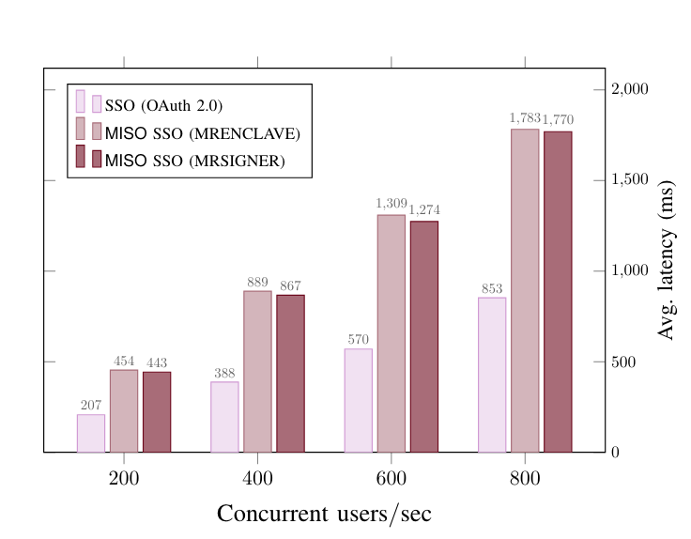
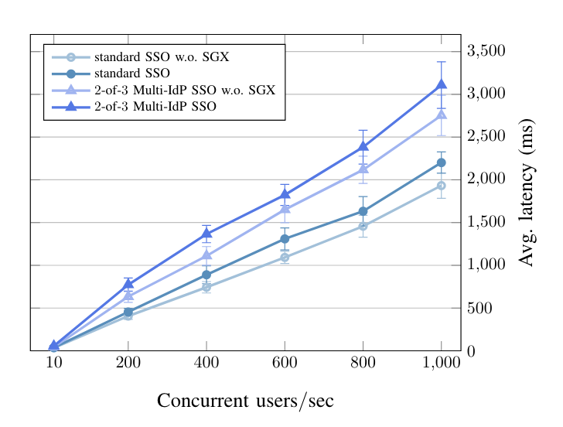
End-to-end Performance
MISO roughly incurs 2× more latency when compared with the normal SSO
The involvement of SGX brings less than 15% extra overhead

Slide 19
Conclusion
We propose the first legacy-compatible privacy-preserving SSO
MISO achieves four security and privacy goals:
  user account unlinkability by the IdP
  unlinkability across RPs
  selective disclosure of user identity
  robust to single-point of failures (w.r.t. account availability)
Our prototype implementation and evaluation suggest that MISO enjoys high usability in real-world applications

Slide 20
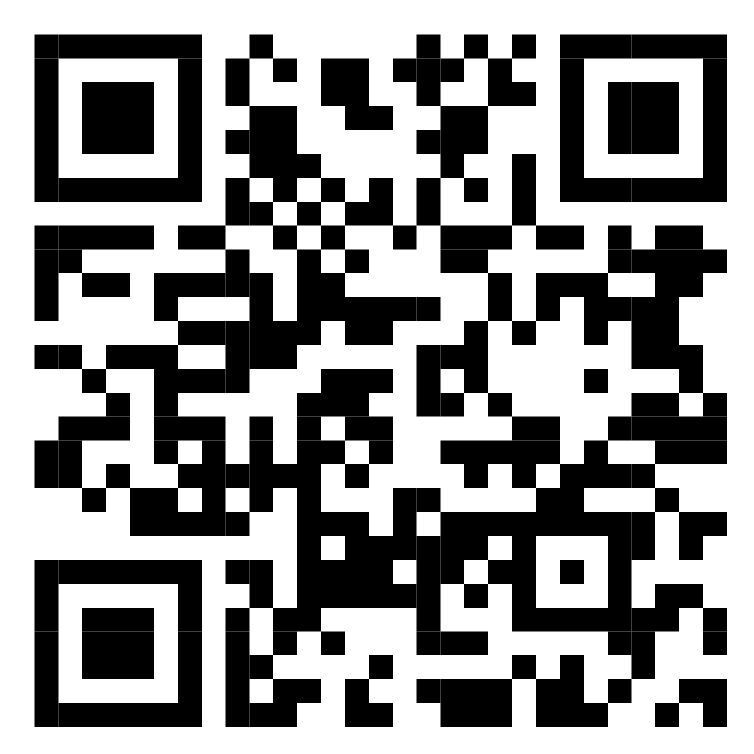
Thanks for listening!
Contact Rongwu Xu for more details
xrw22@mails.tsinghua.edu.cn
arXiv full version

