Slide 1
AoT - Attack on Things: A security analysis of IoT firmware updates
Muhammad Ibrahim
(Purdue University)
Andrea Continella
(University of Twente)
Antonio Bianchi
(Purdue University)

Slide 2
IoT Devices
IoT device: A device that can communicate data over a network.

Slide 3
IoT Devices
Notes:
For example, if you give a bulb or a door lock ability to communicate data

Slide 4
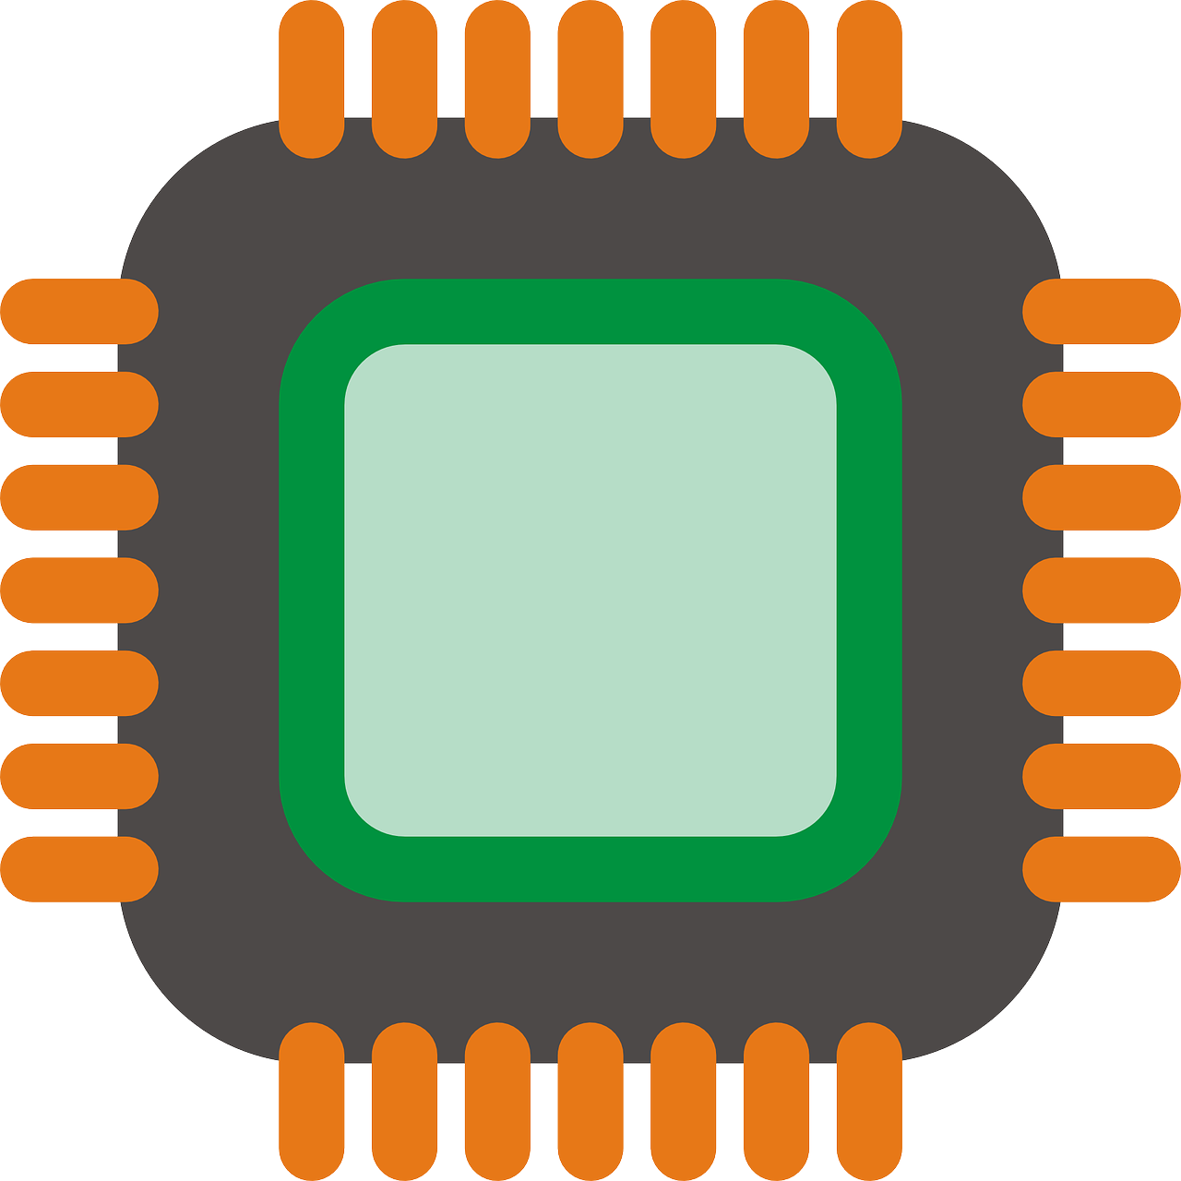
IoT Devices

Slide 5
Companion Apps
<Unlock>
Users interact with IoT devices using companion apps

Slide 6
Device Firmware Update (DFU)
New features, Bug fixes, Security patches
Companion apps mediate device firmware update (DFU).
Notes:
Not only User interaction but also for imp security updates.
Stress Firmware update is imp for operation and security. Give more time.
We found comp app play imp role in this critical imp process.
We were the first one to perform a comprehensive study.

Slide 7
DFU Attacks
Goal: Identify IoT devices with vulnerable DFU mechanisms
What can go wrong?

Slide 8
Threat Model
Intercept and modify communication between the companion app and the IoT device

Slide 9
DFU Attack Categories
Firmware Modification Attack
Inject malicious firmware
Firmware Downgrade Attack
Downgrade to older firmware
Device Bricking Attack
Render the device unusable
Ver 1.0
Ver 9.0

Slide 10
DFU SDK
Apps utilize SDKs for performing DFU.
Notes:
First describe the threats.
Put this between 9 and 10.
Tell our goal before this.
To do this we found that SDKs perform this operation.
We utilize sdks that perform dfu to achieve our goal.

Slide 11
Vulnerable SDKs
One vulnerable in SDK maps to
Multiple companion apps
Multiple IoT devices
Feasible to analyze apps

Slide 12
Methodology
1
IoT DFU Reconnaissance
2
App-Rumbling
Recon-Results
Rumbling-Results
Notes:
Replace with image for the overview. With simpler image.
Show each step with animation.

Slide 13
IoT DFU Reconnaissance
Attack-Tester
Analysis
Firmware
Binaries
DFU
Knowledge
Companion
App
AoT-Scout
Analysis
Attack Category
IoT
Device
SDK Fingerprints
Recon-Results
Notes:
Quick introduce the analysis.

Slide 14
Dataset
Companion
App
IoT
Device

Slide 15
Reconnaissance Dataset
IoT Devices
Top 6 Amazon Bestsellers
16 Categories
Companion Apps
IoTSpotter Dataset
37k apps
20 IoT devices/apps analyzed
Trackers, Cameras, Lights, Plugs, etc.
Companion
App
IoT
Device
Notes:
Less text. Add animation for the text. Make them appear in steps.

Slide 16
Dataset
Companion
App
IoT
Device

Slide 17
AoT-Scout
Firmware
Binaries
DFU
Knowledge
Companion
App
AoT-Scout
Analysis
IoT
Device
SDK Fingerprints

Slide 18
AoT-Scout
DFU Knowledge
Firmware Binaries
1
2
3
4
5
Locate DFU
Code
Trigger
DFU
Obtain
Firmware
Identify SDKs
Fingerprint SDKs
SDK Fingerprints

Slide 19
AoT-Scout
Firmware
Binaries
DFU
Knowledge
Companion
App
AoT-Scout
Analysis
IoT
Device
SDK Fingerprints

Slide 20
Attack-Tester
Attack-Tester
Analysis
Firmware
Binaries
DFU
Knowledge
Companion
App
AoT-Scout
Analysis
Attack Category
IoT
Device
SDK Fingerprints
Recon-Results

Slide 21
Attack-Tester
Send Modified Firmware
Firmware Accepted
Device Bricked
Firmware Rejected
Firmware Modification Attack
Device Bricking Attack

Slide 22
Attack-Tester
Modified Firmware Rejected
Send Older Firmware Version
Firmware Accepted
Firmware Rejected
Firmware Downgrade Attack
No Vulnerability

Slide 23
Reconnaissance Overview
Attack-Tester
Analysis
Firmware
Binaries
DFU
Knowledge
Companion
App
AoT-Scout
Analysis
Attack Category
IoT
Device
SDK Fingerprints
Recon-Results

Slide 24
App-Rumbling
AndroZoo
2
Smali
1
Disassemble APK
3
Download APK
Apktool
Match
Fingerprints
Rumbling-Results
Recon-Results

Slide 25
Recon-Results
6 vulnerable SDKs
Modification Attack
3 SDKs (Nordic, Tuya, JcPrinter)
Downgrade Attack
1 SDK (Telink)
Bricking Attack
2 SDKs (Wemo, NordicSecure)
Recon-Results

Slide 26
Rumbling-Results
37k apps analyzed
1356 apps have at least one vulnerable SDK
Among Top 50 Amazon Bestseller
61 IoT devices affected
Validation
3 additional devices/apps analyzed
100% TP rate against LibScout
Responsible disclosure
Rumbling-Results
Notes:
Mention Libscout. Outperform libscout. Try to animate and reduce text.
We responsibly disclose all our finding. Downloads of apps.

Slide 27
Case Study: Nordic
Modification Attack
No signature check
Spoof CRC
DevKit Testing
Alternate secure version
Bricking attack
Bug bounty
Notes:
Make clear there are two versions of the SDK.

Slide 28
Case Study: Wemo
Bricking Attack
MQTT Server
Receives URL from app
Downloads binary
Sends to IoT Device
Spoof URL
: URL + Version : Firmware Binary
Firmware Repository
{Data}
Developer’s Server
{Data}
4
1
3
{Data}
5
{Data}
2
{Data}
Android Device
IoT
Device

Slide 29
Conclusion
Analyzed 23 IoT devices/companion apps
6 SDKs vulnerable to DFU attacks
1356 apps affected
61 bestseller IoT devices affected

Slide 30
Thank You
Questions?

Slide 31
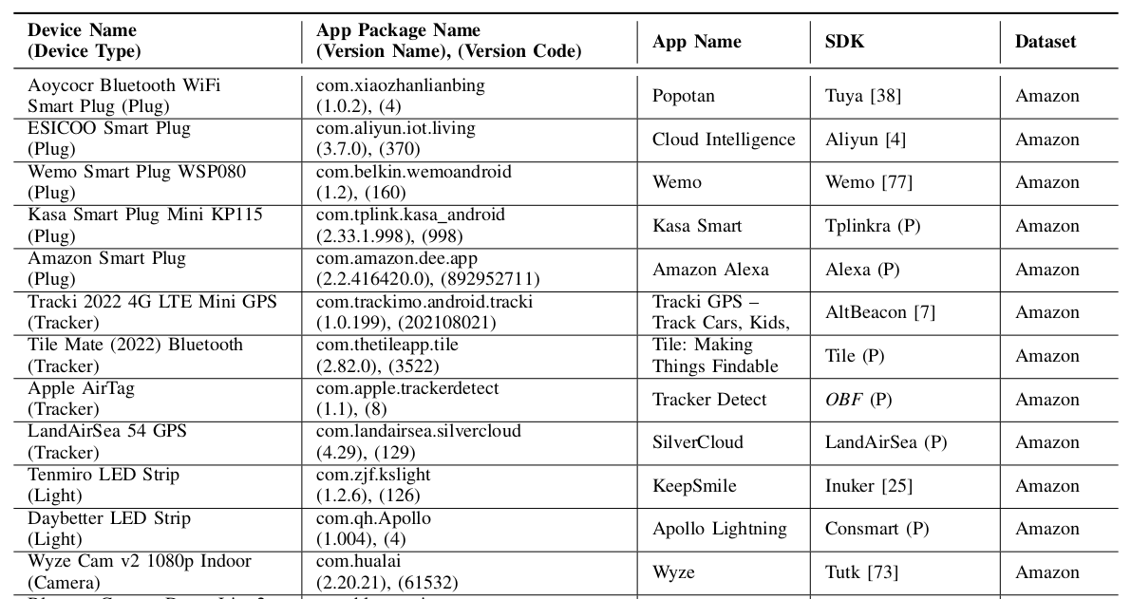
Devices Analyzed

Slide 32
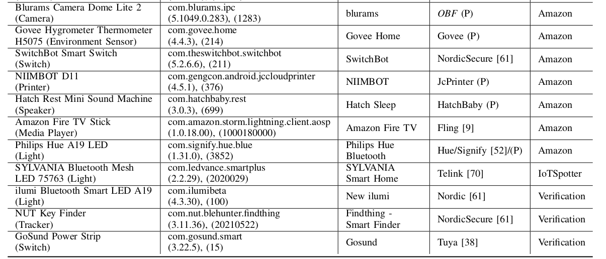
Devices Analyzed

