Slide 1
SoK: Content Moderation in Social Media, from Guidelines to Enforcement, and Research to Practice
Mohit Singhal*, Chen Ling^, Pujan Paudel^, Poojitha Thota*, Nihal Kumarswamy*, Gianluca Stringhini^, Shirin Nilizadeh*
*The University of Texas at Arlington, ^Boston University
The 8th IEEE European Symposium on Security and Privacy
July 6th, 2023
Notes:
This work was done in collaboration with Boston University

Slide 2
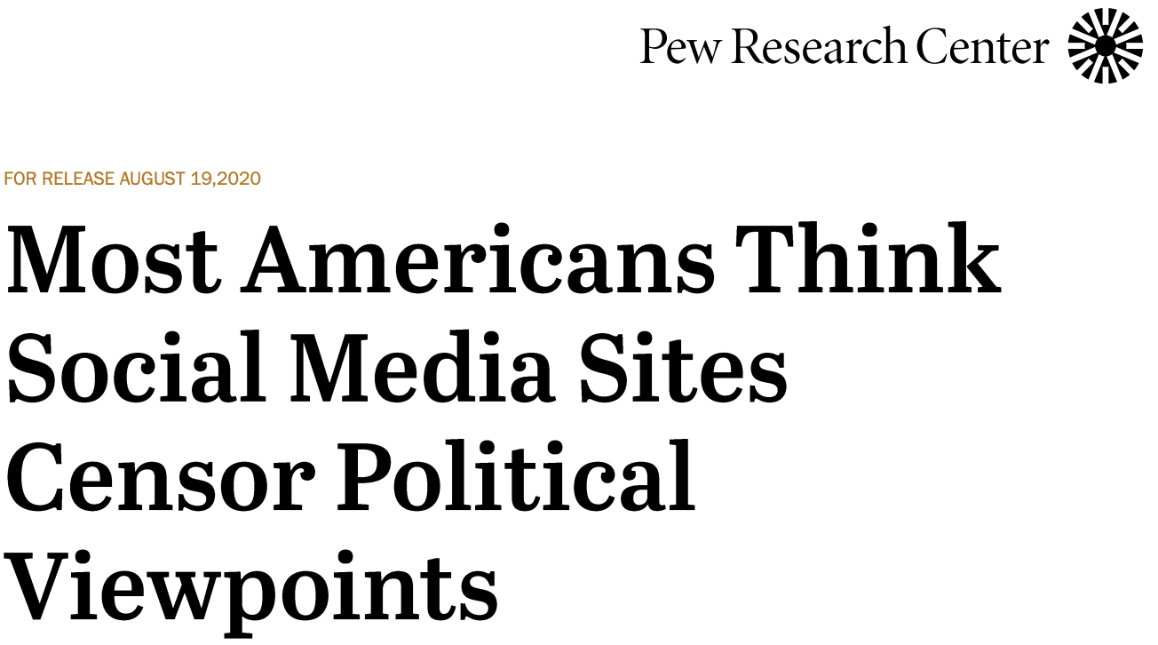
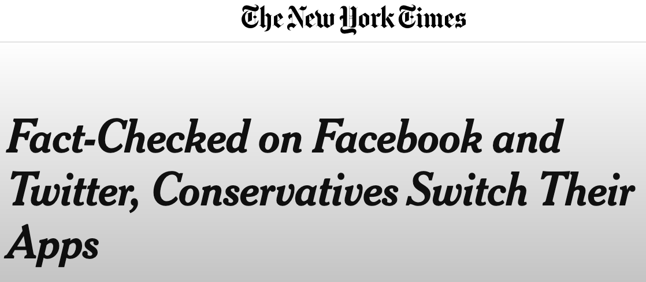
Content moderation is not an easy task! It is controversial and often perceived as biased
Notes:
To curb the spread of harmful as well as illegal content on social media, platforms employ the task of content moderation, however, it is not a trivial task.
Users often claim this practice as biased as they censor their point of view also its not easy to moderate content, as biases in the underlying algorithms or failure of companies to train human moderators in various dialects makes the task harder.

Slide 3
Content moderation is not uniform across different platforms, even platforms that are similar!
Notes:
Content moderation is not uniform. For example,

Slide 4
Content moderation is not uniform across different platforms, even platforms that are similar!
Notes:
We can see a similar case in the mainstream platforms. Hence moderation happens arbitrarily and there is not across the board consensus on some of the categories.

Slide 5
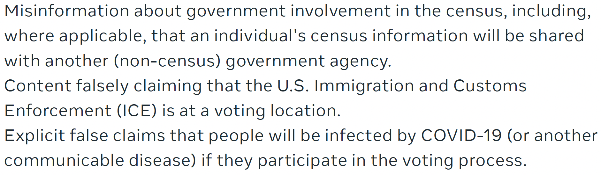
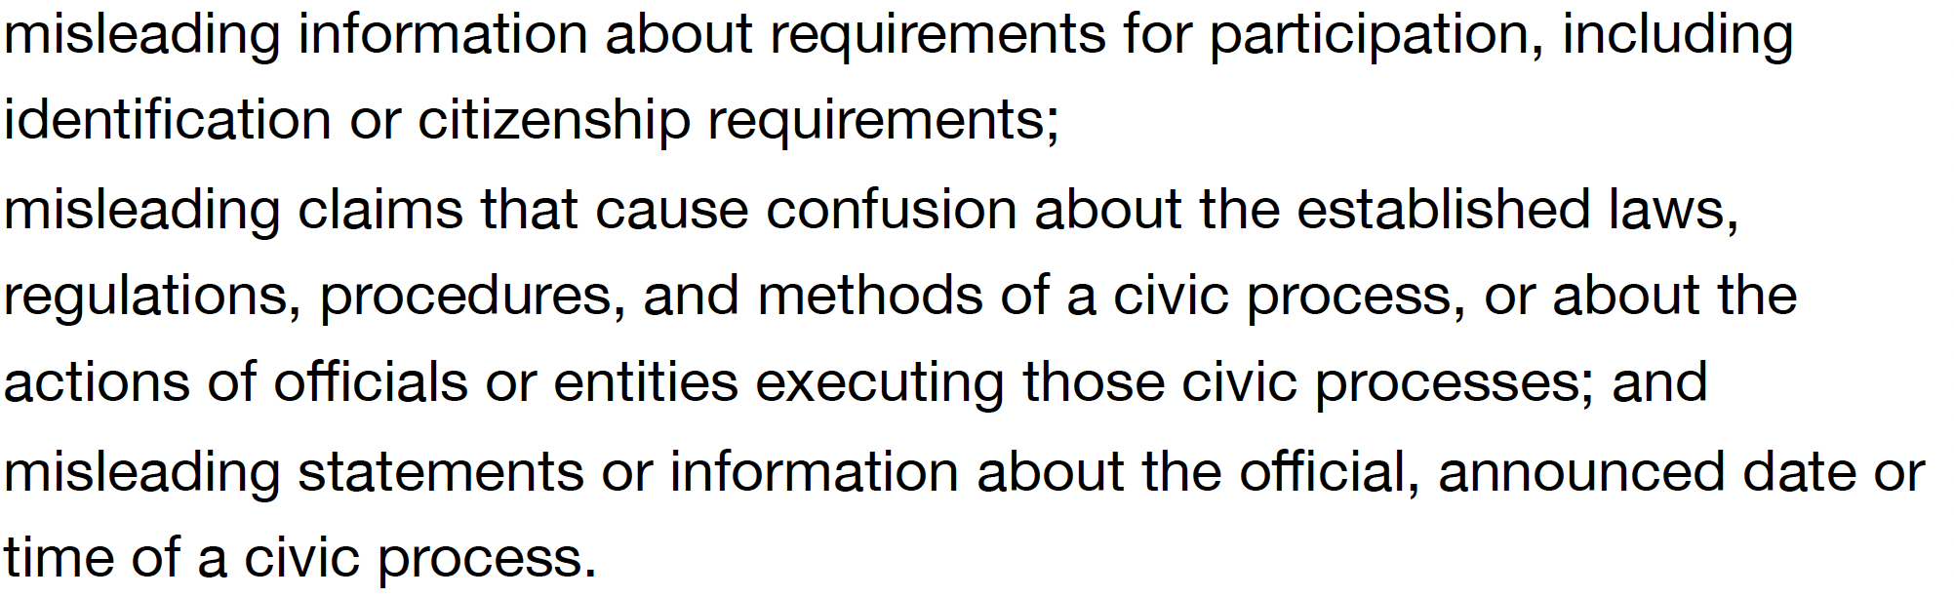
Controversial topics have different definitions across platforms
Misinformation
Notes:
Platforms that are similar, do not agree on common definitions when moderating the grey areas.
Let's see an example, we can see that for one of the clauses in Facebook on misinformation, they mention US ICE at the voting location, however, we do not see that in Twitter.

Slide 6
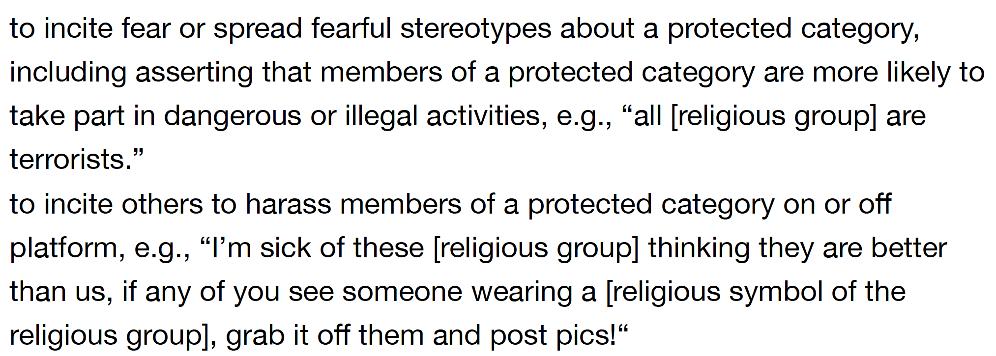
However, there are some grey areas where not all social media platforms agree in moderation of content
Hate Speech
Notes:
A very similar case can be seen for hate speech. Where Facebook in one of its clauses describes dehumanizing, however that is not described in Twitter.

Slide 7
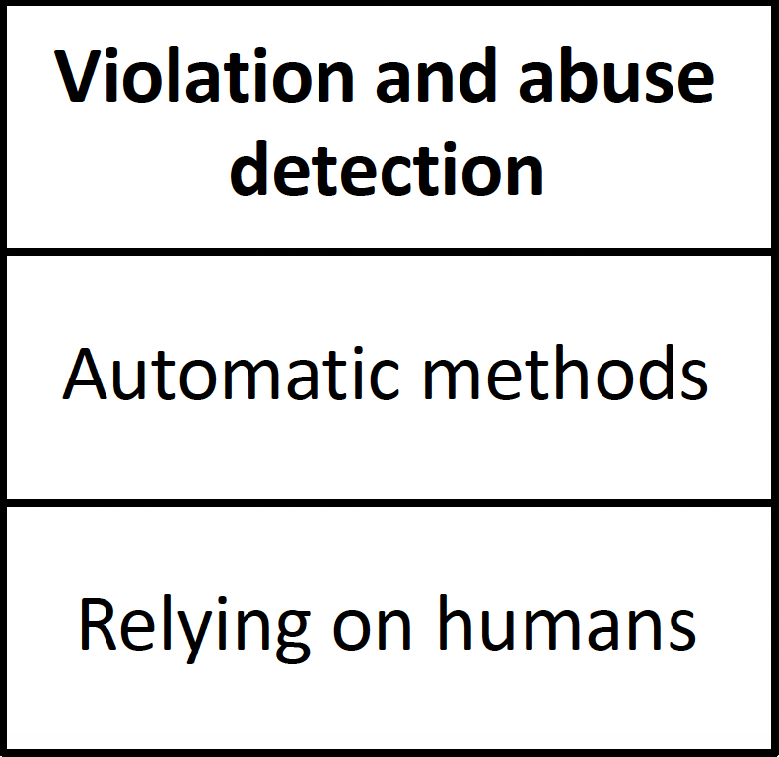
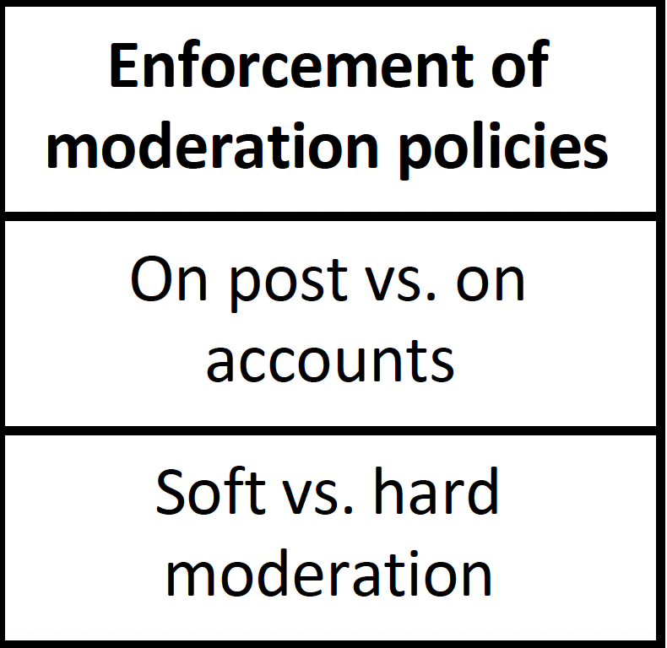
Content moderation is not a one step process, it has multiple interlinked processes
Notes:
Content moderation is interconnection of many processes.

Slide 8
We study and categorize the topics covered in content moderation research. We also investigated the current state of content moderation on several social media platforms.
Notes:
Goals:
What aspects have the research community studied content moderation. What are the research gaps that need to be addressed by research community?
How does content moderation work in practice? How do different social media platforms moderate content?
With this we aim to obtain a comprehensive view of content moderation from the points of view of both the research community and real-world practices.

Slide 9
Collated 200 plus publications about the ever-changing landscape of content moderation
Examined the last five years of conference, workshops, and journal papers on content moderation
IEEE S&P, USENIX Security, NDSS, ACM CCS, Euro S&P, CSCW, ICWSM, KDD, WSDM, ACL Anthology, CHI, WWW, New Media & Society, Political Behaviour, Social Media + Society, IEEE Transactions.
Used related papers as a “seed set” and using snowballing method manually searched through related works.
Notes:
To understand the everchanging landscape of content moderation in research we collated 200+

Slide 10
Using the open coding process, three authors categorized all the papers
Read papers to identify themes and sub-themes
Discuss the themes of the papers
Discuss disagreements to finalize the categories
Notes:
Three authors read each paper to identify the themes of the paper, we then discussed the themes of the papers to see the agreements and disagreements.

Slide 11
Hate speech detection algorithms
Content Based (4)
[101], [102], [255], [258]
Location Based (10)
[72], [87], [115], [126], [205], [263], [297], [307], [310], [321]
[58]–[61], [65], [70], [71], [82], [88], [95], [106], [110], [114], [123], [124], [127], [132], [137], [146], [160], [175], [177], [192], [197], [206], [217], [220], [221], [229], [233], [237], [242], [245], [247], [253], [256], [292], [305], [308], [317], [322], [328], [336], [337], [340]
Deep Neural Based (45)
Hybrid Approaches (7)
[63], [94], [103], [128], [208], [235], [259]
Multi-modal Based (8)
[137], [179], [194], [239], [285], [309], [311], [325]
Notes:
Using the process described in the previous slides, we were able to identify 5 categories for hate speech detection works. Some works were just using the features to detect hate speech, however a lot of work were using deep neural networks for detecting hate speech.

Slide 12
Identified research gap for hate speech detection
Designing richer, robust datasets.
Conflating class labels in hate speech datasets.
Varying definitions of hate speech across manual annotations.
Benchmark datasets should be constructed.
Lack of dialects specific datasets.
Increasing need for cross-linguistic hate speech detection systems.
Need for generalizable multi-modal hate speech detection model.
Notes:
From our analysis, we were able to identify research gaps. We found that there is a need for benchmark datasets as well as datasets specific to various dialects.

Slide 13
Misinformation detection algorithms
Content Based (11)
[104], [119], [150], [154], [156], [238], [243], [287], [313], [314], [338]
Propagation Based (8)
[195], [216], [262], [281], [282], [284], [287], [318]
Hybrid Approaches (5)
[153], [170], [176], [254], [283]
Crowd Intelligence (7)
[171], [181], [202], [241], [280], [301], [312]
Deep Neural Based (18)
[64], [76], [100], [174], [196], [198], [202], [211], [219], [246], [254], [280], [291], [315], [318], [324], [329], [341]
Knowledge Based (8)
[100], [112], [157], [185], [211], [231], [291], [324]
Multi-modal Based (7)
[178], [240], [274], [288], [290], [315], [320]
Notes:
We were able to identify 7 categories for misinformation detection. Again, we saw that lot of works are using deep neural networks to detect misinformation.

Slide 14
Identified research gap for misinformation detection
Need for building comprehensive evaluation systems.
Misinformation are not limited to elections or COVID-19, it can also be related to other topics. These are understudied.
Focus on detecting domain-independent multi-modal misinformation.
Notes:
Misinformation that are in other domains are often understudied. For example, a recent work showed that misinformation about security tools exist, and platforms do not moderate these type of content.

Slide 15
Studies on moderation policies
Moderation Policies
Consumption of news (12)
Engagement of users (21)
Effectiveness (52)
Removal Comprehension (13)
Fairness and Bias (26)
Soft moderation interventions (23)
Hard moderation interventions (29)
Support (13)
Notes:
We were able to identify 6 broad categories.
We were able to identify 12 papers that investigated how users consumed news about misinformation.
We found 21 papers that investigated how users engaged with content that is either hate speech or misinformation content.
We found more papers on effectiveness of hard moderation interventions.
Some scholars have also tried to understand if users support the moderation techniques used by social media platforms.
We also found papers that investigated if users could comprehend why the platforms removed their content.
Lastly, we investigated if users echo that the polices are fair or are they biased.

Slide 16
Identified research gap for moderation policies
Diverse participants with specific demographic, such as age, gender etc., are needed for studies.
More observatory studies for investigating statements in images, memes, and videos are needed.
Data-driven studies focusing on specific groups of users with different cultures and backgrounds can help understand the factors that affect user engagement.
Studies on popular platforms such as Facebook, and Instagram can help understand the impact of deplatforming.

Slide 17
Identified research gap for moderation policies
Scholarships should investigate if labeling every news article can decrease the implied truth effect.
Understanding if there is an echo chamber effect on users, when they are given the option to toggle off content with soft moderated label.
Future scholarships should have participants from fringe websites, to understand what kind of regulations would be most interesting to them.
Investigate novel and effective designs for a redressal system.
Scholarship should further investigate approaches for improving the precision and recall, as well as the algorithmic fairness of abuse detection systems.
Notes:
Add all

Slide 18
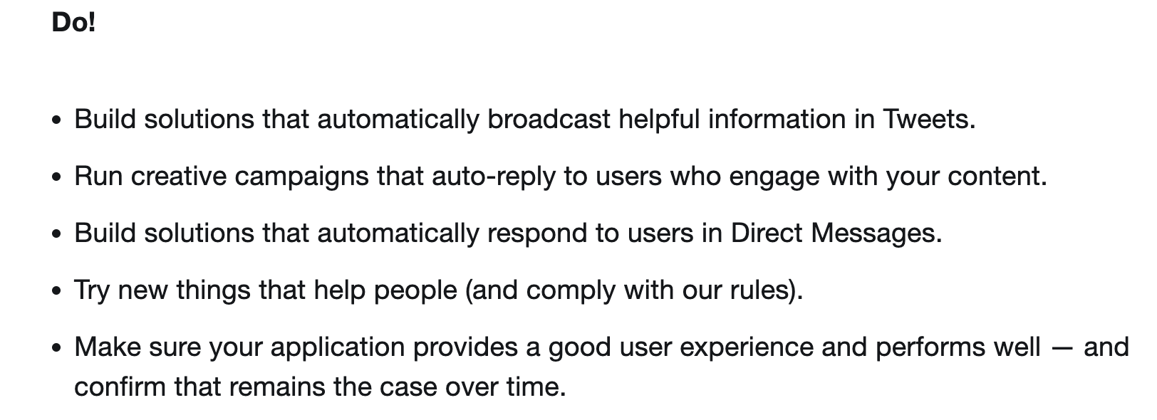
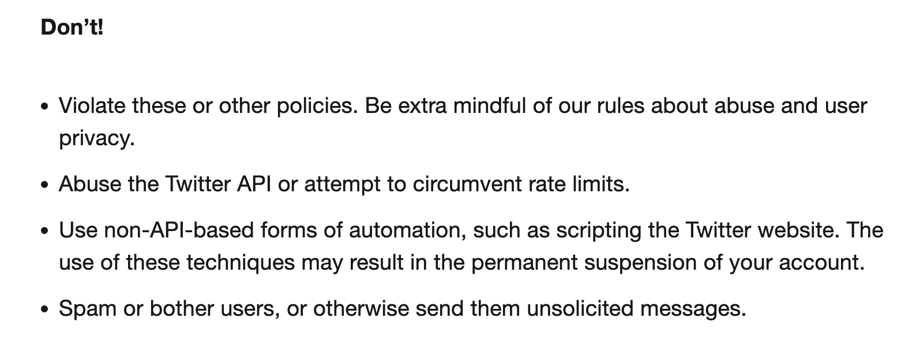
We investigated the terms of service and/or community guidelines
Lays down the rules that users must abide when posting content on social media or when using social media.
Notes:
Terms of service/ community guidelines lays down the rules that user must abide by. We used this to identify how in practice platforms moderate content,

Slide 19
We analyzed 14 social media platforms’ community guidelines and terms of service
We chose platforms from both sides, i.e., mainstream and fringe platforms that are popular in the US.
We focused on platforms that were investigated by prior research studies as well as those from recent political events, i.e., January 6th insurrection.

Slide 20
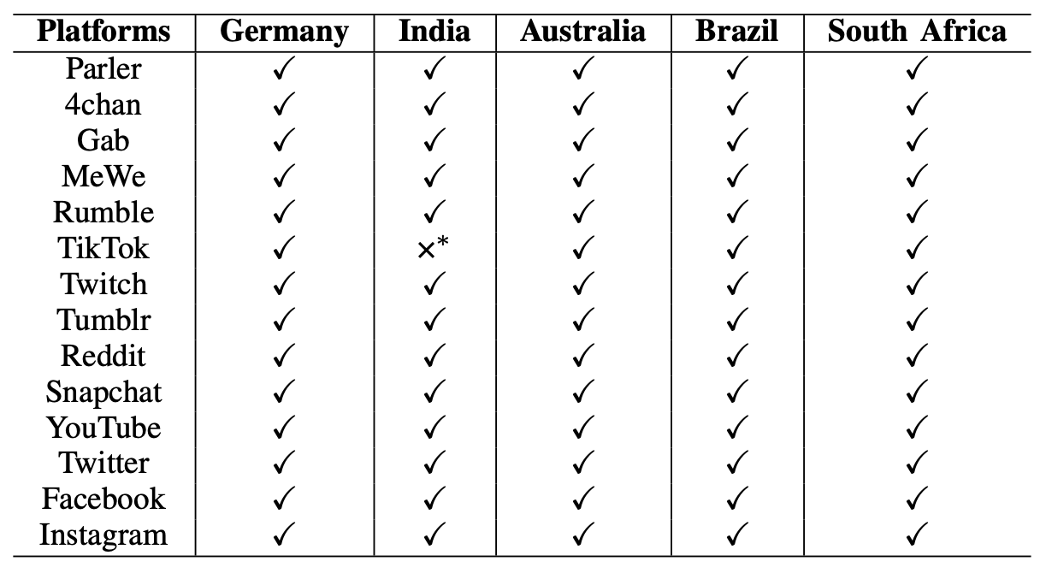
We compared social media platforms in 5 countries and found no differences in the community guidelines and/or terms of service
Notes:
We also investigated community guidelines in 5 different countries and found no differences.

Slide 21
Granularity can help users to understand in more detail the content that is allowed and what content is not allowed
Notes:
If community guidelines are granular i.e, they provide a lot of details and also at the same time provide examples, they can help users to understand what kind of content is allowed or not.

Slide 22
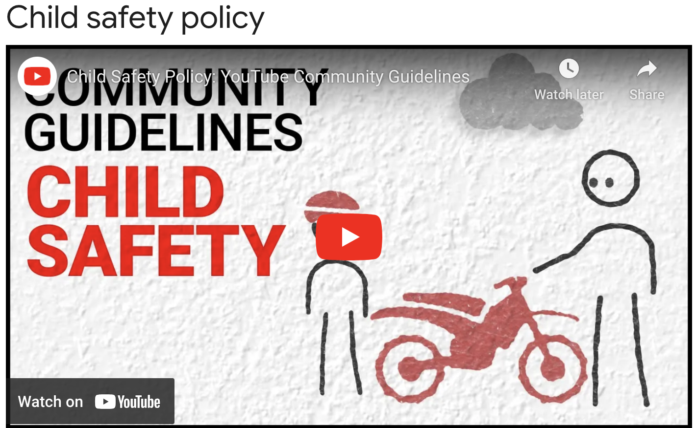
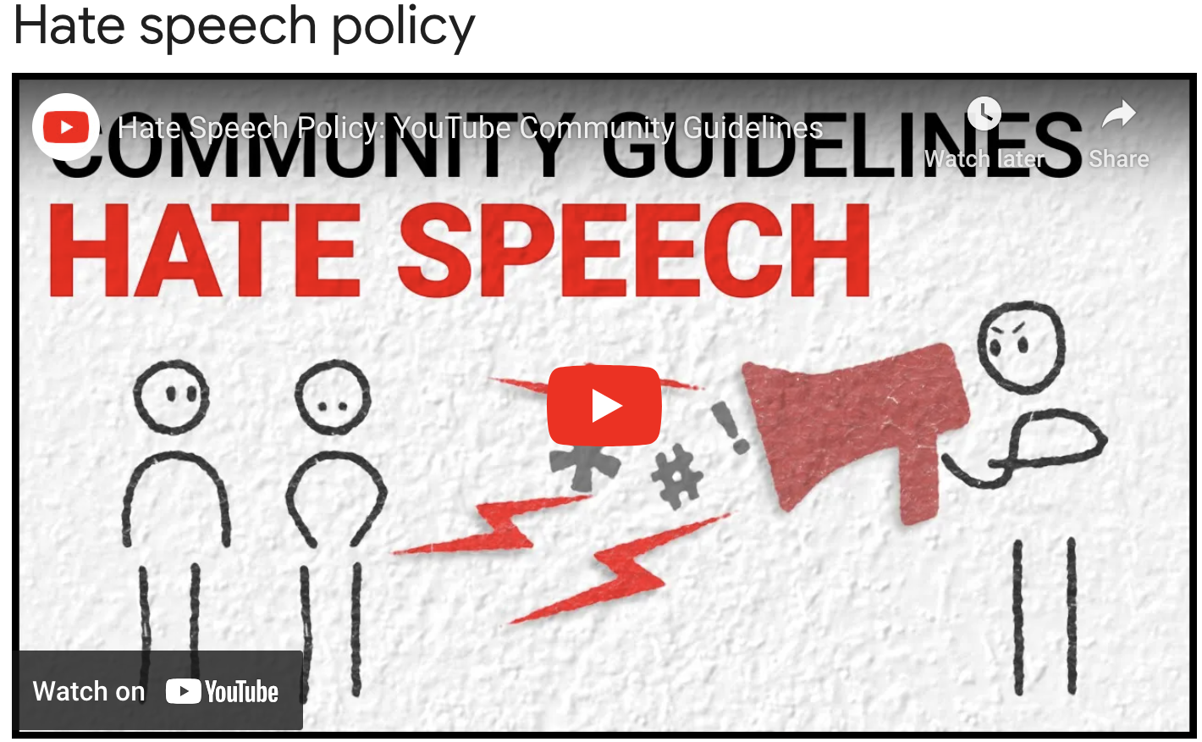
Audio and visual context aid users to grasp the content that will be moderated
Notes:
Videos specifically can be a great way to teach users how platforms will moderate content.

Slide 23
2 authors manually labelled the categories
Read each platforms guidelines
Yes, and Partial was labelled as 1 and No was labelled as 0
Resolve disagreements and calculate the final sum of each platforms

Slide 24
Mainstream social media are more granular and provide more examples than fringe platforms
Notes:
YouTube is the only platform that provides videos for 10 of the studied catgetories.

Slide 25
Let us now discuss some common and high-level research gaps and challenges

Slide 26
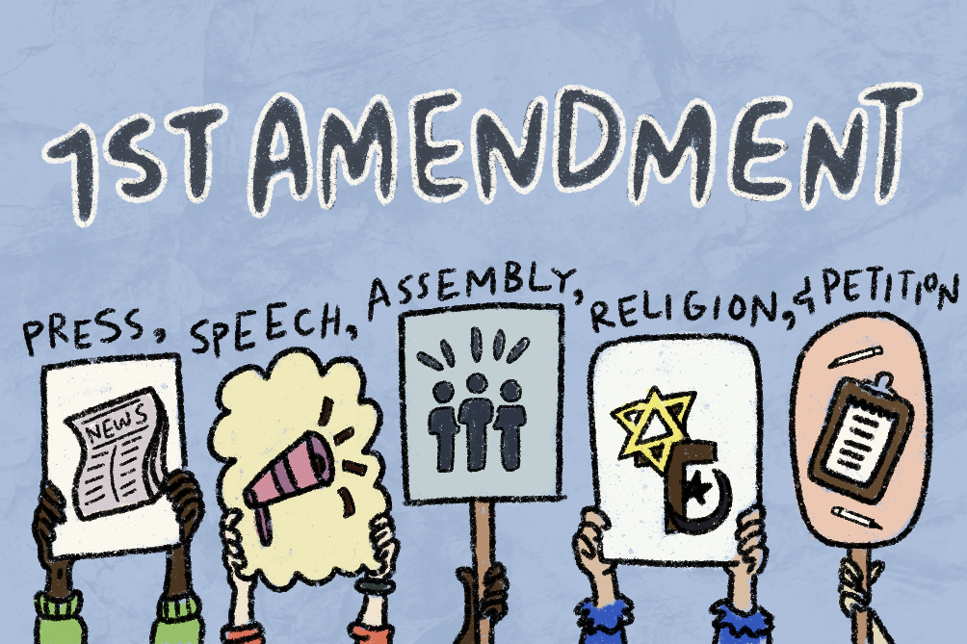
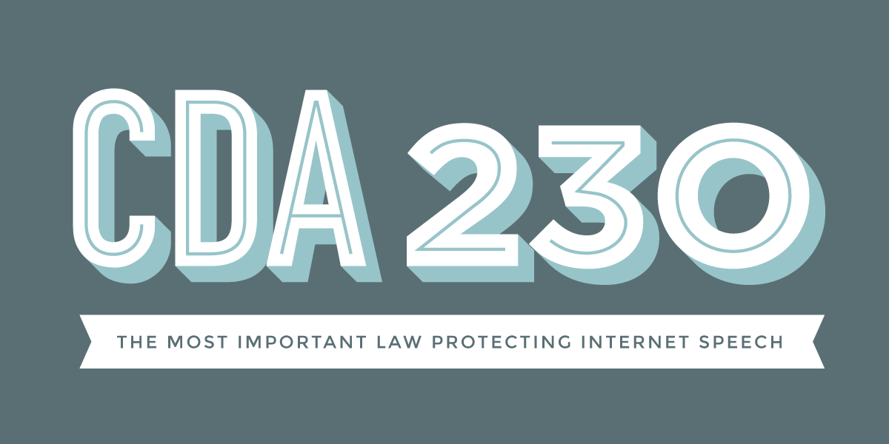
Legal perspectives regarding content moderation
In the US, balance between 1st Amendment and Section 230.
In India and Germany, social media platforms are by law required to publish reports about handling of complaints and what action was taken.
In Australia, users can submit complaints to Australian eSafety Commissioner
Notes:
In the US, users have 1st amendment rights to exercise the right to speech, however users want the same rights on social media, however since social media are not state entity, they don’t have to guarantee the literal definition of 1st amendment and they are shielded by section 230 from prosecution, hence there needs to be a balance in moderation where users can exercise their 1st amendment rights and at the same time platforms can guarantee that they do not suppress the voices of people.

Slide 27
Transparency in moderation is necessary
We echo for transparency reports as well as open APIs to conduct fairness assessment.
Platforms should also publish the number of orders received from government agencies to remove content or suspend accounts, and whether the platform acted or not.
Notes:
Because of the black box structure of moderation, it is difficult to understand the fairness of these models, platforms need make sure that they provide open APIs as well as publish orders received by various governments

Slide 28
One size does not fit all in the amorphous nature of social media platforms
All users should be treated equally, & their voices should not be suppressed.
Platforms should publish policies that govern public figures and heads of states.
Notes:
Current political and social climate matters when moderating content and one size cannot be used to moderate content. Social media should make sure that public figures and head of states do not take advantage of lax rules for incitement of violence.

Slide 29
Need for a collaborative Human-AI decision making
There is a need for more proactive human interventions to offset the errors done by ML based moderation.
We echo for an oversight board that can make amends to decisions made by automated systems. For e.g., Facebook Oversight Board.
It is crucial to develop fully or partially automated methods and algorithms that minimize the impact of bias on moderation decisions.

Slide 30
Conclusion
We investigated the community guidelines and moderation practices of fourteen social media platforms.
We studied and analyzed fourteen most popular social media content moderation guidelines and practices and consolidated them.
We identified the differences between the content moderation employed in mainstream and fringe social media platforms.
We identified the research gaps, differences in moderation techniques, and challenges that should be tackled by the social media platforms and the research community.

Slide 31
Thank You!
mohit.singhal@mavs.uta.edu
mohitinla
Time Specific Snapshots of Platforms Policies
Paper

Slide 32
Security community needs to further advance research in content moderation
Only 4 papers!
Notes:
Interestingly from the top security conference in the last 4 years, we only were able to find only 1.5% papers on content moderation.

Slide 33
One size does not fit all in the amorphous nature of social media platforms
Current political and cultural contexts should be considered when moderating content.
Posts like “Death to Russian army, citizens and Vladimir Putin”
“Death to Dictator” a key protest slogan

