Slide 1
DarkDialogs: Automated detection of 10 dark patterns on cookie dialogs
Daniel Kirkman (Presenting)
Kami Vaniea
Daniel W Woods
Notes:
Good morning everyone, I’m Daniel Kirkman and I’m happy to be here today to present my paper called dark dialogs
I wrote this paper during my time at the University of Edinburgh with my co-authors Kami Vaniea and Daniel Woods.

Slide 2
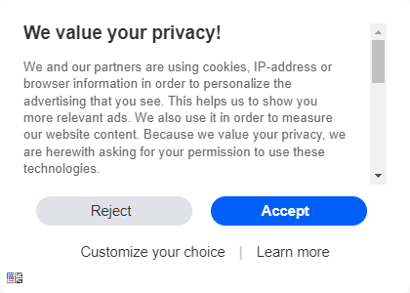
Consent Dialogs
Consent dialogs: Website pop-ups that allow users to express privacy preferences regarding how a website and its partners process the user’s personal data.
Source: mail.ru
Notes:
Consent dialogs (or cookie dialogs as they are sometimes known) are website pop-ups that allow users to express privacy preferences regarding how a website and its partners process their personal data.
You will likely see consent dialogs whenever you access the internet and unless you are an internet privacy-researcher you probably just click the the accept button and move on with your life. But why do we just click accept? What nudges us towards clicking the accept button?

Slide 3
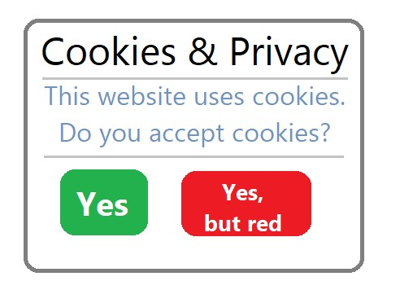
Dark Patterns
Dark Patterns: features of a user interface designed to deceive users into accepting a choice that is not in their best interests.
We looked at dark patterns on consent dialogs
Notes:
Dark patterns are what nudge us towards clicking the accept button.
Dark Patterns are features of a user interface designed to deceive users into accepting a choice that is not in their best interests.
Dark patterns have been identified on many types of user interfaces but our project focuses on detecting on dark patterns located on cookie dialogs.

Slide 4
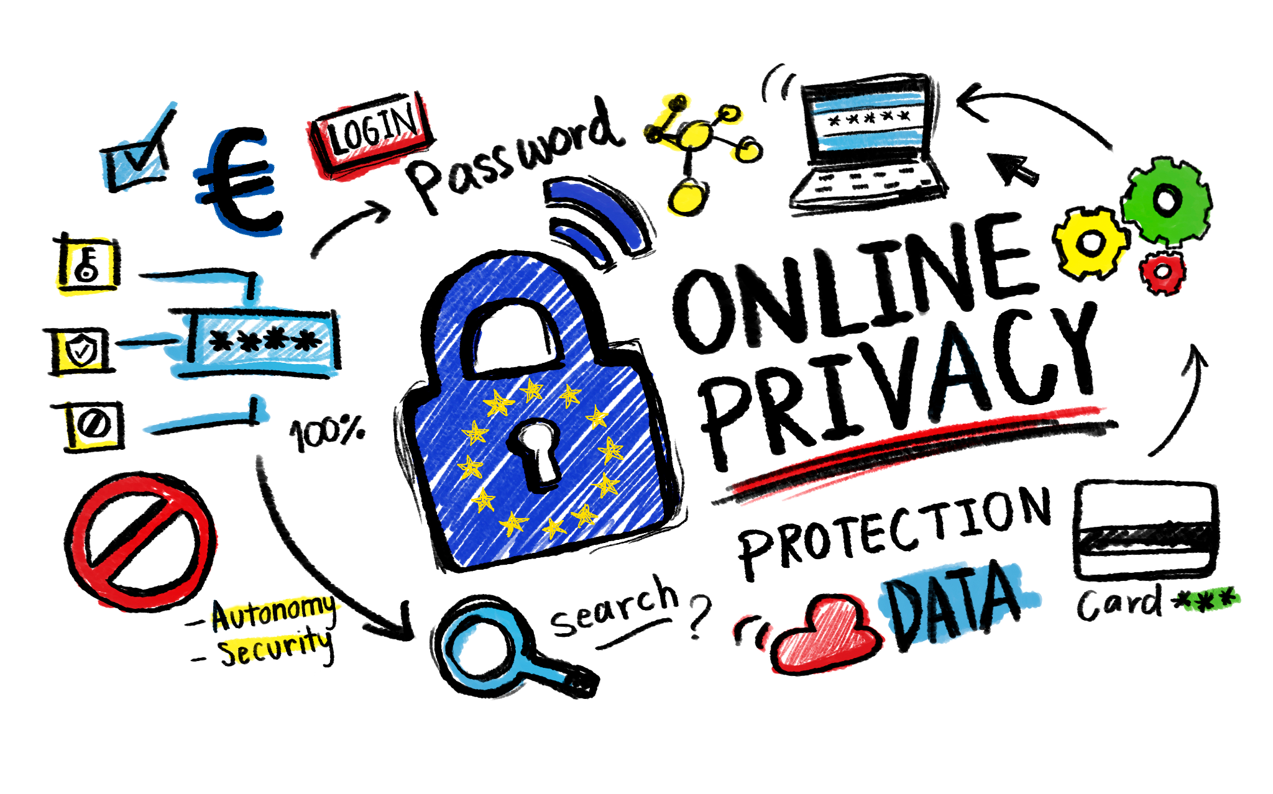
Dark patterns are bad for privacy
Dark patterns undermine user autonomy and violate privacy laws.
Advertising incentivises websites to add dark patterns
Enforcement action can be effective
Source: europa.eu
Notes:
Dark patterns undermine user autonomy and violate privacy laws.
Many websites are reliant on advertising revenue and this requires websites to use tracking cookies.
This incentives websites to add dark patterns to trick users into accepting more cookies.
In the past a limited amount of enforcement action has been effective at getting websites to change consent dialogs to remove dark patterns.

Slide 5
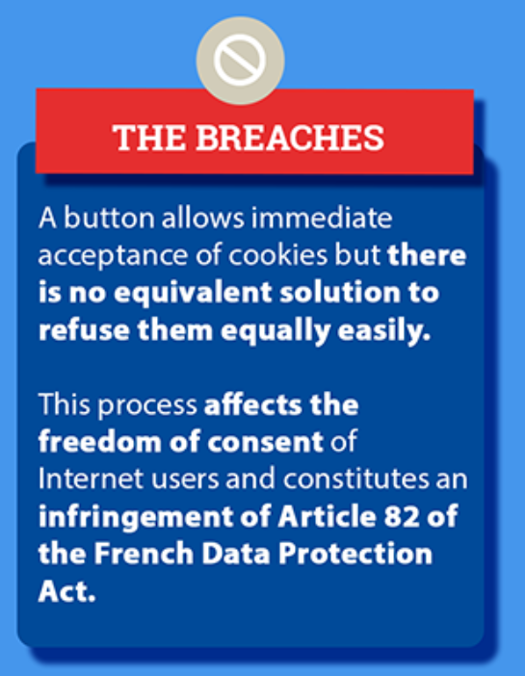
Enforcement Action
Source: cnil.fr
Notes:
Last year the French Data Protection Authority fined Google for making it harder for users to reject than to accept cookies.

Slide 6
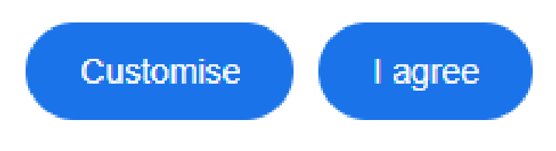
Enforcement Action
Source: google.com
Notes:
You can see that in response to the regulatory action Google added a reject all button making it easier for users to select the privacy-enhancing reject all button.
This shows that regulatory action can have a positive impact on user privacy by helping remove dark patterns.
To help privacy advocates and regulators we need a system that can identity dark patterns accurately at scale.

Slide 7
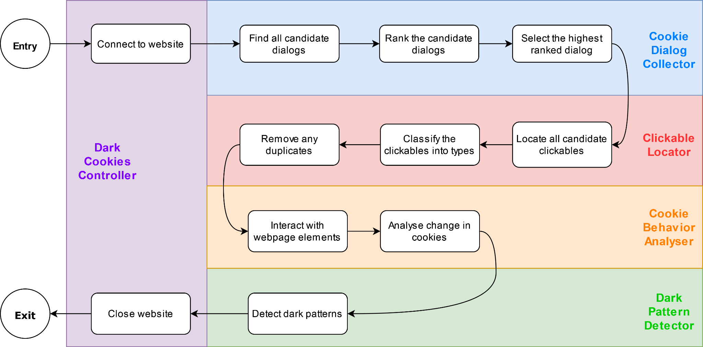
Our Solution: DarkDialogs
DarkDialogs: system to detect dark patterns on consent dialogs
Scales using automation
Extracts dialogs at 98.7% accuracy
Detects 10 different dark patterns at 99% accuracy
Notes:
To address the problem of detecting dark patterns accurately at scale we built dark dialogs.
DarkDialogs is a system to extract consent dialogs from web pages and detect the presence of dark patterns.
DarkDialogs is automated which means it can scale to assess 10,000s of websites.
DarkDialogs has shown a high-level of accuracy.
It can extract consent dialogs from websites at 98.7% accuracy.
And can detect 10 different types of dark patterns at 99% accuracy.
It was challenging to design a system to be this accurate so I’ll briefly talk about some of the challenges we faced

Slide 8
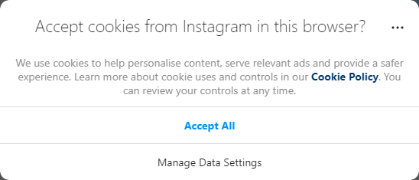
Challenges: extracting dialogs
Few consent Dialogs are alike
!=
Websites purposely make it difficult.
Sources: instagram.com & mail.ru
Notes:
It sounds simple but extracting consent dialogs from a website is challenging…
Firstly, very few consent Dialogs are the same.
There are a wide range of designs, with some being very simple and some extremely complex.
Even within the same company, google.com and google.hk (the landing page for Google in Hong Kong) do not have the same consent dialog design.
Some Websites purposely make it difficult for web scrapers
Main issue, randomly generated css tags which are updated more frequently than online css selector lists.
This example here is particular nasty since this website randomly generates css selectors each time the webpage is loaded.
For these first two challenges, we had to look beyond just using css selector lists and analyse factors such as dialog text and dialog size.
instagram.com and mail.ru
google.hk
Globo.com

Slide 9
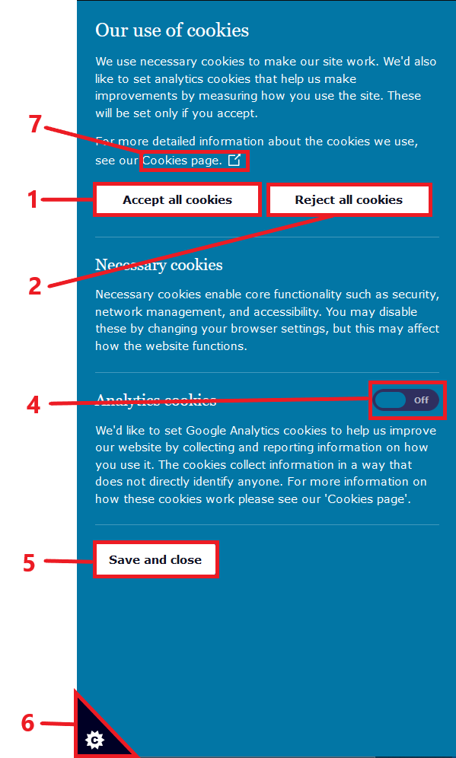
Challenges: detecting dark patterns
How do you detect clickables?
How do you detect a dark pattern?
Source: ico.org.uk
Notes:
It is also challenging to detect dark patterns
In order to detect dark pattern we need determine what clickables are present on the consent dialog. Clickables are interactive elements such as buttons, some examples of clickables are included on the right hand side. The wording of these buttons and the css selectors used to create them vary massively.
Finally, we had to consider how to define dark patterns in a way that it can be detected by a computer.
The dark patterns we identified vary massively from having a highlighted accept button to setting more tracking cookies when the reject button is set.
instagram.com and mail.ru
google.hk
Globo.com

Slide 10
How did we achieve high accuracy?
Dialog Extraction using a ranking system
98.7% accuracy
Find all elements that could be a dialog
Rank them using a range of factors
Dark Pattern Detection using accurate heuristics
99% accuracy
Narrowly defined rules are programmable
Easily extensible and adaptable
Notes:
Our system is more accurate at extracting consent dialogs than previous studies, from our study our system reported an accuracy of 98.7%. We achieved this by creating a new novel ranking-based approach which ranks website elements based on their likelihood of being a consent dialog.
Rather than just use CSS selectors to locate consent dialogs as previous studies have done, DarkDialogs considers a range of features about the dialog including: - the text of the dialog
- the presence or absence of clickable elements
- the colour of the dialog and clickables
- size of the dialog
- the cookie setting behaviour of button
Considering a range of factors about a cookie dialog helped us to reduce false positives and achieve high accuracy.
Our system correctly classified over 99% of dark patterns. We achieved this by opting to narrowly-define dark patterns with clearly defined heuristics. For comparison, a prior study that opted to use machine learning to detect high-level pattern categories like “forced action” and “nagging” achieved achieved accuracy rates of between 54% and 72%. By narrowly defining dark patterns we were able to creating rules that could programmed into our system to detect the presence of a dark pattern. Our rules are clearly defined in our paper and easily adaptable in the code should another author wish to extend or modify the system.
So let's look at a few examples of what dark patterns our system can detect.

Slide 11
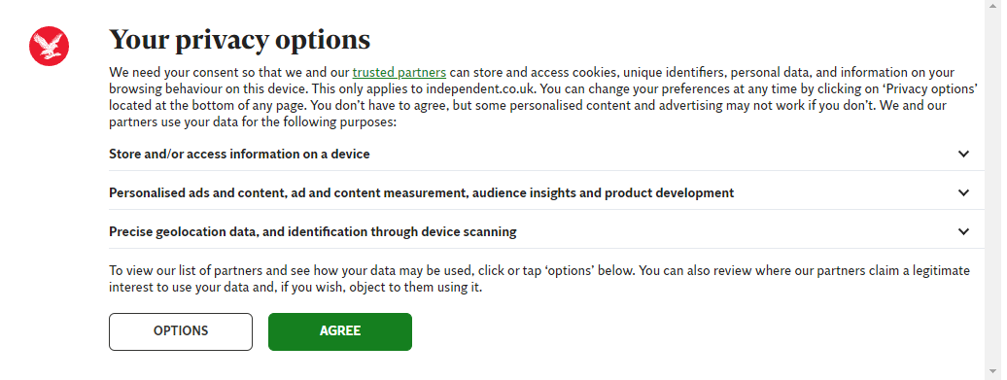
Example: Highlighted Accept button
Dark Pattern: Color of Accept button leads to it being highlighted more compared to Reject button.
Which button stands out more?
Source: independent.com
Notes:
An example of a dark pattern that DarkDialogs can detect is when the Color of accept button leads to it being highlighted more compared to reject button.
This makes the opt-in button stand out more to the user and the example below shows a case where our tool was able to detect this.
Overall we found roughly a 1/4 of websites had this dark pattern.

Slide 12
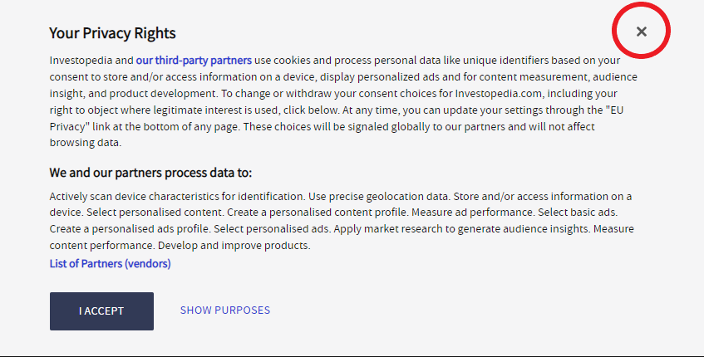
Example: Ambiguous Close
Dark Pattern: Close (x) button with ambiguous function is present.
Does it accept or reject cookies?
Source: investopedia.com
Notes:
Another example our system detects is when close button has an ambiguous function.
I’ve found a good number of examples of this type of button and none of them seem to give a description of what exactly it does, does it reject cookies or accept them or something else?
Example of this close button is shown highlighted below.
We found around 18% of websites had this dark pattern

Slide 13
Example: Multiple Dialogs
Dark Pattern: Multiple consent dialogs
Why???
Source: dealnews.com
Notes:
Finally a strange dark pattern we have identified is the presence of more than one cookie dialog.
This impacts the user as they will be uncertain about which cookie dialog they should interact with and different dialogs may have different options or instructions available.
In the image on the right you can very clearly see the first cookie dialog but the second one is hidden behind the first so I’ve highlighted it in red.
Worryingly we found 8% of websites had this dark pattern. dealnews.com

Slide 14
Data
Collected 3 data sets:
Top 500 most popular websites
Randomly selected 500 websites.
Randomly selected 10,000 websites:
2,417 Dialogs collected
3,744 Dark Patterns detected.
Notes:
We collected 3 data sets as part of this project,
2 smaller data sets of 500 websites each which we used for manual validation. Manually verifying the results of these data sets allowed us to assess the accuracy of the system and is where the accuracy figures quoted on the previous slides came from. We also collected a larger set of 10,000 websites to allow us to assess a range of websites.
In the larger data set we extracted over 2000 consent dialogs and detected 3000 instances of Dark Patterns
The data sets contain a large amount of data including screenshots and text from of cookie dialogs and a large set of cookies. We are not aware of any other data sets that provide such a large set of consent dialogs from a system whose accuracy has been detailed. As part of this project we released these data sets for public use and hope they will contribute to future research.

Slide 15
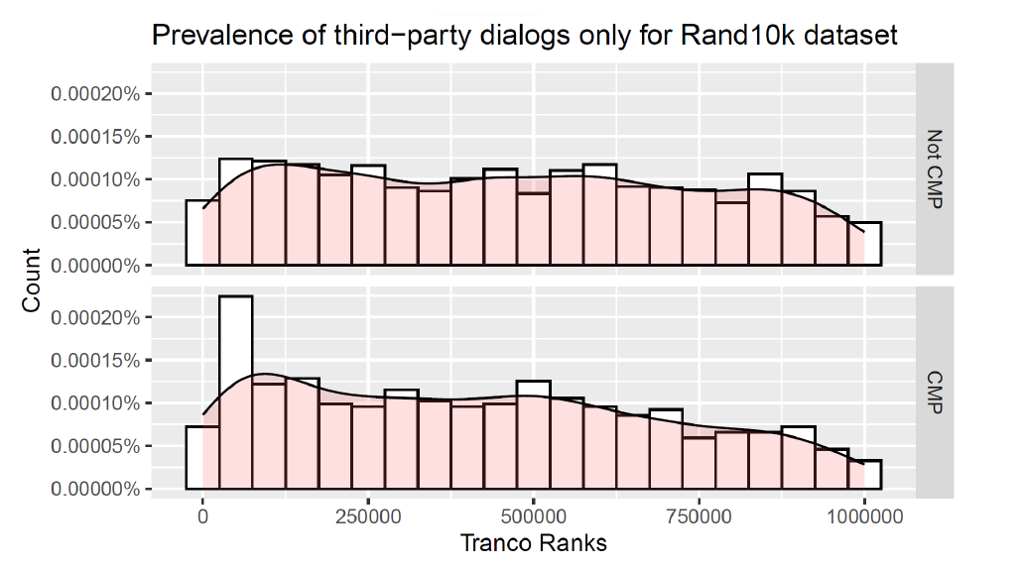
Results
20.9% of websites display a consent dialog
Notes:
I will now talk about some of the most interesting results from our study:
Firstly, we found that only 20.92% of websites displayed a consent dialog, there are legitimate reasons for not displaying a cookie dialog such the website not processing user personal data or if they do so with legitimate interest only. Alternatively, websites not be aware of their obligation to display a consent dialog or may deliberately choose not to display a consent dialog. This percentage is higher than some previous studies which only looked at consent dialogs made by Consent Management Providers whilst our system is designed to detect all consent dialogs.

Slide 16
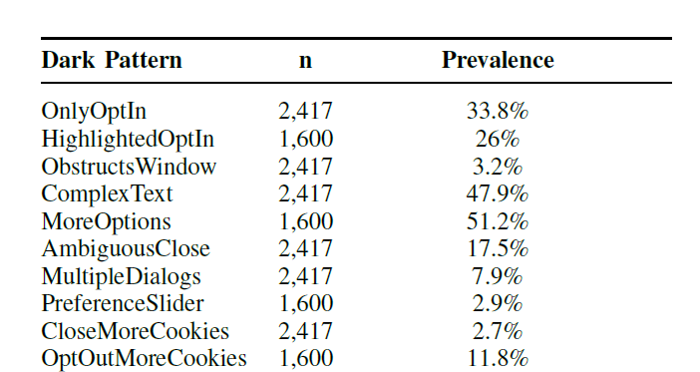
Results
Most common dark pattern was the “More Options button”
Notes:
The most common dark pattern we found was the More options dark pattern which was present on 51% of websites. This dark pattern is detected when the websites hide additional consent options behind a more options button and do not allow the user to reject all cookies with a single click. This incentivises users to accept all cookies rather than make multiple mouse clicks to reject cookies.

Slide 17
Results
Less popular websites are more likely to only allow users to Accept cookies
More popular website are likely to highlight the Accept button over the Reject button.
Notes:
We found that less popular websites were more likely to only allow users to accept cookies. This result suggests that popular websites who have more resources are less likely to implement
this specific dark pattern, possibly because it is so unambiguously non-compliant with data protection law.
In contrast we found that popular websites were more likely to highlight the Accept button so that it stands out more than the reject button. As this dark pattern is more subtle it is possible that more popular and better resourced websites are aware that they can likely get away with having this dark pattern.

Slide 18
Summary
DarkDialogs: Automated system to detect dark patterns on consent dialogs
Analysed 10,000+ websites
Detects 10 different dark patterns at 99% accuracy
Get Dark Dialogs: https://github.com/DarkDialogs/OpenScience
Notes:
To summarise our system is called dark dialogs and it automatically detects dark patterns on consent dialogs.
We’ve analysed over 10,000 websites in our study
and our system can detect 10 different dark patterns at an accuracy of over 99%
I’ve discussed 3 of the dark patterns our system detects here today but there are 7 more in our paper so please have a look.
Finally, Dark Dialogs is available on our GitHub page.

Slide 19
Thank you!
Kami Vaniea and Daniel Woods
Laboratory for Foundations of Computer Science
Euro S&P 2023
Get Dark Dialogs: https://github.com/DarkDialogs/OpenScience
Notes:
Thank you all for listening!

Slide 20
Users
Examples of users who may be interested in this system:
website owners
privacy advocates & researchers
regulators
Notes:
Some of the potential users of our system include:
website owners to proactively avoid legal issues by using our tool to scan their own website for dark patterns
privacy advocates who want to detect and report non-compliant websites, we see our system being used to flag potential dark patterns to privacy researchers who would then make the final decision on whether it constitutes a breach of privacy law.
And we see could see our system being used in a similar way by regulators to collect evidence of privacy violations and issue warnings to websites.

Slide 21
Benefits of automation
Automated detection
10,000+ websites
Consistent & repeatable
Supports dialogs not from Content Management Providers
Notes:
So what makes our system stand out from previous work?
Previous work relied on manual analysis by researchers to identify dark patterns. This is time consuming and limits the number of webpages that can be analysed.
The main advantage of our system is that it is automated and can scale to assess 10,000s of websites. Our system is also designed to detect consent dialogs on all websites not just those from Content Management Providers which was a feature of previous work.

Slide 22
Further work
How do we automatically opt-out from cookies?
Is it possible to make dark pattern detection 100% accurate?
Notes:
Although we are happy with our final system there are 2 unanswered questions from our project that we hope will be answered in the future.
Firstly, DarkDialogs cannot automatically opt-out from cookies as doing so requires having to
navigate through several layers of options.
This situation is due to the complexity and variation in the layout of cookie dialogs which means there is no trivial way to opt-out from all cookies. Ideally, we would like to automate this process as it would allow us to fully assess the cookie setting behaviour of consent dialogs.
Another question we would like to answer is if it is possible to detect dark patterns accurately 100% of the time. Consent dialogs vary massively in layout and the methods used to avoid detection. In addition, websites are constantly changing their consent dialog designs in response to regulatory and advertising demands. This makes detecting dark patterns on consent dialogs a constant battle between detection systems and website designers.
We have attempted to future proof our system by using crowdsourced css selectors for much of our dialog extract and dark pattern detection but we are reliant on the good will of the public to keep our system updated. We encourage researchers to build upon the techniques in our paper to detect novel dark patterns. To aid this goal, we have open-sourced our code repository.

