Slide 1
A Certified Radius-Guided Attack Framework to Image Segmentation Models
Wenjie Qu*, Youqi Li†, Binghui Wang‡
*Huazhong University of Science and Technology
†School of Computer Science and Technology, BIT
‡Department of Computer Science, IIT
07/07/2023

Slide 2
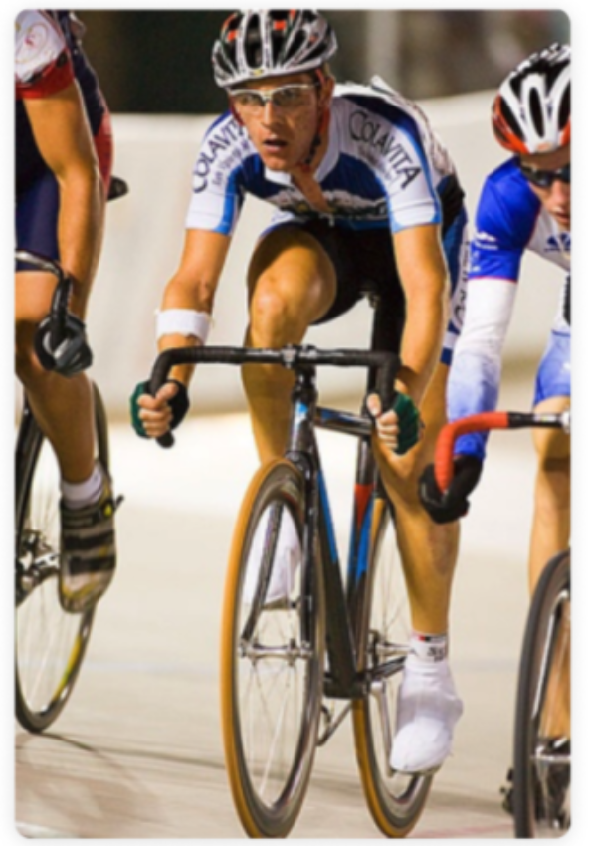
Image segmentation
Image Segmentation
Labeling pixels in an image such that pixels
belonging to the same type of object are assigned a same label.
Person
Bike

Slide 3
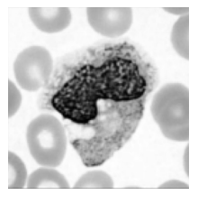
Image segmentation applications
Applications
Medical imaging
Autonomous Driving

Slide 4
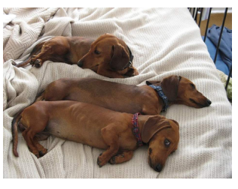
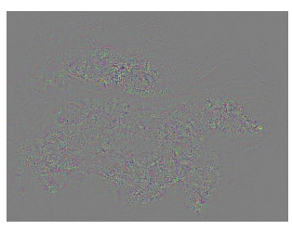
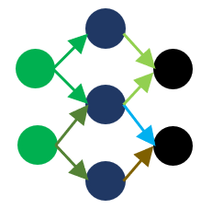
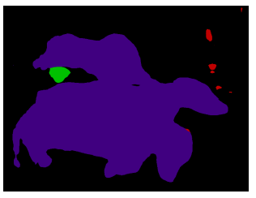
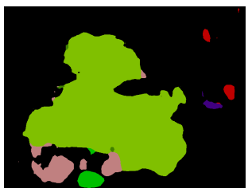
Image segmentation adversarial example
+ = Adversarial
example
Carefully crafted noise

Slide 5
Certified Defense
A certified defense
Build a certifiably robust classifier $h(∙)$ on top of base classifier $g(∙)$
Derive the certified radius
Certifiably robust classifier
$$h(x+δ)=h(x),∀{\left\|δ\right\|}_{2}<R$$
Certified radius
Certifiably
Robust Classifier
Testing input
Perturbation

Slide 6
Randomized Smoothing
Build a certifiably robust smoothed classifier upon a base classifier
$$h(x)=\underset{c}{argmax}\operatorname{Pr}{(}g(x+ε)=c),ε∼N(0,σ^{2}I)$$
Smoothed
classifier
Base classifier
Testing
input
Gaussian noise
Requires the base classifier to predict the labels of multiple noisy versions of a testing input.

Slide 7
Attacker’s Goal
Make as many pixels as possible wrongly predicted
This function is hard to directly optimize.
$\max_{δ} ∑_{n=1}^{N} 1\left[arg⁡\max_{c∈𝒴} F_{θ}(x+δ)_{n,c}≠y_{n}\right]$, s.t., $δ∈Δ$
Segmentation
Model
Input image
Groundtruth
Perturbation

Slide 8
Prior work attack goal
Maximize loss function
Suboptimal
Attack idea follows attacks to classification models,
didn’t leverage pixel-wise information .
$\max_{δ} L\left(F_{θ}(x+δ),y\right)=∑_{n=1}^{N} L\left(F_{θ}(x+δ)_{n},y_{n}\right)$, s.t., $δ∈Δ$
Loss
Function
Segmentation
Model
Input image
Groundtruth
Perturbation

Slide 9
Our attack idea
A more robust pixel should be perturbed by a larger perturbation
How to quantify pixel-wise robustness?
We can calculate pixel-wise certified radius with randomized smoothing.

Slide 10
CR guided attack loss
Associate each pixel’s loss with a weight
$$L_{cr}\left(F_{θ}(x),y\right)=\frac{1}{N}∑_{n=1}^{N} w\left(x_{n}\right)⋅L\left(F_{θ}(x)_{n},y_{n}\right)$$
Weight
Function
Loss
Function

Slide 11
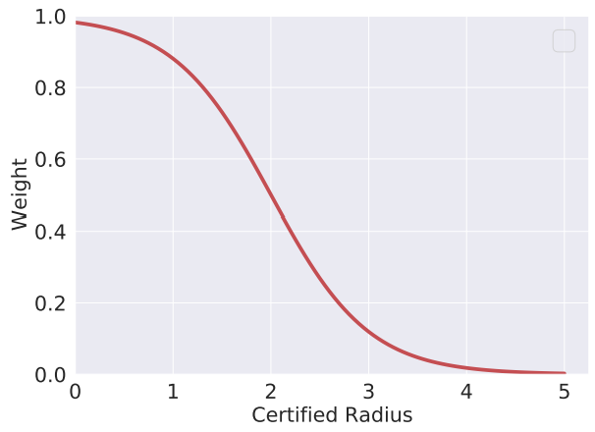
CR guided weight design
Weight function design principle
A pixel with a larger (smaller) certified radius should be assigned a smaller (larger) weight
Weight function design
$$w\left(x_{n}\right)=\frac{1}{1+exp⁡\left(a⋅cr\left(x_{n}\right)+b\right)}$$

Slide 12
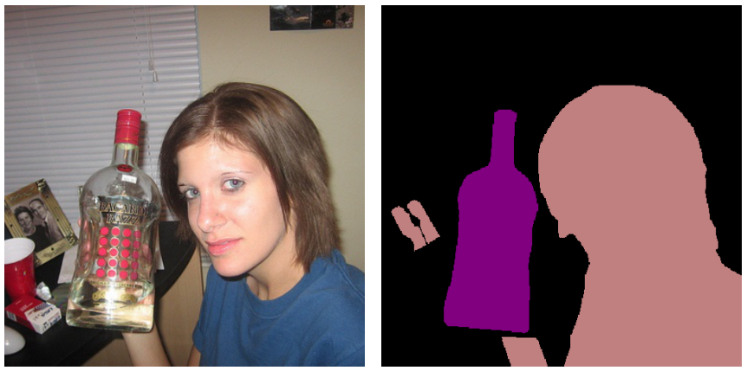
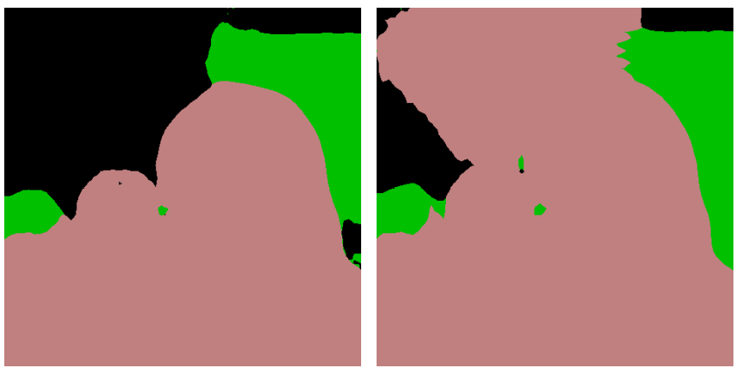
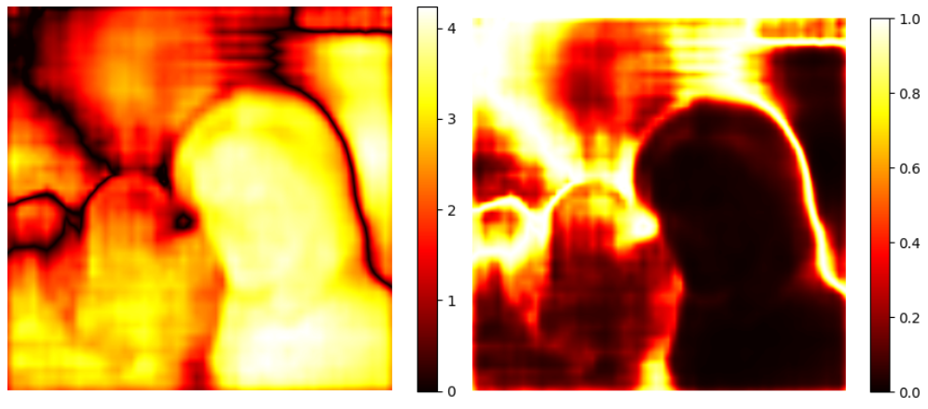
CR guided white-box attack
certified radius-guided PGD attack iteratively generates perturbations as follows: $$δ={Proj}_{Δ}⁡\left(δ+α⋅∇_{δ}L_{cr}\left(F_{θ}(x+δ),y\right)\right)$$
Input Image
Groundtruth
PGD
CR-PGD
Pixel CR
CR Weight

Slide 13
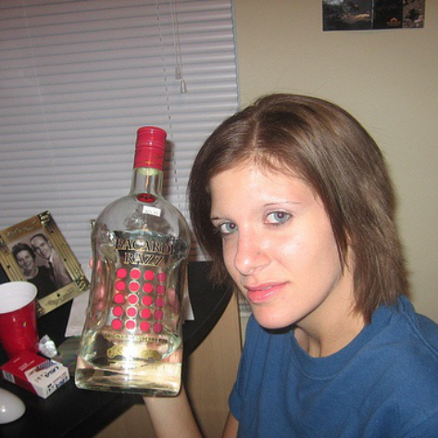
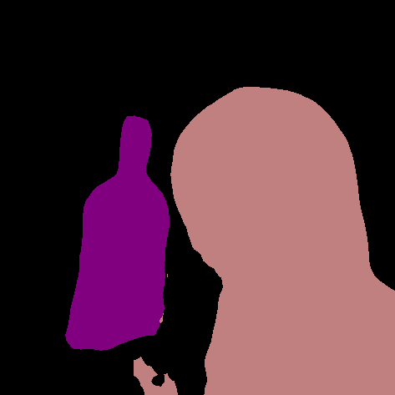
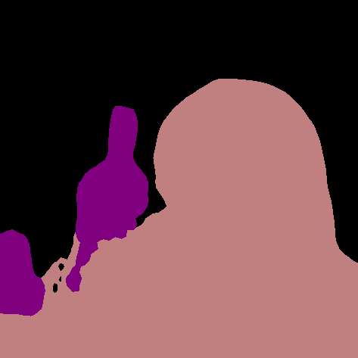
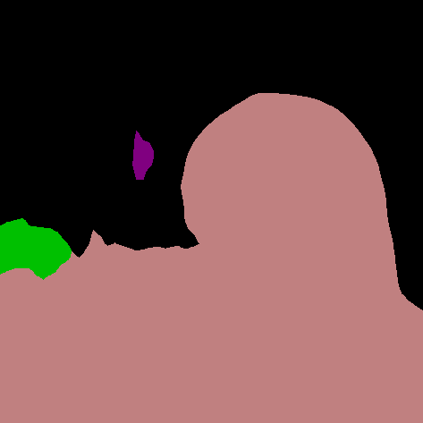
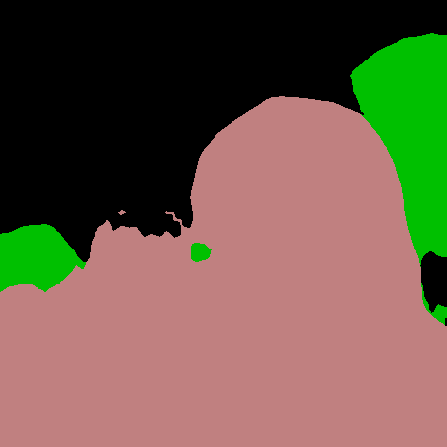
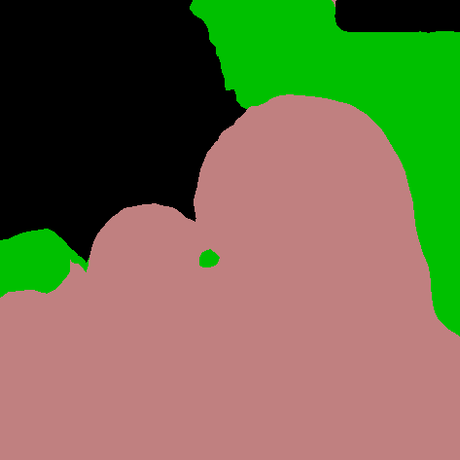
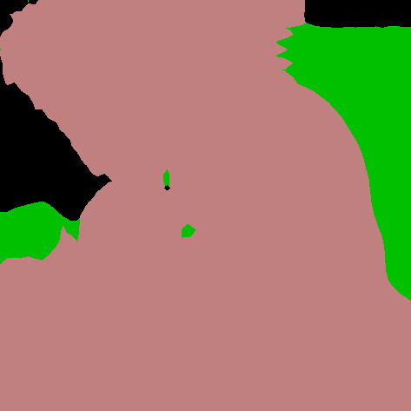
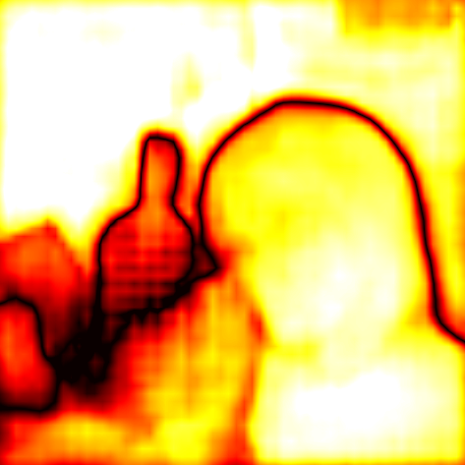
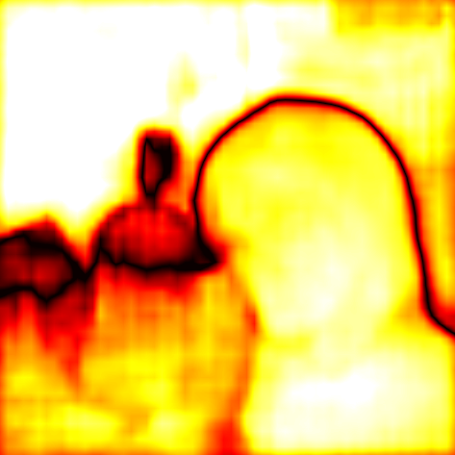
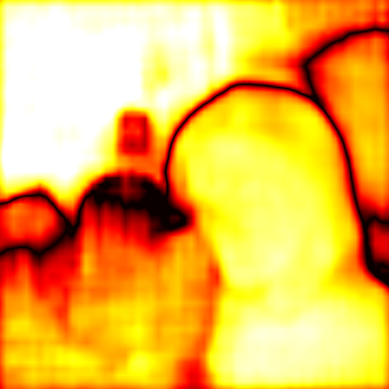
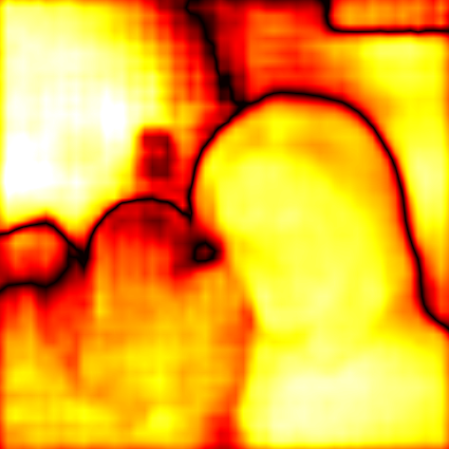
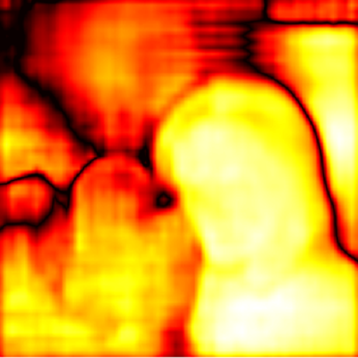
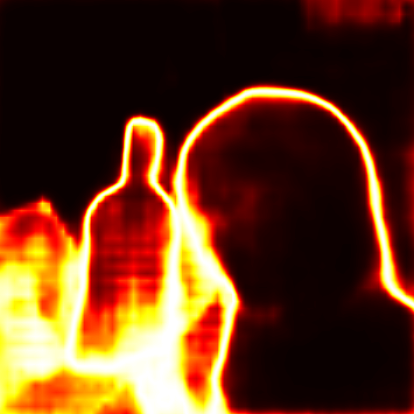
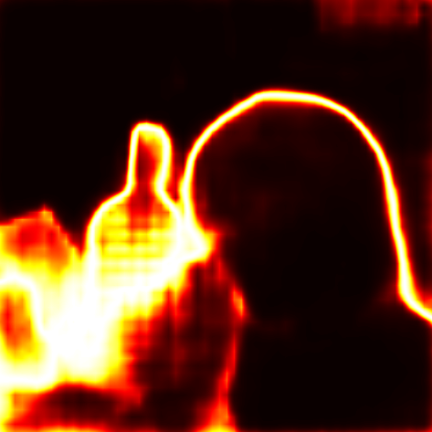
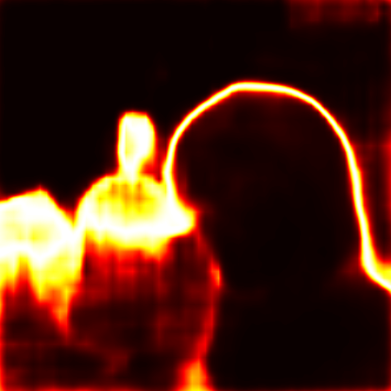
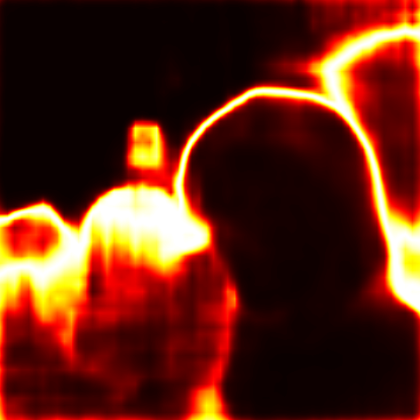
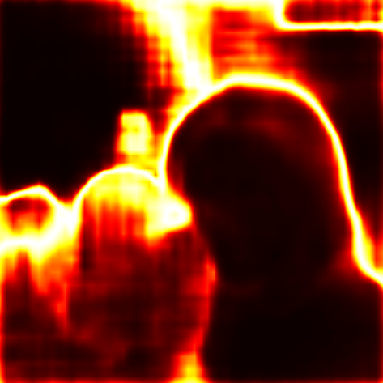
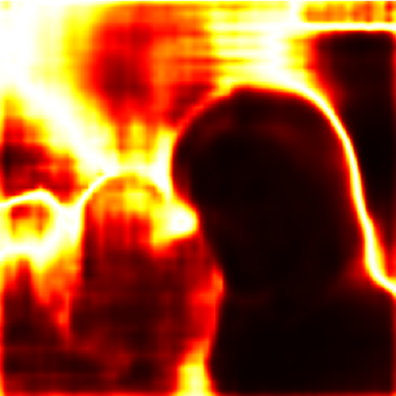
White-box attack example
Iteration 1
Iteration 10
Iteration 20
Iteration 30
Iteration 40
Iteration 50
Input Image
Prediction
Pixel CR
CR Weight

Slide 14
Bandit for Black-Box Attacks
Action: Select an action from action space
action is perturbation $δ^{t}∈∆=\{δ:{\left\|δ\right\|}_{p}≤ε\}$
Feedback: Observe black-box function’s value
attack loss value: $L(δ^{t})$
Goal: Optimize (Min/Max) black-box function
Theoretical performance metric: regret
$R_{𝒜}\left(T\right)=\sum_{t=1}^{T}{𝔼\left[L\left(δ^{t}\right) \right]−\max_{δ∈∆}{\sum_{t=1}^{T}{L(δ)}}}$
minimize the regret to be as sublinear as possible
Core: Estimate gradient with loss feedback
Notes:
In our setting, action is perturbation

Slide 15
Existing gradient estimators
ZOO
$${\overset{ˆ}{g}}_{i}^{ZOO}=∇L(δ)_{i}≈\frac{L\left(δ+γe_{i}\right)−L\left(δ−γe_{i}\right)}{2γ}$$
OPGE
$${\overset{ˆ}{g}}^{OPGE}=∇\overset{ˆ}{L}(δ)=𝔼_{u∈𝒮_{p}}\left[\frac{N}{γ}L(δ+γu)u\right]$$

Slide 16
Two-point gradient estimator
Two-point gradient estimator
${\overset{ˆ}{g}}^{TPGE}=∇\overset{ˆ}{L}(δ)=\underset{u∈𝒮_{p}}{𝔼}\left[\frac{N}{2γ}(L(δ+γu)−L(δ−γu))u\right]$
Comparison

Slide 17
CR guided black-box attack
Projected bandit gradient descent(PBGD)
$$δ={Proj}_{Δ}\left(δ+α⋅{\overset{˜}{g}}^{TPGE}\right)$$
CR guided two-point gradient estimator
$${\overset{ˆ}{g}}_{cr}^{TPGE}=∇{\overset{ˆ}{L}}_{cr}(δ)=\underset{u∈𝒮_{p}}{𝔼}\left[\frac{N}{2γ}\left(L_{cr}(δ+γu)−L_{cr}(δ−γu)\right)u\right]$$
Combine together -> CR guided PBGD:
$$δ={Proj}_{Δ}⁡\left(δ+α⋅{\overset{˜}{g}}_{cr}^{TPGE}\right)$$

Slide 18
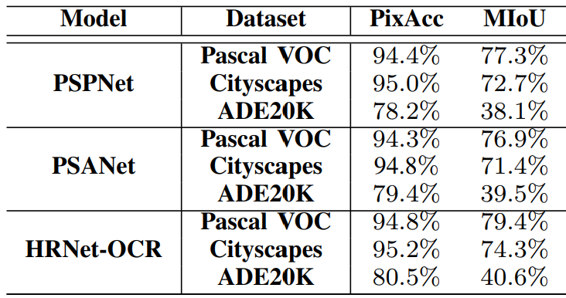
Evaluation
Dataset
Pascal VOC, Cityscapes, ADE20K
Models
PSPNet, PSANet, HRNet-OCR

Slide 19
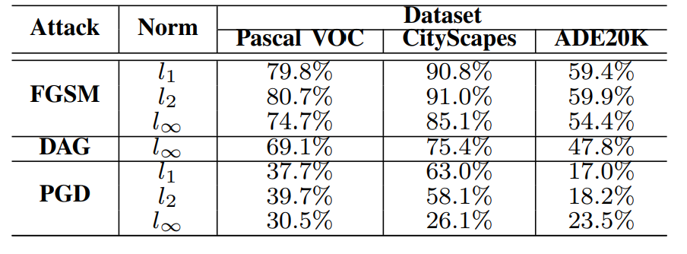
Evaluation baselines
PGD attack consistently outperforms others,
We adopt PGD as our evaluation baseline.

Slide 20
Evaluation metrics
Pixel Accuracy
Fraction of pixels predicted correctly by the target model.
Mean Intersection over Union (MIoU)
For label c, image x, $IoU_{c}^{x}=\frac{\left|P_{c}^{x}∩G_{c}^{x}\right|}{\left|P_{c}^{x}⋃G_{c}^{x}\right|}$
MIoU is the average of $IoU_{c}^{x}$ over all pixel labels and images.

Slide 21
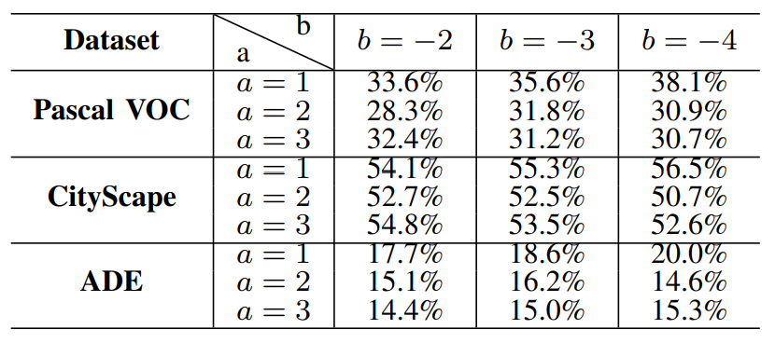
Hyperameter impact: CR-PGD
According to the following result, we choose $a=2, b=−4$ as the default hyperameter for our weight function.

Slide 22
Compare PGD & CR-PGD
CR-PGD consistently outperforms PGD.
Pixel accuracy with L2 perturbation

Slide 23
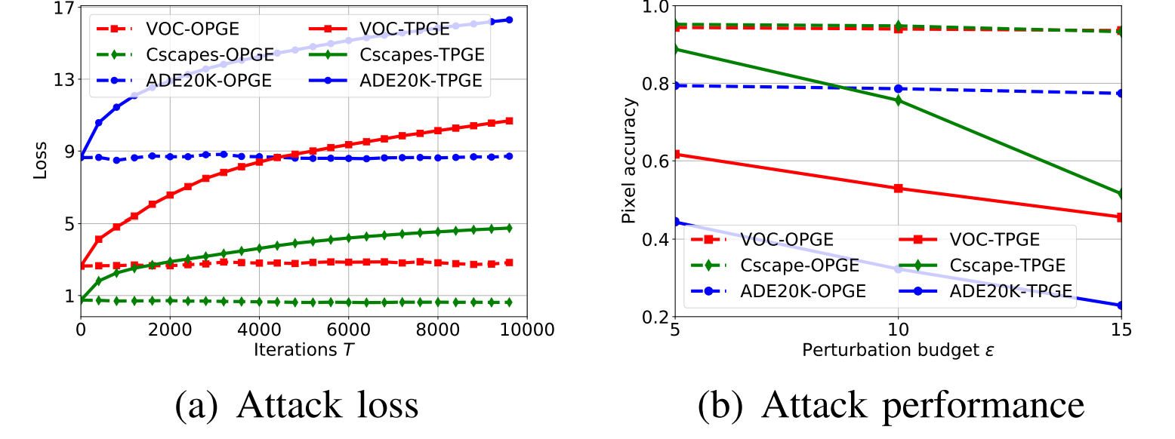
Compare gradient estimators
TPGE outperforms OPGE.

Slide 24
Compare PBGD & CR-PBGD
Certified radius consistently improves blackbox attack performance.

Slide 25
Against Defenses
CR-PGD is more effective than PGD against adversarial training.

Slide 26
Conclusion
We propose to leverage certified radius from attackers’ perspective.
We design a certified radius-guide attack framework for both white-box and black-box attacks
We also design a random-free gradient estimator based on bandit.

Slide 27
Q&A
Thanks for your watching.
Code: https://github.com/randomizedheap/CR_Attack

