Slide 1
Understanding the Security Risks of Decentralized Exchanges by Uncovering Unfair Trades in the Wild
Jiaqi Chen, Yibo Wang, Yuxuan Zhou, Wanning Ding, Yuzhe Tang, XiaoFeng Wang, Kai Li
Syracuse Univ. Indiana Univ. SDSU

Slide 2
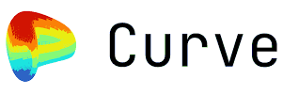
Introduction: Security Risks of DEX by Unfair Trades
Decentralized Exchange (DEX):
Popular DeFi application
Trader Alice deposits Token X to a pool and withdraw Token Y from the pool.

Slide 3
Introduction: Security Risks of DEX by Unfair Trades
A fair trade:
Alice depositing TokenX can withdraw TokenY of the same value.

Slide 4
Introduction: Security Risks of DEX by Unfair Trades
A fair trade:
Alice depositing TokenX can withdraw TokenY of the same value.
Unfair trades:
Standalone deposit/withdrawal

Slide 5
Introduction: Security Risks of DEX by Unfair Trades
A fair trade:
Alice depositing TokenX can withdraw TokenY of the same value.
Unfair trades:
Standalone deposit/withdrawal

Slide 6
Introduction: Security Risks of DEX by Unfair Trades
A fair trade:
Alice depositing TokenX can withdraw TokenY of the same value.
Unfair trades:
Standalone deposit/withdrawal
Bob withdraws Alice’s deposit

Slide 7
Introduction: Security Risks of DEX by Unfair Trades
A fair trade:
Alice depositing TokenX can withdraw TokenY of the same value.
Unfair trades:
Standalone deposit/withdrawal
Bob withdraws Alice’s deposit
Alice withdraws more/less value than her deposit

Slide 8
Introduction: Security Risks of DEX by Unfair Trades
A fair trade:
Alice depositing TokenX can withdraw TokenY of the same value.
Unfair trades:
Standalone deposit/withdrawal
Bob withdraws Alice’s deposit
Alice withdraws more/less value than her deposit

Slide 9
Introduction: Security Risks of DEX by Unfair Trades
Research Problem Understand whether and how often unfair trades occur in operational DEXes?

Slide 10
Outline: Measurement and Data-Analytics Pipeline
Measurement and data analytics
(1) Find unfair trades
(2) Detect theft from unfair trades
(3) Detect lost tokens from unfair trades
Mitigations

Slide 11
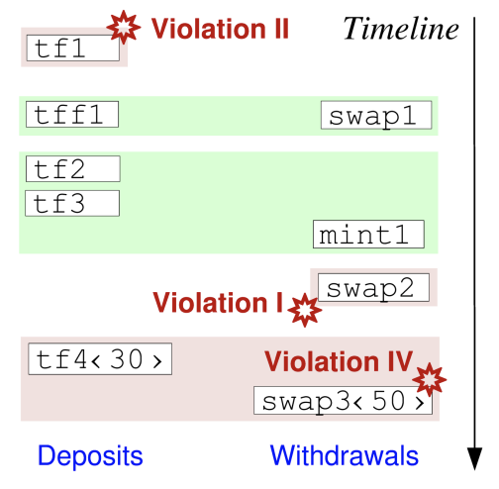
Measurement (1): Find Unfair Trades: Method
Input data: txs, contract calls, and log events
Algorithm:
Match deposits and withdrawals, check the rest for value mismatch and standalone operations.

Slide 12
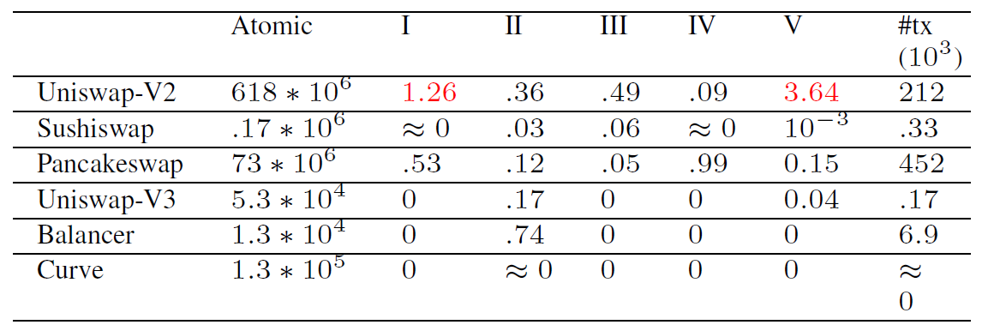
Measurement (1): Find Unfair Trades: Results

Slide 13
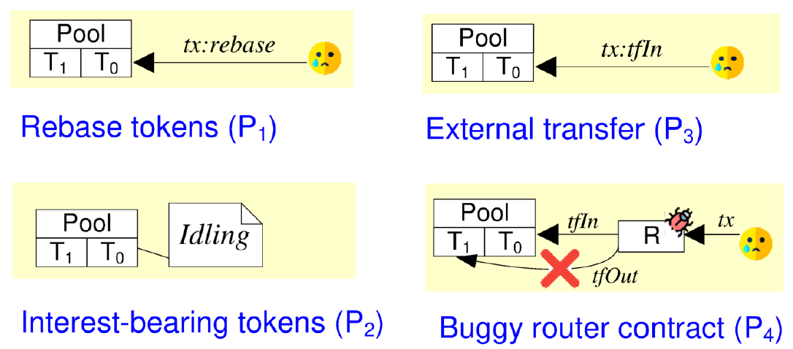
Measurement (1): Find Unfair Trades: Causes

Slide 14
Measurement (2): Detect Token Thefts: Methods
Heuristics-based indicators
a thief would eagerly withdraw an exploitable deposit
a thief may exploit Causes P1/P2/P3, observable by tx patterns
a thief would always withdraw the full balance
a thief does not deposit value
a thief would send frontrunning txs
Cross-check the detected txs with external incident reports.
Notes:
exploitability

Slide 15
Measurement (2): Detect Token Thefts: Results
Found cases
Notes:
exploitability

Slide 16
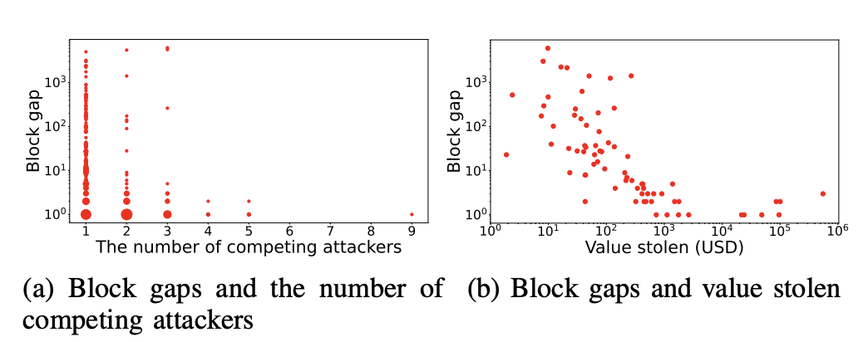
Measurement (2): Detect Token Thefts: Results
Found cases
Block gaps
Notes:
exploitability

Slide 17
Measurement (2): Detect Token Thefts: Results
Found cases
Block gaps
Top attackers
Notes:
exploitability

Slide 18
Measurement (2): Detect Token Thefts: Results
Found cases
Block gaps
Top attackers
Top victims
Notes:
exploitability

Slide 19
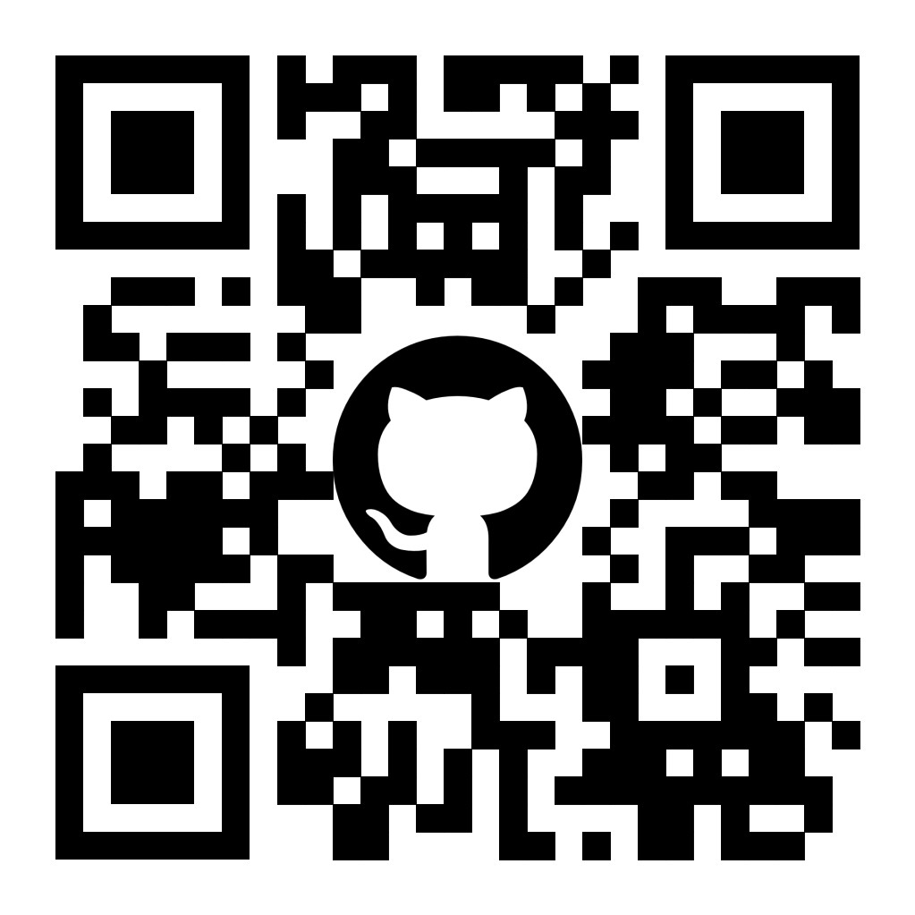
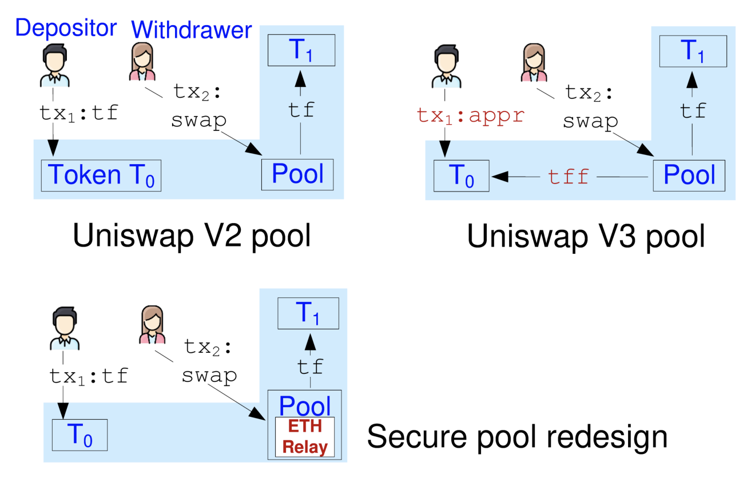
Mitigation: Secure Redesign of DEX
Idea: Use ETHRelay to reconnect the deposit and withdrawal in two separate transactions.
Notes:
exploitability

Slide 20
Conclusion and Q/A
Measure the unfair trades in the wild on leading DEXes.
Detect resultant security incidents including token thefts and lost tokens.
Propose mitigations to patch or redesign DEXes.

