Slide 1
General Chair’s Report
Robert Cunningham
IEEE S&P 2012
Westin St. Francis, San Francisco, CA
22 May 2012
Notes:
1
1

Slide 2
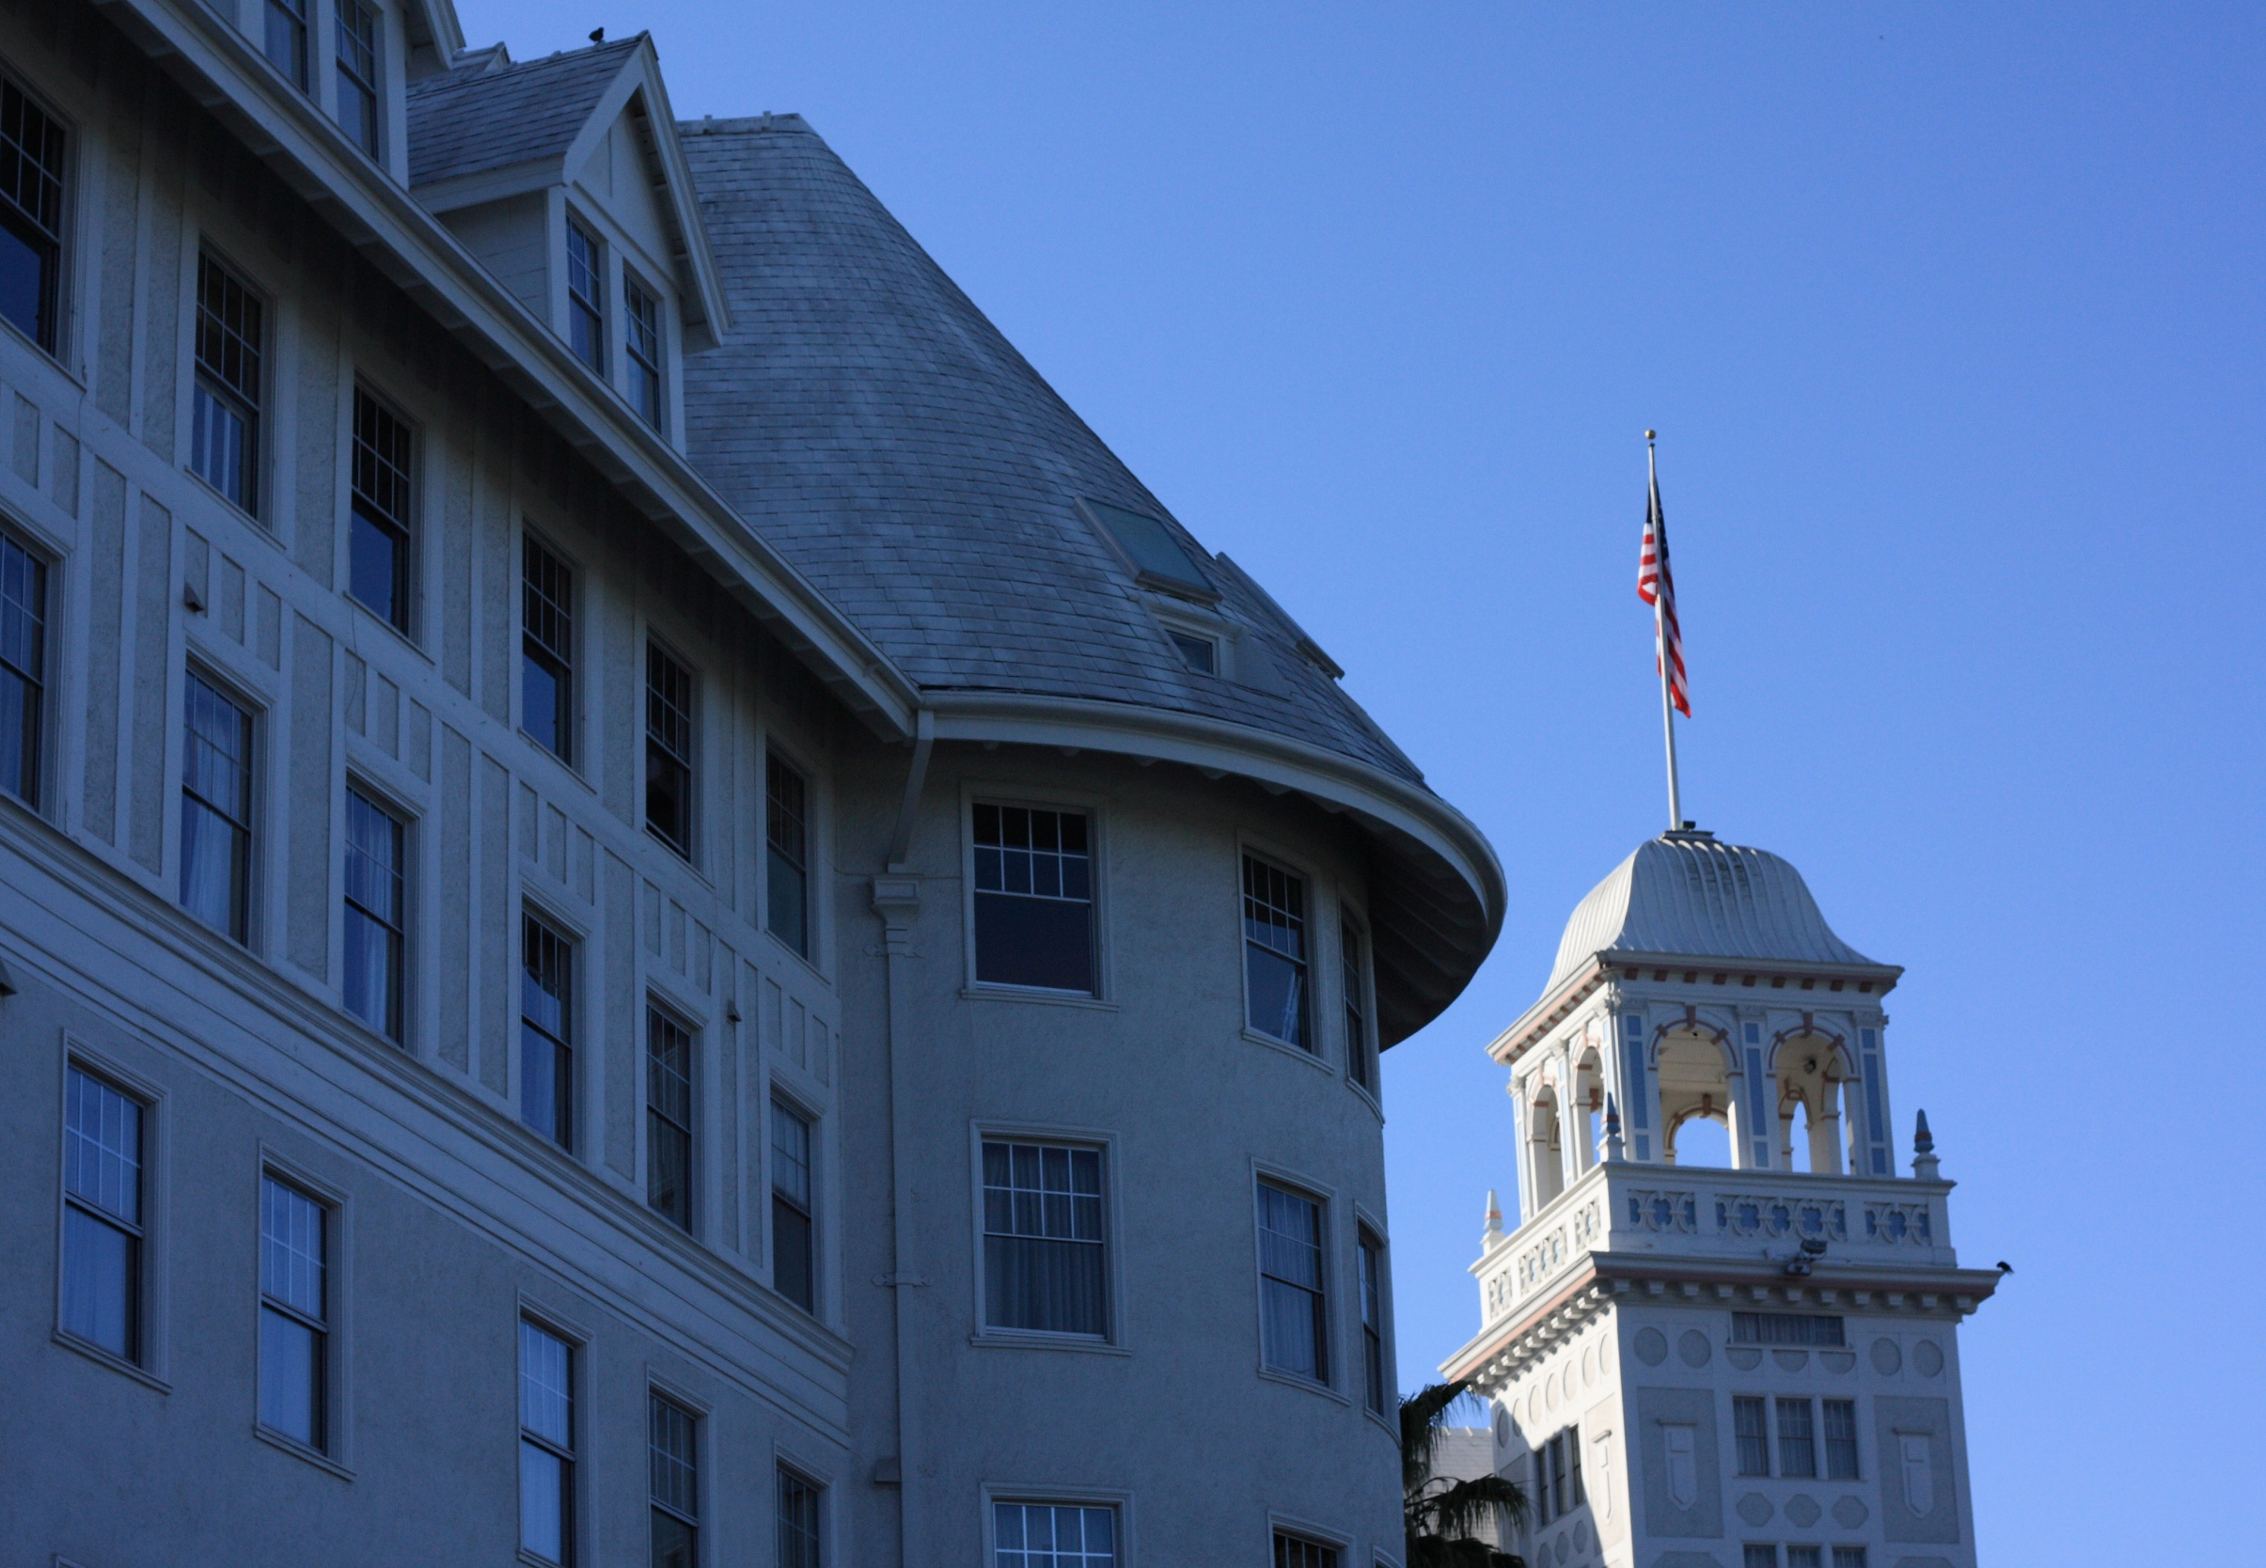
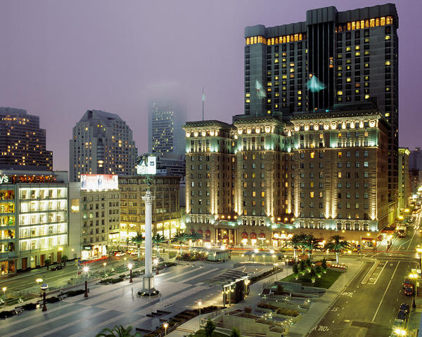
Executive Summary
We moved to a new location
Over 450 people registered,
The program was terrific,
Most people smiled.

Slide 3
Organizing Team
General chair: Rob Cunningham (MIT Lincoln Laboratory)
Program chairs: Somesh Jha (University of Wisconsin, Madison) and Wenke Lee (Georgia Tech)
Vice Chair and Registration Chair: Robin Sommer (ICSI and Lawrence Berkeley National Laboratory)
Treasurer: Greg Shannon (CMU CERT)
Donations Chair: David Molnar (Microsoft Research)
Publications Chair: Kevin Butler (University of Oregon)
Site Chair: Ed Talbot (Consultant)
Publicity and Media Chair: Ulf Lindqvist (SRI International)
Student Travel Committee Chair: Terry Benzel (USC Information Sciences Institute)
Poster Chair: Adam Chlipala (MIT)
Web Chair: Andrew Johnson (Harvard University and MIT Lincoln Laboratory)
TC Chairs: Hilarie Orman–outgoing (Purplestreak) and Sven Dietrich (Stevens Institute of Technology) and Patrick McDaniel (Penn State)

Slide 4
Goals for 2012
Keep the culture of 32 years of IEEE S&P
Make room for all who want to attend
Enable greater student participation
Acquire more lenient copyright rules
Enable room for a few more high-quality papers
Strengthen the workshops

Slide 5
Keep the Culture,
Grow the Community
Shared time together
  Breakfast and lunch
  Breaks to encourage conversation
Consistent conference structure
  Sunday reception
  Monday posters
  Tuesday business meeting
Interesting content
  Carefully peer-reviewed papers
  5-min short talks and a broad set of posters
Carefully control change to maintain the collaborative atmosphere

Slide 6
Keep the Culture,
Grow the Community
Make room
  New venue allowed attendance by >450 people (vs. 350)
  Extend the conference to a full day Wednesday to allow for 40+ papers
Support student attendance
  23 grants supported by donors
  6 grants from the technical committee
Formalize donor offerings
Record one session (Attacks II) for the web
Explore a new IEEE copyright form
Independently organize workshops

Slide 7
Other
Continued “Go Green” theme
  Program on the web
  Printed proceedings only for those who pay
Continued press chair to coordinate media interactions
  Articles in magazines and newspapers
Challenges
  Logistics for two hotels (Westin St. Francis & Airport)
    Overcrowded shuttle bus
    More people on bus than those staying at the Westin Airport!
  Filling all contracted rooms at the Westin Airport

Slide 8
Thank You to Our Donors
Gold: Google
Silver: IBM, CERT, Microsoft Research, NSA, Symantec
Bronze: MIT Lincoln Lab; Van Pelt, Yi, & James LLC; facebook
In-kind: IEEE Security and Privacy Magazine
Student grants: National Science Foundation

